Slide 1


Internet of
Things (IoT)
IoT is one of the fastest growing industries of today workforce.

Slide 2
The Project Goal
Develop necessary basic skills needed as a specialist (technician) within the Internet of Things (IoT). Understanding the basic skills needed for maintaining, troubleshooting and development of a personal or organization Networking system and ending with the building, programing and running of an Arduino Breadboard with LED & Sensor on a Real Time Operating System (RTOS).

Slide 3
Technology & IoT Growth
As our technology and our digital lives expand so will the demand for individuals whom understand the role of IoT within the industry. As a System Administrator or Technician we have to know understand the importance of the Operating System(OS). Such as should we use a Linux, Windows, or some other OS? What Protocol will we be using, TPC, DCHP, LPv4 or/and LPv6 just to highlight a few.

Slide 4
IoT Career -
Technician or Administer
System/Network
User
Applications
Hardware
Operating System
As a Computer Technician or System Administrator, one has to have a basic understanding of how everything works together to achieve the goals of the individual or organization.

Slide 5
Technicians/Administrators Responsibilities
PC/System Maintenance
Room conditions: 70-74 ℉ (prevent overheating) & Humidity of 40-70 % (prevents ESD), independent HVAC system (better temperature control), positive air flow for better air quality (dust reduction)
Preventing: Electronic Interference (EMI), Radio Frequency Interference (RFI), Hacker/Virus Attacks, protect power source, through online/offline UPS units.
Troubleshooting: Identify symptoms & potential causes, Establish any changes, create hypothesis, Create action plan, Implement fix, Ensure user satisfaction, and Document the solution (TestOut Corporation, 2019). The technician can a variety of commands to troubleshoot the networking system (shown in following table)

Slide 6
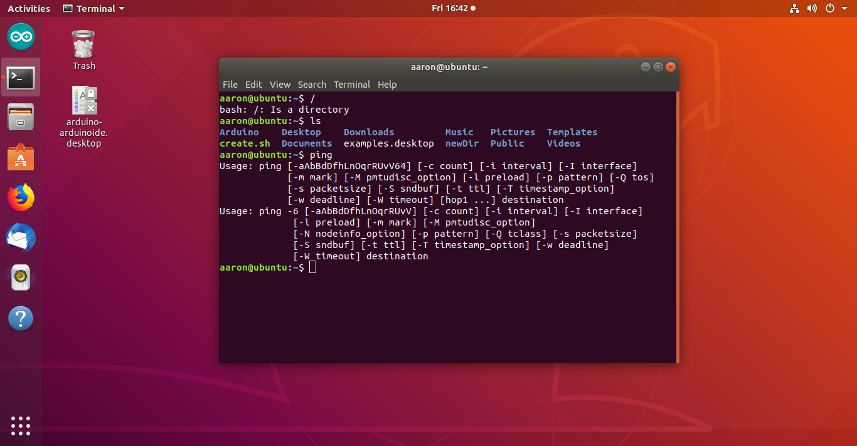
Technicians/Administrators Responsibilities (cont.)
Small list of frequently used commands in the Bash Linux OS.
user is: aaron@unbutu
command " / " shows that we are using Linux Bash OS
command " ls " displays the color coded list of the
directory (blue are directory and green are
Executable or recognized data file(s)
command "ping" verified connection between hosts within network (first ping is IPv4
and second ping is IPv6)

Slide 7
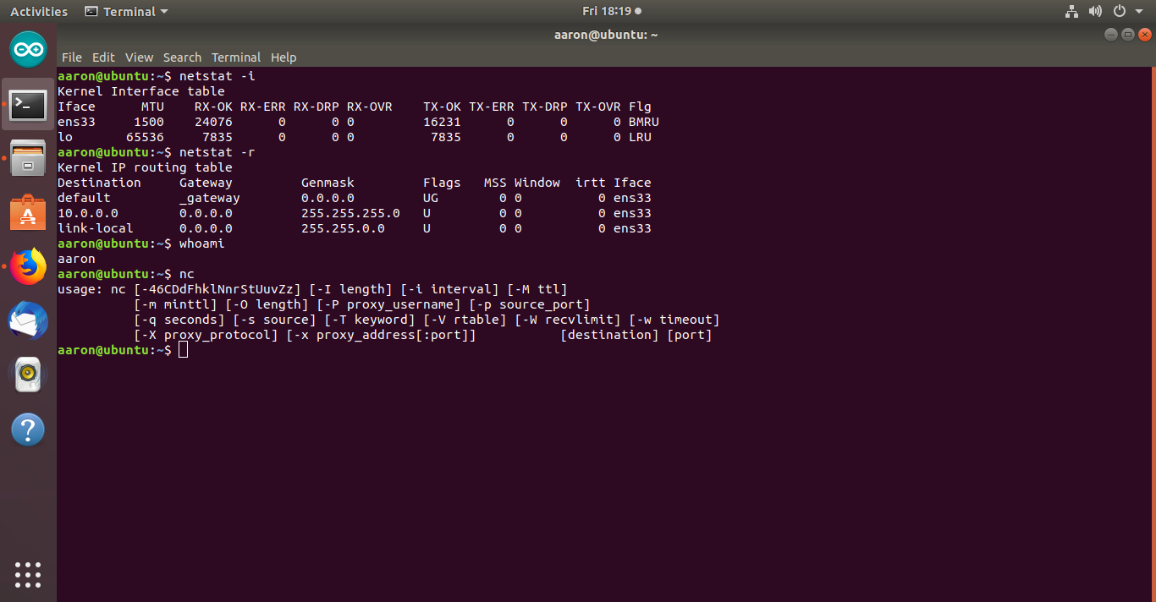
Technicians/Administrators Responsibilities (cont.)
Small list of frequently used commands in the Bash Linux OS (cont.)
command " netstat -i " displays Kernel
Interface table
command " netstat -r " displays Kernel IP
routing table
command " whoami " shows that the user is
arron@unbuntu
command " nc " test the communications
between network host
command " history " shows the history
command " clear " will clear the screen as
soon as enter key is pressed (not
shown)
command " exit " close the terminal window
(not shown)

Slide 8
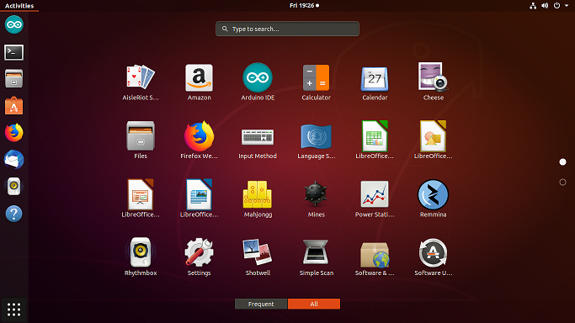
Linux (bash) OS Desktop
On the far left the “Activities” column shows the most often used programs (favorites) this are is customizable by click, hold, drag and drop the Icon you wish to have easy access to. For example I added the “terminal” icon as the second icon for quicker access. Otherwise I have to click the bottom dot on the right side of the screen to change to another page of the desktop (shown in next slide).

Slide 9
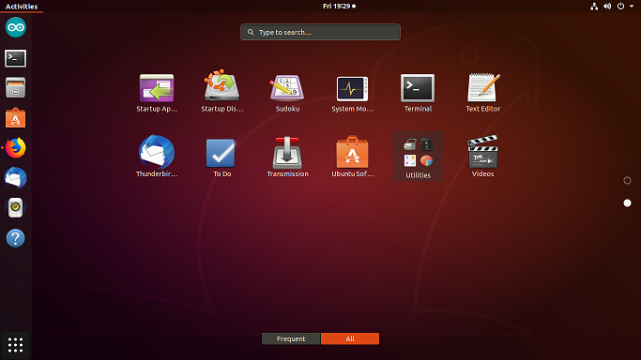
Linux (bash) OS Desktop (cont.)
Use “Terminal” for access to the Linux OS command line.

Slide 10
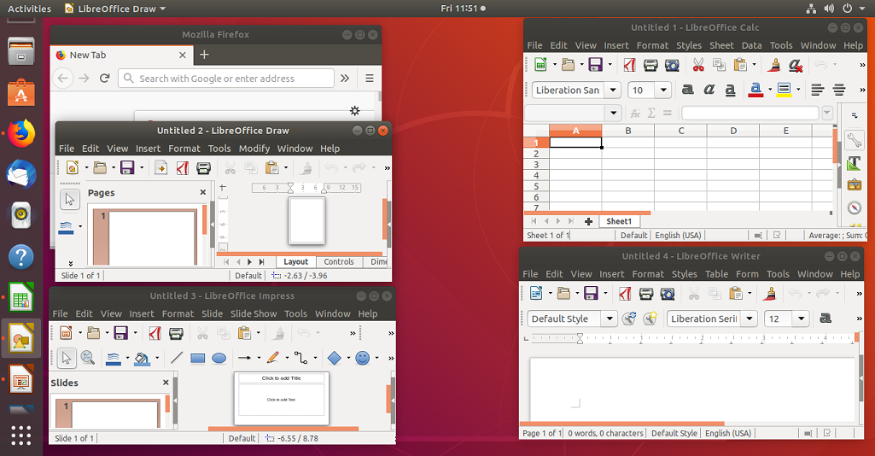
Linux (bash) OS Desktop
Applications similar to MS Office Applications
Firefox Web Browser
Similar to MS Excel
Similar to MS Paint
Similar to MS Power Point
Similar to MS Word

Slide 11
Comparisons
Linux Vs Windows
Access and Flavors/variety
Linux: User has access to source code and various customizable distributions based on user(s) needs | Windows: Only select members have source code access with limited customization availability
Licensing
Linux: Open Operating Source means users can modify, reuse or even sell with General Public License (GPL) | Windows: No access to modify software and can only install for number of Licenses purchased.
Command Line/ Run Level
Linux: A very useful tool for user administration & completion of daily tasks. Stops at different run levels/GUI to locate and repair issues – not much difference for end-users | Windows: No Linux command line, but run and enter “cmd” to open Requires a restart and run at level 3 to find and fix issues
Updates/Security
Linux: user(s) has control on updates, install as needed and takes less time. More security making it harder for hackers/viruses to gain access | Windows: can happen inconvenient times causing frustration, takes longer to update/install. Major target of Viruses & Malware without anti-virus software
Support
Linux: Vast support via community, online forums & Website searches | Windows: Online support, accessible forums, web searches, and paid support

Slide 12
Command Line Comparison
Linux can be customized to what the user is wanting​ ( such as bash,
It can have different security protocols programed to prevent any intrusions​
Windows cannot to programmed to what user needs when Linux can be very flexible on what the network or user wants​
Linux has build-in spam ware but windows require a third-party software.
With Linux the administer as the ability to block specific traffic, eliminate bugs and threats. Windows has numerous loops holes that weaken its security protocols, and prevents the administor’s ability to strengthen system defenses.

Slide 13
Command Line Comparison (cont.)
In troubleshooting the administrator can preform ‘traceroute’ (Linux) uses User Datagram Protocol (UPD) to random port numbers while Windows uses Internet Control Message Protocol (ICMP) packets.
In Linux administrator can grant permissions to limited commands for example: from srosey account, use su –c “usermod –l arr0ws –d /home/arrows arr0ws” when requested enter password if the individual has permission he/she will be granted access and the correction in spelling will be completed, only the Administrator has this control

Slide 14
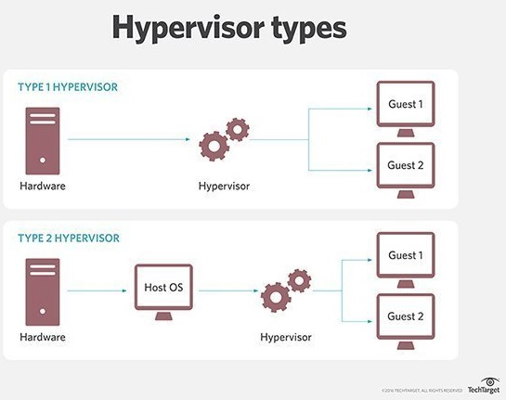
Hypervisor types
Type 1 Hypervisors operates on the physical hardware of the host machine, meaning it does not require an OS and is very secure.
Type 2 Hypervisors or hosted hypervisors require the an OS and device drivers be installed first.
Bigelow, 2019

Slide 15
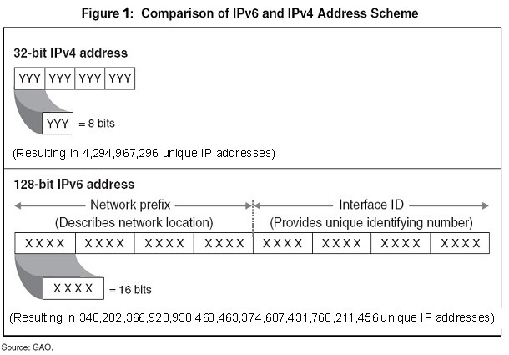
Comparison ipv6 vs ipv4
IPv4 is a based on 32-bit a decimal system with a limit of over 4 billion IP addresses, with industry grows availability becomes limits or no existent. However with IPv6 a 128-bit hexadecimal with 340 undecillion IP addresses allowing for further expansion and innovation for years to come.
Internet Protocol Version 6ipv consumers, 2017

Slide 16
Planning & Design
Be prepared as much as possible, making sure to have all need tools
If installing a system of computers and network plan on how your going to design it so that equipment is accessible, but wiring, cords, etc. are secure, work area are designed to be efficient and safe.
Eight sets to “troubleshooting” issues:
Identify problem
Back up system
Identify Possible causes and identify a theory of probable causes.
Test your Theory, was it something simple (unplugged wire) or do you need more information or to escalate to higher level tech.
Create action plan, how long will system be offline, is the resolution best left for other time of day, or is there a temporary solution for immediate use.
Test solution, confirm solution is working and didn’t cause other issues, if possible take additional actions to prevent reoccurrence of problem.
Ensure solution, explain to customer and insure customer’s satisfaction
Document the problem, solution and process of everything done, this is important in case the issue reoccurs in the future.

Slide 17
Planning & Design (cont.)
Preparing to install Virtual Software and connect Arduino Breadboard using Linux OS
Installed Virtual Machine (VM)
Installed Linux on VM
Arduino installed on Linux
FLOWCHART
Arduino Hardware Setup
Run Arduino via VM (virtual machine)
Install RTOS Library for Arduino

Slide 18
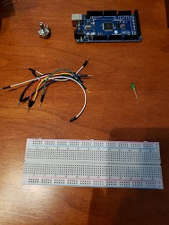
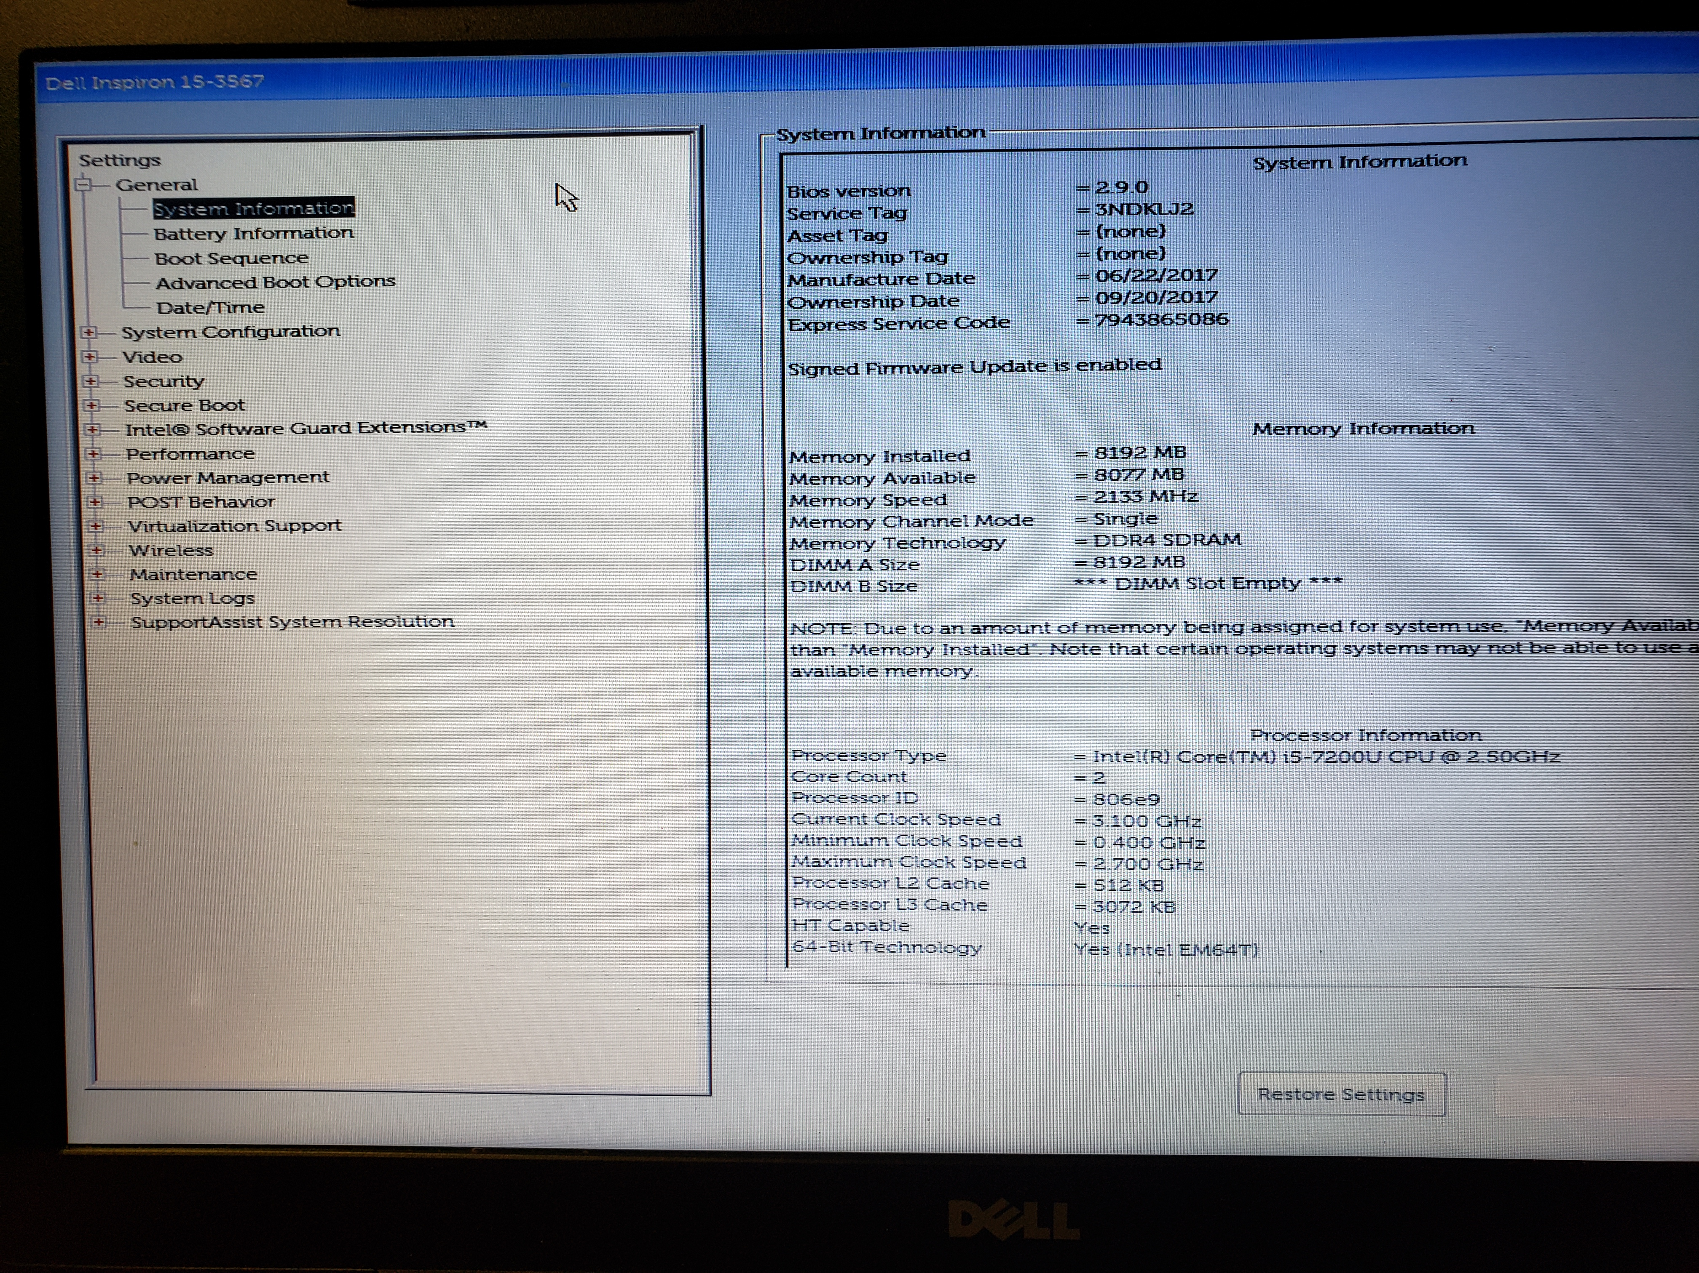
Inventory & Bios
The inventory in this photo it for an Arduino Breadboard that will be connected to Windows OS and operated via Virtual Machine using Linux OS system. It is also necessary to make sure that the bios has “virtualization” enabled

Slide 19
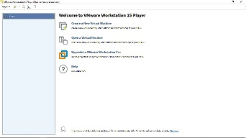
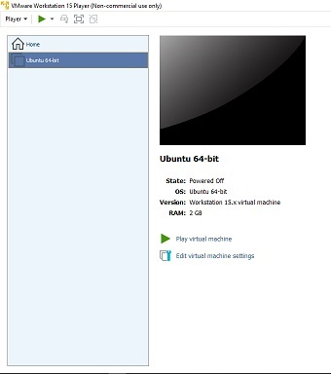
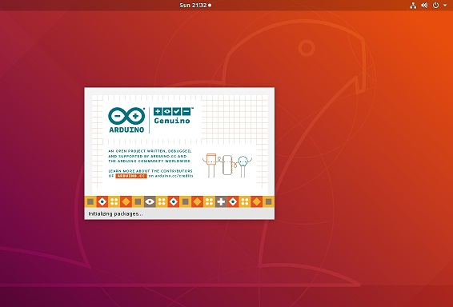
Software Installation
Home screen of VMware
Ubuntu 64-bit Linux ISO
Arduino Software

Slide 20
Real Time Operating System (RTOS)
Using RTOS allows a technician/Systems Administrator to perform more than one task at a time. For example the following will illustrations show the building an Arduino Breadboard with LED and Sensor.
Parts needed from inventory to build Arduino Breadboard with LED & Sensor.
  Arduino Mega Board Breadboard LED Light Potentiometer Wires

Slide 21
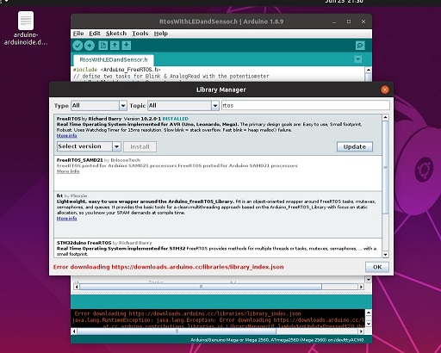
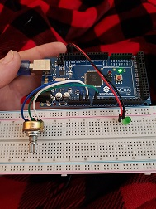
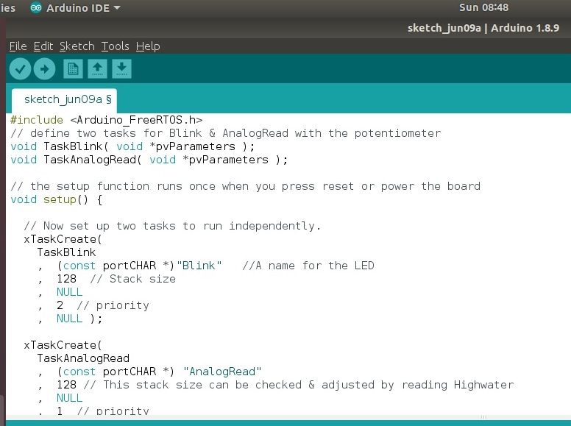
Project completion
Installation of RTOS Software
Arduino Board with LED and Potentiometer
RTOS coding for Arduino IDE

Slide 22
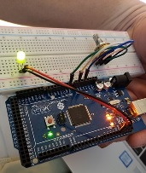
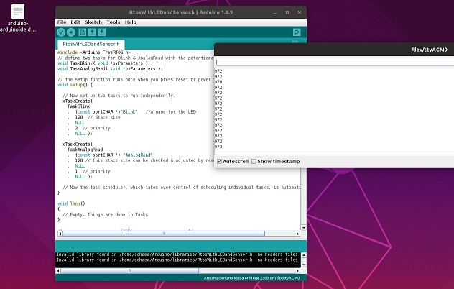
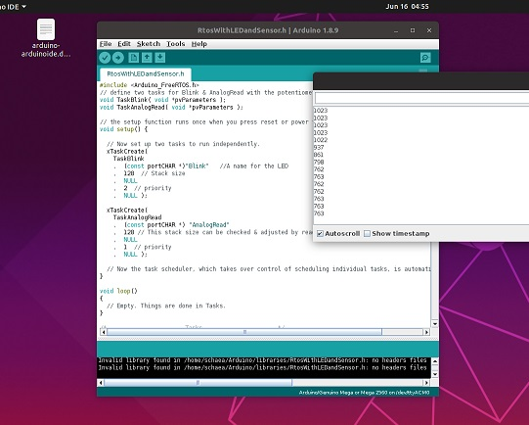
Project completion (cont.)
Arduino connected to laptop showing LED light is on
Initial data from Arduino Board with LED & Potentiometer readings
Final reading from Arduino Board after adjusting the Potentiometer.

Slide 23
Module 6 Deliverable
Running the Arduino IDE from the Virtual Machine (VM)
Rubric
Activity | Requirements | Points
Running LED and Potentiometer from Virtual Machine | Picture or Video | 30
Data display | Picture | 25
Set permissions on serial Port | Explanation of command | 5

Slide 24

Assembled Hardware
(Photo on left) Parts needed to build the Arduino IDE breadboard (center photo ) assembled, (photo on left) shows Arduino IDE with light (turned-on) and potentiometer.

Slide 25
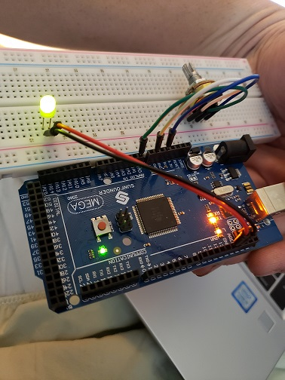
Running The Arduino via Virtual Machine (VM)
These pictures show the Arduino board assembled, connected to the VM via a laptop & (pic 2) shows that the LED light is on.

Slide 26
Serial Monitor
These photos demonstrate the potentiometer values before and after adjust of the tool values on the Serial Monitor

Slide 27
Challenges, Experience
& Skills Obtained
Understanding the basic components of a computer: CPU, Monitor, Printer, Mouse, etc. and being able to run basic maintenance tasks such as: having a reliable power source, cleaning system equipment regularly to prevent overheating and have software to protect against viruses and unauthorized use. My one challenges was understanding the terminology and how much more is involved in set up, maintenance, and updating a networking system. However the biggest challenge was understanding the differences in Operating Systems, and how from a Network Administration point Linux is often viewed being superior to Windows.

Slide 28
Challenges, Experience
& Skills Obtained (cont.)
Linux offers extensive customization to the system administrator, because it is an open source operating system free to the public, whereas Windows limits the access to administrator only if he/she is authorize and for the number of licenses that were purchased. After taking this class I know have a basic understanding of how to make sure that networking system is not only stable with a reliable power source, but that it is protected through its security settings so that hackers, viruses, and/or malware intrusions are prevented.

Slide 29


Challenges, Experience & Skills Obtained (cont.)
The knowledge I have gained during this course will enable me to gain employment in an entry level position as a technician and/administrator assistant. The biggest challenge I see is to stay knowledgeable about upcoming technology and the vast new products as new technology and software become available, while achieving personal educational and career goals.
This Photo by Unknown Author is licensed under CC BY-SA-NC
This Photo by Unknown Author is licensed under CC BY-ND

Slide 30
References:
Bigelow, S. J. (2019). TechTarget. Retrieved from What's the difference between Type 1 and Type 2 hypervisors: https://searchservervirtualization.techtarget.com/feature/Whats-the-difference-between-Type-1-and-Type-2-hypervisors
Internet Protocol Version 6 ipv consumers. (2017, September 8). Retrieved from Federal Communications Commission: https://www.fcc.gov/consumers/guides/internet-protocol-version-6-ipv6-consumers
TestOut Corporation. (2019). 11.6.2 Troubleshooting Methodology Facts. Retrieved from TestOut Linux Pro : https://cdn.testout.com/client-v5-1-10-565/startlabsim.html?ccache=TElOS0VELSUzZTNDNDYxMDZGLUU4NDItNEY1RC1CNTIzLTkzOUVCQUJCNzYwQyU3YyElN2MlN2VpbnRlcm5hbCUwZCUwYSU3YyElN2M2JTJmMjYlMmYyMDE5KzQlM2E0NSUzYTAzK1BNJTdjISU3YzUyMDM=&closeonlogout=true&lid=325&rid=

