Slide 1

Fundamentals of Information System Security
DeVry University
SEC285 – Professor Roger Gulledge
By Aaron Schaefers
June 27th, 2020

Slide 2


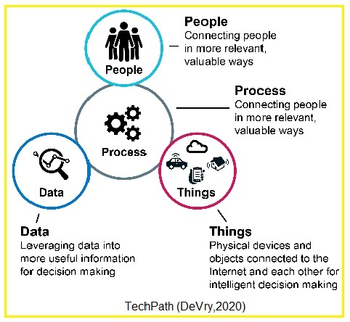
Introduction
Fundamentals of Information System Security
Objectives:
Define Fundamentals of computer network defense.
Assessing possible weaknesses and/or threats to the infrastructure of the network
Classify available security controls and strategies.
Compare comprehensive policies that safeguard network infrastructure.
Clarify strategies for physical security
Categorize the common weaknesses in host devices
Review the evolving career opportunities within the IoT security field.
Create a network Home Security System.
Weekly Module Titles:
Computer Networks & Defense Fundamentals
Network Security Threats, Vulnerabilities & Attacks
Network Security Controls Protocols & Implementation
Network Security Policy Design & Implementation
Physical Security
Host Security
Technology Careers & Opportunities
Complete Coursework
Notes:
This was and 8 week course with each week (module) representing a different course objective (DeVry,2020). Each new module within this presentation will be Identified by its core objective or that module’s titles.

Slide 3
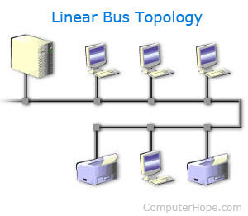
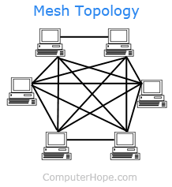
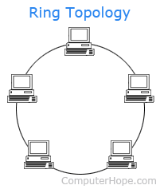
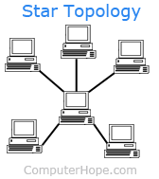
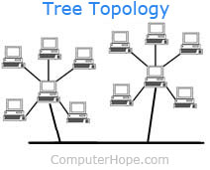
Fundamentals of Information System Security
Computer Networks & Defense Fundamentals (slide 1 of 3)
Networks
Protocols
Addressing
CND (Certified Network Defender)
Module 1 Hands-on-project – 2 Light Smart-home Control System
Notes:
This week ( shown as bullets on this slide) was broken down into four lessons and one hands-on project, where students were asked to build a 2 Light Smart-home Control System and/or the optional challenge task of a 3 Light Smart-home Control System. We gained a better understanding of the different types of networks. Such as Linear Bus (Unknown, Linear bus topology, 2017), Mesh Topology (Unknown, Mesh topology, 2018), Star Topology (Unknown, Star topology, 2018), and Tree Topology (Unknown, Tree Topology, 2017). We also discussed commonly used hardware components such as NIC which permits a connection from a computer to the network, a repeater will increase or boost the strength of an incoming signal in the network so that it is at an acceptable strength level. The router is responsible for receiving data packets from one network segment and forward them to another. The gateway allows communication between different types of environments and protocols, (DeVry University, 2020). Just as important as the hardware used is the Protocols needed that make it possible for us to communicate via the internet, email, Wi-Fi (just to mention a few) to millions around the world. We compared the differences between the OSI model and TCP-IP model do that we had a better understand of what takes place in order for two devices to communicate with each other. And how each layer is subservient to the previous layer, (DeVry University, 2020). We took a closer look at the addressing and why it is necessary for each device to have its own IP address, how to create a subnet, and why we now most network devices have both an IPv4 (32-bit) address and IPv6 (128-bit) address. Our final topic of discussion was the computer network defense (CND) which involves establishing the defenses (protection) for securing the network which is also part of an organization’s Computer Network Operations (CNO) which must include the following elements to provide complete network security: detection, analysis, and response to various network attack. Simply put CND is a combination of people, technology and operations (DeVry University, 2020). Our final task was the hands on project which is further explain in the following two slides.
.

Slide 4
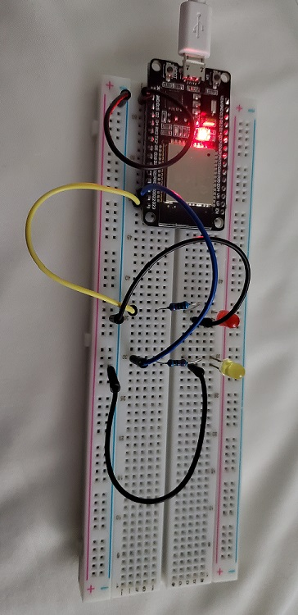
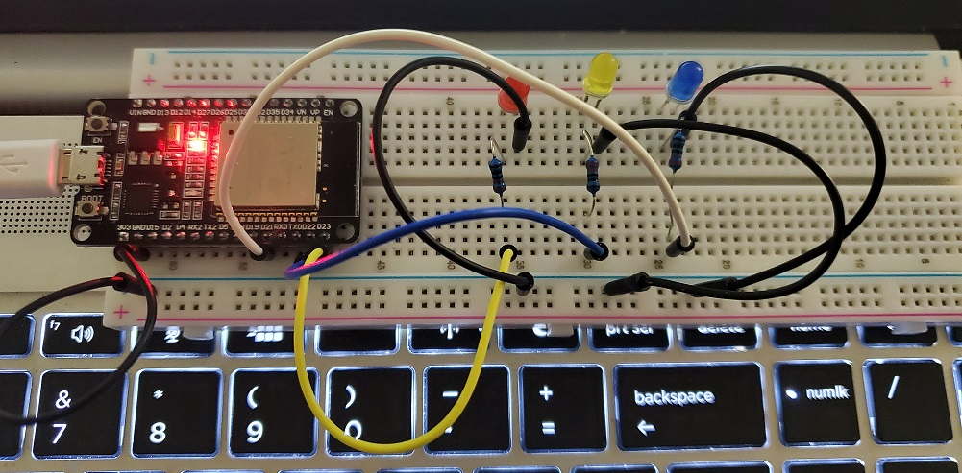
Fundamentals of Information System Security
Computer Networks & Defense Fundamentals (slide 2 of 3)
Parts List:
ESP32 microcontroller
Breadboard
Wires
LEDs
Resistors
Three Light control System (challenge option)
Two Light control System
Notes:
Part 1 of this module our goal was to collect and build a two light control system, students also had the ability to (optional) challenge themselves by doing a three light control system. Part 2 of this module was to install program software using Python 3.7 for Windows. Other software we had to download from the internet and install were the CourseCodeProFonts.zip, CP21x_Universal_Windows_Driver.zip. At this point students were required to locate (in the newly created folder) and double-click on the application “CP210xVCPInstaller_x64 to install the driver package.

Slide 5
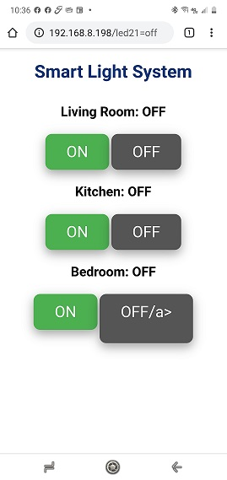
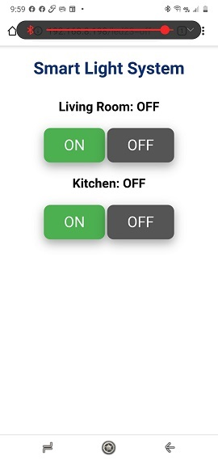
Fundamentals of Information System Security
Computer Networks & Defense Fundamentals (slide 2 of 3)
2 Light Control System
3 Light Control System
Notes:
In part 3 of this module we Implemented the code via the uPyCraft IDE to connect to the ESP32 microcontroller via our . This code will allow us the ability to turn the lights of either the two or 3 light control systems on and off via the Wi-Fi network and our smartphone. Our final required task (part 4) was to access our Yellow router address of 192.168.8.110 which allowed us access to our original (two light) Smart Light System (Schaefers, 2020)
. As shown in the screen capture on the left which indicates that both the Living Room and Kitchen Lights are currently turned on. Using that same IP address via a different General Purpose Input/output (GPIO) port we are able to see that the optional Challenge (part 5) Smart Light System was also successful, showing that we now have the additional light for a bedroom turned on as well as the kitchen and living room lights (Schaefers, 2020). By the end of module 1 an individual could use his or her smart phone to connect to their home router IP address via the internet to check the current status of there lighting control system and either turn the lights on or off if they wanted to do so.
.

Slide 6
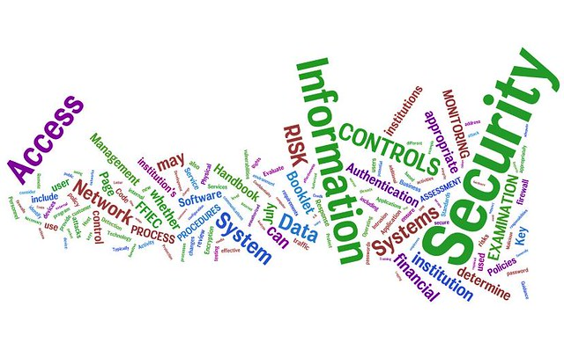
Fundamentals of Information System Security
Network Security Threats, Vulnerabilities & Attacks (Slide 1 of 6)
Network Security
Recon Attacks
Access Attacks
Notes:
This weeks focused on the threats, vulnerabilities, and attacks. Often when we think of security we think in relation to when we are online. However, in actuality there is much more to making any business and our home networks secure. Threats come from both internal and external sources. Vulnerabilities are weakness within the organization’s security procedures pertaining to daily operations as well as how they have set up their networks. One example of a vulnerability is how well the organization has trained the personnel in protecting the organization’s assets, data, and customer information. Another is how their network has been set up to prevent others from accessing the network without proper authorization. This week we take a look at how to prevent or severely reduce these vulnerabilities.

Slide 7


Fundamentals of Information System Security
Network Security Threats, Vulnerabilities & Attacks (Slide 2 of 6)
Network Security - Threats
    Internal
    External
(Unknown, Is human nature inherently evil?, 2020)
(Nasi, 2018)
Notes:
Internal threat can come from improperly trained personnel, venders, or visitors. This type of threat could be unintentional or on purpose. For example a vendor that has proper authorization may be asked to hold the door for someone that claims to be a company employee but because he/she is carrying a large box of files is unable to reach there ID, so the vendor allows that individual to enter the building (secured area) first, because the vendor allowed the person access he/she may have just let a total stranger (posing as an employee, or perhaps a person that was previously terminated by the organization back into the organization. Either way if the person has access now to the organization and could gain further information that he/she should not have by simply observation of other employees, listening to what other say or even asking question that seem innocent of other employees. Another type of internal threat could come from employees leaving his/her workstation on when they are not physically at the workstation, or even posting his/her password on a note and leaving on the desk or attached to the edge of his/her computer, or perhaps a co-worker has shared his or her password with a different coworker.
An External threat comes from outside the organization, and is generally via the network but by no means is that to say that it doesn’t happen in other ways as explained previously. The other two types of threats are Unstructured, which is an novice individual who tries to access the organization’s network and the Structured threat which is the highly skilled person, commonly referred to as a hacker, that very motivated and skilled in breaching an organization’s network protocols, (DeVry, 2020).

Slide 8
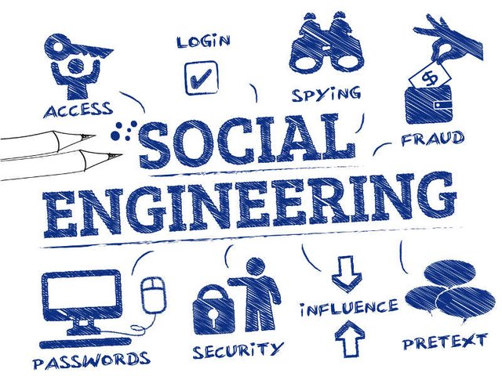
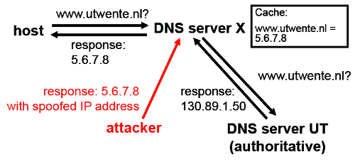
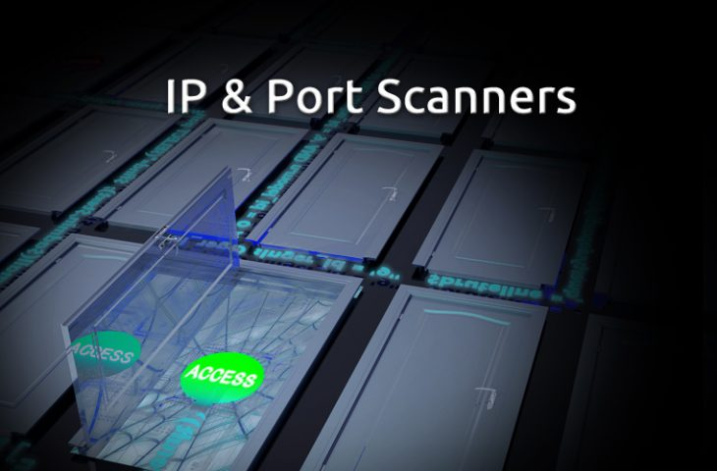
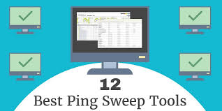
Fundamentals of Information System Security
Network Security Threats, Vulnerabilities & Attacks (Slide 3 of 6)
Reconnaissance Attacks
          Social Engineering
          Port Scanning
          DNS Foot printing
          Ping Sweeping
(Kirkbride, 2019)
(Kapil, 2015)
(Wilson, 2019)
(Cooper, 2020)
Notes:
As shown above there are four common areas that an experienced hacker will focus his/her efforts towards, this is considered Reconnaissance, in other words the hacker is trying to gain as much information as he/she can about the organization. The following is and explanation of each term listed above: Social Engineering – is the human side of gaining information, the attacker depends on human interaction, will trick treat individual into break security regulations, these attacks happen at a physical and psychological level. The way to prevent Social Engineering is to make sure that all employees receive proper and detailed training on how to recognize this type of attack and what the organization’s security procedures and requirements include. Port Scanning – is where the hacker uses a program (readily available from the internet) such as NMAP to scan for open port on the organization’s network. If he/she is able to find open ports then there is a possibility that he/she could gain access to that organization’s network. To reduce the possibility of Port Scanning attack the network administration team needs to “harden” the security of the network by closing all open (unused) ports.
DNS Foot printing will give the hacker vital information about the hosts in the network, as well as location and type of servers, this type of information also make it easier for the hacker to conduct the Social Engineering attacks, (DeVry, 2020). Ping Sweeping is a commonly used term for the (ICMP sweep) in which an hacker will send an ICMP Echo request to gain information about the IP addresses that are active within the organization’s network. This can give them some information for possible attack points, (Rouse, 2020).
.

Slide 9
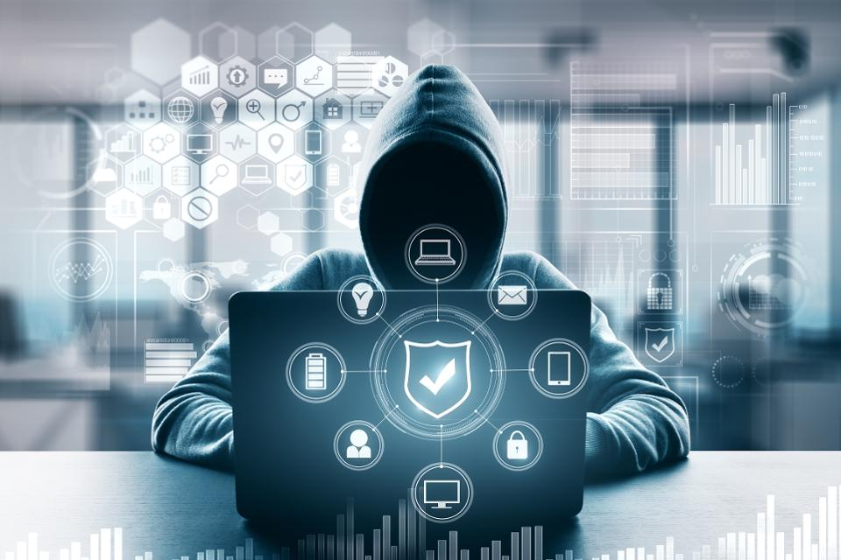
Fundamentals of Information System Security
Network Security Threats, Vulnerabilities & Attacks (Slide 4 of 6)
Access Attacks
    Password attacks
    Network Sniffing
    Man-in-the-Middle
    Replay
    Privilege Escalation
    DNS poisoning
    DNS Cache poisoning
    ARP Poisoning
    DHCP Starvation
    DHCP Spoofing
    Switch port stealing and
    MAC Spoofing/Duplicating
(Doffman, 2019)
Notes:
This focus here is on Access Attacks, although these bulleted attacks name only a few of the hundreds if not thousands of different kinds of attacks that can be perpetrated against an organization, it is possible to decrease the organization risk.

Slide 10
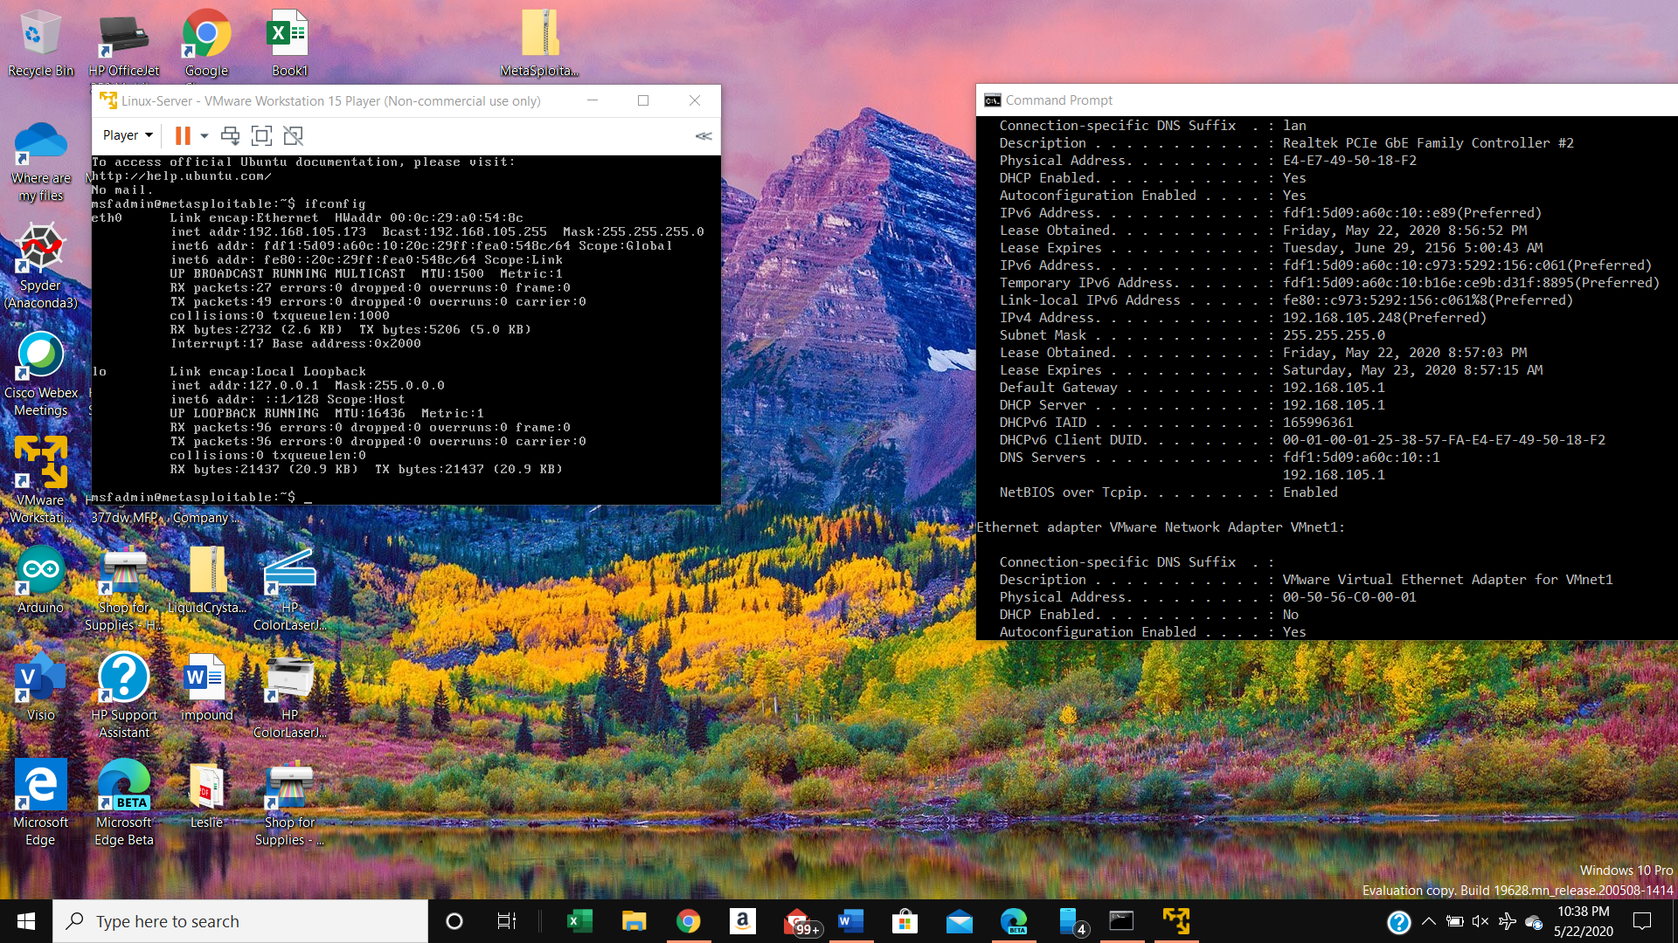
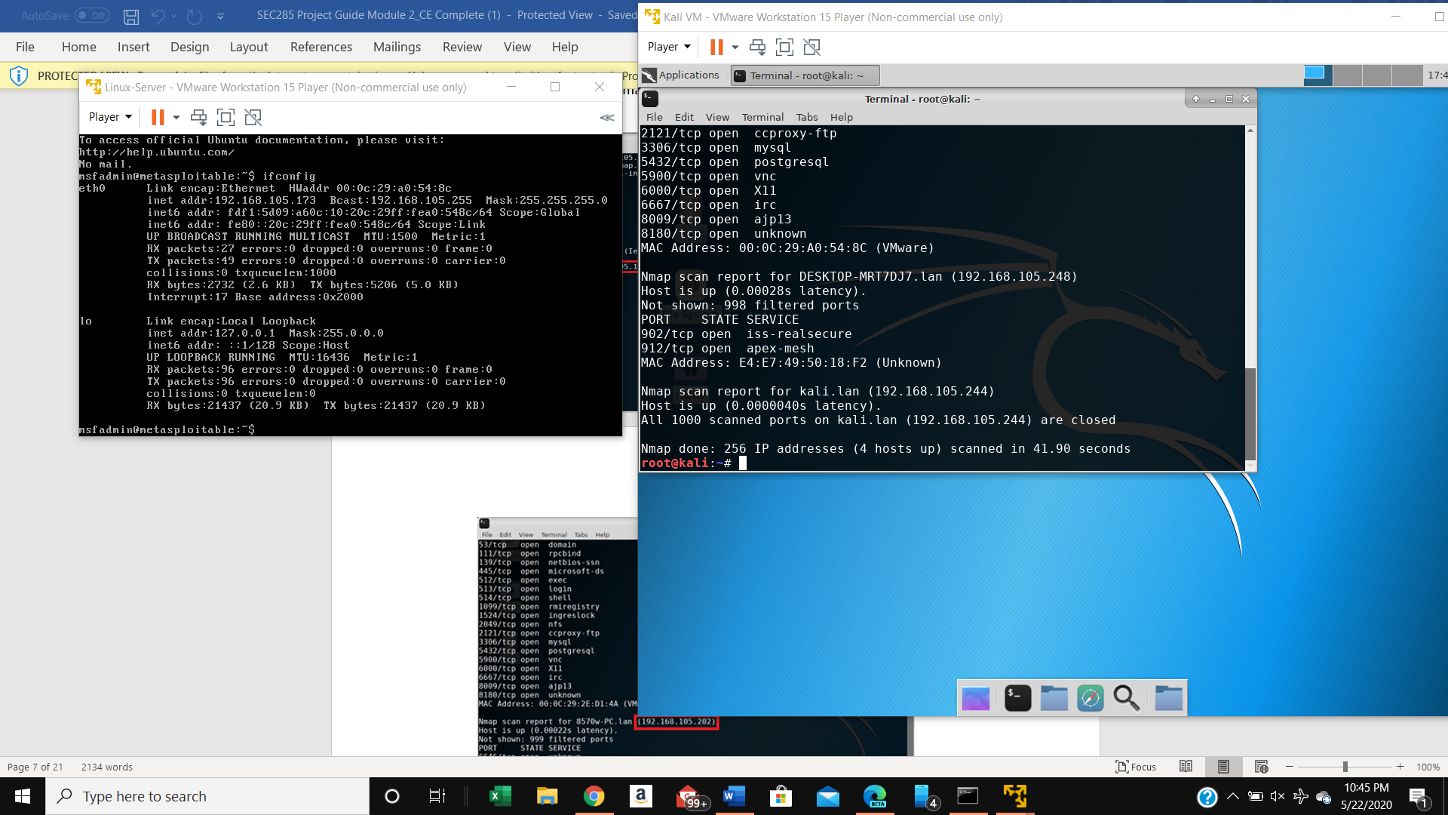
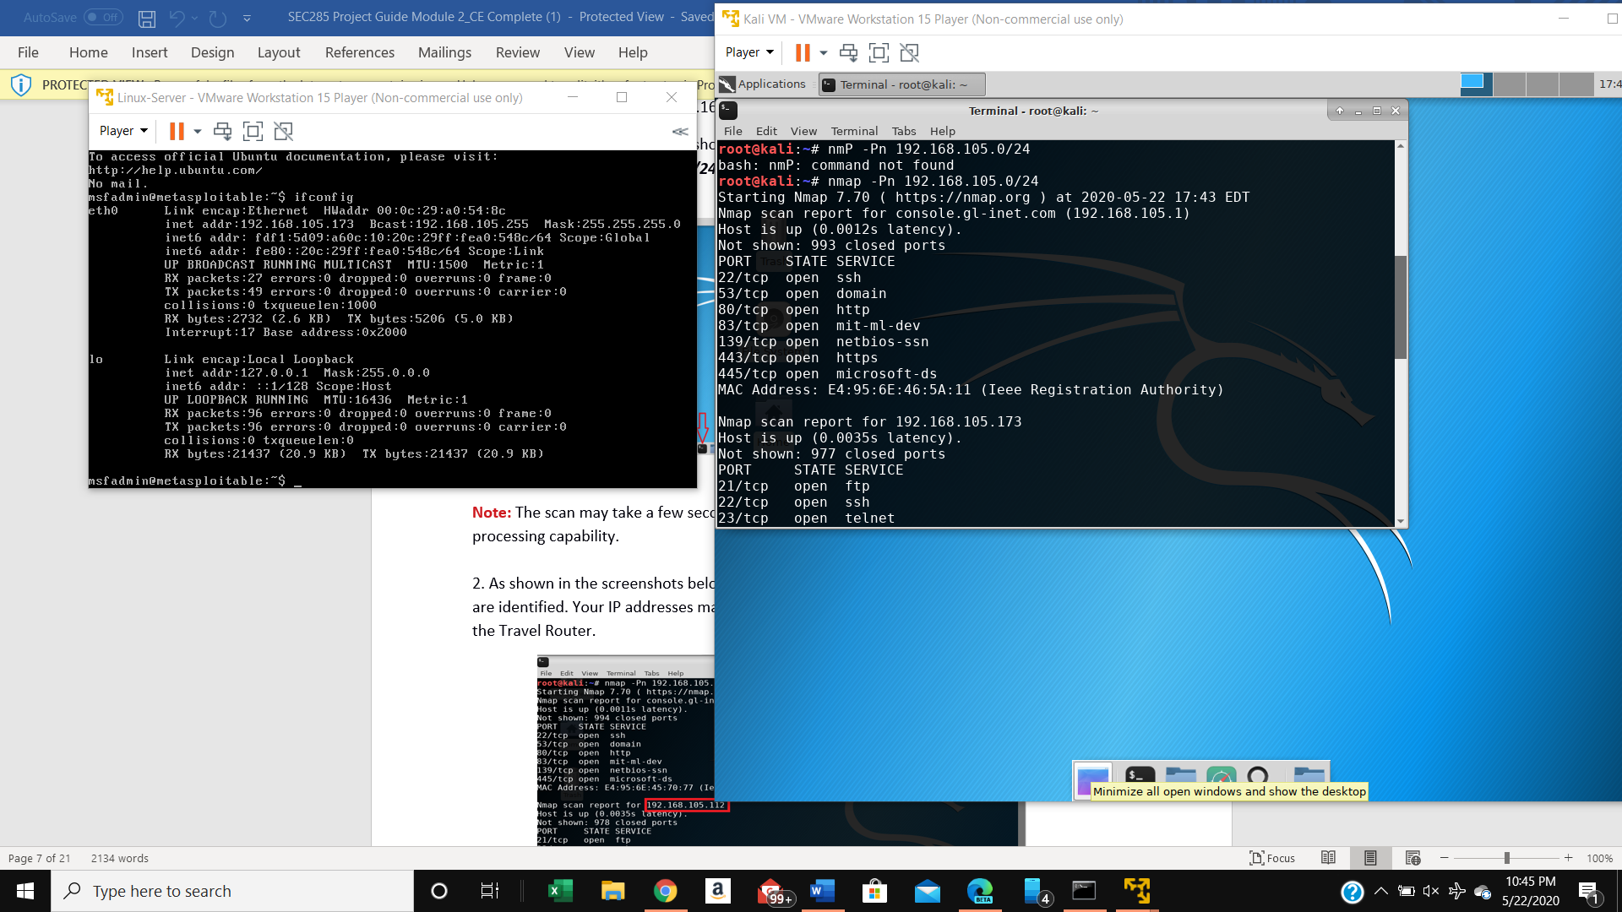
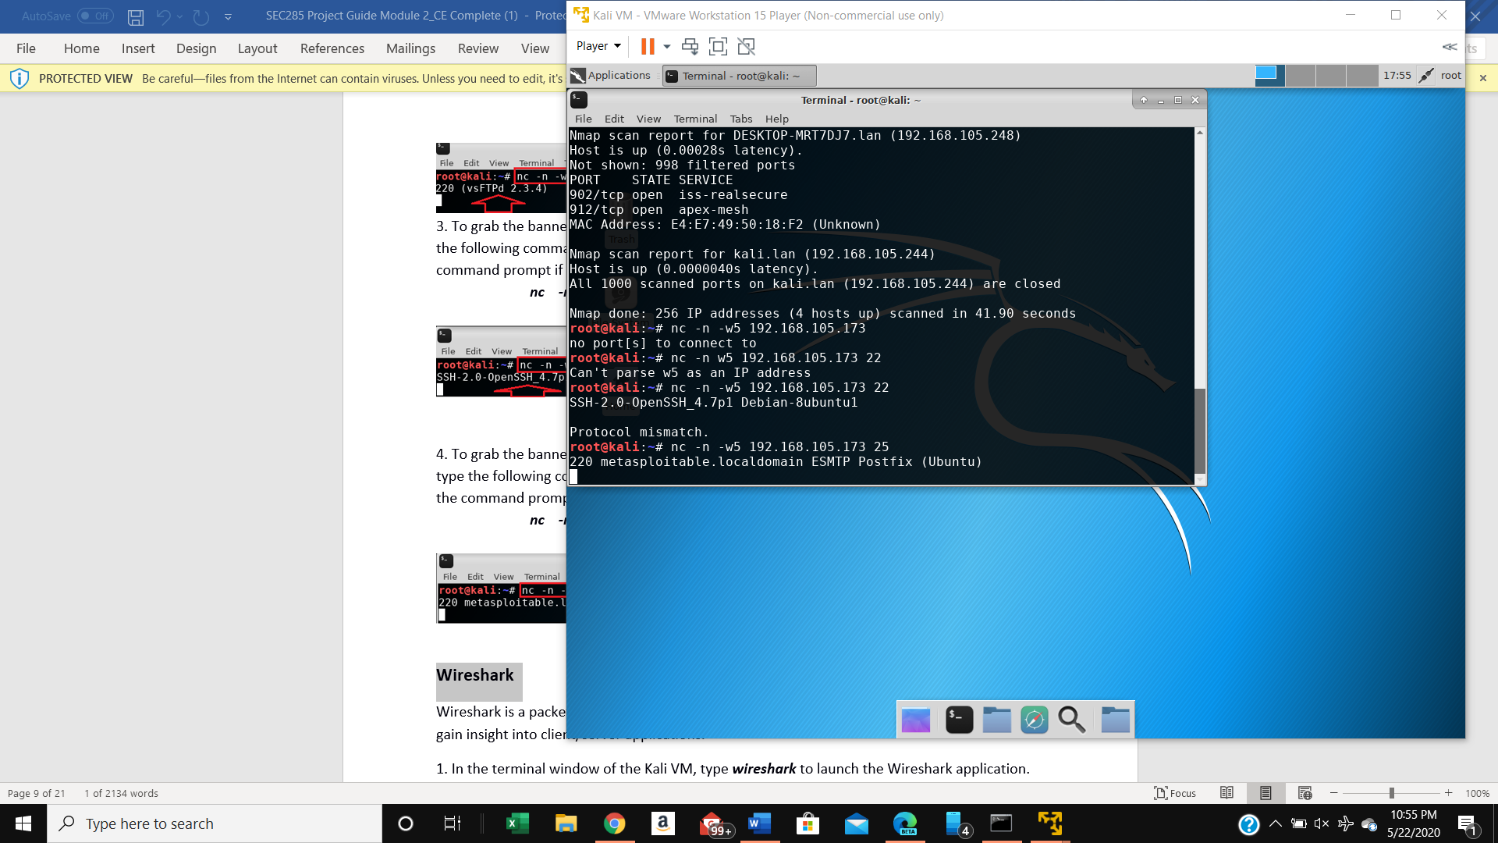
Fundamentals of Information System Security
Network Security Threats, Vulnerabilities & Attacks (Slide 5 of 6)
Vulnerability Assessment
NMAP Scam
Screen shots include the IP addresses of the host, Linux-Server VM, Kali, and Home Light control system
Notes:
We had to perform the ifconfig command and verify all four IP address by using nmap scan. We used the Linux-Server VM ( sometimes referred to as: MetaSploitable VM)
By using this program we were able examine a list of exploits that would identify weaknesses within the network, (Schaefers, 2020). We then had to generate a full report that included one Critical, one High, and one Medium risk. This was to simulate what it is like to preform a full security assessment project
The following slide demonstrates these risks.

Slide 11
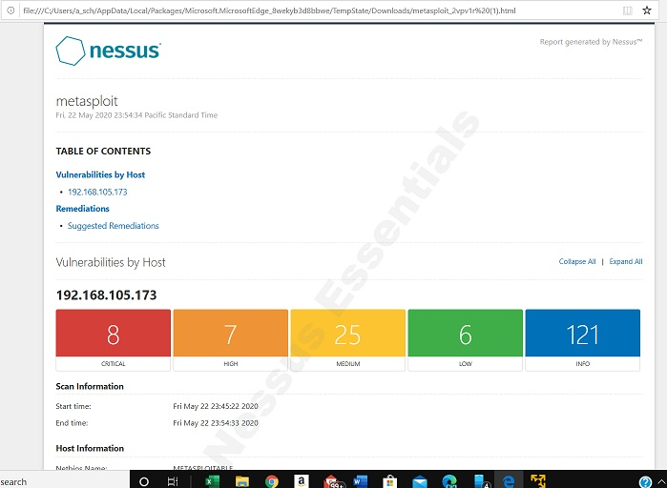
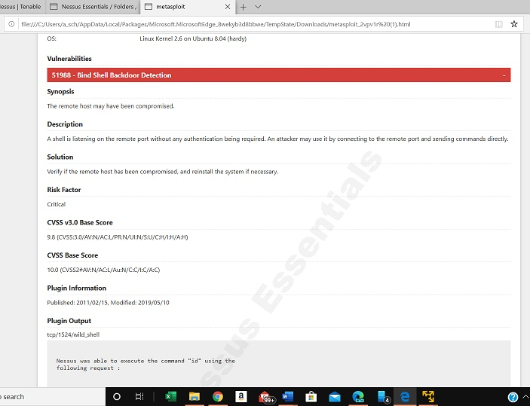
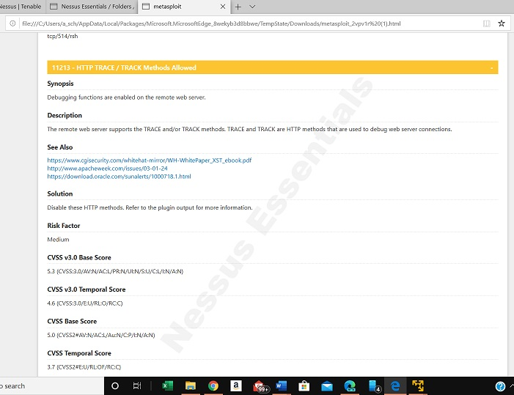
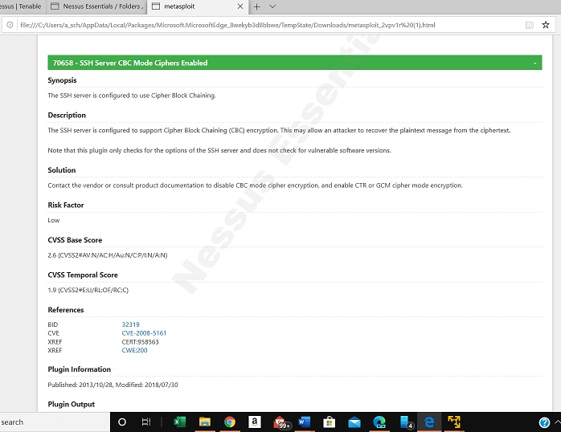
Fundamentals of Information System Security
Network Security Threats, Vulnerabilities & Attacks (Slide 6 of 6)
Vulnerability of Severity Rating
Critical Vulnerabilities
(Schaefers,2020)
Executive Summary
(Schaefers,2020)
Medium Vulnerabilities
(Schaefers,2020)
Medium Vulnerabilities (Schaefers,2020)
Notes:
Upon completion of this module I was able explain that the significance of vulnerability rating. Because the Nessus ranks vulnerabilities by color coding according to severity as follows: : Red= Critical Alert ,is one where immediate attention is needed because it could bring down the entire network. Orange = High/Sever Alert risk, Yellow = Medium/Moderate risk and Green = Low/small risk, Blue = a warning alert of a potential issue/problem is developing. This ranking allows the Network Administrator and technicians to determine what issues need immediate attention as well as allows these issues to be assigned to technicians based on his/her expertise (experience). By having the most experienced technicians resolve the most critical issues and allowing the least experienced technicians to the low risk or warnings issues the organization is maximizing their resources. Another significant part of the Nessus Report is the about of details included in the report. This report gives a details about the network’s intrusions that effect the both the systems hardware and software and the report gives recommendation on how to correct/prevent the reoccurrence of these issues.

Slide 12

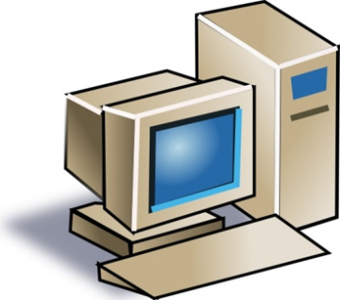
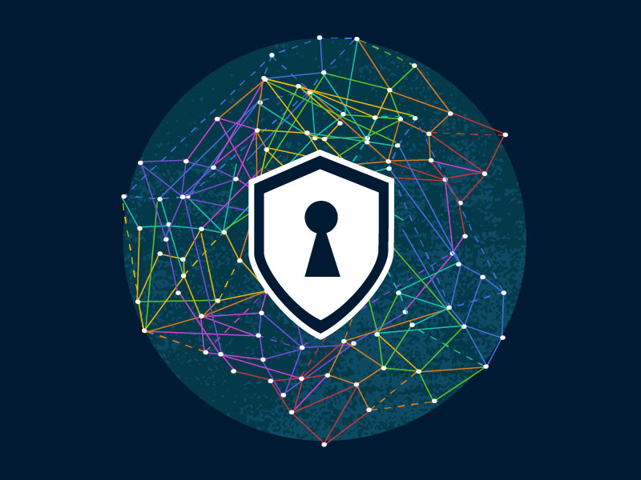
Fundamentals of Information System Security
Network Controls, Security Protocols & Implementation (Slide 1 of 9)
Control
(Unknown, Vector Change, configurations, control icon image, 2005-2020)
Protocols
(Unknown, Images for Non-Commercial Use, 2005-2020)
Implementation
This Photo by Unknown Author is licensed under CC BY
Notes:
The following slides will cover the topics of Controls, Protocols and Implementation. Which are all vital parts in the development of security controls and strategies for any organization.

Slide 13
Fundamentals of Information System Security
Network Controls, Security Protocols & Implementation (Slide 2 of 9)
The Seven areas of Control are:
  Access
  Identification
  Authentication
  Authorization
  Accounting
  Cryptography and
  Security policy
Control
(Unknown, Vector Change, configurations, control icon image, 2005-2020)
Notes:
In following slides will be three slides will be discussing each of these topics in greater detail.

Slide 14


Fundamentals of Information System Security
Network Controls, Security Protocols & Implementation (Slide 3 of 9)
Access & Identification
This Photo by Unknown Author is licensed under CC BY
Visitor or Employee Access
(White, 2015)
Notes:
Here we’ll discuss the Access and Identification as it pertains to being an element of the control environment. Every network policy must have guidelines for accessing the organization’s network and these guidelines must be updated on a regular basis, for example; on a semi or annual bases. We can limit access by placing selective access to a location as well as to the organization’s network. Naturally we want to be able to identify the individual within the physical building by know why he/she is there, is the person an employee or a visitor? One way of doing this is the requirement of a badge or ID card, where actual employees have an actual ID with some information that identifies the individual’s position within the organization such as name and what department he/she works in.

Slide 15
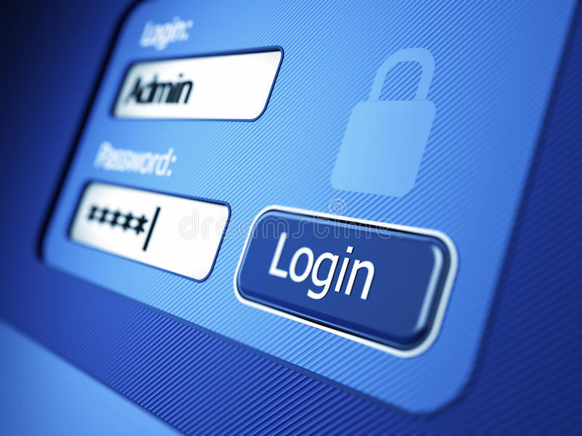

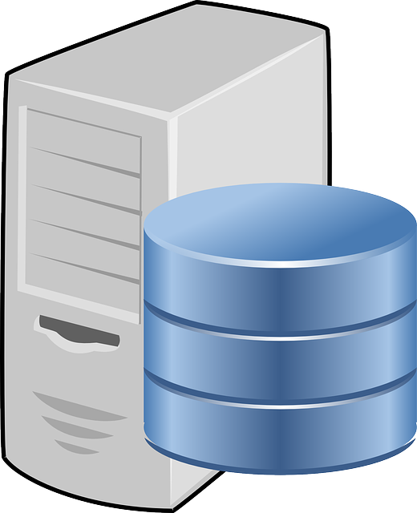
Fundamentals of Information System Security
Network Controls, Security Protocols & Implementation (Slide 4 of 9)
Authentication, Authorization & Accounting
Authentication
(unknown, illustrations of login screen, 2000-2020)
Access Control Function set by System Admin.
(unknown, Network and computer system administrator, 2014)
System Resources/Data Base
(unknown, computer - 156948_640, 2013)
Notes:
Access control principles is a three step progress, 1 the user logs into the network (Authentication), this information is then forwarded to the Authorization database that has been set up by the system administrator, once the information is processed it has passed the Access Control Function and is then forwarded via Access control to the System Resources (database) where the information the user is seeking is stored, (DeVry,2020).

Slide 16
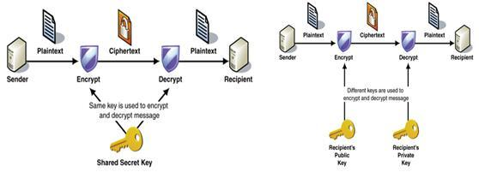
Fundamentals of Information System Security
Network Controls, Security Protocols & Implementation (Slide 5 of 9)
Cryptography & Security Policy
Symmetric and asymmetric encryption [3]
(Mohamad, 2017)
Notes:
To protect the (data) information that is being transmitted via the network we use protocols and software that encrypts it so that it is unreadable format using an symmetric or asymmetric method of encryption. In a Symmetric encryption the sender and receiver both use the same Secret Key to encrypt and decrypt the message, this requires that somehow the sender has to notify the receiver in advance of sending the message of what the shared secret key is. Whereas with an asymmetric encrypted message the recipient’s has a public key that is used to encrypt the message and a private key is used to decrypt the message. Both of these methods are illustrated in the slide image.
Now that we have covered the network controls we move on to the Security Protocols section.

Slide 17
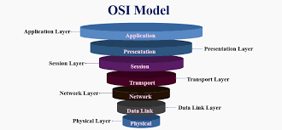
Fundamentals of Information System Security
Network Controls, Security Protocols & Implementation (Slide 6 of 9)
Network Security Protocols
Transport Layer 4
Application Layer 7
Network Layer 3
Data Link Layer 2
(Unknown, Network Security Tutorial - Overview of the OSI Model, 2020)
Notes:
Security Protocols are vital to the maintain the over all strength of the organization’s ability in preventing the unauthorized use of its data and resources. Protocols make it much harder for hackers to gain unauthorized access to the organization’s network, physical security measures aide in prevention of unauthorized individuals coming into the physical location of the organization. We focused on specific areas of the OSI Model because these are areas where further “hardening” will lower the vulnerabilities of the network. We started with Transport layer 4 – Segments: which handle the following protocols: TCP (Transmission Control Protocol), UDP (User Datagram Protocol), ECN (Explicit Congestion Notification), SCTP (Stream Control Transmission Protocol, DCCP (Datagram Congestion Control Protocol), (Unknown, CompTIA Network+, 1992-2020).
The Application Layer 7- Data: protocols are HTTPS (HyperText Transfer Protocol/S-HTTP(Secure HyperText Transfer Protocol), FTP (File Transfer Protocol, IRC (Internet Relay Chat),(Unknown, Internet Relay Chat, 2020), SSH (Secure Shell), DNS (Domain Name Server, PGP (Pretty Good Privacy, S/MIME (Secure Multipurpose Internet Mail Extension, KERBEROS ( based on tickets that allow nodes communicating over a non-secure network to prove their identity to each other in a secure manner), (DeVry, 2020). The protocols that Network Layer 3 - Packets are as follows: IP (Internet Protocol, IPSec (Internet Protocol Security), (DeVry, 2020) ICMP(Internet Control Message Protocol, (Rouse, ICMP (Internet Control Message Protocol), 2000-2020)), IGMP (Internet Group Management Protocol, (Unknown, What is IGMP and how does it work? - Technical Tip - 132521, 2018)). The last part of the OSI Model is the Data Link Layer 2 – Frames: the protocols handled by this layer are: RADIUS is an acronym for Remote Authentication Dial-In User Service which provide a centralized authentication, authorization and accounting functions by remote access, (DeVry,2020)), TACACS+ (Terminal Access Controller Access-Control System Plus uses authentication, authorization, and accounting for a network device (DeVry, 2020).
.

Slide 18
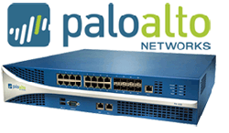
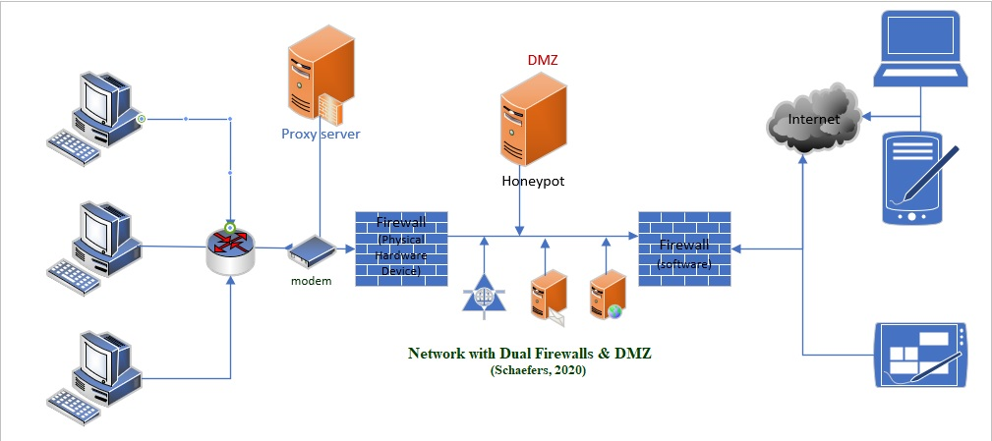
Fundamentals of Information System Security
Network Controls, Security Protocols & Implementation (Slide 7 of 9)
Appliances
Firewall
Proxy Servers
Honey Pot
Intrusion Detection System (IDS)
Intrusion Prevention System (IPS)
Firewall-hardware (unknown, Palo Alto Firewalls, 2000-2018)
Notes:
Firewalls can be either software or hardware, organization will often use a combination of both to aide in securing its network from the unsecure public network such as the world wide web (internet). Often the organization will use a physical device to separate their organization’s network from the Internet and then will use a software based firewall which are both illustrated in the diagram above. The proxy server is typically placed between the network where the client accesses it instead of the actual server, the benefits of this are, better control of internet usage, Hides IP address, location, improves the speed and bandwidth of the network and improved security. While there are various proxy tools available here are just a few: Burp Proxy, Charles, Proxifier, WinGate, ProxyCap and Fiddler, (DeVry, 2020). The Honeypot is created by the organization to deliberately attract the attention of individuals that are trying to hack into the organization’s network without risking the organization entire network. Here are five honeypot tools available online: HIHAT, HONEYBOT, Canary, ARGOS, and Thug. Another available appliance readily available is the Intrusion Detection System (IDS) which is capable of monitoring all in/outbound traffic on the network. The IDS is located in two places, one placed after the router and to the left and right (second location of IDS) of the DMZ, (although not shown in illustration) by doing this it protects the network from a hacker that is attempt to access the network, keep in mind though that IDS will detect intrusions it can’t stop them. However, the Intrusion Prevention System(IPS)has the ability to actively prevent and block intrusions on the network, (DeVry,2020). There are IDS/IPS solutions available via the internet, such as Snot, Next-Generation IPS, IBM Security Network Intrusion Prevention System and McAfee Host Intrusion Prevention for Desktops, and Strata IDS/IPS just to name a few, (DeVry,2020). The final goal of the week three module was the implementation of “Stateful Firewall and Multi Factor Authentication (MFA). The following two slides demonstrate this hands-on assignment.

Slide 19
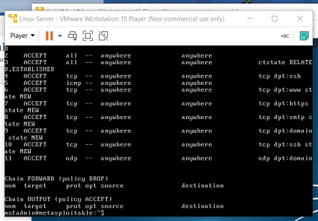
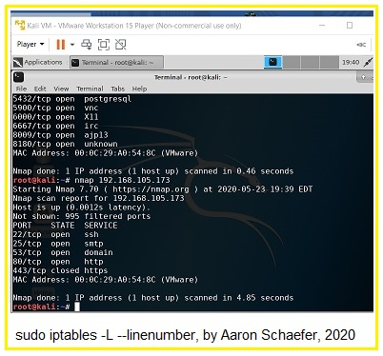
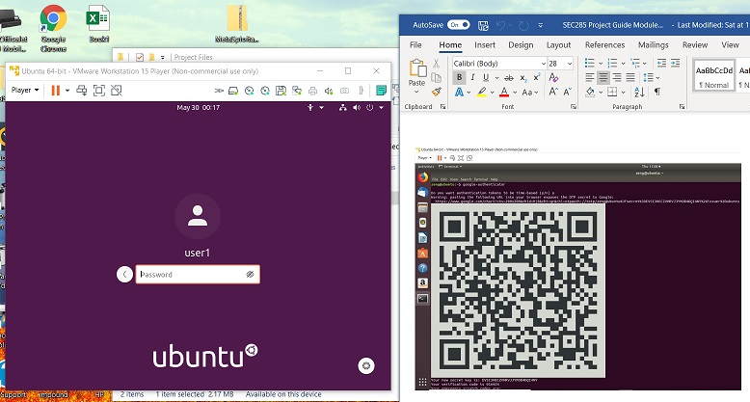
Fundamentals of Information System Security
Network Controls, Security Protocols & Implementation (Slide 8 of 9)
Stateful Firewall and Multi Factor Authentication (MFA)
(Schaefers, 2020)
Notes:
This slide shows screen shots of the Nmap Scan result, which shows that there a small number ports open (image on left). We were then ask to show and image of the sudo iptables after applying rules (middle image), and finally we had to show the Ubuntu Login screen (image on right), after the MFA had been activated. To initiate the Stateful Firewall students were required to enter new rules into iptables. Our goal was to limit access to the server by only allowing Web (HTTP/HTTPS), email (SMTP), name resolution (DNS) and SSH services. First thing we had to do was to flush the input, output and forward chains of the iptables, via Ubuntu's command terminal. The student entered the following three commands (shown in italicized font), First command was, sudo iptables –F INPUT second command was, sudo iptables –F OUTPUT and the third command was, sudo iptables –F FORWARD. To confirm that all rules were deleted the student then enter the command sudo iptables –L –line-numbers, it was then necessary to drop all invalid packets on the server by entering the command sudo iptables –A INPUT –m conntrack –-ctstat INVALID –j DROP. At this point it was necessary to set up the new rules as follows to forward all traffic on the loopback interface using the following commands: sudo iptables –A INPUT –I lo –j ACCEPT and sudo iptables –A OUTPUT –o lo –j ACCEPT . To accept commands from the TCP connection, incoming SSH sessions, and the incoming ICMP packets the following command had to be entered (respectively) sudo iptables –A Input –m conntrack –ctstate ESTABLISHED,RELATED –j ACCEPT … sudo iptables – A INPUT –I eth0 –p tcp –dport 22 –J ACCEPT … and sudo iptables –A INPUT –p icmp –j ACCEPT. The last slide (9) displays other command that student needed to enter and the final steps taken to finish his/her hands-on assignment, (DeVry,2020).

Slide 20
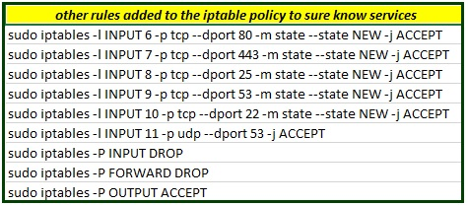
Fundamentals of Information System Security
Network Controls, Security Protocols & Implementation (Slide 9 of 9)
(Schaefers, 2020)
Notes:
After entering all of the command shown on this slide the student was require to save his/her work to make sure that the iptables would be retained and available when the system rebooted by entering the following command, sudo iptables-save at this point the student then confirmed that the new rules were in place by sudo iptables –L --line-numbers. However, the students required to create a new user account on ubuntu by via the use of sudo commands as follows: sudo useradd –m user1 and sudo passwd user1 as well as adding this command, sudo usermod –aG sudo user1 he/she also implemented the MFA system in Ubuntu to mitigate security concerns. Iptables are part of the firewall protection within ubuntu which by default allow all traffic to flow, however upon completion of the hand-on task he/she changed the default setting so that the network was more secure and traffic was better controlled. Giving him/her a better understanding of the difference between the iptables –A and iptables –I options. The first allows changes to the iptables rules and the later option requires a two option rule which inserts a rule into the INPUT chain as the 5th rule on the list, (Gunnar, 2020). A lot of today’s organization now allow employees to use his/or her own wireless devices in the course of their duties, which brings us to the topic of module 4 of network security policy design, and implementation.

Slide 21
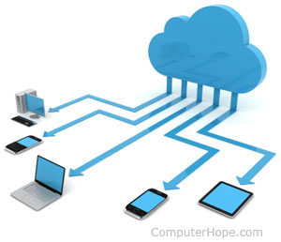


Fundamentals of Information System Security
Network Security Policy Design & Implementation (Slide 1 of 4)
This Photo by Unknown Author is licensed under CC BY-SA-NC
This Photo by Unknown Author is licensed under CC BY-SA-NC
Notes:
The issue of security pertains to many things in business, such as the safety of the building and grounds, safe guarding employees, and of course the protection of the business’s network. Our primary focus will pertain to the security policy in relation to the use of the internet by employees and the use of employee own devices being used for company business.

Slide 22
Fundamentals of Information System Security
Network Security Policy Design & Implementation (Slide 2 of 4)
Enterprise Information Security Policy
This policy covers the business’s direction of its Security policies
Issue Specific Security Policy
Directs the viewers on the usage of technology based system with the aid of guidelines
System Specific Security Policy
Directs users while configuring or maintaining a system.
Notes:
Each of these categories cover different areas of the organization security policies. Examples of Enterprise Information Security Policy (EISP) are: Application Policy, Network and Devices security policy to include the auditing, back up and restore, system security and server policies. The Issue Specific Security Policy (ISSP) highlights the following areas: Remote assess/wireless policies, an incidence response plan, policies for passwords, the use of personal devices, account user policies, and the use of the internet/web policies, and the third type of information security policy is the System Specific Security Policy (SSSP) which covers policies for the following: DMZ, Encryption, Acceptable use policy (AUP), secure cloud computing, intrusion detection/prevention policies, and Access control policy, (DeVry, 2020). The hands-on project for this model was the develop of the Bring Your Own Device (BYOD) policies for an organization. He/she were also asked to answer a couple of questions which are shown in the next slide.

Slide 23
Fundamentals of Information System Security
Network Security Policy Design & Implementation (Slide 3 of 4)
Bring Your Own Device (BYOD) Security Policy Outline
    Overview
    Purpose
    Scope
    Policy
    Policy Compliance
    Related Standards, Policies, and Processes
    Definitions and Terms
    Revision History
Student’s response to the following questions:
In what way does risk assessment impact the development of Program (security) Policies?
When is it appropriate to review an organization’s Issue-specific (security) Policy?
Notes:
The hands-on task required student to develop each of the bolded and italicized topics of the BYOD Security Outline and give a response to two questions (which will be answered in the following (final) slide of this section. Let’s start with the section titled as:
1. Overview: Smartphones including iPhone, Android, Blackberry and Windows phones are allowed (the list should be as detailed as necessary including models, operating systems, versions, etc.). Tablets including iPad and Android are allowed (the list should be as detailed as necessary including models, operating systems, versions, etc.).
Connectivity issues are supported by IT; employees should/should not contact the device manufacturer or their carrier for operating system or hardware-related issues.
Devices must be presented to IT for proper job provisioning and configuration of standard apps, such as browsers, office productivity software and security tools, before they can access the network. While IT will take every precaution to prevent the employee’s personal data from being lost in the event it must remote wipe a device, it is the employee’s responsibility to take additional precautions, such as backing up email, contacts, etc. The company reserves the right to disconnect devices or disable services without notification. Lost or stolen devices must be reported to the company within 24 hours. Employees are responsible for notifying their mobile carrier immediately upon loss of a device. The employee is expected to use his or her devices in an ethical manner at all times and adhere to the company’s acceptable use policy as outlined above.
2. Purpose: The purpose of this policy is to define the appropriate use and procedures for using personally owned mobile and other devices on the business network and to protect the security and integrity of private and confidential data residing in the business infrastructure.
3. Scope: This policy applies to any employee, student, visitor, client or guest of the business who makes a connection from a personal device to any business provided network or connects to any business provided software, service, data or resource. BYOD is a rapidly changing technology and Networking and Technical Services may elect to implement additional requirements or processes to safeguard the businesses computing resources (e.g. mobile device management (MDM), remotely removing data, or requiring additional registration processes).
4. • Using reasonable physical security measures procedures such as enabling a PIN,
password, biometric or other additional security features to prevent unauthorized access
to the device and encrypting the device before connecting to business services, resources
and/or data
• Refraining from storing sensitive work data or confidential business records and
Information mobile device or unencrypted portable storage (e.g. USB thumb drive)
• Destroying, removing or returning all business owned data, electronic or otherwise, once
your relationship with the business ends or once you are no longer the owner or primary
user of the device. (e.g. the sale or transfer of a device to another person)
• Removing or returning all software application licenses belonging to the business when the
personal device is no longer used for the business
• Notifying the HelpDesk of any theft or loss of a personal device containing data or
software application licenses belonging to the business
• Not connecting a personal device to the wired college network without prior approval
from the director of Networking and Technical Services. Before making a wired
connection with a personally owned device, the employee MUST contact the HelpDesk
to start the approval process
• Not connecting a personal mobile device that has been "jailbroken" or "rooted" to any
business network, software, service, data, or resource. Business owned mobile devices that
are “rooted” or “jailbroken” MAY be allowed to join a Business network with prior
approval from the director of Networking and Technical Services
• Providing any necessary power cables and/or adapters required to connect to projection
devices, audio reinforcement, sound systems or other guest connection hardware within
offices, meeting rooms and other business locations and comply with any
posted instructions about connecting or disconnecting devices
• Following any announcements prohibiting live streaming or recording via personal
devices of events, performances or other business activities.
Now let’s turn our attention to the answering the two questions shown in the slide, as previously stated the responses will be on the next (final) slide for this module.

Slide 24


Fundamentals of Information System Security
Network Security Policy Design & Implementation (Slide 3 of 4)
Student’s response to the following questions:
In what way does risk assessment impact the development of Program (security) Policies?
When is it appropriate to review an organization’s Issue-specific (security) Policy?
This Photo by Unknown Author is licensed under CC BY-NC
This Photo by Unknown Author is licensed under CC BY-SA-NC
Notes:
The following are the responses to each of the questions shown on the slide:
Organizations identify and evaluate risks to the confidentiality, integrity and availability of their information assets. This process can be broadly divided into two components: 1. Risk assessment — The process of combining the information you have gathered about assets and controls.
The purpose of a comprehensive review is to take an in depth look at existing administrative policies to: 1) determine if a policy is still needed or if it should be combined with another administrative policy; 2) determine whether the purpose and goal of the policy is still being met; 3) determine if changes are required to improve the effectiveness or clarity of the policy and procedures; and 4) to ensure that appropriate education, monitoring and ongoing review of the policy is occurring.

Slide 25
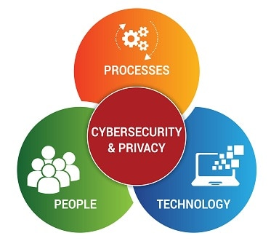

Fundamentals of Information System Security
Physical Security (Slide 1 of 4)
Administrative Control
Physical Control
Technical Control
This Photo by Unknown Author is licensed under CC BY-ND
This Photo by Unknown Author is licensed under CC BY-SA
Notes:
This week (module 5) students have to understand the important aspects of Security control as it pertains to the following areas: Administrative, Physical, Technical, and Administrative. Then as his/her hands-on tasks will put this knowledge to use in developing a Home Security System, upon completion of the project it will be similar to a home security system with the capability to identify the location of an a detected motion. Each of these topics will be further details over the next few slides.

Slide 26
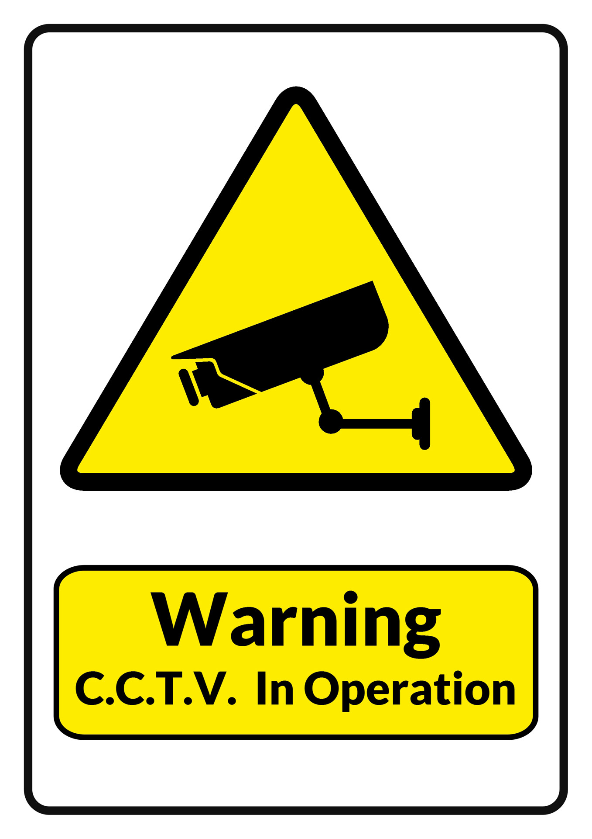

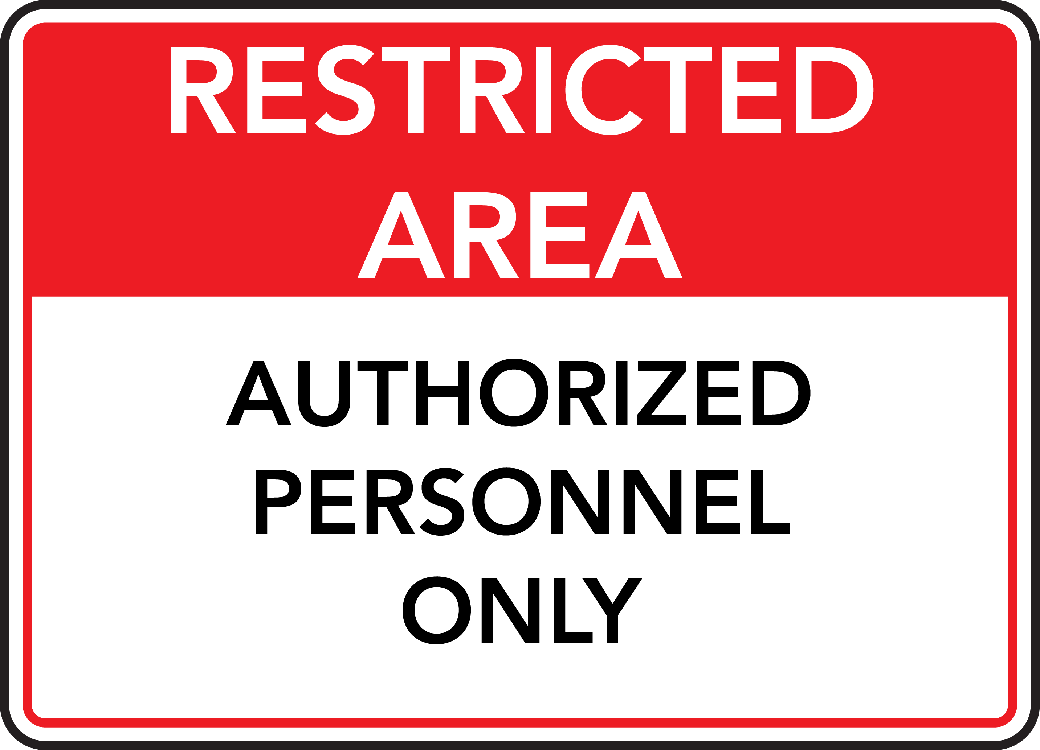



Fundamentals of Information System Security
Physical Security (Slide 2 of 4)
Administrative Control
This Photo by Unknown Author is licensed under CC BY-NC
This Photo by Unknown Author is licensed under CC BY
This Photo by Unknown Author is licensed under CC BY-SA-NC
This Photo by Unknown Author is licensed under CC BY-SA
Notes:
Administrative control involves all levels of the organization personnel from the hourly employee to the top CEO and every department in between. Administration is also the has the primary responsibility for setting up of management constraints, operational procedures, accountability procedures, information system protection and the overall personnel-oriented techniques to control an individual’s behavior,(DeVry, 2020).

Slide 27

Fundamentals of Information System Security
Physical Security (Slide 3 of 4)
Physical Control
Business Building
Visitors
Employees
This Photo by Unknown Author is licensed under CC BY-NC-ND
This Photo by Unknown Author is licensed under CC BY-SA-NC
Notes:
Physical control isn’t dealing with just people but must also take into account the organization building(s), natural disaster(s), fire, accidental damages, any physical threats such as device theft/loss or unauthorized access. Factors that effect physical security include protecting infrastructure from more nature events such as fires, floods, earthquakes, thunder, lighting, temperature and humidity. But also have to consider the man-made threats like vandalism, device loss/damage, social engineering, terrorism, theft and unauthorized access to systems. In addition to the physical locks or barriers and the hiring of security personnel (DeVry, 2020).

Slide 28
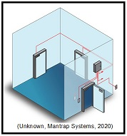
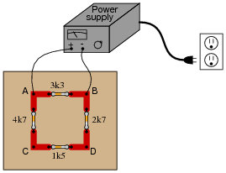
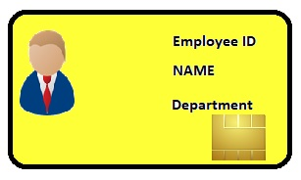
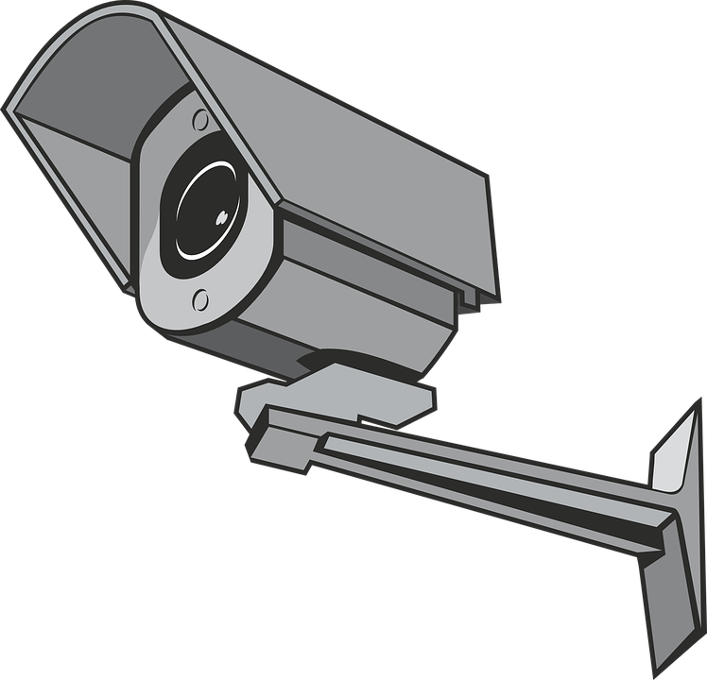

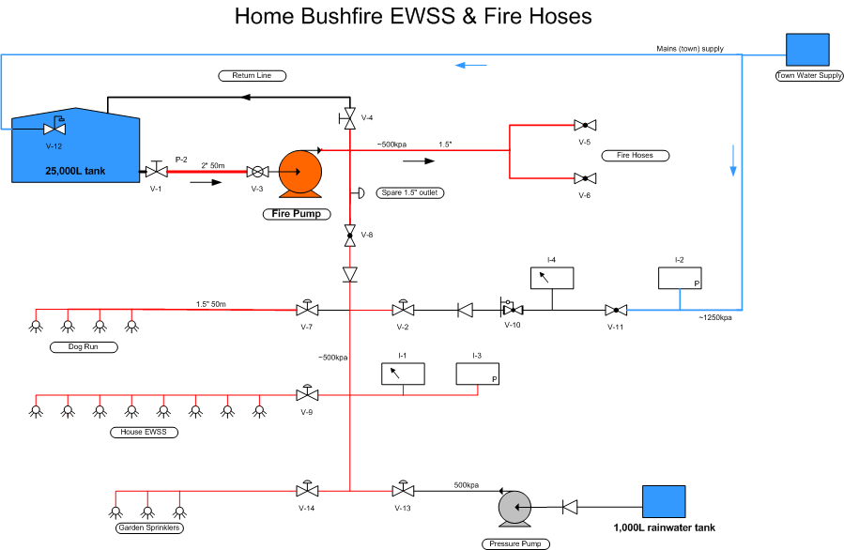
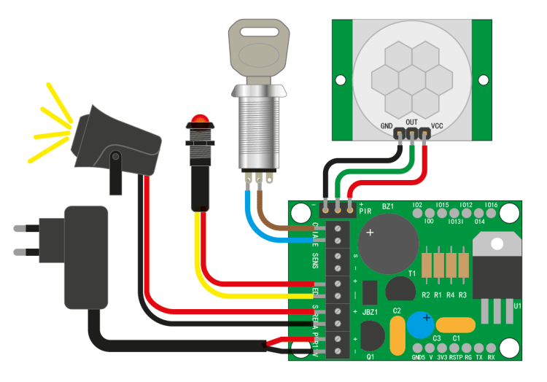

Fundamentals of Information System Security
Physical Security (Slide 4 of 4)
Technical Control
  Access Control
  Mantrap
  Fire Fighting System
  Lighting
  Alarm Systems
  Power Supple
  Video surveillance
  Weapon/Contraband Detection
  Environmental Controls
This Photo by Unknown Author is licensed under CC BY
This Photo by Unknown Author is licensed under CC BY-NC-ND
This Photo by Unknown Author is licensed under CC BY-SA
This Photo by Unknown Author is licensed under CC BY-SA-NC
Notes:
Technical controls is makes use of technology to control and maintain many of the assets of the organization. Generally they are incorporated via hardware, software, operation or applications to control the access to sensitive areas. These areas include the Access Controls, Mantraps, Fire Fighting Systems, Lighting, Alarm Systems, Power Supply, Video Surveillance Weapon/Contraband Detection and Environmental Controls. In many organizations today will use a room that has only two doors on opposite walls from each other a person would enter the room from one side and could not go through the second door on the opposite side unless he/she has the proper access code that can be either keyed in by hand or has an ID card with the imbedded information that can be scanned, this type of room is referred to as a mantrap because if the person doesn’t have the correct information for further access to be authorized then he or she is “trapped” until someone (generally and security team member, as they are the ones that can monitor the room via video surveillance) lets them out. The final objective of for this week was the hands-on task, of building the “Home Security System” with motion sensor, passive and active buzzers.

Slide 29
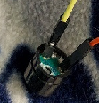
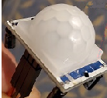
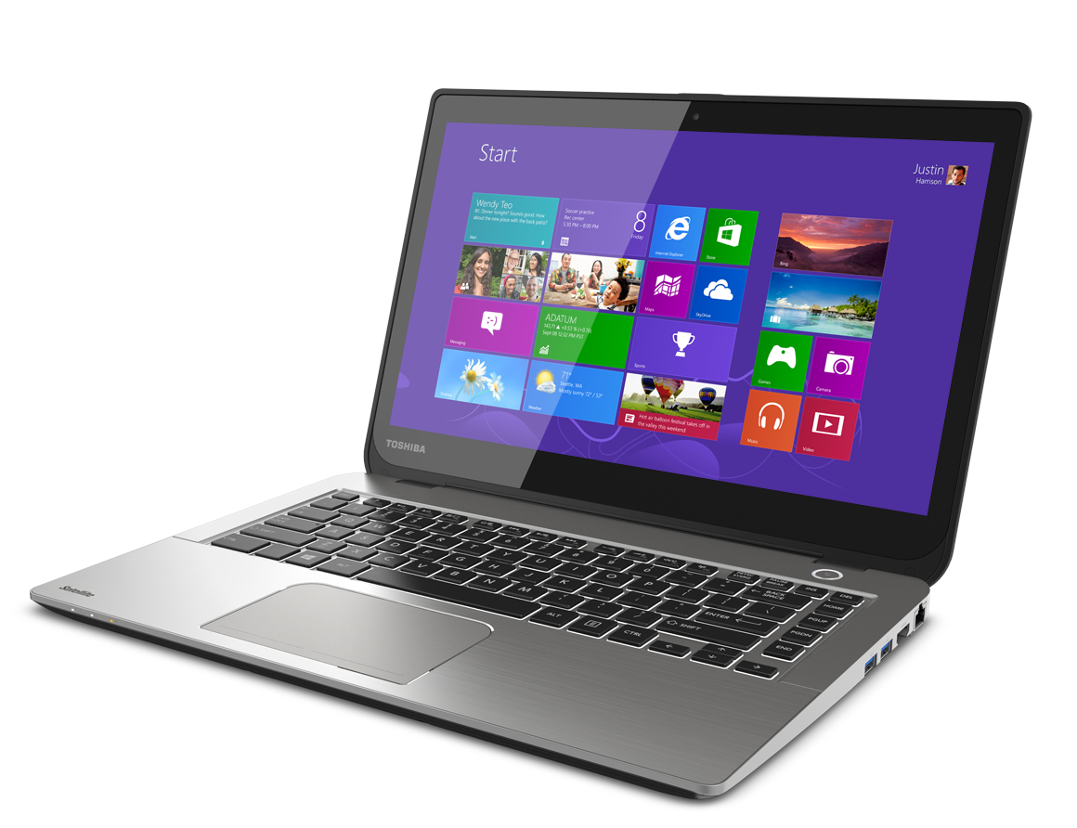

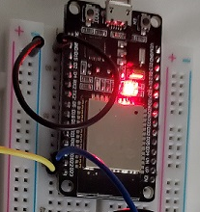
Fundamentals of Information System Security
Home Security System (Slide 1 of 2)
Inventory Needed
  Laptop
  ESP32 Microcontroller
  Breadboard
  Wires
  Active Buzzer
  Passive Buzzer
  PIR motion sensor
This Photo by Unknown Author is licensed under CC BY-NC
Notes:
The goal is to build a home security system with alarm (buzzer) and motion sensor. As shown we had to assemble all of the parts listed above, starting with the breadboard, we then connected wires to the positive and negative side of the board, then had to place the ESP32 Microcontroller to the board and run the wires from it to the breadboard. We then connect the two buzzers and the motion sensor. The following slide will show the complete project as well as the screenshot of the system output for both the passive and active buzzers when motion is detected.

Slide 30


Fundamentals of Information System Security
Home Security System (Slide 2 of 2)
Notes:
On the left are the results of the passive buzzer and the image on the right shows the result of the active buzzer, both are with the motion sensor. At first this project was difficult to accomplish due to a faulty motion sensor. These difficulties and the steps taken will be given in further detail in the challenges section of this presentation. So far each week students have gained new skills and concepts that allow him/her to build on their networking skills, in week (module) six the objective is to classify the common susceptibilities of host devices.

Slide 31

Fundamentals of Information System Security
Host Security (Slide 1 of 6)
Host Consideration
Host Configuration
Serversm, Hardware, Virtualization
Notes:
One might ask what is a host and why is it important, the simplistic answer is these shown are all (and many others) able to connect to the network, basically any device that has an IP Address is a host (DeVry,2020). During this week’s skill building students were able take their knowledge of the Identification and access Management IAM)and those of physical security by combining them with the use of sensors and intelligent software.

Slide 32

Fundamentals of Information System Security
Host Security (Slide 2 of 6)
Host Consideration
  Workstations
  Laptops
  Routers
  Network servers
  Wirelessly Networked Devices
  Switches
Notes:
According to our reading assignments this week any device that has an IP Address is consider to be a host if it is connected to the network, this also includes any hardware or virtual machine. This is of vital importance because the security of the network starts with the individual host, (DeVry,2020). During this week student will take a comprehensive line of attack to strengthening the Host operating systems. Lastly student’s put the knowledge gained in his/her final hands-on project. The slide image is offered as a visual representation of a network system with and without hardening of the Host. This whole week our primary goal has been to strengthen the organization’s security system. If one doesn’t remember to harden all host systems then he/she would basically be leaving an avenue of vulnerability. Which, could be accessed by anyone and more dangerously by someone that wants to do harm (hacker).

Slide 33

Fundamentals of Information System Security
Host Security (Slide 3 of 6)
Host Assessment
Notes:
Before we can take steps to further protect the devices, software or applications within the organization’s network we need to understand the role of each device has from the point of its being a host. So the system administrator/technician needs to ask him/herself the following questions: What is the purpose of it? What is the information that stored/processed by the host? What re the Security requirements need to protect that information? What network services are provided by the host? One example given in our course readings was if you harden (lock) all ports then the port that is require by the device would be unavailable, and the request fail (DeVry, 2020) This is why you need to know which user/user group(s) have been granted permission to use these services or devices. Therefore, it is important to know the individual baseline (operational requirements of the OS, Server, and Applications) of each device as these differ based on the type of device in question (DeVry, 2020). Determining a baseline can be done with tools like Microsoft Baseline Security Analyzer (MBSA) which is a tool offered on Windows however, according to Renaud Larue-Langlois are better alternative to this program, and the top four alternatives are: 1. SolarWinds Network Configuration Management (free trail), 2. OpenVAS, 3. Retina Network Community and 4. Nexpose Community Edition (Larue-Langlois, 2020). Other steps that certainly need to be taken are: setting up the BIOS Password not only is it the first line of defense but it also helps in maintaining the OS security, regular auditing of the Windows Registry will aid in the detection of malicious activity because the OS records every action that occurs within the registry. As most people already understand the use of strong passwords (alpha-numeric and at least 8 characters in length), routinely check and install any updates, disable any unused system services (IIS, FTP, SQL Server, Proxy Services, Telnet, Universal Plug/Play on any machine that is not a server, make sure that security setting are appropriately base for the organization’s local network, configure windows firewall settings, install antivirus software using either Windows Defender or a Third Party software, install Spam filter software such as Symantec Email Security or AVG AntiVirus. The technician should also enable Pop-Up Blockers and on a regular basis review the Windows Event Logs for the following logs: System log, Security logs, Setup logs and Application logs. While some would consider a weekly/bi-weekly review, however one should keep in mind that “critical systems” should require a daily log review, (DeVry, 2020).

Slide 34
Fundamentals of Information System Security
Host Security (Slide 4 of 6)
Host Configuration
      IDS/IPS
      Detection
      Monitoring
Notes:
Host based Intrusion Detection Systems (IDS) / Intrusion Prevention Systems (IPS) implementing this software on each machine the network technician is able to detect and prevent malicious activities that could pose a threat to the system’s rootkits or critical configuration files. Since the IDS/IPS is a dual function (monitor/report) software program it is a very effective in its ability to track any illicit use from authorized (users) insiders. Other benefit is the Alien Vault Unified Security Management (USM ) with nine areas of intrusion detections: 1. System compromises,2. Rootkits, 3. Unwanted applications, 4. Stopped critical services, 5. Malware, 6. Modification to critical files like the registry, /etc/password, 7. Rogue processes, 8. User access to system/applications, 9. Privilege escalations (DeVry,2020). Tripwire is the host based IDS for Linux that offers the same types of prevention and detection abilities.

Slide 35



Fundamentals of Information System Security
Host Security (Slide 5 of 6)
Seversm, Hardware, Virtualization
Switch
Servers
Hardware
Virtual Machines
This Photo by Unknown Author is licensed under CC BY-SA
This Photo by Unknown Author is licensed under CC BY-SA
Virtual Machine
router
(Schaefers, 2020
This Photo by Unknown Author is licensed under CC BY-SA
Notes:
The goal is to create a network that offers the highest level of security protection as possible. Now that we have hardened the machine (PC) Operating System(s) for Windows and/or Linux we need to our attention to other areas. It is recommended that each Server be used for a single purpose (i.e., FTP Server, Email Server, Data Storage, or Web Server, etc.) It is also recommended that the web server be on a separate subnet then other servers cause of its contact with the internet, ideally inside the DMZ so that it is isolate from the organization’s internal network, however the precautions shouldn’t stop there, the technician should also harden the server by disabling unnecessary ports, telnet access, setting permissions, etc., and place a firewall between it and the SQL server. Using the same policies, guidelines and standards, that were required for hardening each pc the technician should harden all routers, switches and firewalls by restricting traffic between the supporting server, external network and the webserver, remember to base web access based on appropriate authorization. It also important to allow access to the web server software to only individual’s that are authorized because they will have access to files like: the server log, system software including the configuration files and password files. It is also an excellent practice to establish a dedicated logging server so that network devices (i.e., routers, switches, printers, web-servers) can send/store logging events and information on this dedicated server known as the Syslog Server and recorded events are referred to as “Syslog Messages” that are store in one location. Components of the Syslog are: Syslog listener, Database and Management/filtering software, (DeVry, 2020). This log should also be reviewed on a regular basis to aide troubleshooting and monitoring. The use of the Virtual Machine(s) that allows the organization to in essence add a workstation without the additional cost of having to purchase the physical equipment because the VM uses the same resource that the Host (pc) uses yet has the ability to have its own OS whether it is Windows or MAC based and can do the same types of tasks that any physical computer can do. The hands-on task this week was to implement secure file management and password procedures to diminish risks to the organization’s data assets. The results of this are shown (via screenshots) on the following slide.

Slide 36





Fundamentals of Information System Security
Host Security (Slide 6 of 6)
Asymmetric Key Encryption & Password Policy
4
1
3
2
5
Notes:
The following is an identification of each screenshot image: 1) Cat command, 2) Public & Private Key Generation, 3) Failed Logins, 4) ls test & gpg test file and the final image is 5) Shred command.

Slide 37


Fundamentals of Information System Security
Technology Careers & Opportunities
This Photo by Unknown Author is licensed under CC BY-NC-ND
Notes:
My goal is to become a System Administrator with a focus on Cyber Security. According the US Bureau of Labor and Statistics “Employment of network administrators in the computer systems design and related services industry is projected to grow 24 percent from 2018 to 2028”, (U.S. Bureau of Labor and Statistics, 2020).

Slide 38



Fundamentals of Information System Security
Challenges, Goals and Conclusion
This Photo by Unknown Author is licensed under CC BY-SA
This Photo by Unknown Author is licensed under CC BY
This Photo by Unknown Author is licensed under CC BY
Notes:
There were only two real challenges to me during this course, the first being balancing my work schedule (due to increased overtime) and Module 5 where it turnout to be a faulty motion sensor that prevent my originally completing the task. Where my work hours and personal obligations for family and school, I was able to re-organize the family obligations to occur during my academic break next week. As for work; instead of working 7 days a week to cover the hours of co-workers that couldn’t work, I was able to work longer hours each days so that I could have at least one day a week to dedicate to my academic goal.
The challenge of the faulty motion sensor was the largest challenge, I had the following steps: Checked all connections that are connected correctly
Downloaded pin cross reference chart for pin numbers
Verified the code to make sure no errors in code
Made sure that motion sensor is not near any heat source and light near the motion sensor
Used a multimeter to check any voltage coming to the sensor and when waive the sensor no voltage is reading when the is reading to the sensor
Determine that the sensor is bad and needs replaced
Reach out to instructors and fellow students.
Yet, none of these steps worked in resolving the issue so at this point I decide to order a new motion sensor as well as a new ESP 32 board, I felt this the best option just in case it was the actual board and not the sensor. My suspicions were confirmed when the new parts arrived and was able to successfully complete the objectives of the project. The downside of this challenge was that I wasn’t successful in meeting the original deadline for the project, however, as shown earlier in this presentation I was able to update that section with the completed work for that section. My goals at this time due to the COVID-19 pandemic have change somewhat, in relation to when I will be able to actually get my certification, at this time with the added responsibilities at work I will have to put this on hold until just a time as my work hours are reduced to a regular 40 to 50 hour work week instead of the 60 to70 hours I am currently doing. In the meantime I will continue on with my course studies, and take advantage of the practice test that are available via DeVry’s library and the internet.
In closing, the past eight weeks has presented at times an overwhelming about of information but by taking each of the weekly reading assignments one step at a times, and carefully scheduling other obligations with the exception of actual work hours I was able to successfully achieve completion of all course materials and task. When I first start this course I had little knowledge on how to harden the security of many devices. I knew to reset all generic passwords but did not realize just how many open ports were still available within my home network. Now, am confident that I have hardened my personal home network and already noticed that my connection to the internet takes less time and that the possible threat alerts have decreased as well as I no longer have the annoyance of pop ads.

Slide 39
Fundamentals of Information System Security
References
Alder, S. (2020, February 13). 2019 Healthcare Data Breach Report. Retrieved from HIPAA Journal: https://www.hipaajournal.com/2019-healthcare-data-breach-report/
Cooper, S. (2020, May 29). 12 Best Ping Sweep Tools and Software for 2020. Retrieved from compaitech: https://www.comparitech.com/net-admin/ping-sweep-tools/
DeVry. (2020). Certified Network Defender (CND) Part 1. In EC-Council/Academia. Unknown.
DeVry University. (2020). The DVU Tech Path. Retrieved from DeVry: https://devryu.instructure.com/courses/56261/files/8461840/preview
Doffman, Z. (2019, September 14). Cyberattacks On IOT Devices Surge 300% In 2019, "Measured In Billions", Report Claims. Retrieved from Forbes: https://www.forbes.com/sites/zakdoffman/2019/09/14/dangerous-cyberattacks-on-iot-devices-up-300-in-2019-now-rampant-report-claims/#60b81ee85892
Gunnar, H. (2020, April 11). Iptabales How To. Retrieved from Ubuntu: https://help.ubuntu.com/community/IptablesHowTo
Kapil, D. (2015, September 8). DNS Security. Retrieved from Dhaval Kapil: https://dhavalkapil.com/assets/images/DNS-Security/dns_cache_poisoning.png
Kirkbride, P. (2019). Interview with a Social Engineer - Getting Free Product from fitbits to $150,000 Medical Equipment. Retrieved from steemit: https://steemit.com/hacking/@kirkins/interview-with-a-social-engineer-getting-free-product-from-fitbits-to-usd150-000-medical-equipment
[please note that additional references are continued in the slide notes ]
Notes:
References (continued from slide)
Larue-Langlois, R. (2020, February 3). Best Alternatives to Microsoft Baseline Security Analyzer. Retrieved from Addictive Tips: https://www.addictivetips.com/net-admin/microsoft-baseline-security-analyzer-alternatives/
Mohamad, R. A. (2017). Symmetric and asymmetric encryption. Retrieved from ResearchGate: https://www.researchgate.net/figure/Symmetric-and-asymmetric-encryption-3_fig1_320741257
Nasi, E. (2018, February 7). Hacking around HTA files. Retrieved from Sevagas: http://blog.sevagas.com/?Hacking-around-HTA-files
Rouse, M. (2000-2020). ICMP (Internet Control Message Protocol). Retrieved from TechTarget: https://searchnetworking.techtarget.com/definition/ICMP#:~:text=ICMP%20(Internet%20Control%20Message%20Protocol)%20is%20an%20error%2Dreporting,prevent%20delivery%20of%20IP%20packets.
Rouse, M. (2020). ping weep (ICMP sweep). Retrieved from TechTarget: https://searchnetworking.techtarget.com/definition/ping-sweep-ICMP-sweep
Schaefers, A. (2020, May - June). Screen Shots from personal computer. Centralia, WA.
U.S. Bureau of Labor and Statistics. (2020, April 10). Occupational Outlook Handbook. Retrieved from Network and Computer Systems Administrators: https://www.bls.gov/ooh/computer-and-information-technology/network-and-computer-systems-administrators.htm#tab-6
Unknown. (1992-2020). CompTIA Network+. Retrieved from ASM Educational Center: https://asmed.com/comptia-network-osi-model/
unknown. (2000-2018). Palo Alto Firewalls. Retrieved from Firewall.cx Team: http://www.firewall.cx/networking-topics/firewalls/palo-alto-firewalls.html
unknown. (2000-2020). illustrations of login screen. Retrieved from dreamstime: https://www.dreamstime.com/stock-images-login-password-d-render-image31974834
Unknown. (2005-2020). Images for Non-Commercial Use. Retrieved from clipart-library: http://clipart-library.com/images/5TRKG5xqc.jpg
Unknown. (2005-2020). Vector Change, configurations, control icon image. Retrieved from 123RF Limited: https://www.123rf.com/photo_94908336_stock-vector-change-configurations-control-icon-image-can-also-be-used-for-computer-hardware-computer-network-and.html
unknown. (2013, July 13). computer - 156948_640. Retrieved from pixabay: https://cdn.pixabay.com/photo/2013/07/13/10/17/computer-156948_640.png
unknown. (2014). Network and computer system administrator. Retrieved from bizmanualz: https://www.bizmanualz.com/wp-content/uploads/2014/05/Network-and-computer-system-administrator.png
unknown. (2016, October 16). cyber-security-1784985_960_720. Retrieved from pixabay.com: https://cdn.pixabay.com/photo/2016/10/31/06/12/cyber-security-1784985_960_720.png
Unknown. (2017, April 26). Linear bus topology. Retrieved from Computerhope.com: https://www.computerhope.com/jargon/l/linear-bus.jpg
Unknown. (2017, October 30). Tree Topology. Retrieved from Computerhope.com: https://www.computerhope.com/jargon/t/treetopo.htm
Unknown. (2018, November 13). Mesh topology. Retrieved from computerhope.com: https://www.computerhope.com/jargon/m/mesh.htm
Unknown. (2018, November 13). Ring topology. Retrieved from Computerhope.com: https://www.computerhope.com/jargon/r/ringtopo.htm
Unknown. (2018, January 24). Star topology. Retrieved from Computerhope.com: https://www.computerhope.com/jargon/s/startopo.htm
Unknown. (2018, August 14). What is IGMP and how does it work? - Technical Tip - 132521. Retrieved from Dell Technologies: https://www.dell.com/support/article/en-us/sln68773/what-is-igmp-and-how-does-it-work-technical-tip-132521?lang=en
Unknown. (2020, May 28). Internet Relay Chat. Retrieved from wikipeia: https://en.wikipedia.org/wiki/Internet_Relay_Chat
Unknown. (2020). Is human nature inherently evil? Retrieved from CreateDebate: https://www.createdebate.com/debate/show/Is_human_nature_inherently_evil
Unknown. (2020). Mantrap Systems. Retrieved from Security Door Controls: https://www.sdcsecurity.com/mantrap-systems.htm
Unknown. (2020). Network Security Tutorial - Overview of the OSI Model. Retrieved from EDUCBA: https://www.educba.com/what-is-osi-model/
White, S. K. (2015, May 28). How your employees put your organizations at risk. Retrieved from CIO: https://www.cio.com/article/2927598/how-your-employees-put-your-organization-at-risk.html
Wilson, M. (2019, January 8). IP & Port Scanners. Retrieved from PC & Network Downloads: https://www.pcwdld.com/best-free-ip-scanners-port-service-scannin

