Slide 1
CEIS101
Module 6
Networking and security

Slide 2
Router (Screenshot)
Screenshot of router setup page

Slide 3
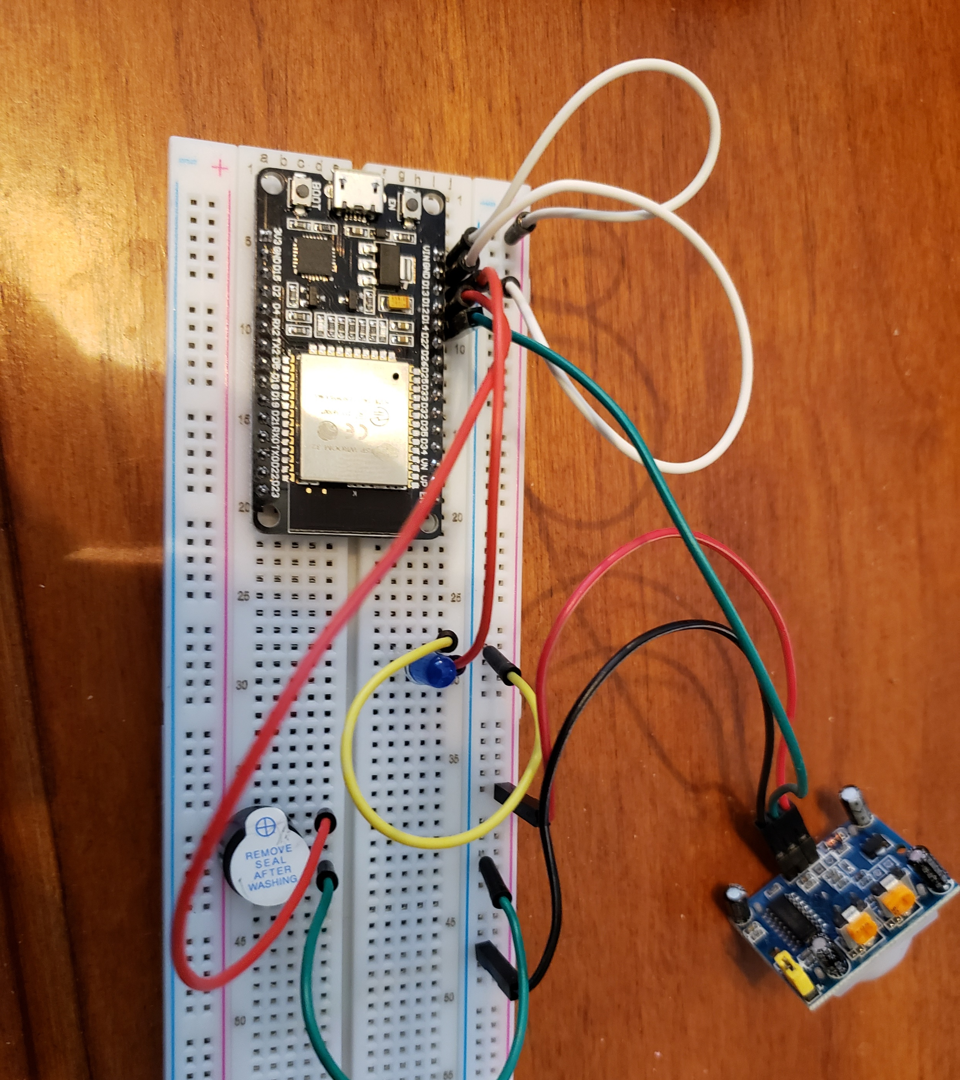
Circuit (Picture)
Picture of circuit with ESP32 board on breadboard with LED

Slide 4
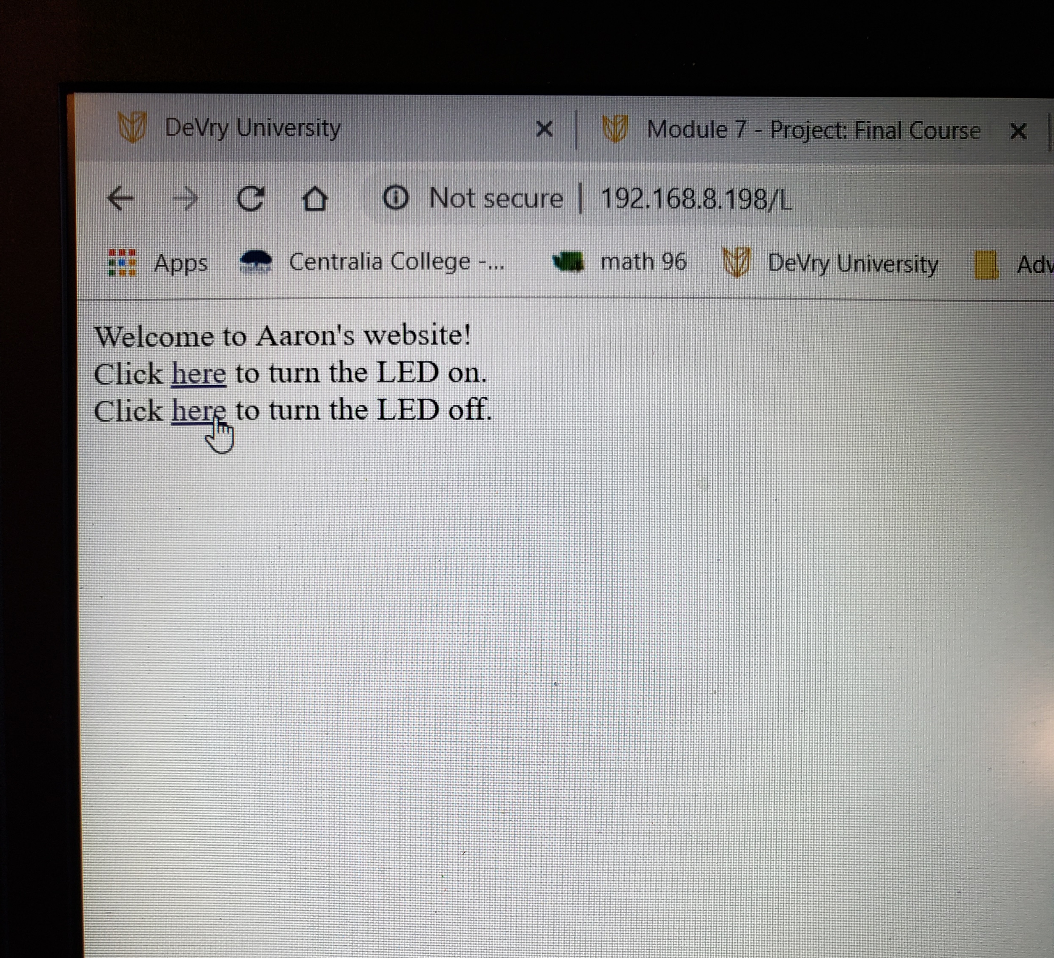
Web page (Screenshot)
Web server screenshot showing turning on and off the light from the web.

Slide 5
Challenge Assignment

