Slide 1

CEIS110
Introduction to Programming
(Part 1 of 2)
By Aaron Schaefers
Devry University
Instructor:
Natalie Waksmanski

Slide 2
Introduction
Internet of things is growing
This project uses an IOT device to gather data from a temp device
The data is analyzed using python programming and analytics

Slide 3

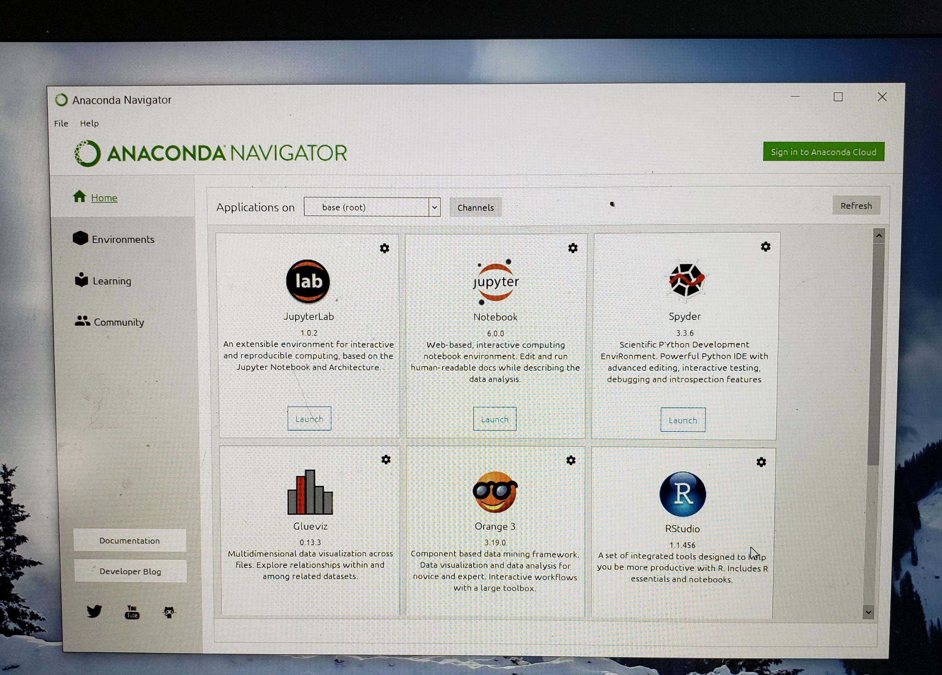
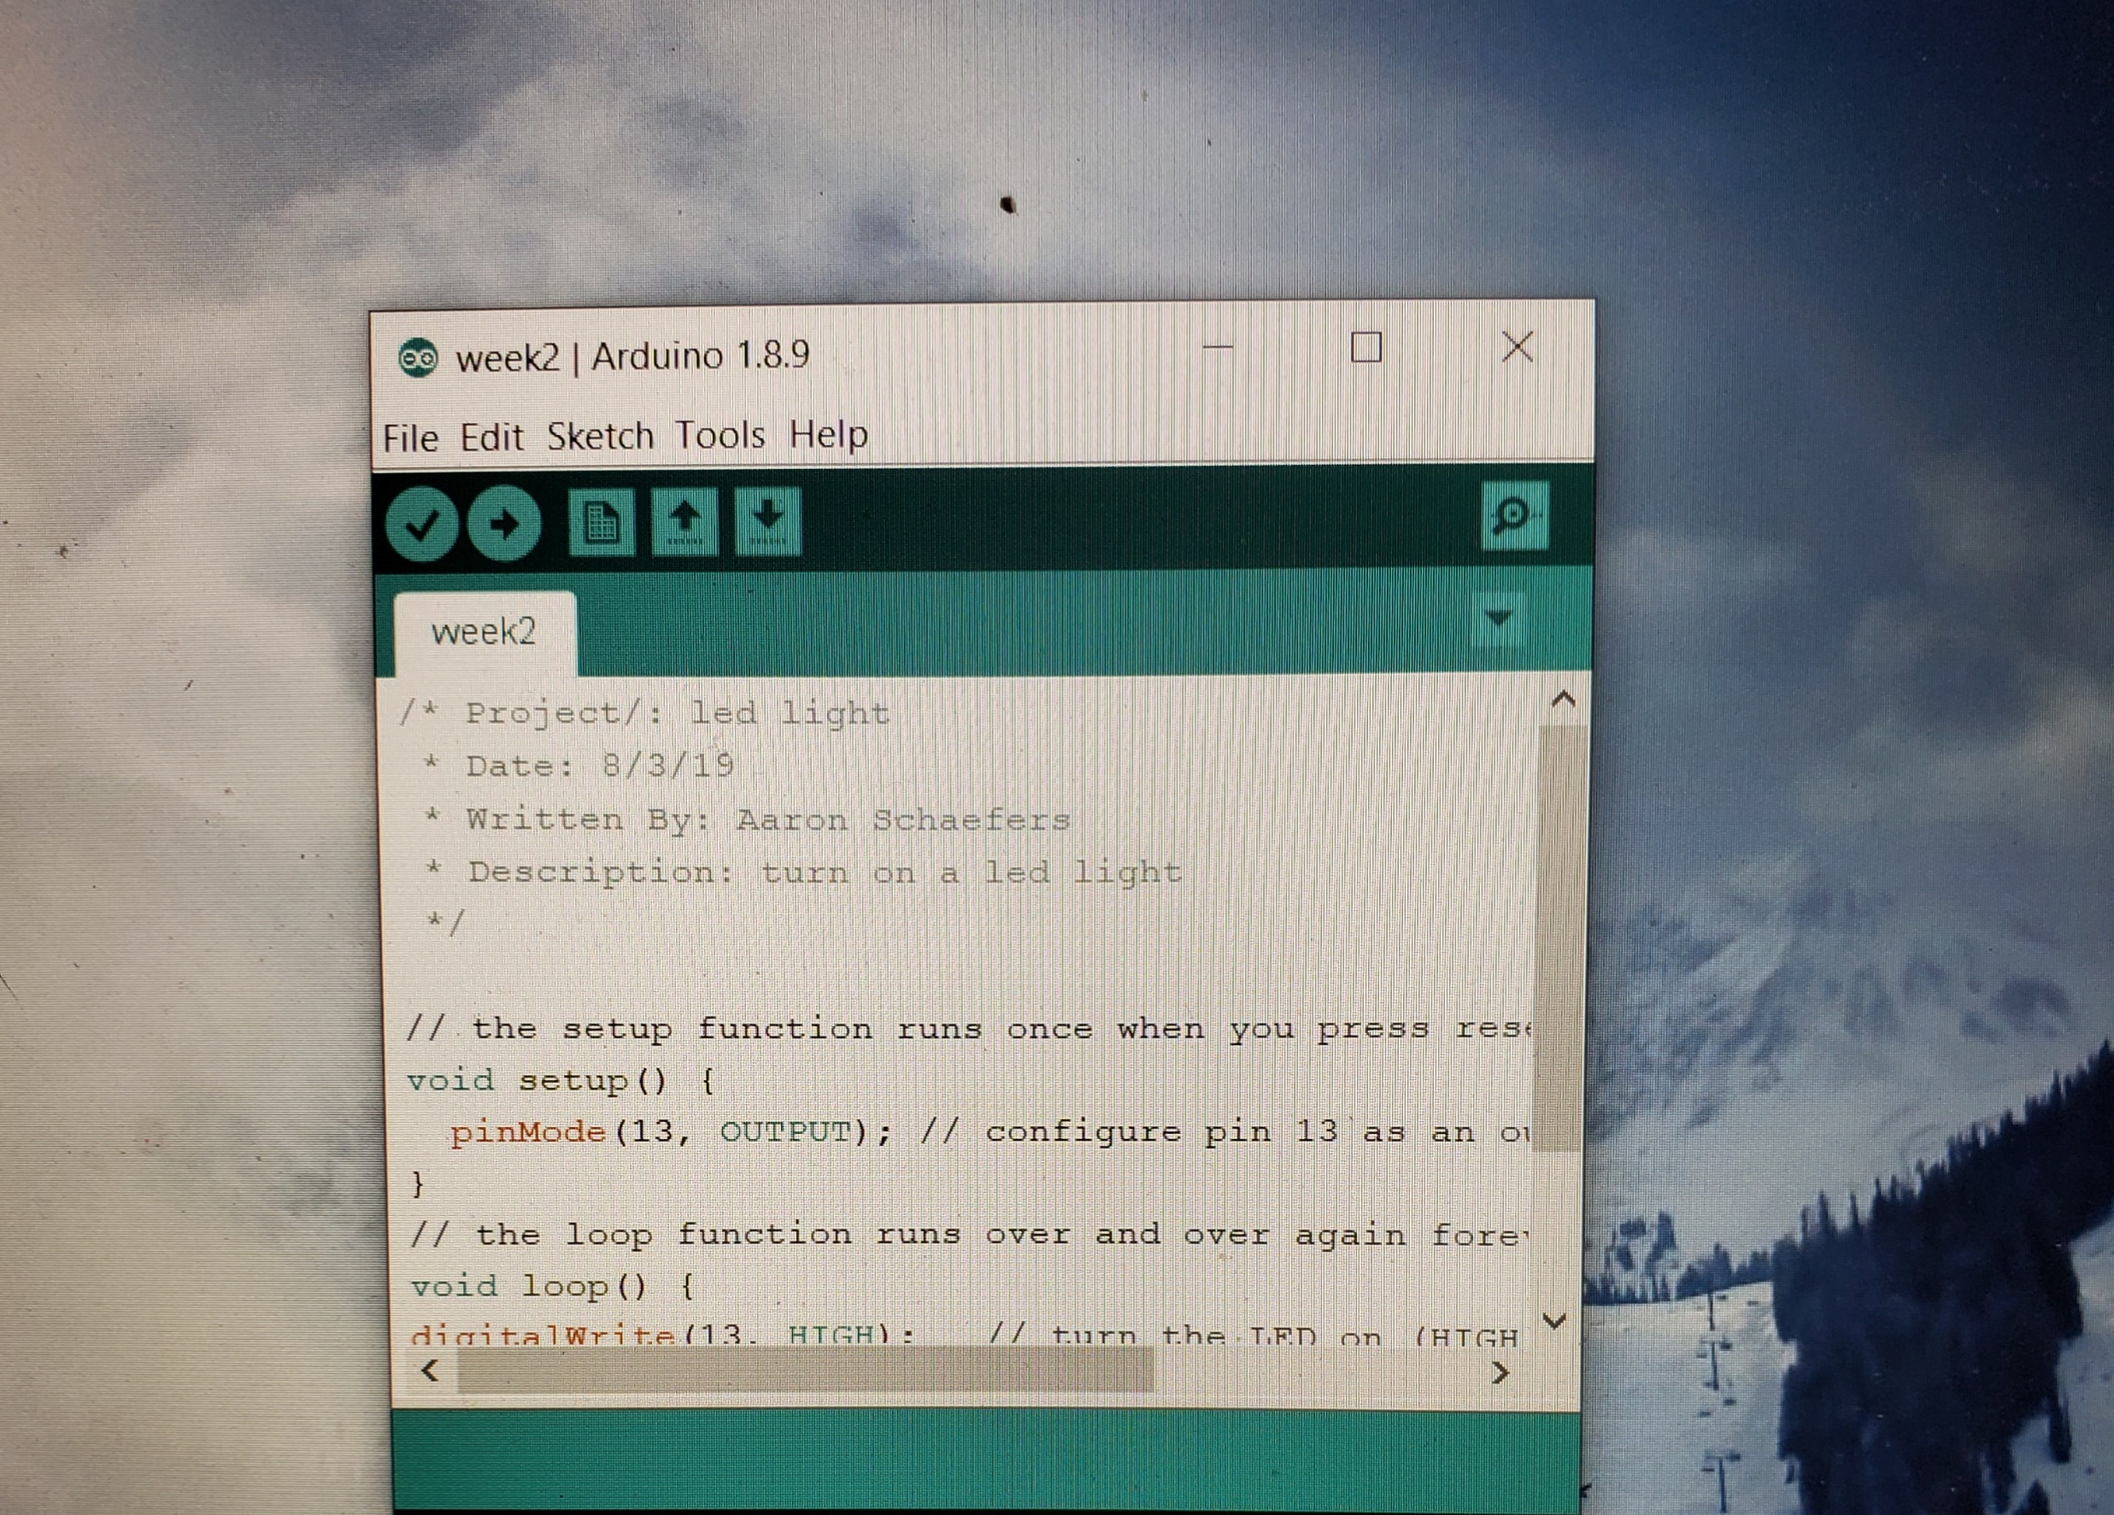
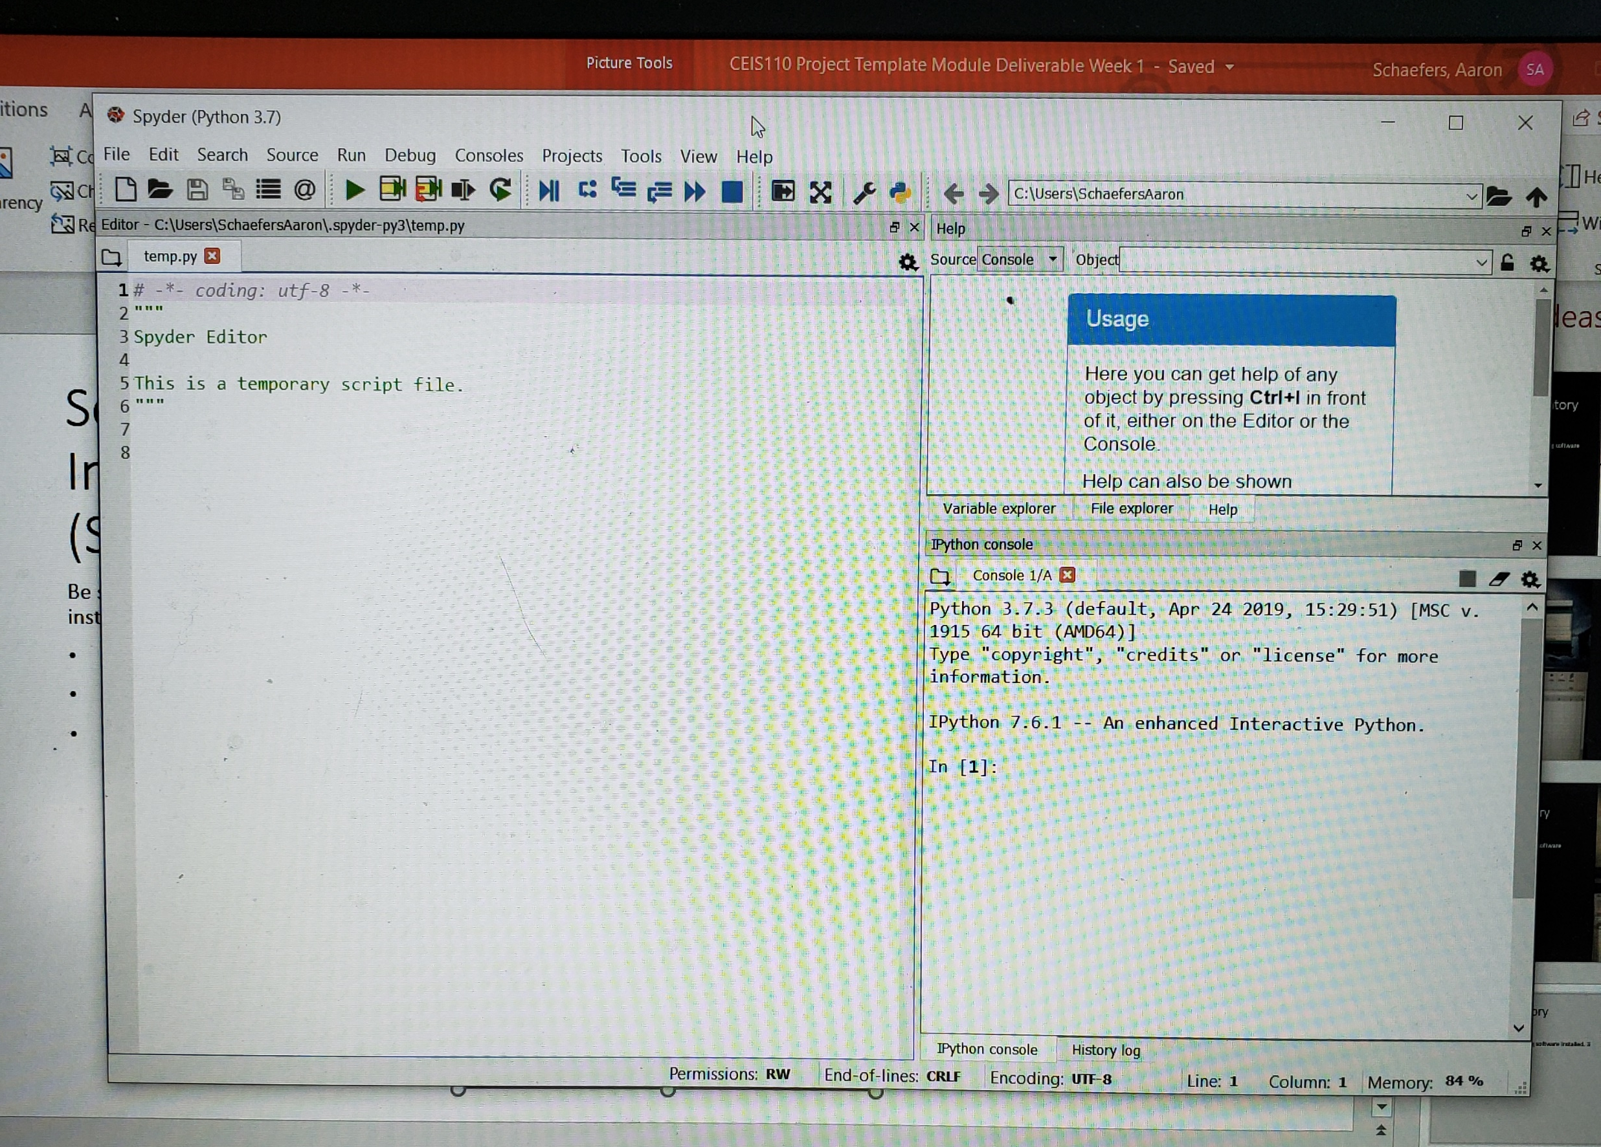
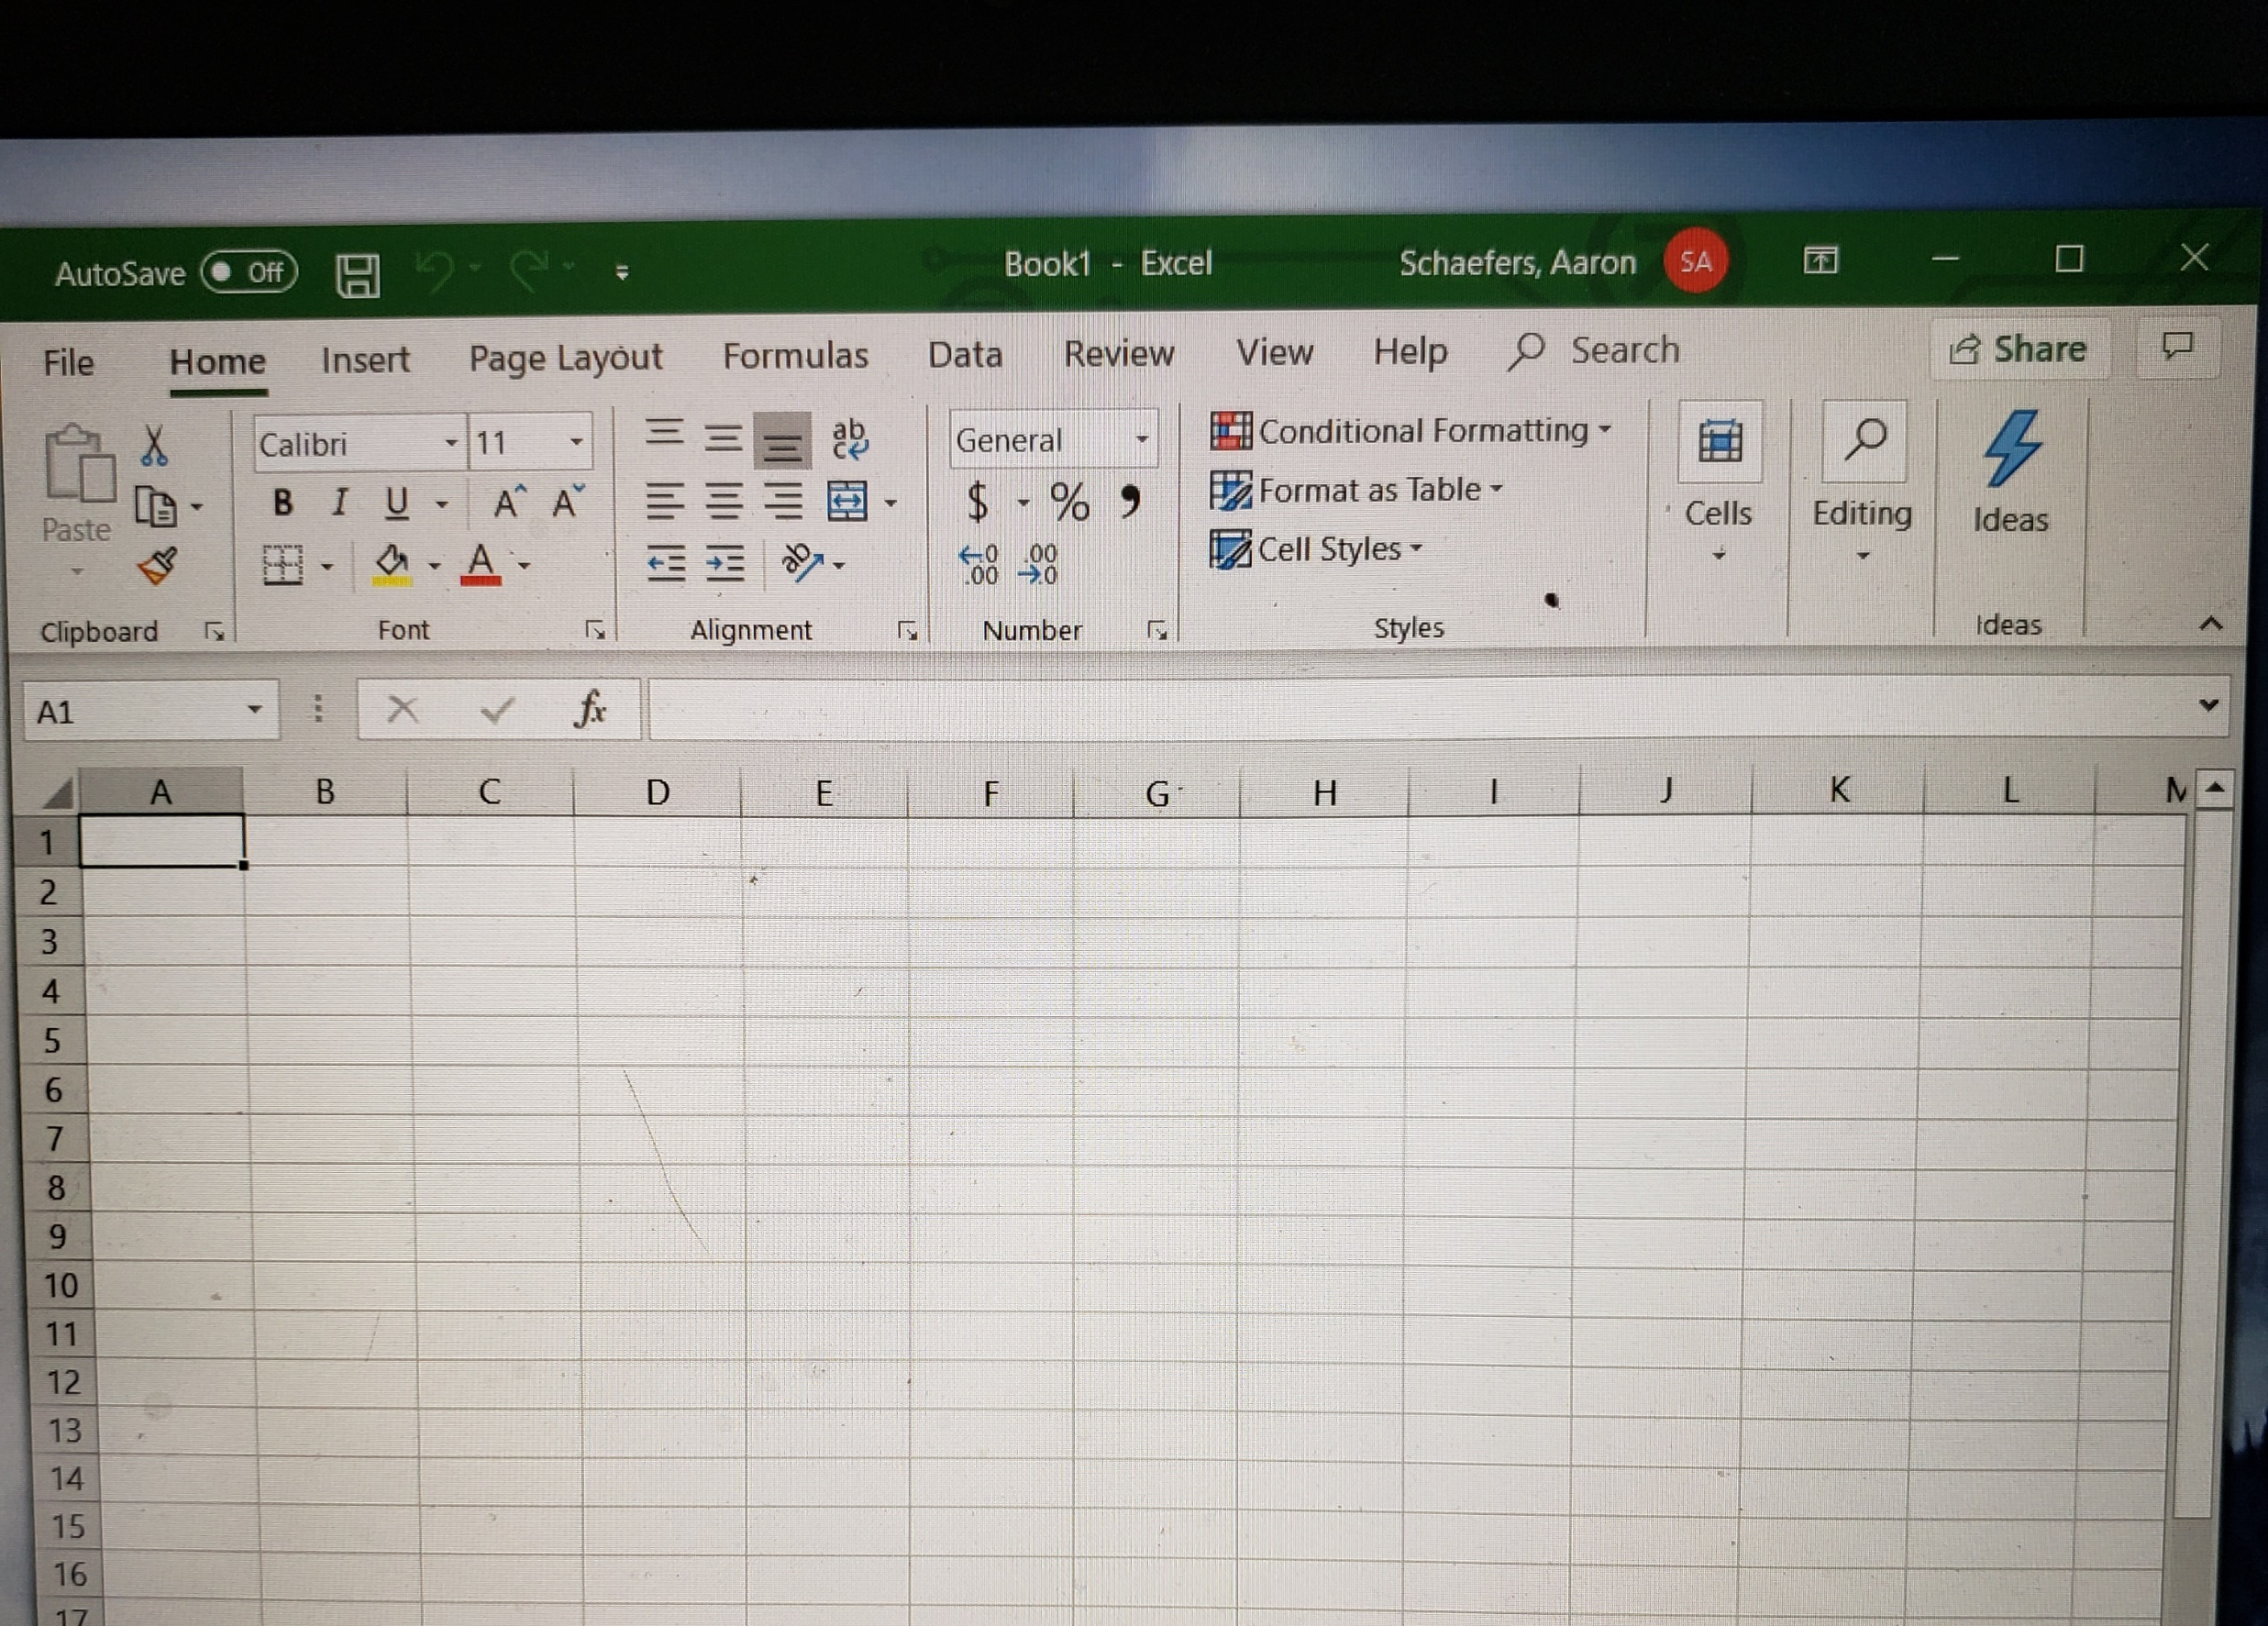
Software Inventory
(Screenshots)
Be sure you have the following software installed. 3 screenshots needed:
Arduino IDE
Python- Anaconda/ Spyder
Excel

Slide 4
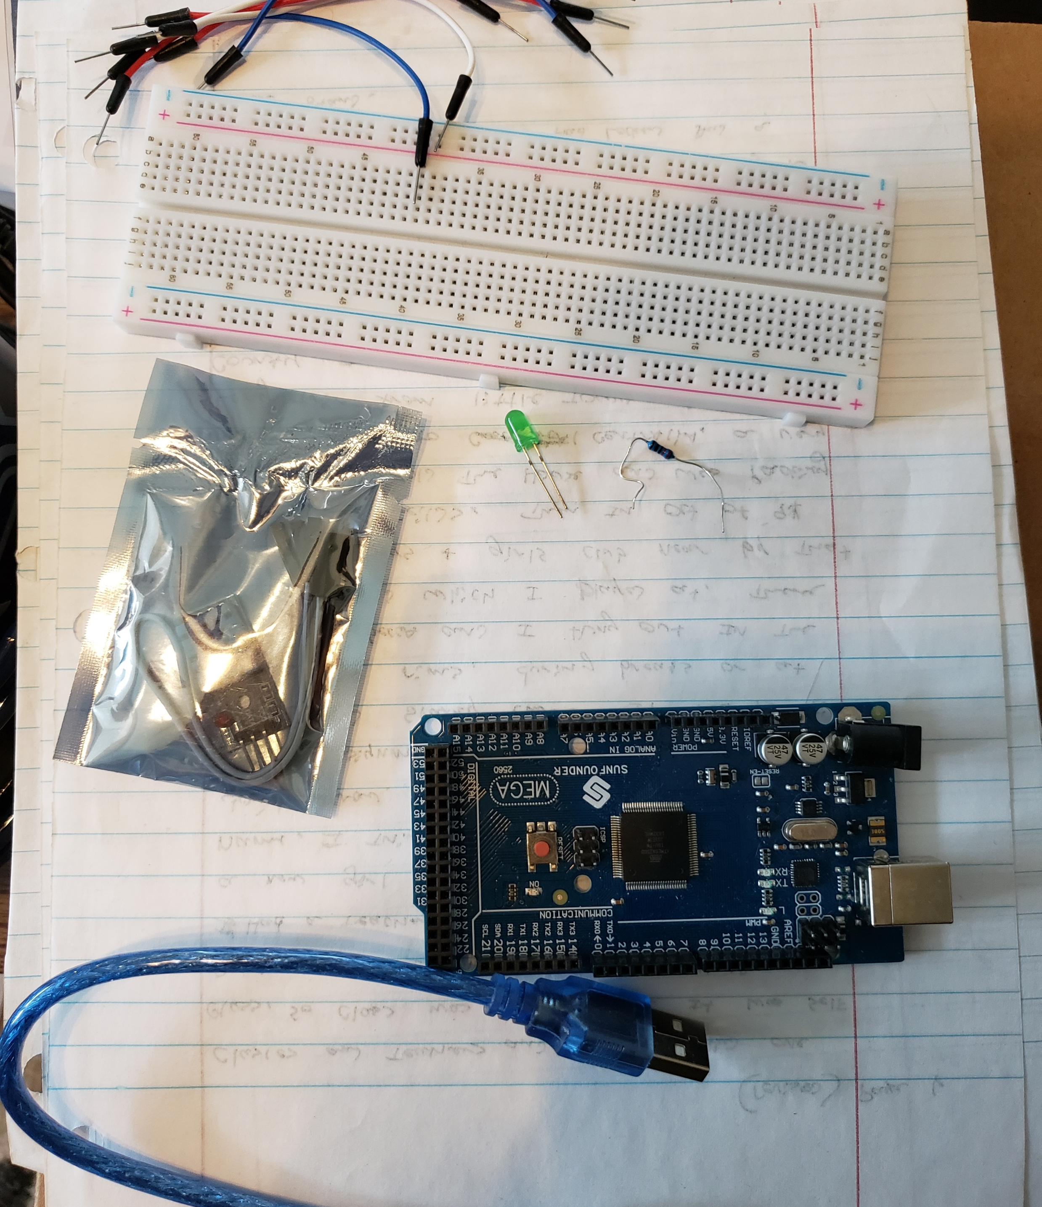
Inventory (Picture)
Arduino Mega board
Breadboard
Wire(s)
DHT11 Temperature and Humidity sensor
Cable to connect Arduino to computer

Slide 5
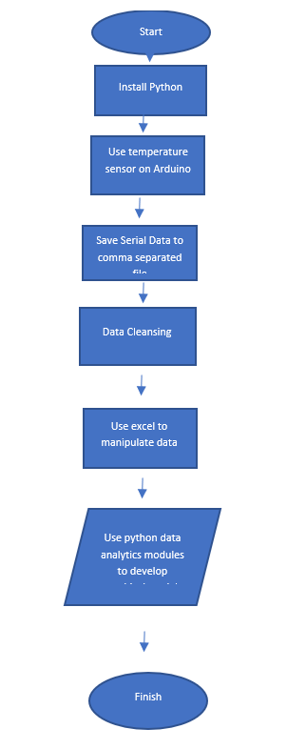
Flowchart
Include the following processes:
Install python
Use Temperature/Sensor on Arduino to monitor temperature and humidity
Save serial data to a comma separated file with python
Cleanse data from Arduino
Use Excel to manipulate data
Use python data analytics modules to develop graphical models

Slide 6
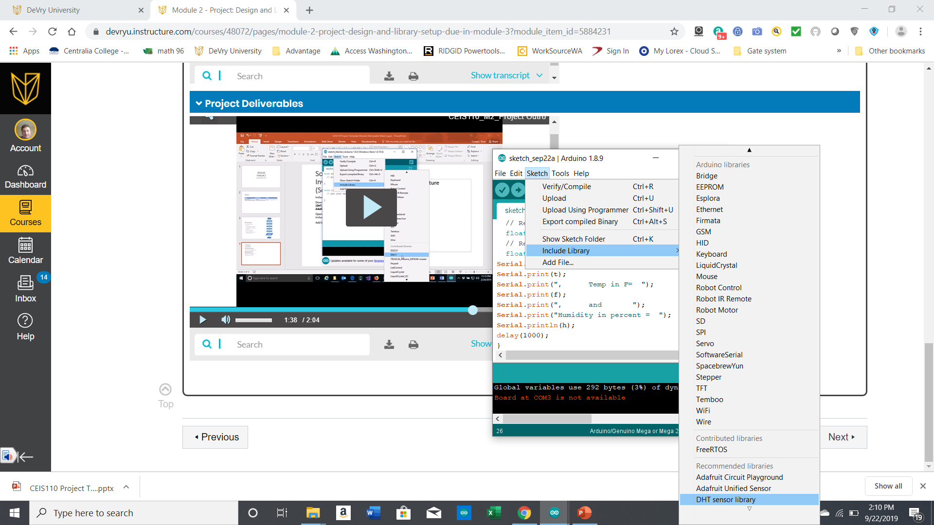
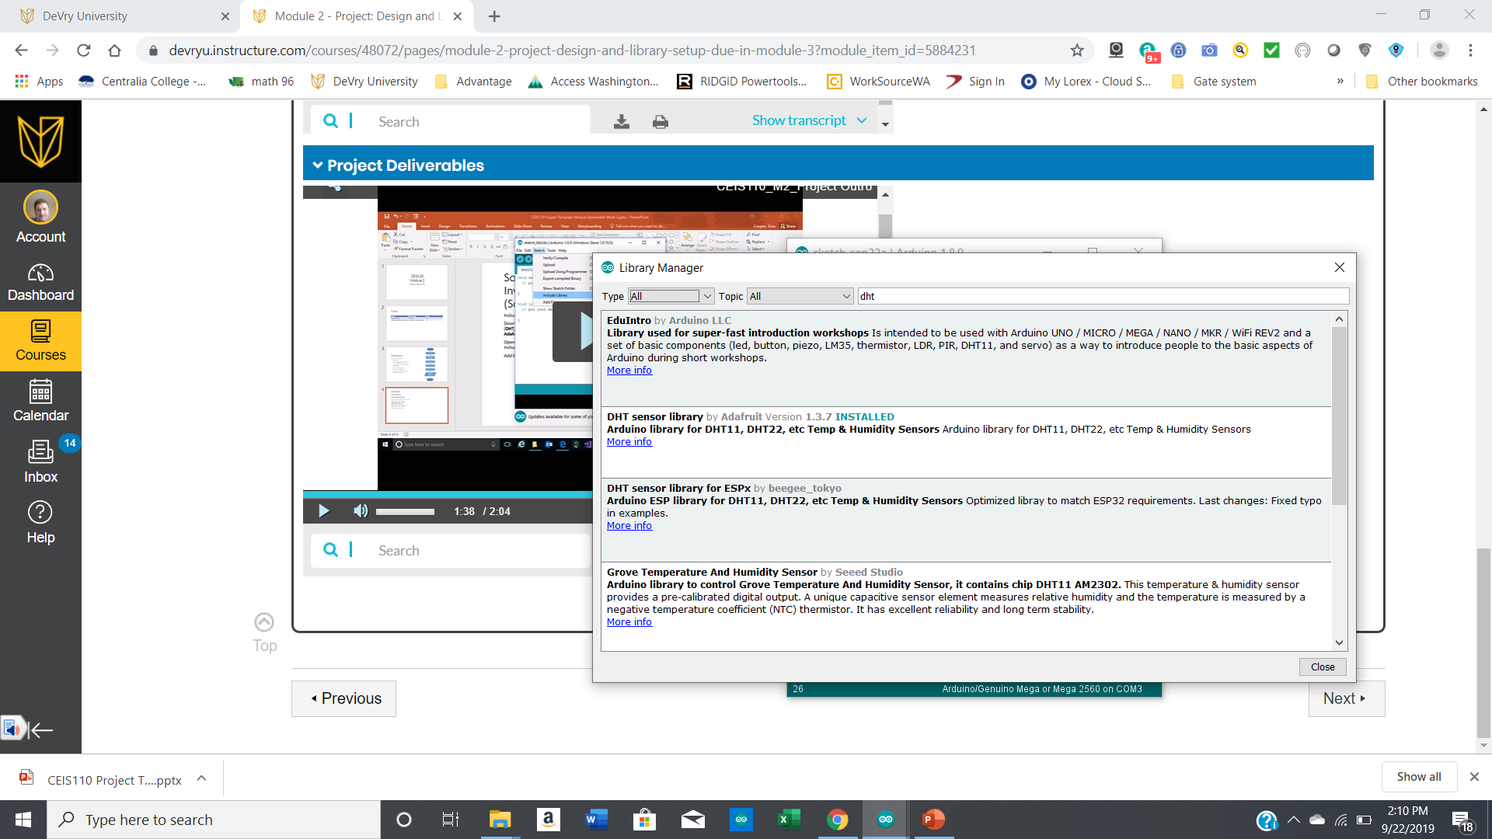
Software Inventory
(Screenshots)
Include screenshot of DHT11 library installed
Download the two sensor libraries (DHT_sensor_library.zip , and Adafruit_Sensor_master.zip)
Open the Arduino IDE and go to Sketch-> Include Library -> Add .ZIP library
Add both libraries one at a time

Slide 7
Collecting Temperature data
After planning and design
The Arduino was connected to the commuter
The data was shown on the serial monitor

Slide 8
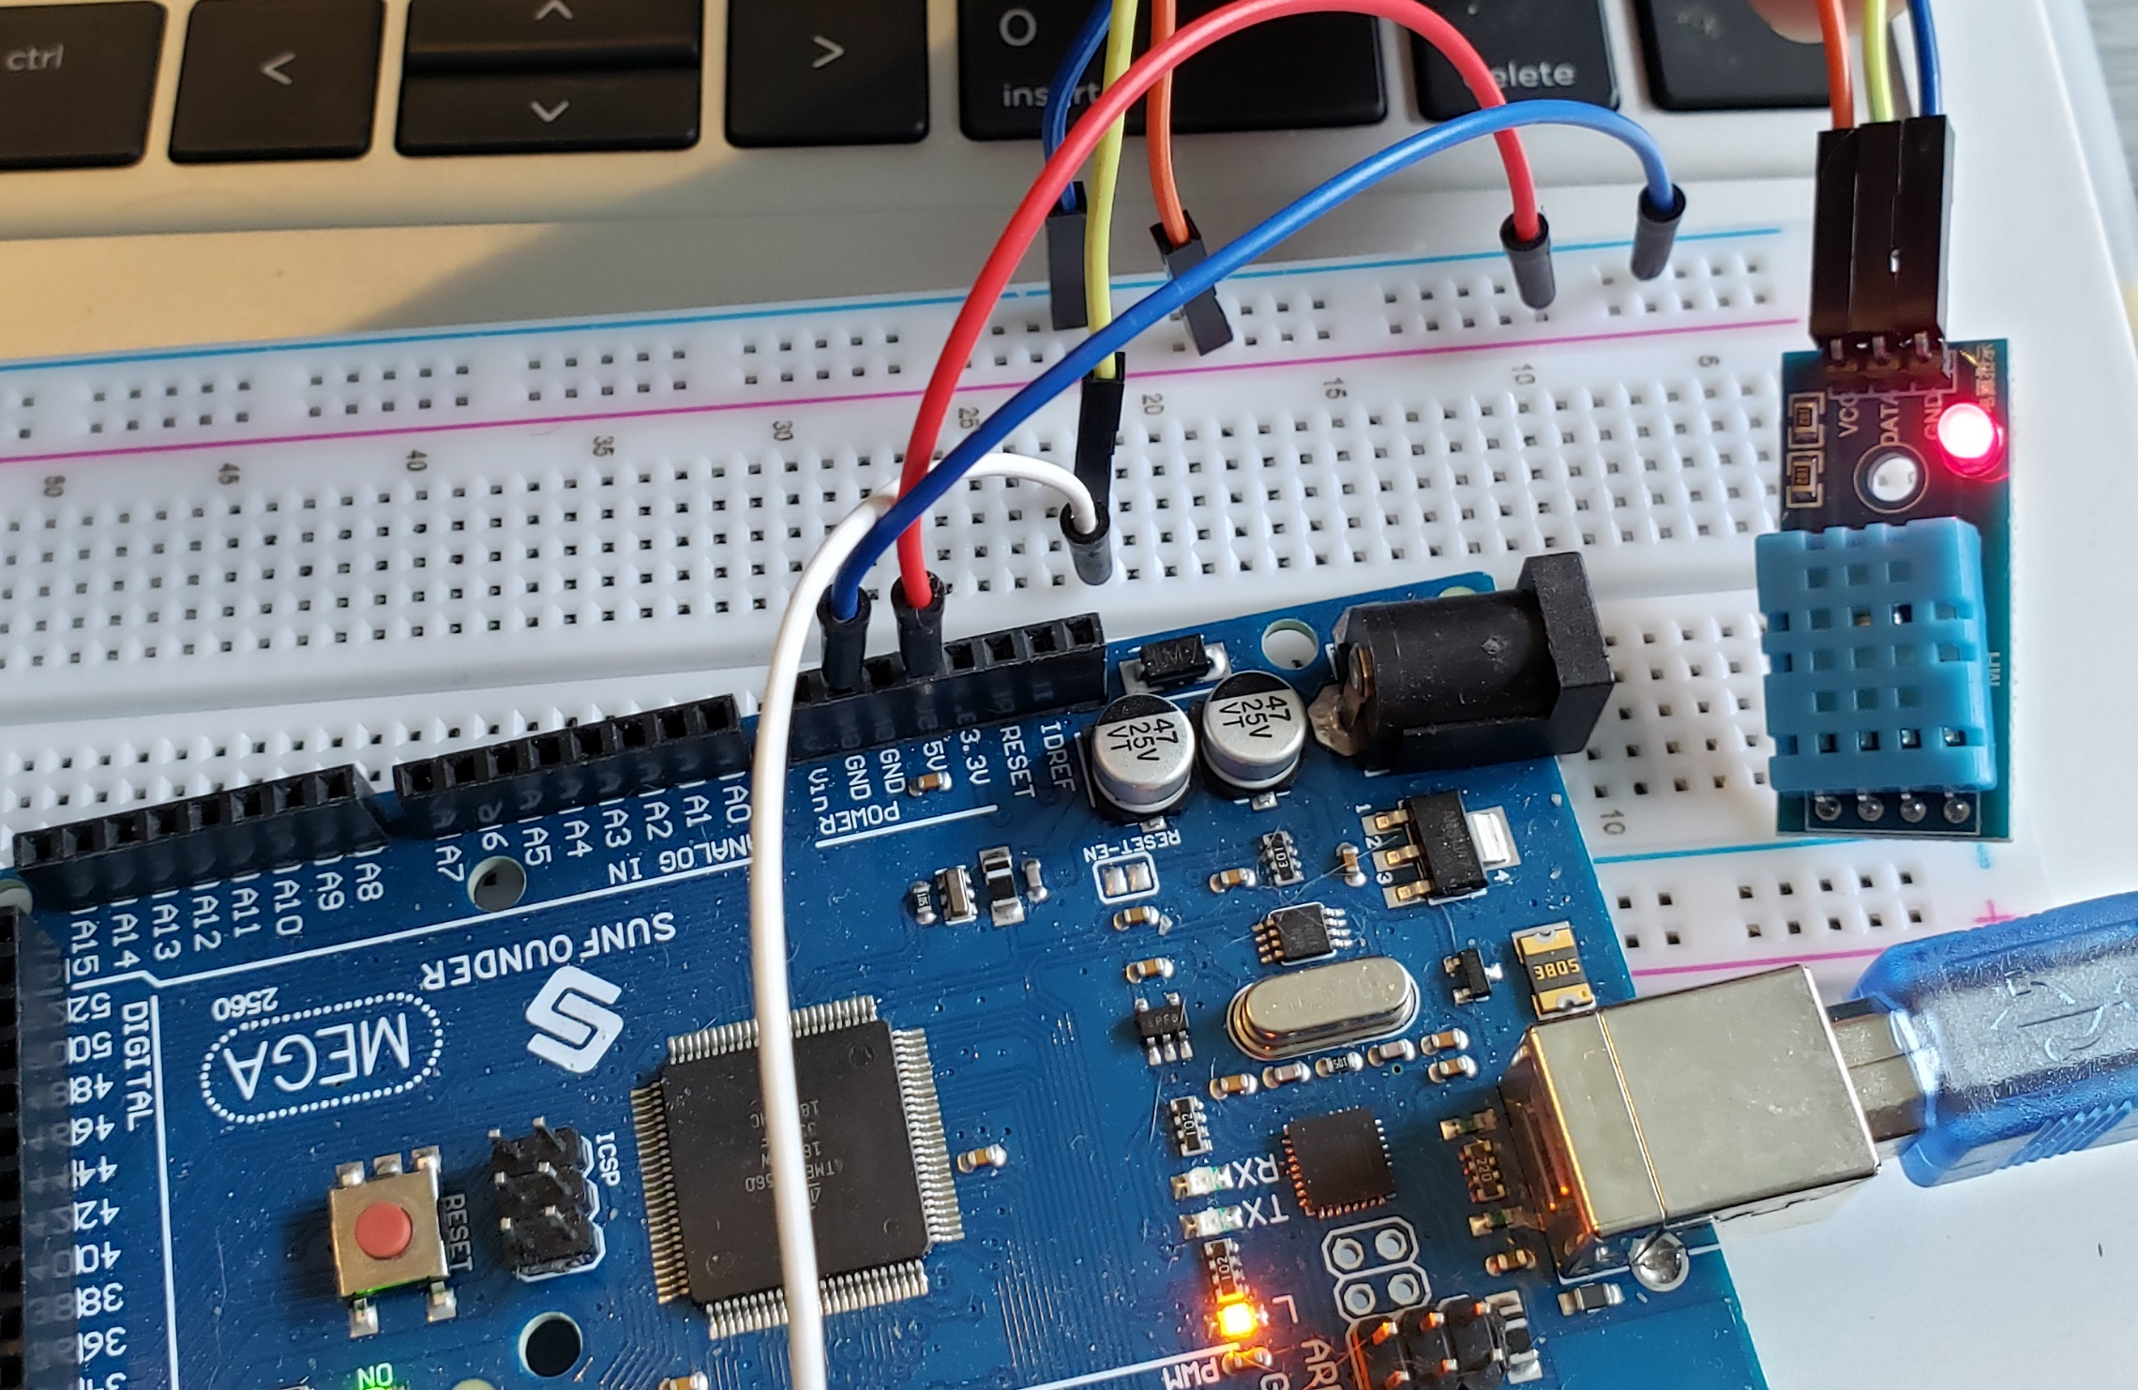
Circuit (Picture)
Arduino Mega board
Breadboard
Wire(s)
DHT11 Temperature and Humidity sensor

Slide 9
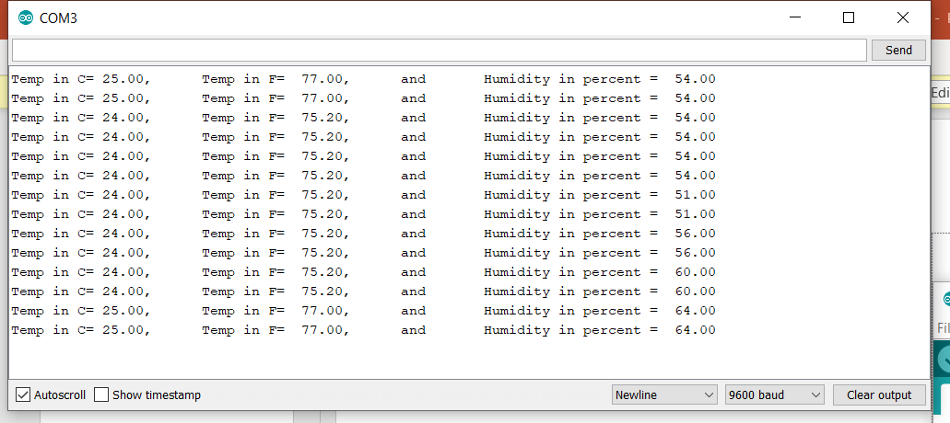
Serial Monitor
(Screenshots)
Screenshot of serial monitor showing temperature and sensor output data

Slide 10
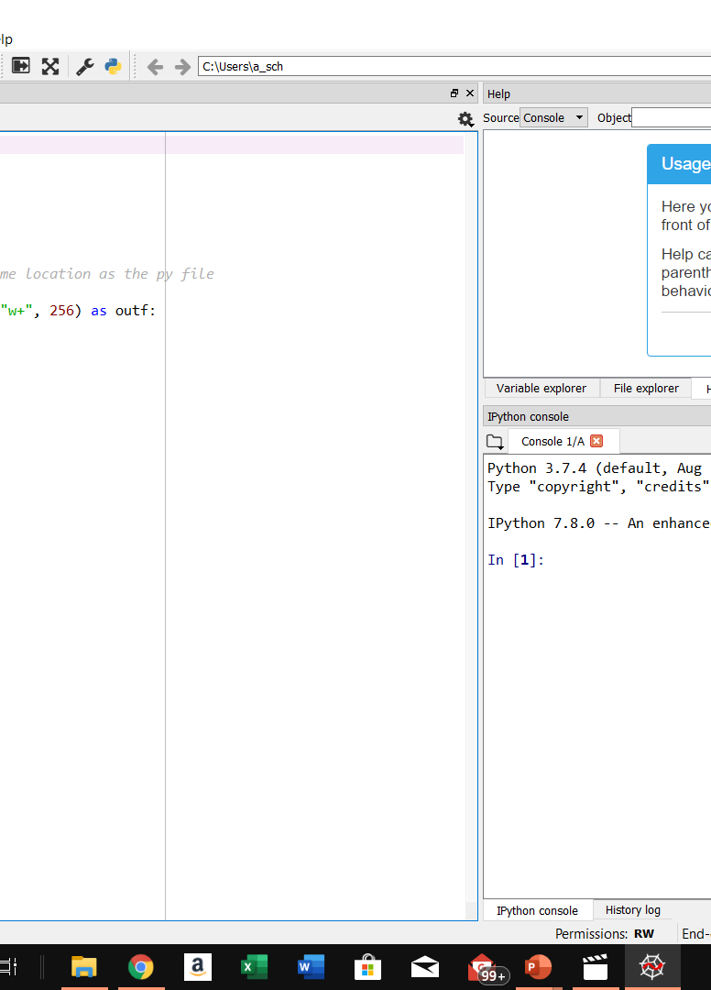
Code
#Purpose: Save data from an Arduino into file using python
#Name: Aaron Schaefers
#Date: the date
#filename = myfile.txt
import serial
port_addr='COM3' # com port of the Arduino
baud='9600'
file_name='mydata.txt' # this file will be saved in the same location as the py file
with serial.Serial(port_addr,baud) as port, open(file_name,"w+", 256) as outf:
for i in range(200): #read 200 lines into the file
fullline = port.readline()
line = str(fullline)
outf.write(line)
outf.write('\n')
outf.flush()

Slide 11
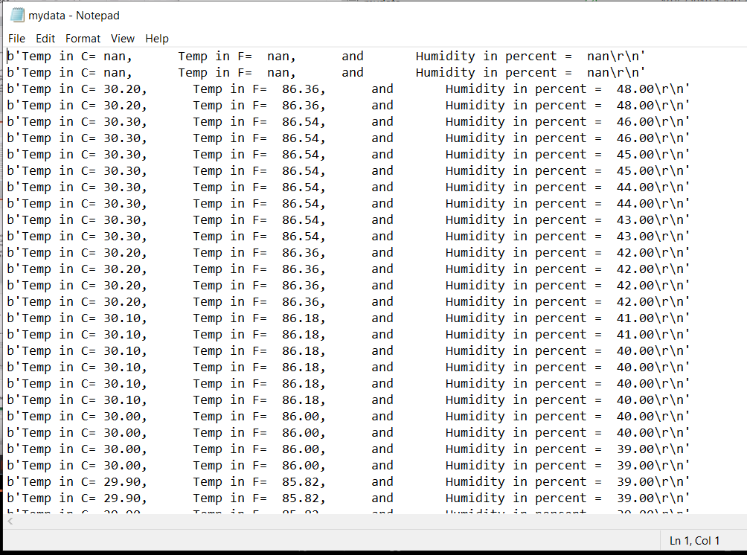
Data
The Data from the python text file

Slide 12
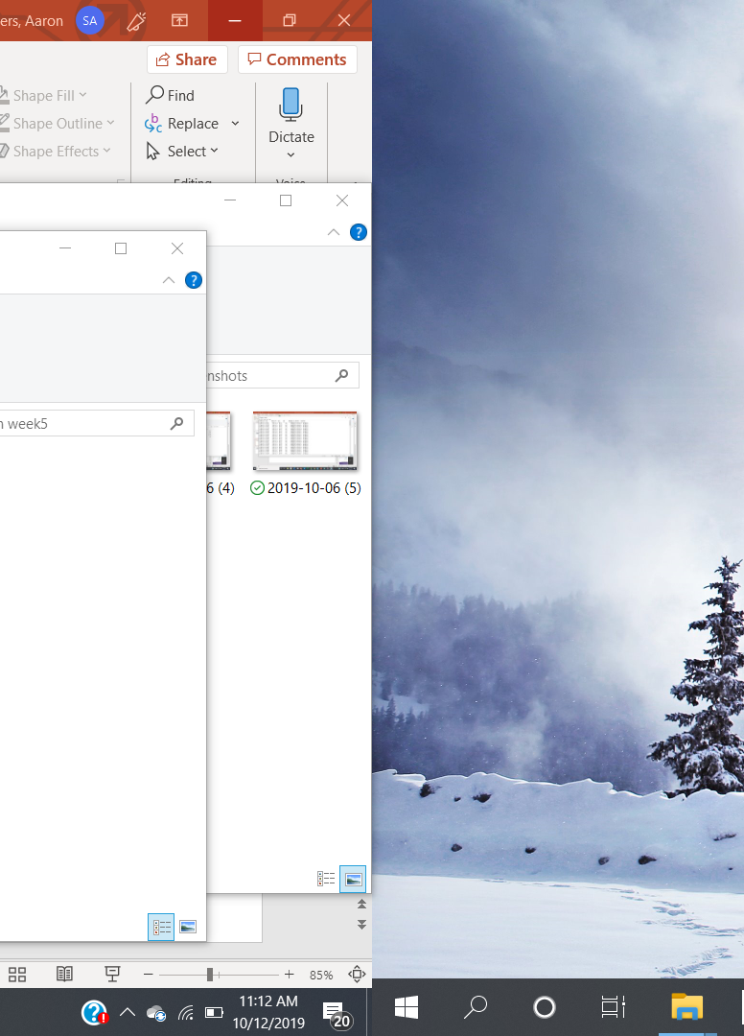
Read Data into csv format (Screenshot or file)
Formatdata.csv file in Excel or copy of file

