Slide 1

CEIS110
Introduction to Programming (Part 2 of 2)
By Aaron Schaefers
Devry University
Instructor:
Natalie Waksmanski

Slide 2
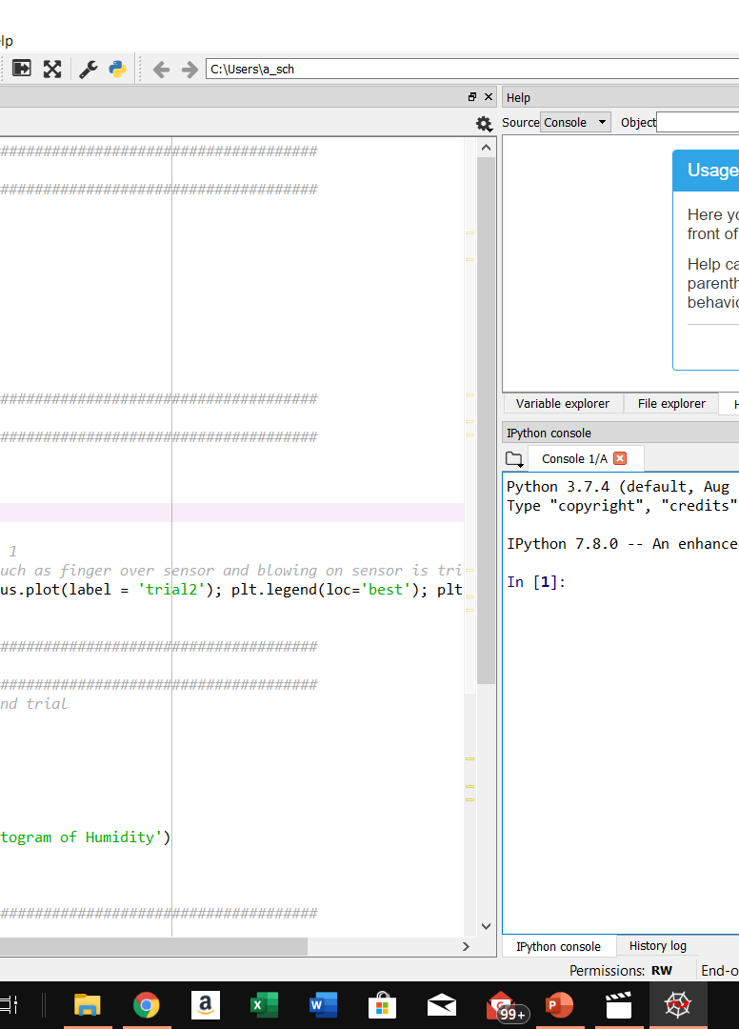
Code
################################################################################################
#Box plot code
################################################################################################
#Purpose: Create box plot for trial 2 data
#Name: Aaron Schaefers
#Date: 10/13/19
import pandas as pd
import matplotlib.pyplot as plt
df2 = pd.read_csv("formatdata2.csv")
df2.boxplot(); plt.suptitle('Trial 2 box plot')
plt.show()
################################################################################################
#Compare trial plot
################################################################################################
#Purpose: Create Celsius plot comparing trial 1 and trial 2
#Name: Your name
#Date: Your date
import pandas as pd
import matplotlib.pyplot as plt
df1 = pd.read_csv("formatdata.csv") #baseline data is trial 1
df2 = pd.read_csv("formatdata2.csv") #data with variation such as finger over sensor and blowing on sensor is trial2
plt.figure(); df1.Celsius.plot(label = 'trial1'); df2.Celsius.plot(label = 'trial2'); plt.legend(loc='best'); plt.suptitle('Celsius')
plt.show()
################################################################################################
#Histogram
################################################################################################
#Purpose: Create a histogram of humidity data from the second trial
#Name: Your name
#Date: Your date
import pandas as pd
import matplotlib.pyplot as plt
df1 = pd.read_csv("formatdata.csv")
df2 = pd.read_csv("formatdata2.csv")
df2['Humidity'].hist(bins=10, alpha=0.5); plt.suptitle('Histogram of Humidity')
plt.show()
################################################################################################
#Scatter plot
################################################################################################
#Purpose: Create scatter plot of humidity for trial 1. Can replace df1 to df2 to display second trial data
#Name: Your name
#Date: Your date
import pandas as pd
import matplotlib.pyplot as plt
df1 = pd.read_csv("formatdata.csv")
df2 = pd.read_csv("formatdata2.csv")
plt.scatter(df1.index.values,df1['Humidity']); plt.suptitle('Humidity')
plt.show()
"""
Created on Sun Oct 13 11:09:22 2019
@author: SchaefersAaron
"""

Slide 3
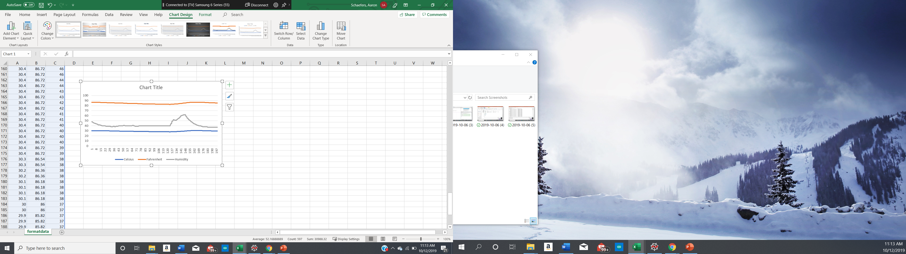
Temperature and Humidity Trial 1
(Graph)
Excel chart based on data from Arduino

Slide 4
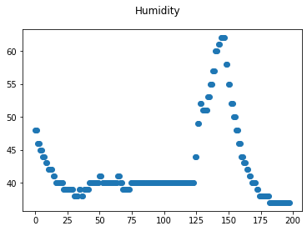
Plot #2
(Screenshots)
Box
Line
Histogram
Scatter
Research your own!

Slide 5
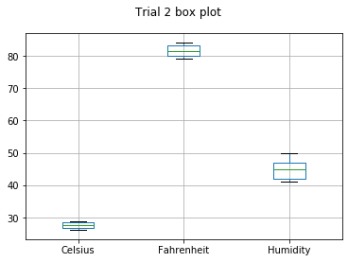
Analysis
In analysis is developing a question and reviewing the data to answer the question
Question 1: what is the difference in Fahrenheit and Celsius?
Question 2: What is humidity?

Slide 6
Prediction
Develop a prediction based on the data. How would the data be different if you simply blew on the sensor without touching it? How would it be different if you gathered the data on a rainy or dry day?
Based on the data that I received form the python reports that when the current room that the sensor was in was no change other then the temperature when I touched the sensor externally with my finger on it.
When touching the sensor the humidify did not really change all that much other then the current temperature went up a few degrees
If I was outside, then the readings would defiantly change from the different type of air temperature and the humidify would change from inside a warm house to a cold temp outside.

Slide 7

Career Skills
Understanding algorithms and data
Ability to comprehend core programming languages
Excellent verbal and written communication skills
Ability to be a team player or work independently needed.
Pixabay 2019

Slide 8


Challenges
Computer Programmer 7% decline in demand (BLS, 2019), being new to the field
Being able to locate and repair programming errors when client doesn’t understand when failure initially appeared.
Debugging and data transfer errors
Working with a variety of programming languages
Determining client’s specific needs when client isn’t sure exactly what his/her goal is.
Overcoming the Challenges:
Information Security Analysts, with an expected growth of 32%. (BLS, 2019)
More likely to obtain an entry level position
Ask client what he/she was trying to do when error originally appeared.
Take very detailed notes on where error was location and what actions taken where to resolve the issue(s) causing the error.

Slide 9
Conclusion Slide
In today’s world technology has is a significate role in our personal and professional lives. Know how to develop new software and debug existing programs is a vital part of being able to preform various tasks in our everyday lives. The skills that one learns as a computer programmer will allow the individual to further his/her career goals into other fields such as Information Security Analysts, because the ability to read the programming code as a computer programmer can be extremely useful when trying to fix a security issues as a Security Analysts.

Slide 10
References:
BLS. (2019, April 12). UNITED STATES DEPARTMENT OF LABOR: Bureau of Labor Statistics. Retrieved from Occupational Outlook Handbook: Computer and Information Technology: Information Security Analysts: https://www.bls.gov/ooh/computer-and-information-technology/information-security-analysts.htm
BLS (2019, September 4). Computer Programmers. Retrieved from Bureau of Labor Statistics -Occupational Outlook Handbook: https://www.bls.gov/ooh/computer-and-information-technology/computer-programmers.htm
Calvetti, L. (2000-2019). Light Bulb with question mark inside. Retrieved from Dreamstime.com: https://www.dreamstime.com/royalty-free-stock-photo-light-bulb-question-mark-inside-image22519745
Cole, W. (2000-2019). Picture of exclamation mark. Retrieved from Thumbs.dreamstime.com: https://www.dreamstime.com/royalty-free-stock-photography-exclamation-mark-icon-image6215447
Unknown. (2019). Computer Program Code. Retrieved from Pixabay.com/ photos: https://pixabay.com/photos/code-code-editor-coding-computer-1839406/

