Slide 1
Course Project
SEC290
Fundamentals of Infrastructure Security
Final Project

Slide 2
Introduction
Vulnerability Management Program and Vulnerability Scans
Cloud Security, Infrastructure security, and IAM Security
Software Development Security, Security Monitoring and Incident Response Program
Indicators of compromise and Forensic Analysis
Risk Management, Policy and Compliance

Slide 3
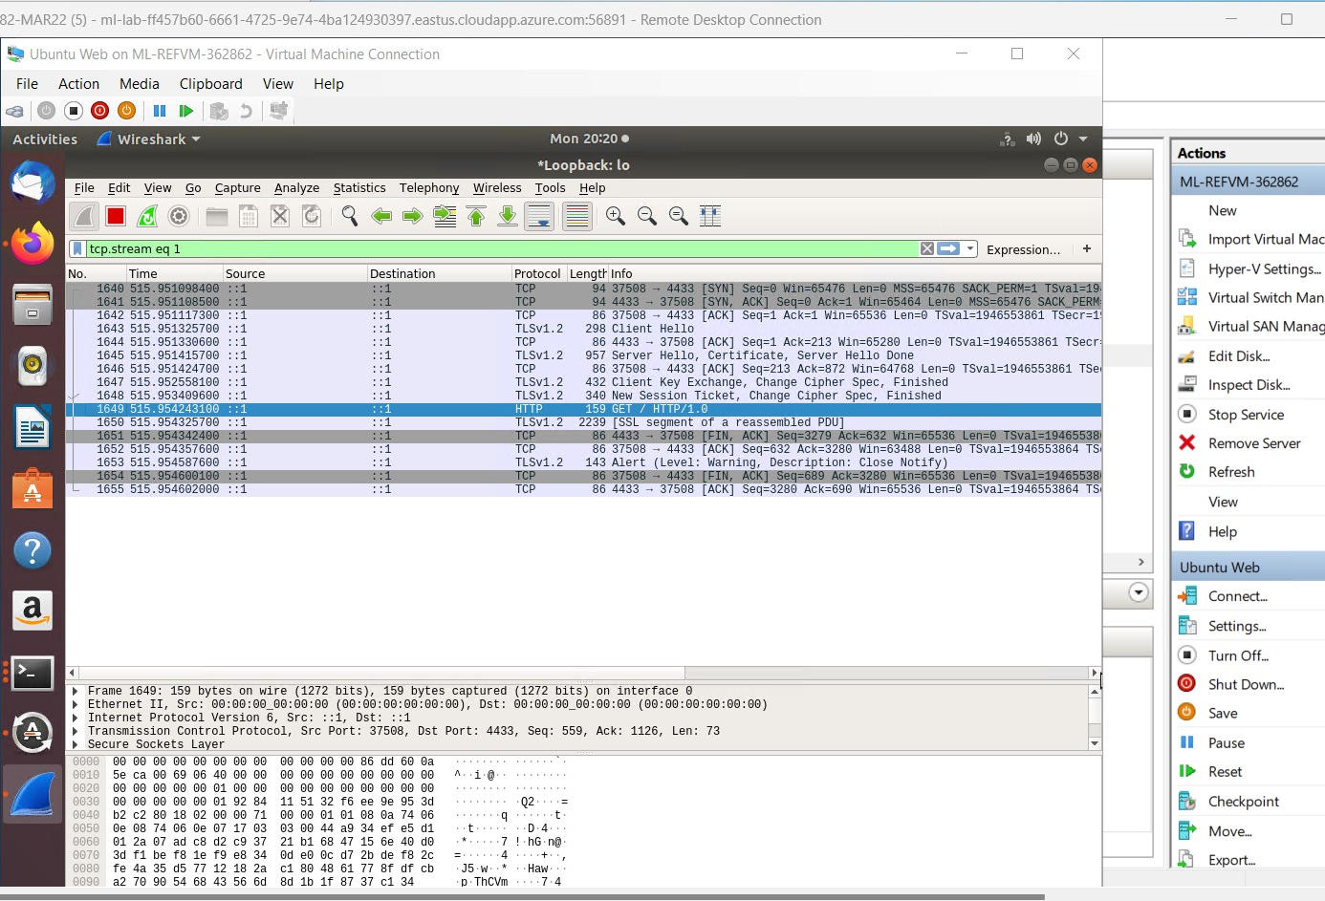
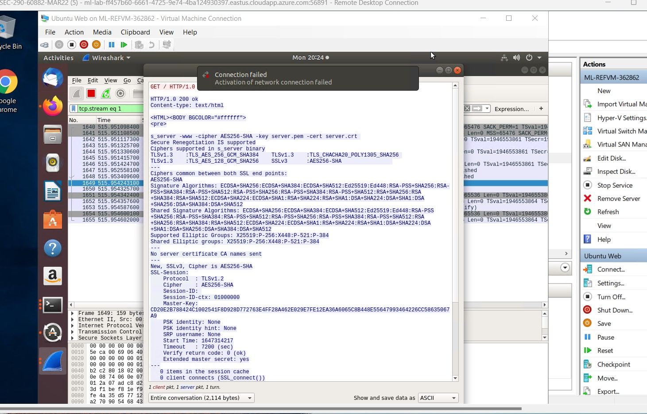
Creating and testing an SSL/TLS file

Slide 4
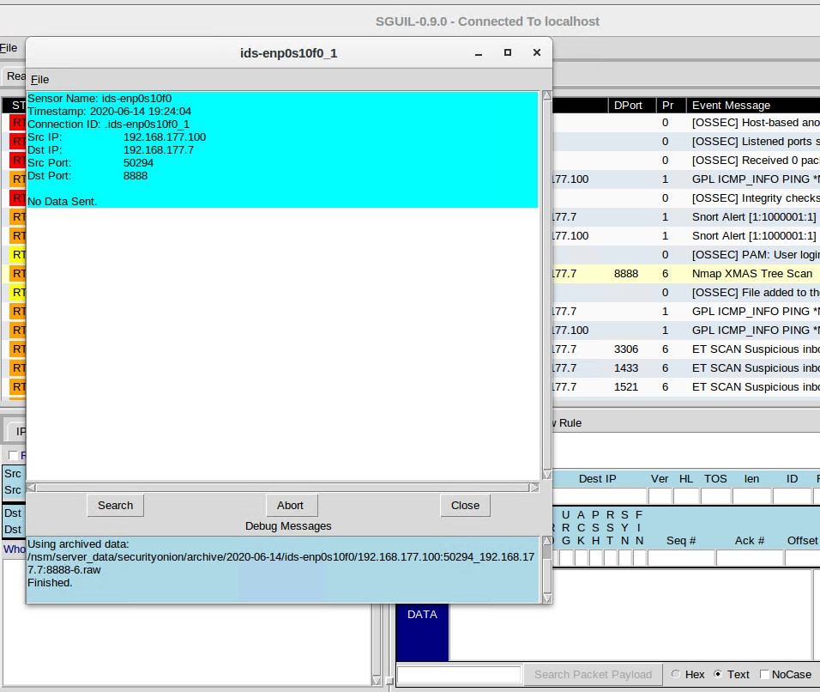
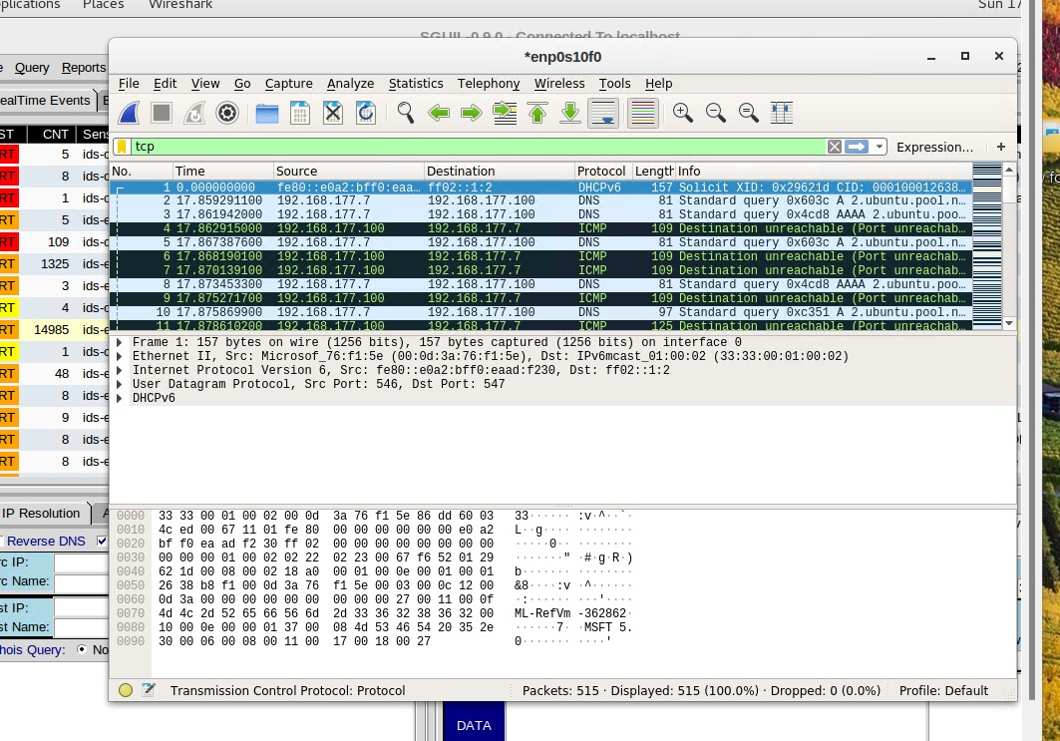
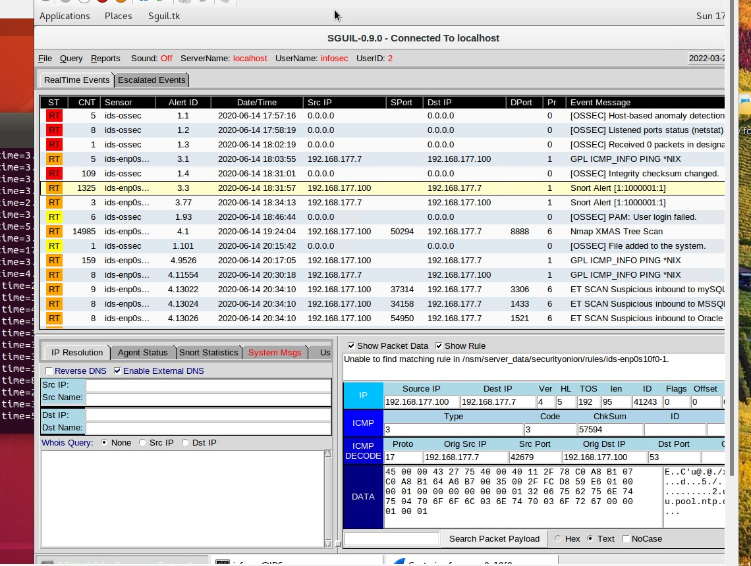
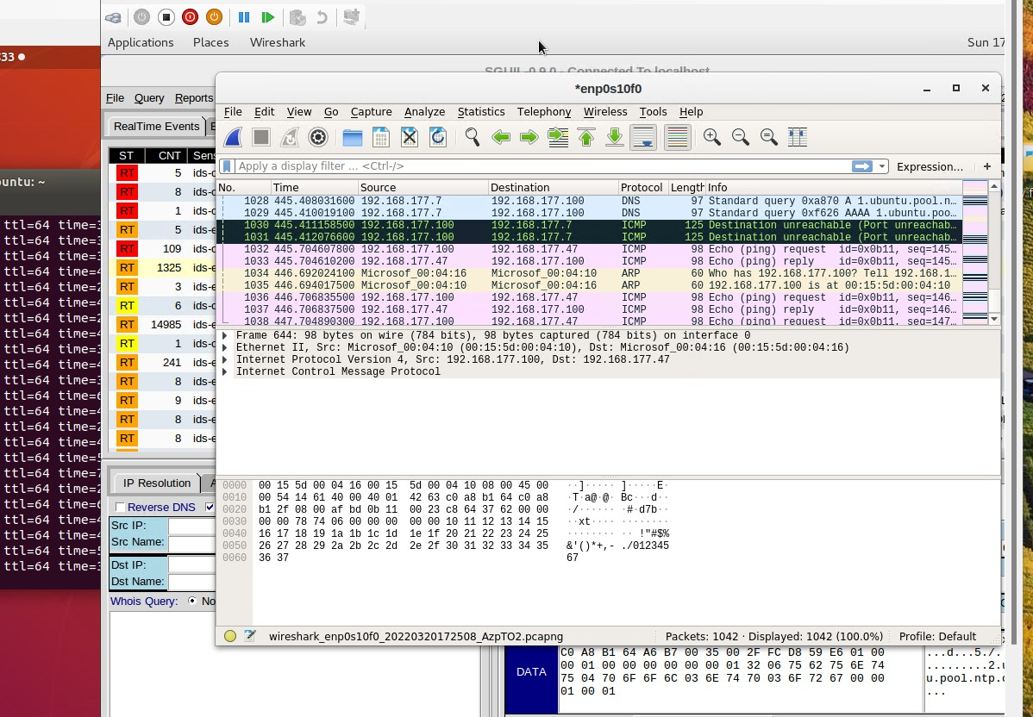
Testing Snort Rules
Notes:
When using Snort Rules you should see some alerts, TCP Packets generated by the scans, Any PING Activity alerts.
ICMP packets should also be showing the ping activity

Slide 5
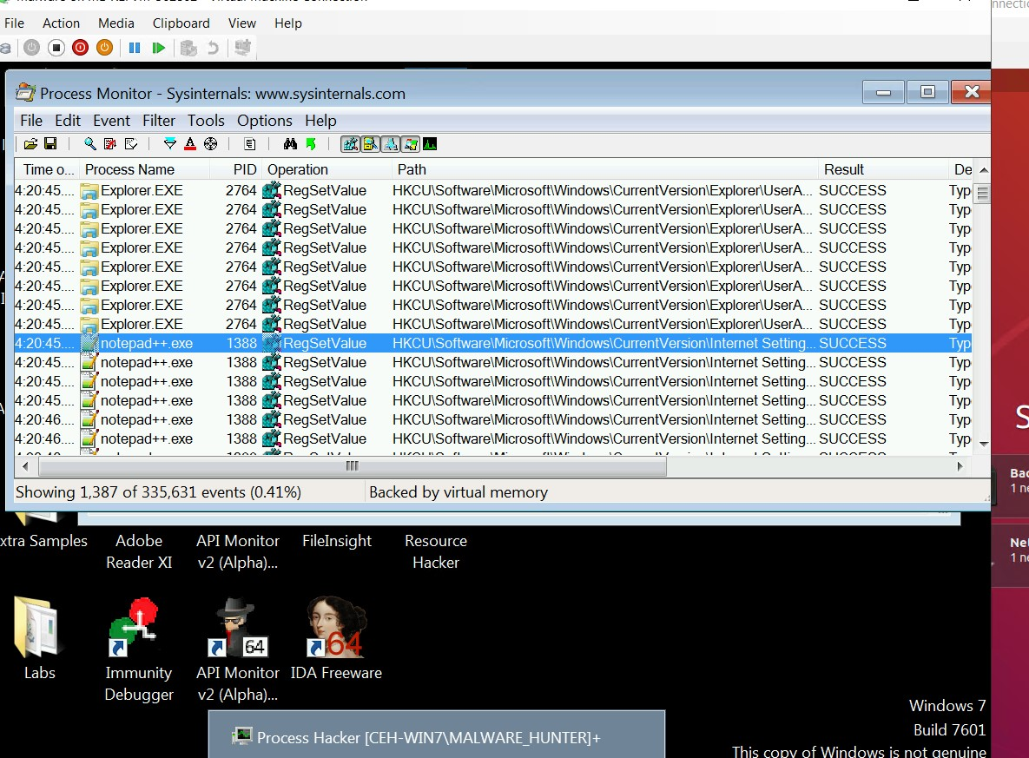
Process Monitor

Slide 6
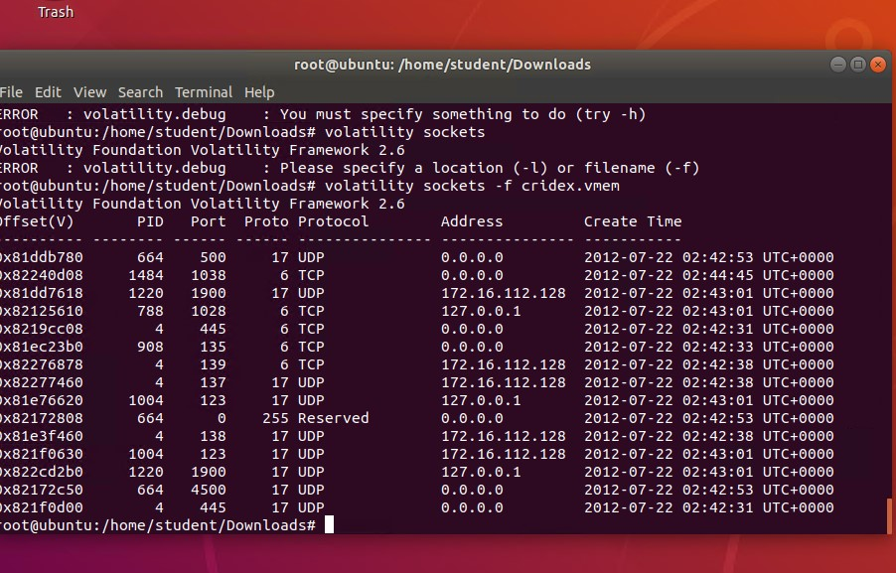
Volatility

Slide 7
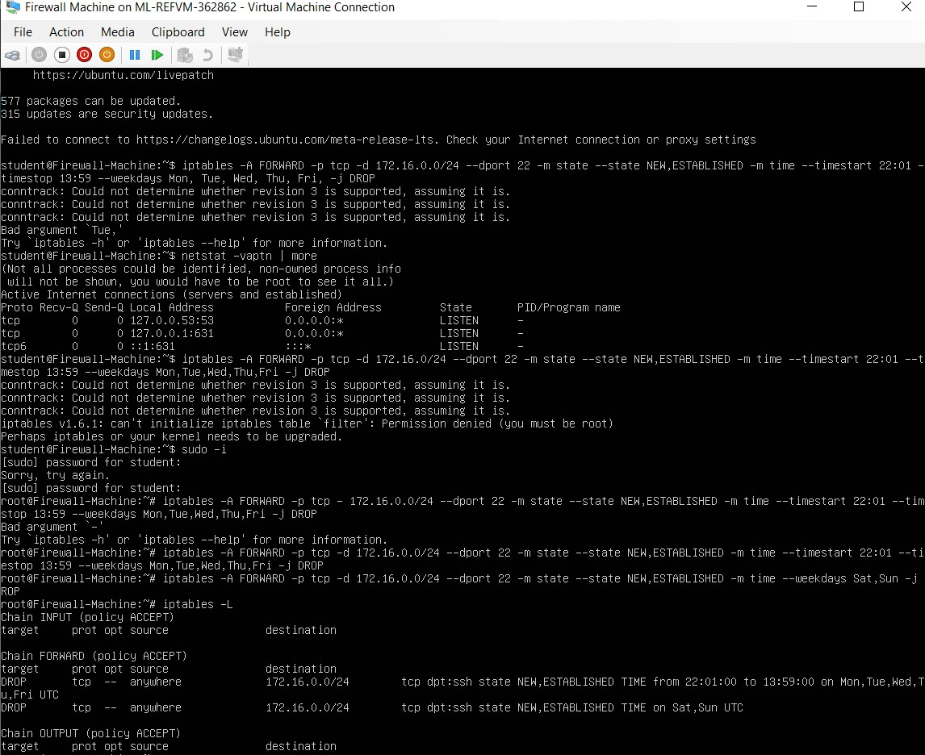
Time-based Access

Slide 8
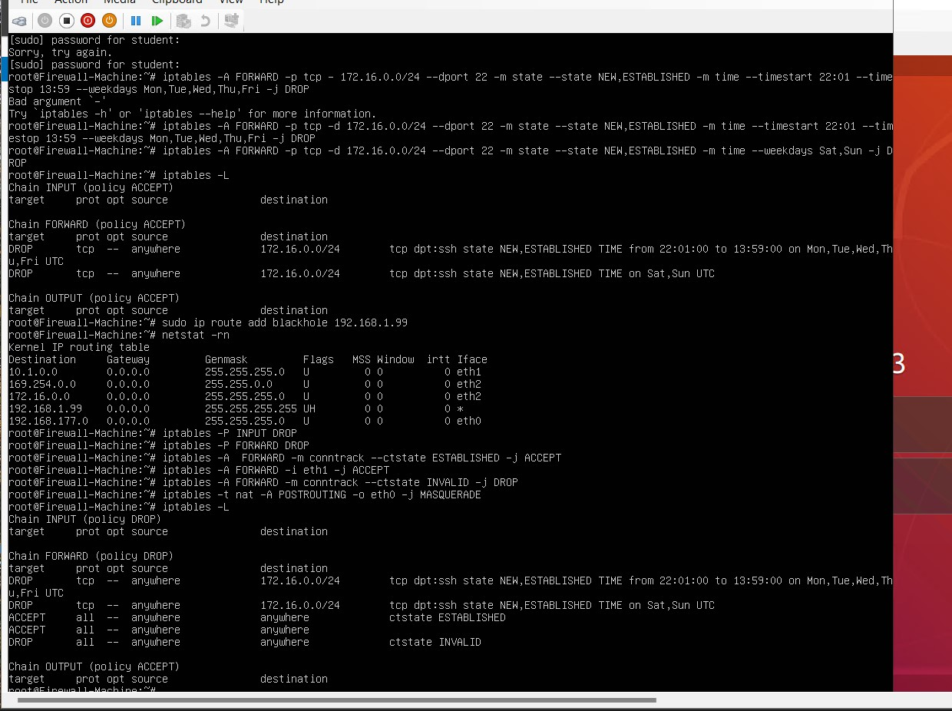
Dynamic NAT

Slide 9
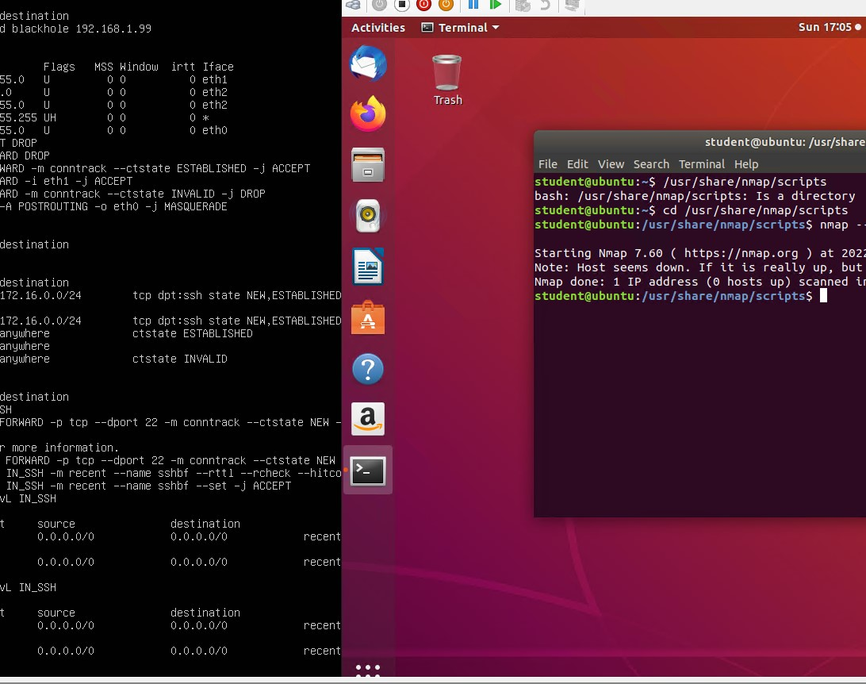
Forcing the SSH Logins

Slide 10
Career Skills
Responsibilities
Help build out the security risk management program around our security standards.
Provide security thought leadership in the organization around Training and Awareness
Collaborate with all parts of the business and technology teams, to make sure we’re meeting the requirements from our regulators, and clients
Help implement the security roadmap
Diagnose and resolve complex issues with technical assistance from vendors, common carriers and technical IT management
Admin responsibilities for security solutions such as vulnerability scanning as well as phishing, audit-logging, identity management (Okta) and training tools

Slide 11
Some Tier 2/3 support for end users as it relates to security
Qualifications
2+ years' experience in information security
First-hand experience with security risk management including frameworks and tools
Experience with security policy management, awareness, security audits and due diligence
Strong presentation, verbal and written communication skills
Experience providing information security advice and communicating security requirements as a subject matter expert
Security risk assessments, reviews and recommendations
Security assurance to review, monitor, measure and report control effectiveness
Security metrics and KPI’s
Knowledge of legal and regulatory standard such as GDPR / CCPA / NY Cyber regulations / HIPAA
Security certifications CISM, CISSP, CISA, CRISC

Slide 12
Challenges
Server Time outs
Not Fully Logging out and jumping the gun

Slide 13
Conclusion
Contacting the correct administrator
Double check to make sure server is fully logged out by using the ping command

