Slide 1
Engineering and Information Sciences
DeVry University
Aaron Schaefers
NETW-310 Dr. Messaoud Laddada
April 10th, 2023

Slide 2
Introduction
Over an 8-week course covers the following:
Communication System Basics
Baseband Signals and AM/FM Signals
Pulse Code Modulation (PCM) and Line Codes
Cables and Structured Cabling
Antenna Gain and Free Space Path Loss
Bit Error Rate of Fading Channels
Technology Careers and Opportunity
Course Connections and Completion

Slide 3
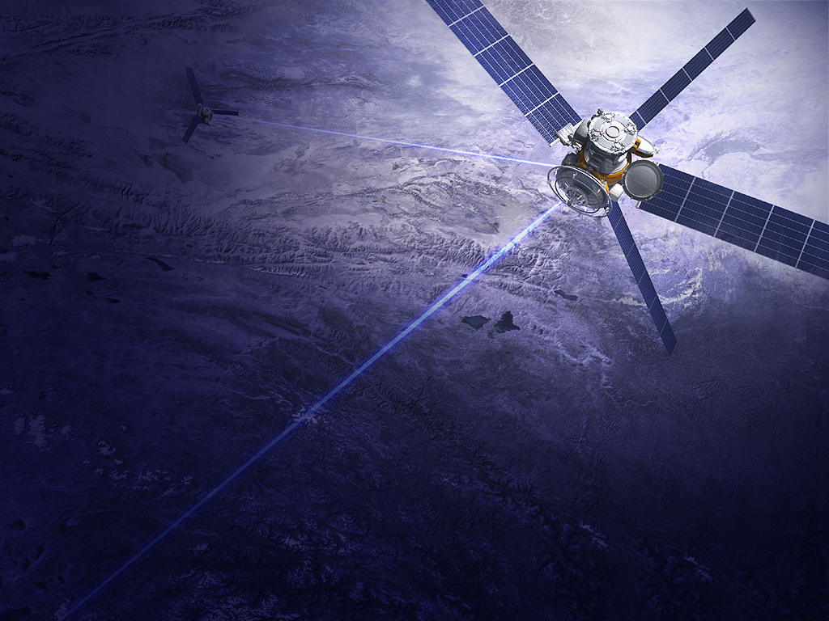
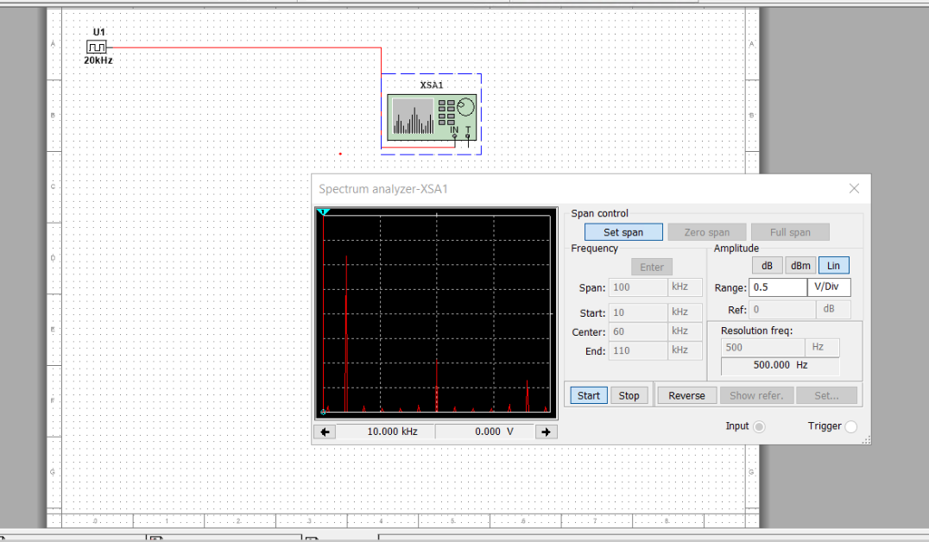
Baseband Signals
Harmonic Frequency | Signal (Volts)
20 kHz | 1.714v
40 kHz | 0
60 kHz | 898.903Mw
80 kHz | 0
100 kHz | 254.396Mv
Notes:
The screenshot show the spectrum analyzer displaying the signal’s harmonic spectrum along with how the spectrum analyzer displaying the signal’s harmonic spectrum and its panel settings. The bottom picture shows the Harmonic Frequency at various Khz and the voltage of the signal (Frenzel, Jr, 2015)
.

Slide 4

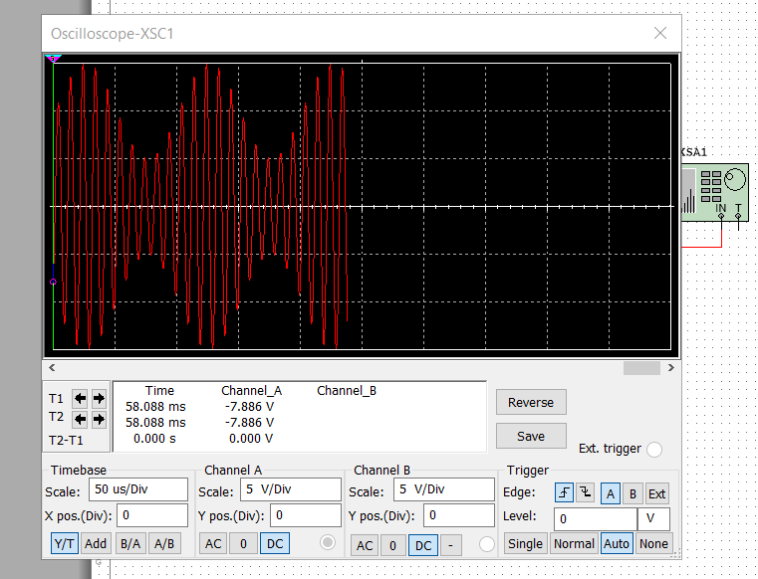
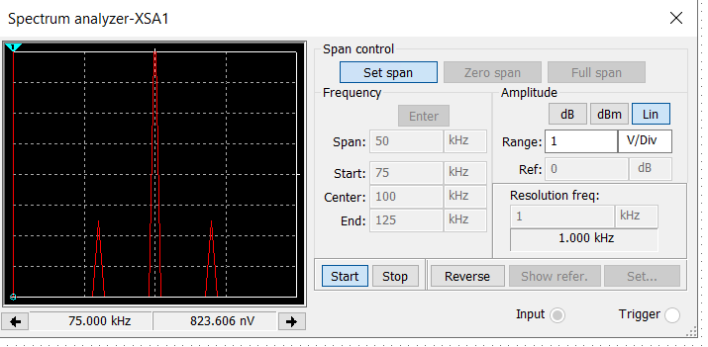

AM/FM Signals
Oscilloscope screenshot here
Spectrum Analyzer screenshot here
AM Modulation | Frequency (kHz)
Lower side band | 90.035
Carrier | 99.825
Upper side band | 109.965
Equations
Carrier signal is: 10 SIN(2$π100+0)$
Modulating (information) signal is: 5 SIN(2 $π$10+Oc)
Notes:
The Oscillo scope the signal including the panel settings of the oscilloscope and the Spectrum Analyzer show the signal and panel setting of the analyzer. The table below sow the lower side band, carrier, and upper side band (Frenzel, Jr, 2015)
.

Slide 5
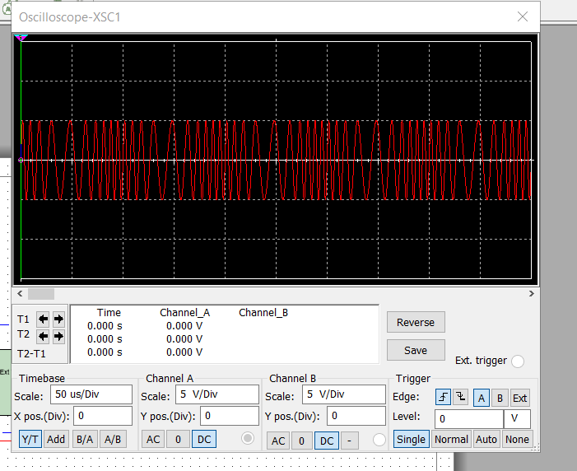
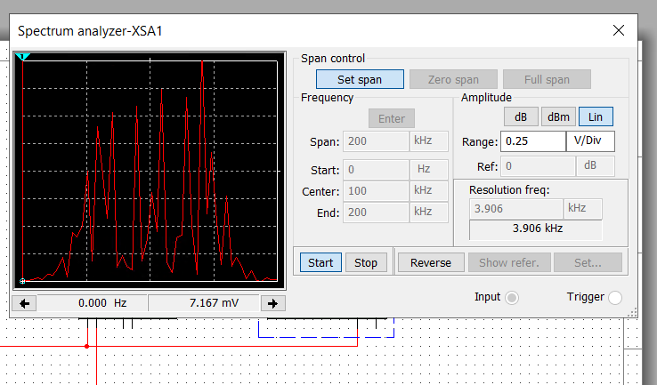
AM/FM Signals (continued)
Oscilloscope
Spectrum Analyzer
The carrier frequency is 101.399.
Notes:
(Frenzel, Jr, 2015)

Slide 6
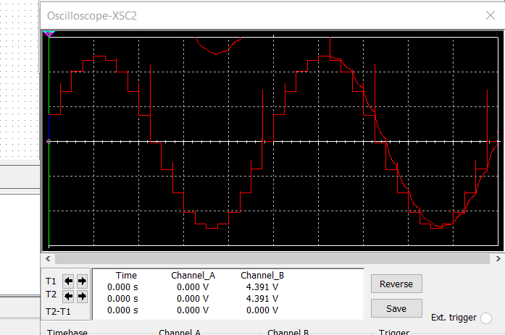
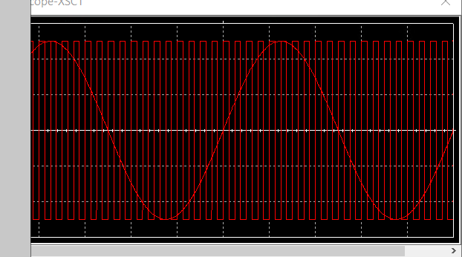
Pulse Code Modulation (PCM) and Line Codes
Oscilloscope-XSC2 display with analog input signal and sampling clock at the input to the digital to analogue converter (DAC) output.
Oscilloscope-XSC1 display with analog input signal and sampling clock at the input to the analog-to-digital converter (ADC)
Notes:
(Frenzel, Jr, 2015)

Slide 7
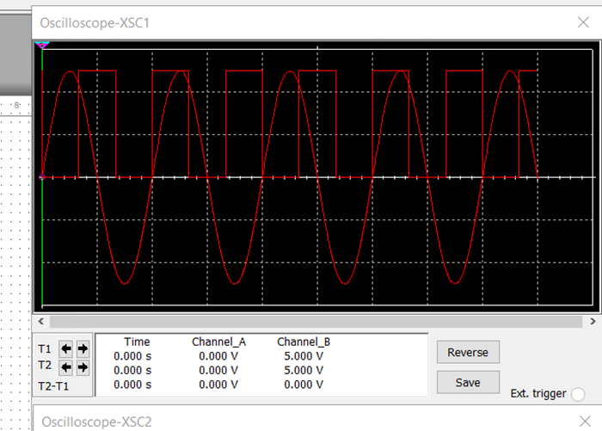
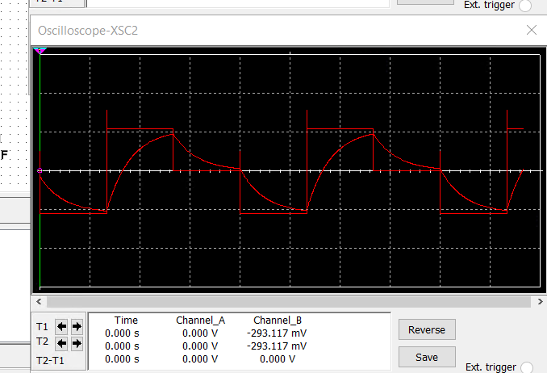
Pulse Code Modulation (PCM) and Line Codes (continued)
Oscilloscope-XSC2 display
Output of the DAC
Oscilloscope-XSC1
Analog input signal with sampling clock
Notes:
I can see the increasing noise in the right chart you see the noise as the signal decreases the noise get quieter. You will notice that the left chart shows the FM signal broadcasting and, on the right, you can see the detail of the same signal (Frenzel, Jr, 2015).

Slide 8
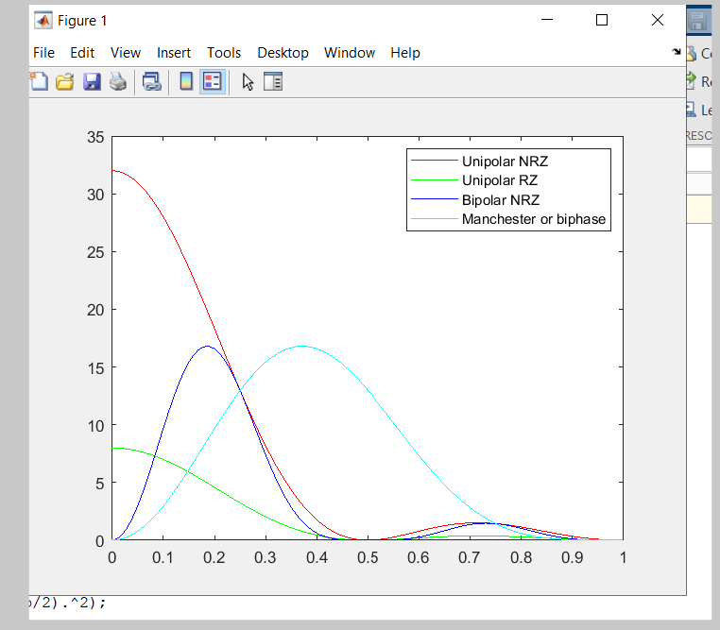
Pulse Code Modulation (PCM) and Line Codes (continued)
MATLAB Diagram
Notes:
Shows the power spectral densities of four-line codes: NRZ-Polar, NRZ-Unipolar, NRZ-Bipolar, and Manchester-Polar. The Manchester requires more bandwidth. I say this because the reference on attached screen shot is chart that says the Manchester uses 16dB and .08 Hz when the bipolar uses same 16 dB and only 0.4 Hz

Slide 9
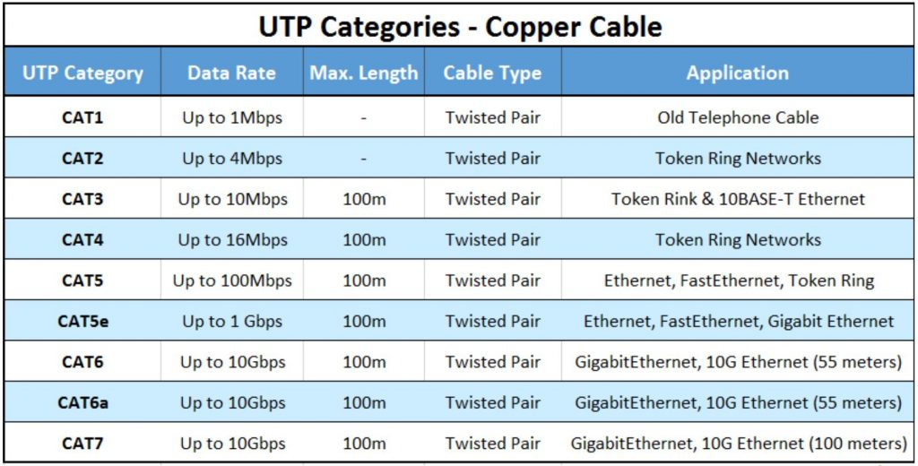
Cables and Structured Cabling
The individual wires are twisted individual wires in a UTP cable to help reduce crosstalk and interference which is important to ensure that the transmission of the data is uncorrupted (Frenzel, Jr, 2015).
The UTP cable must be a minimum distance from 110 volts electrical cable of 3 feet (Frenzel, Jr, 2015).
Horizontal cabling goes from the telecommunication room (TR) to the Work Area Outlet (WAO) to individual outlets on the ground or to the workstation, in addition the horizontal cabling must adapt to specific fire-rating specification which differ from project to project (FIBERPLUS, 2022).
Notes:
Proper maintenance of any part of the network cable will help to reduce crosstalk, and interference to ensure that the transmission of the data is uncorrupted. The most common type used for Horizontal runs is copper cabling; however, fiber optic and coaxial cables can also be utilized. Keep in mind that regardless of the cable type, horizontal cabling should be limited to 90 meters in length between the WAO and the termination point in the telecommunications room to satisfy the TIA standards (Digital Thinker, 2023). Maintenance should also include the grounding of a facility is mostly for the safety of the equipment, but it also enhances the safety and performance of sensitive electronic equipment (Kleronnomos, 1994).
.

Slide 10
Cables and Structured Cabling (continued)
Simply put a Plenum Cabe is an Ethernet networking cable this is used in the space between floors and a dropped ceiling of a building. These cable are designed reduce the risk of fire and also designed to not-emit toxic smoke and injurious fumes should a fire occur in the area of the Plenum Cable (Smart Tech Cables, 2023).
Are used in between raised floors just like Plenum cable the main difference is that these cable can be the backbone that transmits data, audio, and video signals and are available in multiple categories from Cat5e, Cat6, Cat6A, Cat7A and Cat8 (Niswander, 2019).
The grounding of a facility is mostly for the safety of the equipment, but it also enhances the safety and performance of sensitive electronic equipment (Kleronnomos, 1994)..

Slide 11
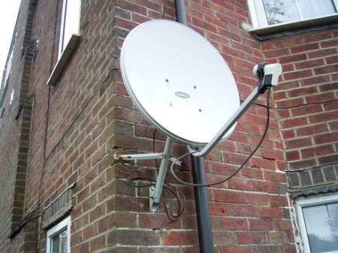
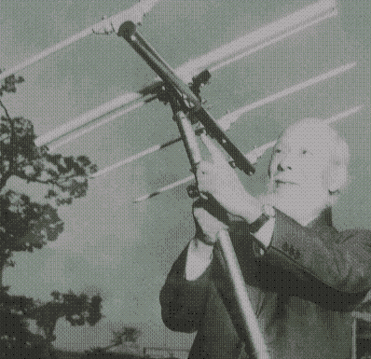
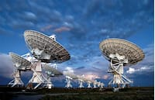
Antenna Gain & Free Space Path Loss
Parabolic Dish Antenna
The man is holding a Yagi antenna
The VLA in San Agustin , New Mexico
Notes:
Image on the left is of a Parabolic Dish Antenna (unknown, 2017) and the image on the right is of a Yagi Antenna (Yagi-Uda, 2015).
The VLA’s unique shape gives us three nice long arms of nine telescopes each. The VLA in New Mexico has 28 antennas (including a spare) each has a Y shape that is functional. Giving the user three long arms of nice telescopes each and allows the flexibility of stretching when zooming in on an object is necessary and each dish is 82-feet across 8 receivers tucked inside and each telescope is on rails that are moved three times a year via a special rail truck called a (Transporter) over a course of 16 months each VLA will lengthen its legs from 2/3s of a mile to 23 miles long. (NRAO, 2023). The common dish antenna at 2.4 GHz band has a gain of 22.379 verses that of a common dish at 5 GHz which has a gain of 29.079. The VLA in New Mexico on a 5 GHz frequency has a gain of 63.059, this because of its larger dish size (Frenzel, Jr, 2015). The free space loss in dB at 2.4 GHz of -80.4 and at 5 GHz it is 87.2, over all there is -7.2 difference in frequency which means they are basically the same(Frenzel, Jr, 2015).

Slide 12
Antenna Gain & Free Space Path Loss(Continued)
1. What is the maximum theoretical antenna gain of a common dish antenna at the 2.4 GHz band? [4 points]
Answer: 22.379
2. What is the maximum theoretical antenna gain of a common dish antenna at the 5 GHz band? [4 points]
Answer: 29.079
3. Given the same sized reflector, which signals, high-frequency, or low-frequency, can be more efficiently focused by a common dish antenna (i.e., result in a higher antenna gain)? [5 points]
Answer: The 5 GHz frequency (bandwidth) would result in a higher antenna gain.
4. What is the maximum theoretical antenna gain of the dish antenna used in the VLA radio telescopes in New Mexico at the 5 GHz band? [4 points]
Answer: 63.059
5. Given the same signal frequency, which dish antennas, large-sized or small-sized, are more efficient at focusing the signal (i.e., result in a higher antenna gain)? [5 points]
Answer: Larger antennas are more effective at focusing the signal

Slide 13
Antenna Gain & Free Space Path Loss(Continued)
Free Space Path Loss (continued)
1. What is the free space path loss in dB at the 2.4 GHz band? [4 points] Answer: -80.4
2. What is the free space path loss in dB at the 5 GHz band? [4 points] Answer: -87.2
3. How does the free space path loss at a higher frequency (e.g., the 5 GHz band) compare with that at a lower frequency (e.g., the 2.4 GHz band)? [5 points]
Answer: although there is about a -7.2 difference between the two frequencies that are basically the same
4. What is the free space path loss in dB over 20 meters at the 2.4 GHz band? [4 points]
Answer: -66.421
5. What is the free space path loss in dB over 40 meters at the 2.4 GHz band? [4 points]
Answer: -72.441
6. What is the free space path loss in dB over 80 meters at the 2.4 GHz band? [4 points]
Answer: -78.462
7. When the distance doubles, how does free space path loss in dB change approximately? [5 points]
Answer: There is a difference of approximately 1.012 in the path loss at the higher distance.

Slide 14
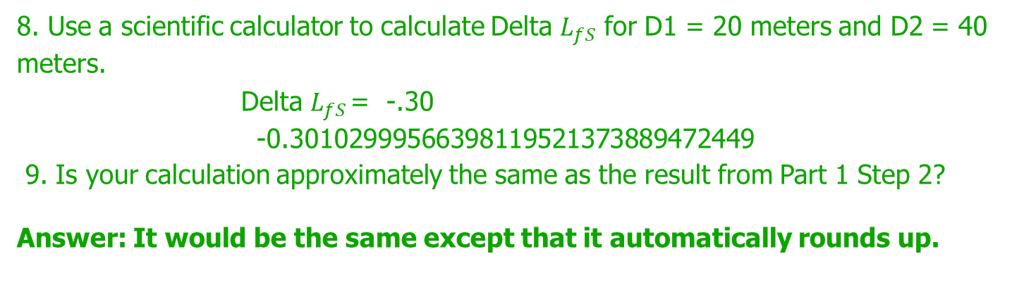
Antenna Gain & Free Space Path Loss(Continued)
Free Space Path Loss (continued)
8. Use a scientific calculator to calculate Delta $L_{fS}$ for D1 = 20 meters and D2 = 40 meters.
Delta $L_{fS }$= -.30 -0.30102999566398119521373889472449
9. Is your calculation approximately the same as the result from Part 1 Step 2?
Answer: It would be the same except that it automatically rounds up.

Slide 15
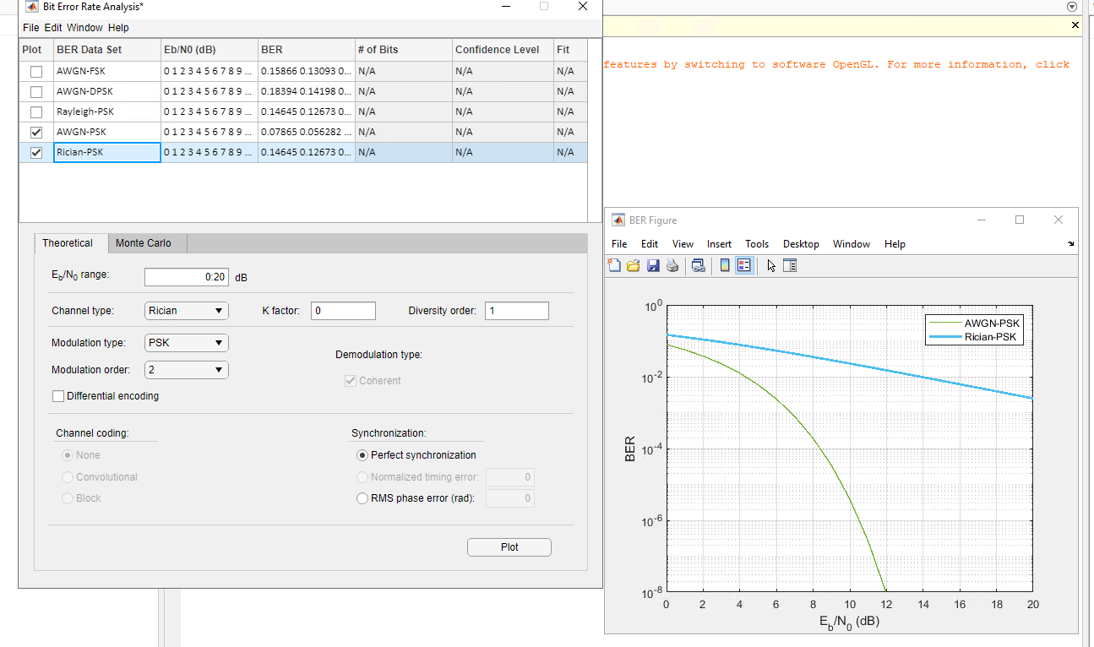
Bit Error Rate of Fading Channels
bit rate error performance of both AWGN and Rician fading channels.
Notes:
The above image shows the difference between the AWGN and Rician performance, the stronger the wave is on the AWGN-PSK (0.078) is more consistent the Rician-PSK (0.146) signal raises as the wave increases.

Slide 16
Conclusions
The NETW-310 course at DeVry gave me a greater understanding on a variety of system security vulnerability. Using various types of media commonly used to connect computing and digital devices to networks by using different types of media such as copper, coax cable, fiber optic cable, wireless and microwave media. Both physical and a virtual system are implemented and secured. The use of MATLAB, an Oscilloscope, spectrum analyzer, to analyze time-domain and frequency-domain of a signal and review power measurements in Watts and decibels (dBs).

Slide 17
References
FIBERPLUS. (2022, April 7). What are the Cables for Horizontal Cabling. Retrieved from Fiberplus: we connect you to the future: https://www.fiberplusinc.com/services-offered/what-is-horizontal-cabling/#:~:text=Horizontal%20cabling%20expands%20from%20a%20telecommunications%20room%20%28TR%29,connects%20each%20work%20area%20to%20the%20telecommunications%20room.
Frenzel, Jr, L. E. (2015). Principles of Electronic Communication Systems. In J. L. Frenzel, Principles of Electronic Communication Systems (p. 509). New York, NY: McGraw-Hill Learning Solutions, 2015.
Kleronnomos, C. C. (1994, April 15). Effective Equipment Grounding. Retrieved from ECOS Electronics Corporation: https://www.epgco.com/effective-equipment-grounding/#:~:text=Effective%20grounding%20creates%20an%20electrical%20environment%20that%20results,quality%20must%20be%20viewed%20from%20a%20total-system%20standpoint.
Unknown. (2017). satellite dish on building. Retrieved from Images All Free Download.com: https://images.all-free-download.com/images/graphiclarge/satellite_dish_on_building_210248.jpg
Yagi-Uda. (2015). Yagi-Uda Antenna. Retrieved from Antenna Theory: https://www.antenna-theory.com/antennas/travelling/yagi.php
Notes:
The Oscillo scope the signal including the panel settings of the oscilloscope and the Spectrum Analyzer show the signal and panel setting of the analyzer. The table below sow the lower side band, carrier, and upper side band (Frenzel, Jr, 2015)
.

