Slide 1
Multimedia Networks: Protocols, Designs and applications
DeVry University
NETW-320 Professor Noel Broman
Aaron Schaefers
October 21st, 2022

Slide 2

Welcome
This divided into 8 section (modules)
Introduction, Requirements, Audio, Image, Video Coding, and Transmission
Underlying Network Functions, Synchronization and Adaptation
Session Initiation Protocol
Other Standard VoIP Protocols
WebRTC Streaming and Over-the-Top TV
Home Networks, High-End TV, Solutions and Summary
CCNP certification practice exam
  Entry
  Associate
  Professional
  Expert
  Architect
Final Project – PowerPoint presentation

Slide 3


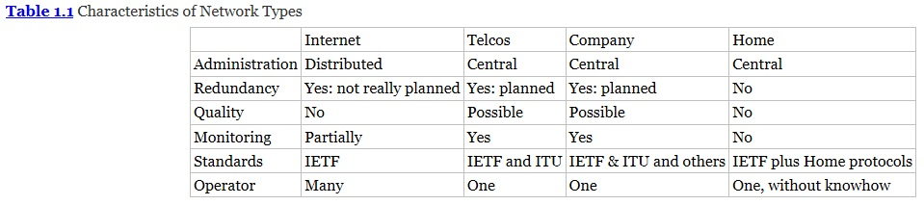
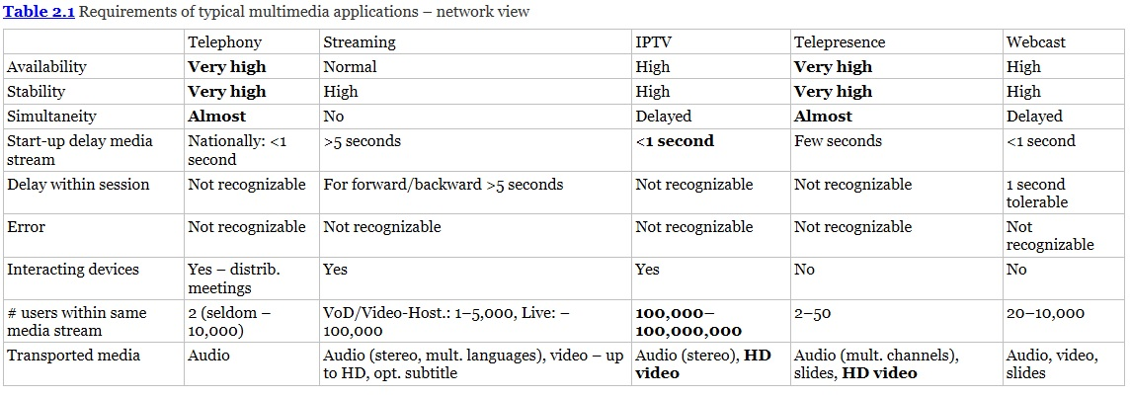

Introduction
Notes:
In this module, I learned how multimedia applications fit into existing network types, as well as standard organizations, market segments related to such applications, and the various requirements. After examining the audio and video coding basics, we will review video compression standards, error handling at the application layer, and trans-coding techniques. There are several types of multimedia however certain ones only work in certain network types, throughout this course we will gain a better understanding of the best application and network is best (Barz & Bassett , 2016)

Slide 4
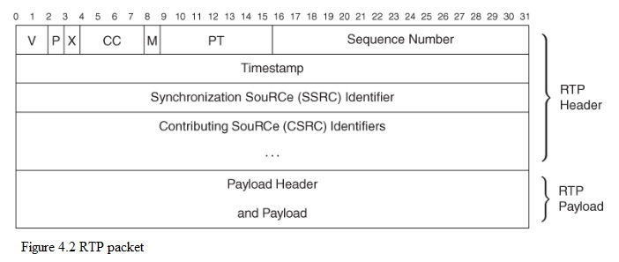
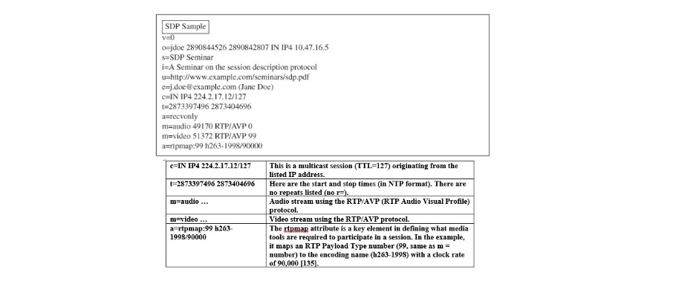
Underlying Network Functions, Synchronization and Adaptation (1 of 2)
Notes:
Comprehension of the capabilities and protocols is critical to understanding multimedia network services. The participants gain a better understanding of the protocols at both transport and application levels such as real-time protocol (RTP} session description protocol (SDP), real-time streaming protocol (RTSP), and the handling of characteristics of packet loss, delay, queuing, and jitter treatment (Barz & Bassett, 2016).

Slide 5
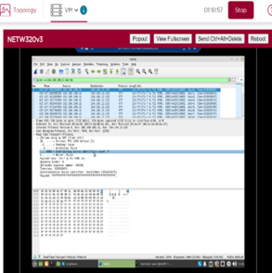
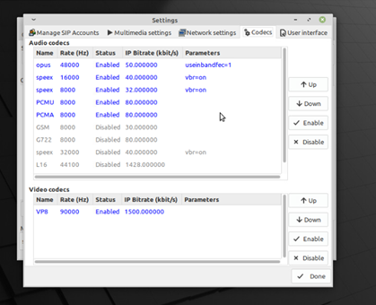
Underlying Network Functions, Synchronization and Adaptation (2 of 2)
Notes:
The above screenshot is the tree view section of 2 RTP packets, with a difference of 1 between their sequence numbers, respectfully. When one unit of the time stamp clock represents 1/8,000 of a second, it would take .02 seconds/milliseconds of conversation are carried in each RTP pack (Barz and Bassett, 2016).
The 6.711 codec bit rate of 64,000 bits per second would have a payload of 1280 bits Using the previous stated length I subtract the following 20bytes for IP header, 8 bits for UPD header, and 12 bytes for the RTP header. requires the most bandwidth, of at least 96Kbps per line, however if you reduce the compression your get a slightly better audio quality but will need to increase the bandwidth per line to either 112Kbps or 128Kbps (Weichhand, 2016). Linphone uses H.264, h.265 and VP8 and a one-hour video call would (depending on the quality of the call stream) is generally between 540MB (the default SD) and 1.62 GB (full HD) (Xplornet Communications Inc., 2022).

Slide 6
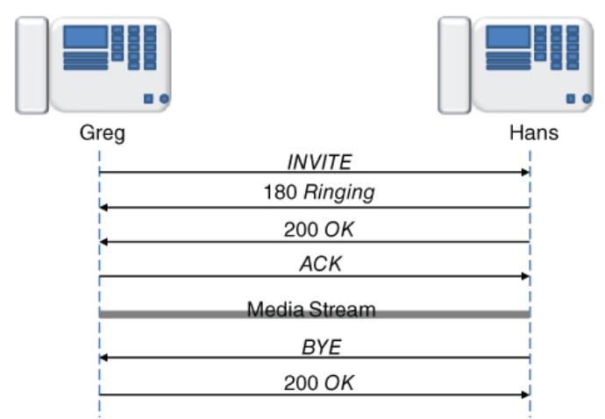
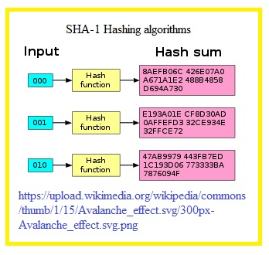
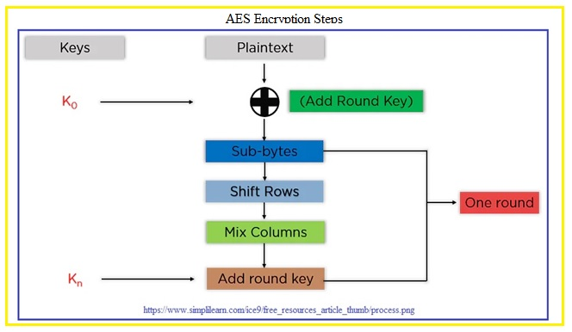
Session Initiation Protocol (1 of 2)
Notes:
Image on the left is the Session Initiation Protocol (VoIP) that allows voice calls, video conferencing, messaging, and media distribution (Barz & Bassett, 2016). The top right is a sample of the SHA1 hash algorithm which has an avalanche effect. Making it harder for hackers to decrypt the message because when a single bit is changed the hash sum becomes totally different (Barz & Bassett, 2016).

Slide 7
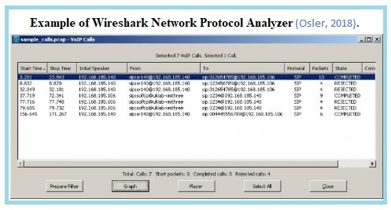
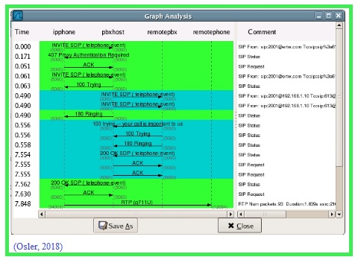
Session Initiation Protocol (2 of 2)
Notes:
Having an understanding SIP and how it works has become as vital to a Unified Communication Engineer as it was for Telephony Experts to read signaling trace in Q.931/Q.921/DS1/QSIG generated by T1/E1 PRI-BRI ISDN lines. The image on the left is a screen shot of Wireshark’s Network Protocol Analyzer and the image on the right is a Graph Analysis done also using Wireshark (Osler, 2018).

Slide 8
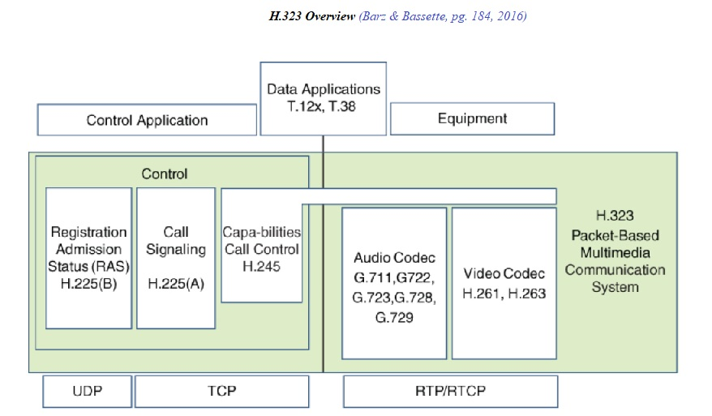
Other Standard VoIP Protocols
Notes:
The above image is an overview of various protocols that the H.323. was originally independent of SIP but today it and others are used as part of the SIP protocol (Barz & Bassett, 2016).

Slide 9
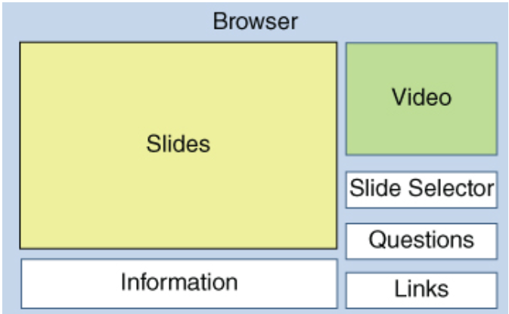
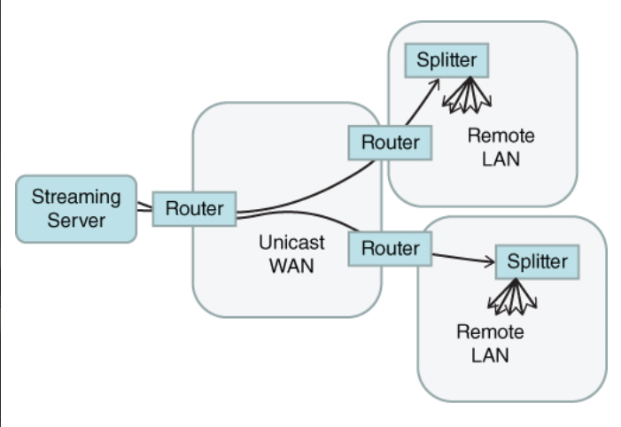
WebRTC , Streaming and Over-the-Top TV
Notes:
Image on left is figure 12.1 Webcast browser, middle figure (12.2) is a Webcast streaming and figure 12.3 is of a Unicast splitters (Barz & Bassett, 2016).

Slide 10
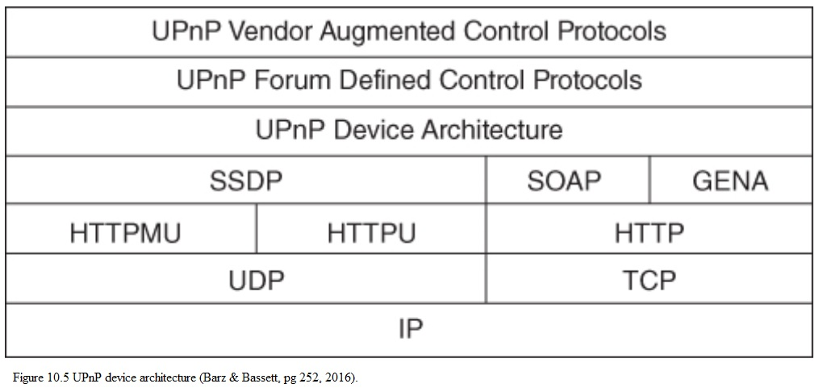
Home Networks, High-End IPTV
Notes:
The Universal Plug and Play (UPnP) has one basic protocol but has many methods and device description, Digital Living Network Alliance (DLNA) use the UPnP and other standards to develop profiles for connected devices, The Home Gateway Initiative (HGI) publicized recommendations for home network gateways, I3A was responsible for defining standards of exchanging pictures. They developed the Picture Transfer Protocol (PTP) between cameras, computers, and other devices. However, the standard is now maintained by ISO (Barz & Bassett, 2016).

Slide 11


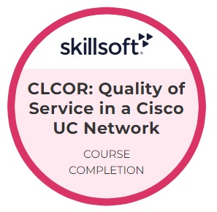




Solutions and Summary
Notes:
The CCNP practice exams practice exam has five levels of network certification as follows: 1. Entry, 2. Associate, 3. Professional, 4. Expert and 5. Architect. This exam had 25 questions that consisted of multiply choice, true/false, and order of sequence. To pass this test it was necessary to score of 70% or higher. In preparation for the practice test the students were awarded a series of badges for each area as shown above.

Slide 12
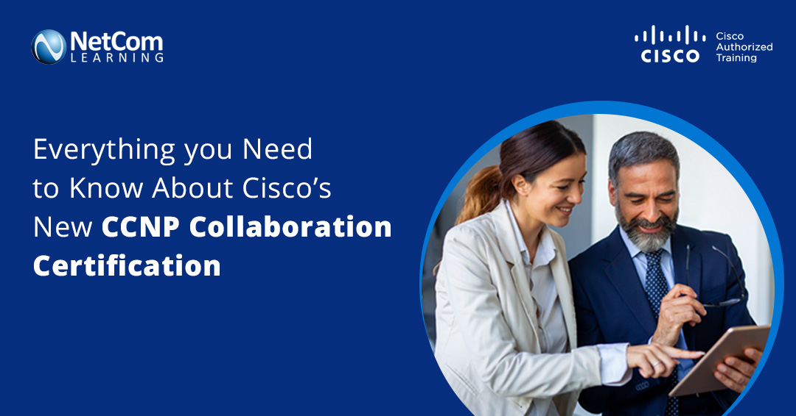
Cisco Certified Network Professional Collaboration Certification
(CCNP) Practice Exam
Notes:
The final practice exam had 25 questions which required a passing grade of 70% or more(Barz & Bassett, 2016). However, the actual CCNP Collaboration exam has 90 – 110 questions, testing time is 120 minutes, and to passing the exam requires a score of 750-850 out of 1000 (Ciufo, 2022).

Slide 13
References
Barz, H., & Bassett, G. A. (2016). Multimedia Networks: Protocols, Designs, and Applications. John Wiley & Sons, Ltd.
Ciufo, B. (2022, March 3). Everything you Need to Know About Cisco’s New CCNP Collaboration Certification. Retrieved from Netcom Learning: https://www.netcomlearning.com/blogs/454/everything-you-need-to-know-about-cisco%E2%80%99s-new-ccnp-collaboration-certification.html
https://blog.jscrambler.com/hashing-algorithmsWestbay Engineers, Ltd. (2022). Erlangs to VoIP bandwith Calculator. Retrieved from Erlang: https://www.erlang.com/calculator/eipb/
https://www.google.com/url?sa=i&url=https%3A%2F%2Fwww.nwexam.com%2Fcisco%2Fcisco-300-101-certification-exam-sample-questions-and-answers&psig=AOvVaw1Ojs4WRiB6omEuXg1jup6d&ust=1665980174568000&source=images&cd=vfe&ved=0CAwQjRxqFwoTCNCn1vTx4_oCFQAAAAAdAAAAABAE
https://www.netcomlearning.com/blogs/454/everything-you-need-to-know-about-cisco%E2%80%99s-new-ccnp-collaboration-certification.html
Osler, D. (2018, July 19). Analyzing SIP and SIP calls. Retrieved from WILDIX BLOG: https://blog.wildix.com/analyzing-sip-calls/
Weichhand, S. (2016, August 4). How VoIP Codecs Affect Call Audio Quality. Retrieved from Telxyx: https://telnyx.com/resources/codecs-affect-voip-sound-quality
Xplornet Communications Inc. (2022). Monitor and Manage Your Data When Video Calling: Video Calls. Retrieved from Xplornet Communications Inc.: https://www.xplornet.com/support/internet/managing-data-using-skype/

