Slide 1
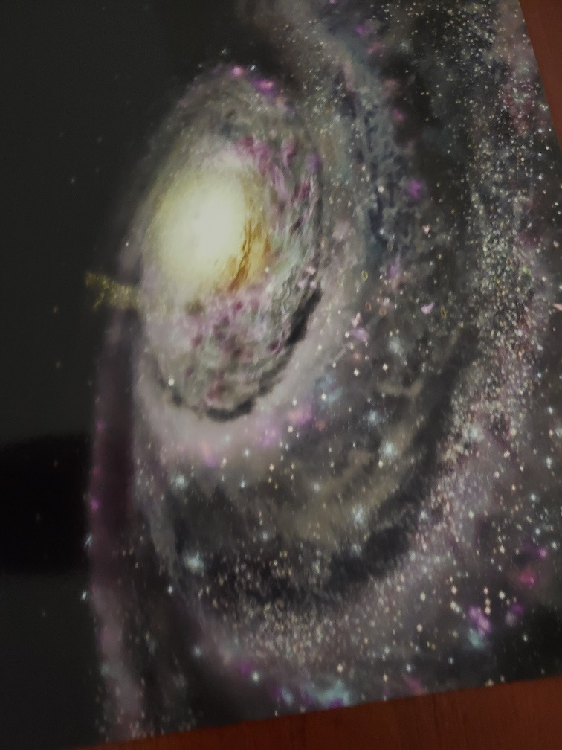
Applied Physics 204
By Aaron Schaefers
DeVry University
Professor: Dr. Neda Adib, Ph. D
August 18, 2021

Slide 2
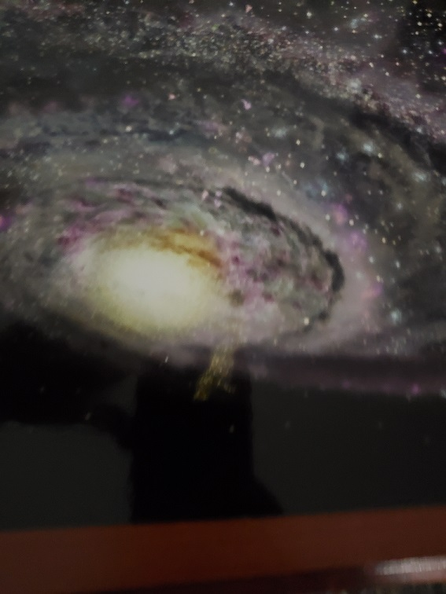
Introduction
Development of Final Project
  Units and Linear Motion
  Forces & Momentum
  Work & Energy
  Circular Motion
  Charge & Electric Field
  Magnetic Force Fields and Induction
  Waves
  Challenges/Skills, Conclusion, & References
Notes:
The over the last eight weeks of applied physics, time was devoted to developing a basic understanding of the role of physics in our lives. Through the setup of experiments, gathering data and the analysis of that data, an individual gains a better understanding of how physic works in the universe and in our daily lives.

Slide 3
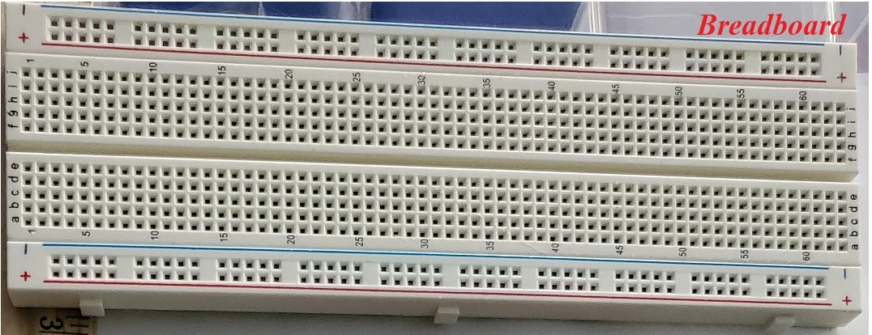
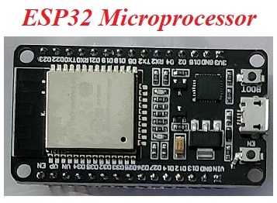


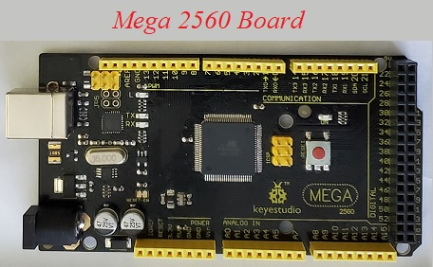
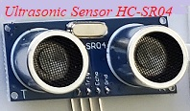
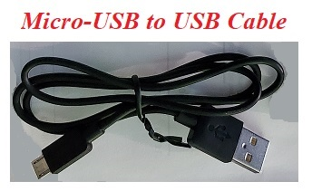
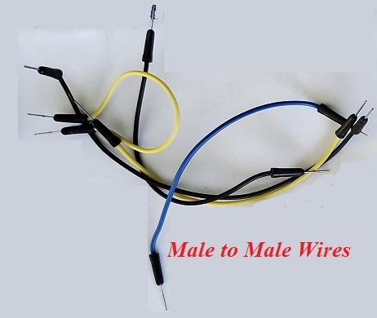
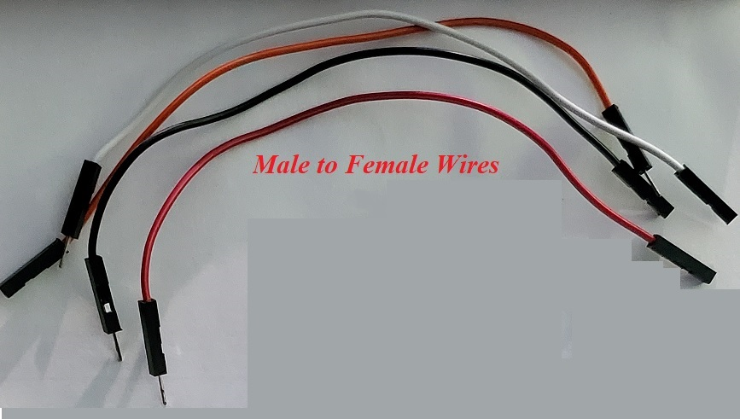
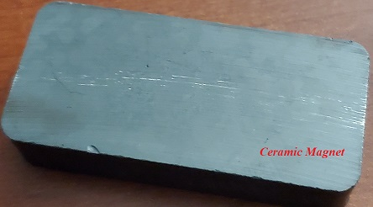
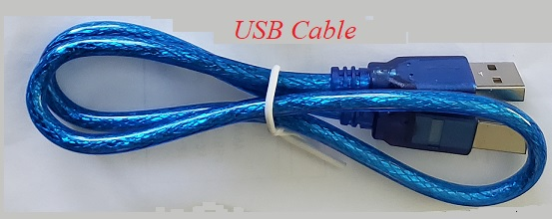
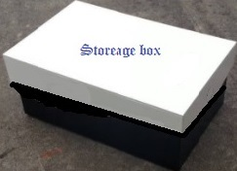


Materials List (slide 1 of 2)
Notes:
This slide shows the hardware and objects used through out this course to able to complete specific tasks for data collection and analysis. During module one and two the goal was to collect the needed materials and set up the software in preparation for the actual experiments, which will be conducted throughout the course until the module seven and eight which will be devoted to the analysis and comprehensive reporting from the results of the experiment(s) performed. Note: picture left to right row one, is the breadboard, ESP32 Microprocessor, Mega2560 Board, Rotary Decoder Module KY-040, Ultrasonic Sensor HC-SR04 and an ice bucket, the middle row shows the following: Micro-USB to USB cable, Male-to-Male wires, Male-to-Female wires, a magnet, finally in the bottom row we have a USB cable, wooden ruler and a shoebox, and a ball.

Slide 4
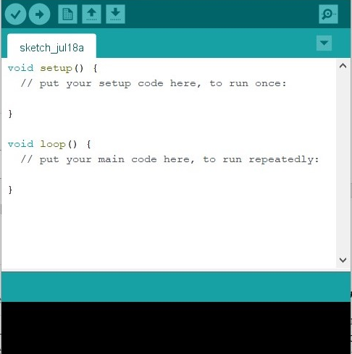
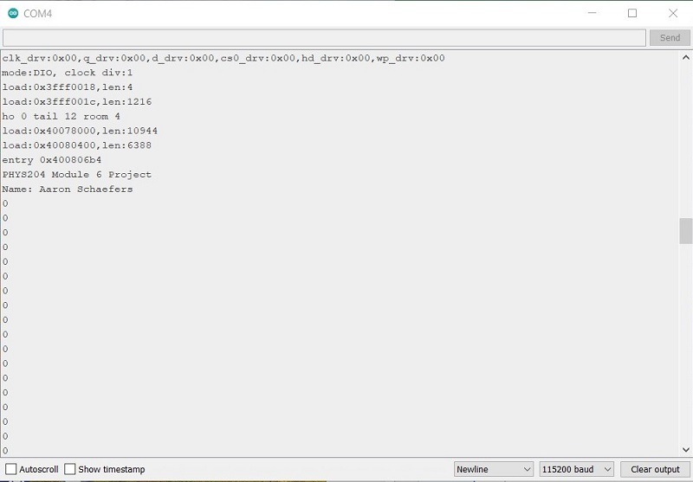
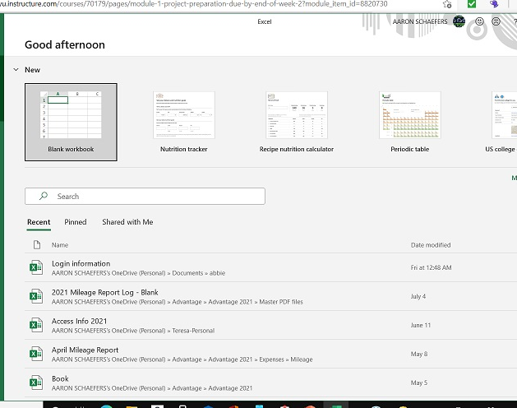
Materials List Continued (slide 2of 2)
Arduino Software
Serial Monitor
Microsoft Excel
Notes:
Using the Arduino software, I was able to upload the code(s) to either, the ESP32 Microprocessor, Mega2560 Boards, that is necessary for the sensors to collect the data. The code will allow me to collect data during each of my four experiments and analysis the data by means of graphical representation in Microsoft Excel.

Slide 5
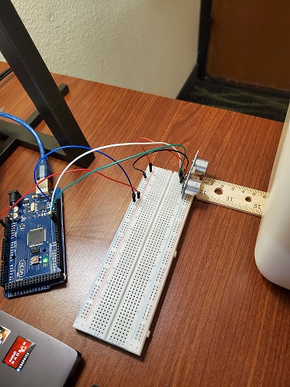
Units, Linear Motion, Forces, and Momentum
Precision of the Ultrasonic Sensor
Notes:
The Ultrasonic HC-SR04 sensor operates at 40 kHz for a range of 3 centimeters (cm) to 3 meters (m) my goal is to test the accuracy of the sensor, by using the following equation distance = V_{sound} X t_{measured .}

Slide 6
Experimental Set-up
Materials List:
Mega 2560 Board
Ultrasonic sensor HC-SR04
Male to Male Wires
Breadboard
Ruler or tape measurer
Object to act as obstacle
Notes:
This pictures show the hardware required to conduct this experiment. When the ice bucket was placed in from of the ultrasonic sensor, the sensor sent out a ultrasonic sound burst and then time how long the too for it to receive the echo of that burst signal. At first, I had difficulty getting the sensor to register the room temperature ice-bucket, however after adding ice in the bucket I was able to activate the sensor. There are some general characteristics that one should keep in mind when choose an object for this test. Such as the shape of the object is essential, because a curved object has the potential of cause the signal to bounced off the object and deflect it away from the sensor.

Slide 7
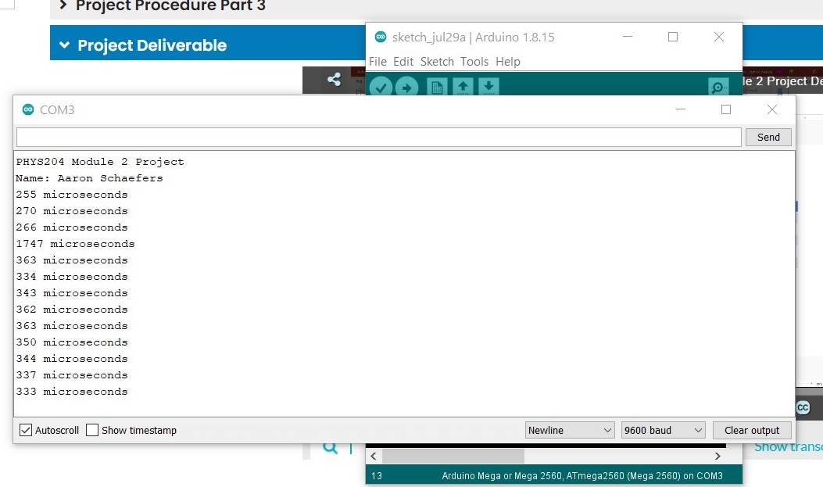
Raw Data (Screenshot)
Notes:
This image is an example of one of the five test ran during this experiment. The Arduino registered several readings from the signal hitting the side of the ice-bucket and then the echoing of that bust of sound. The results of this raw data are show in the next slide.

Slide 8
Data Collection
Trial | Ruler Distance (cm) | Total Roundtrip Distance (m) | Time from Serial Monitor (microseconds) | Roundtrip time (s) | Velocity = distance/time (m/s)
1 | 8 | .16 | 456 | .000456 | 350.09
2 | 4 | .08 | 255 | .000255 | 313.70
3 | 7 | .14 | 394 | .000394 | 355.33
4 | 12 | .24 | 695 | .000695 | 345.32
5 | 6 | .12 | 331 | .000331 | 362.54
Notes:
Each line of this table represents the result of each of the five tests done with the ice-bucket at different distances from the ultrasonic sensor.

Slide 9

Data Analysis
Average velocity from table
Percent difference where $v_{sound}=343 m/s$
$v_{avg}= \frac{v_{1}+v_{2}+v_{3}+v_{4}+v_{5}}{5}=\frac{350.09+313.70+355.33+345.32+362.54}{5}=345.40$ m/s
$$Percent difference = \frac{\left|v_{avg}−v_{sound}\right|}{v_{sound}}×100\%=\frac{\left|345.40−343.00\right|}{v_{sound}}∗100\%= .07\%$$
Notes:
At the beginning of this experiment, I had some difficulty finding a suitable object that the sensor could detect, because of my location. However, I was able to resolve this issue by using the hotel’s ice-bucket that I filled about halfway with ice. I believe the original difficulty I had with the empty bucket was because the plastic bucket was at room temperature adding the ice to it made the plastic cold and there by allowing the ultrasonic sensor recognize that there was a project present. The next experiment will demonstrate

Slide 10
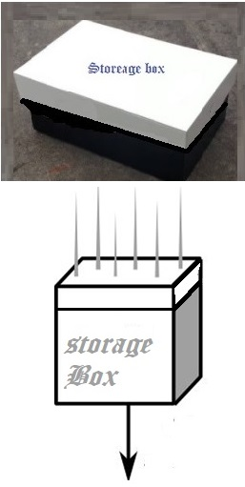
Work and Energy
Gravitational
Acceleration
Notes:
Gravity has an acceleration speed and is noted as: g = 9.80 m/s²
When an object is at rest, such as the box before being dropped, the notation is: v₀ = 0
An object in free-fall is noted as: ${y(t)=1/2 〖at〗^2+v}_{0}t+y_{0}$
To measure the fall distance from a reference point as a function, shown as: y(t) can be calculated using the following equation: $y\left(t\right)=\frac{1}{2}{gt}^{2}+ y_{0}$ where y₀ is the initial distance from the reference point.

Slide 11
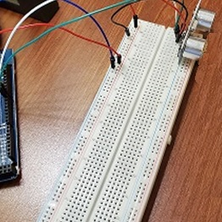
Freefall Experiment
Materials List:
Mega 2560 Board
Ultrasonic sensor HC-SR04
Male to Male Wires
Breadboard
Object to undergo free fall motion
USB Cable
Notes:
I choose a storage box as the falling object to determine the results of this free-fall gravity experiment. Ideally a book would be heavy and flat enough for the ultrasonic sound wave to

Slide 12
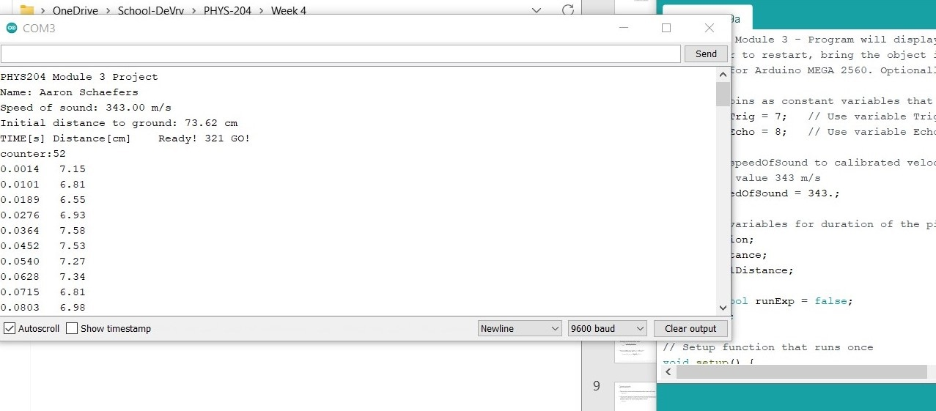
Serial Monitor (collection of Raw data)
Notes:
In this free-fall experiment the sensor was 73.62 cm from the ground and took 52 readings during the experiment from the time the box started falling to when it landed on the ground (floor). This raw data was then imported into excel for the completion of graphical analysis.

Slide 13
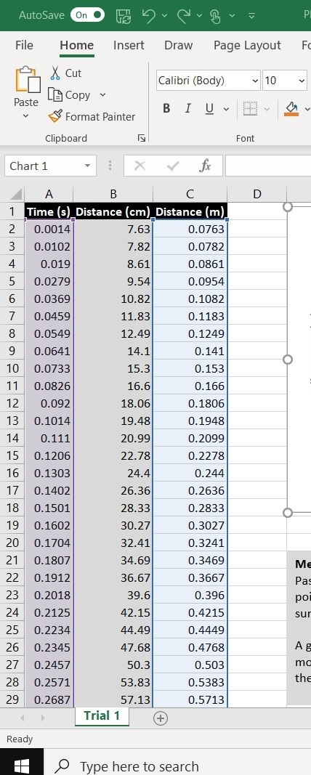
Excel Table
(analysis of raw data)
Notes:
This is a single trail of the free-fall experiment, showing the raw data collected for time (s), Distance (cm), and Distance in (m)

Slide 14
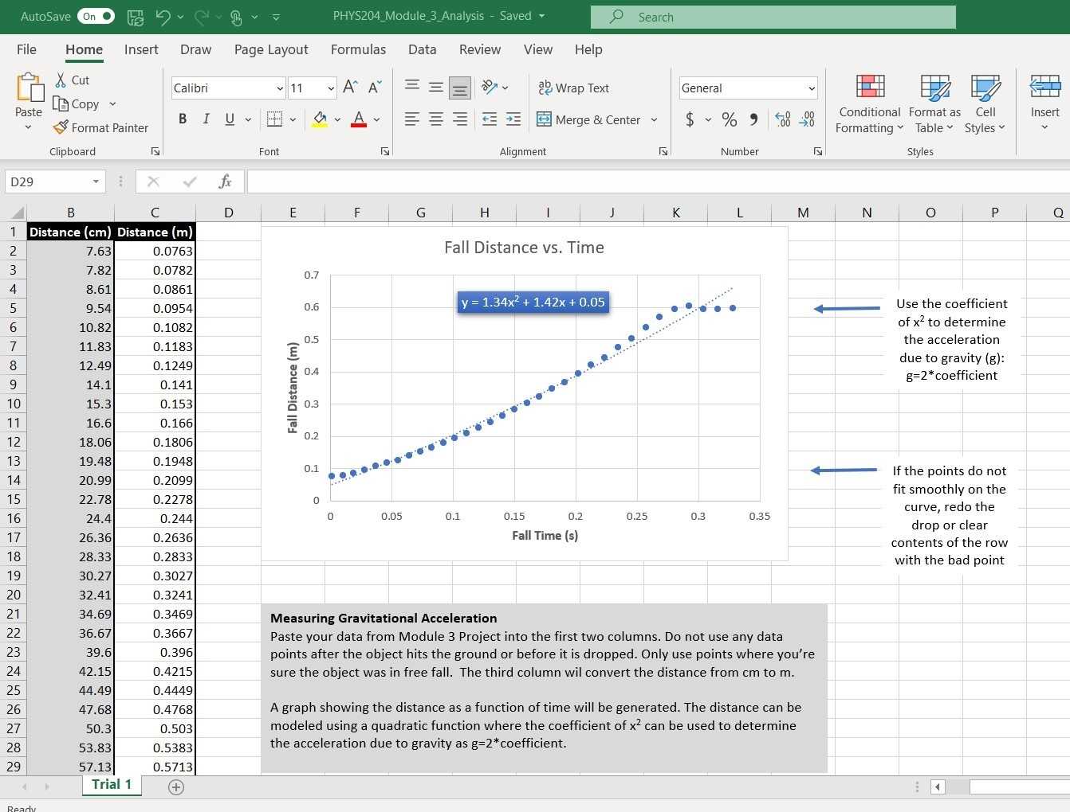
Excel Graph
(free-fall data)

Slide 15
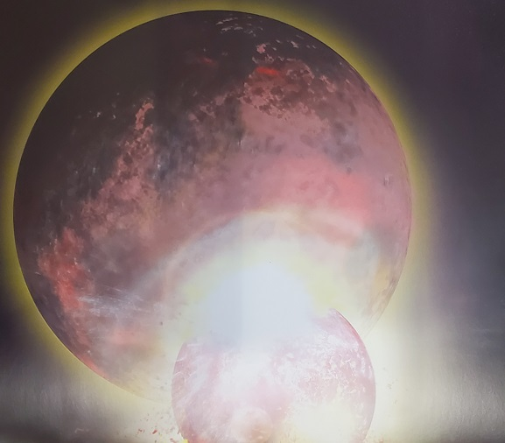
Data Collection
Trial | x² coefficient value from curve fitting | Acceleration (m/s²) = 2* (x² coefficient)
1 | 1.34 | 2.68
2 | 2.01 | 4.02
3 | 2.18 | 4.36
4 | 2.00 | 4.00
5 | 3.61 | 7.22

Slide 16
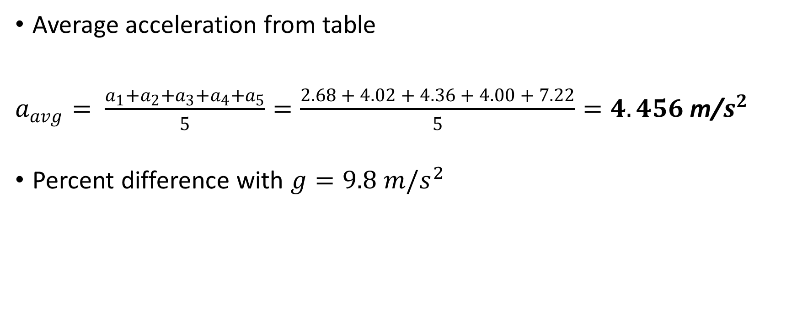
Data Analysis
Average acceleration from table
$a_{avg}= \frac{a_{1}+a_{2}+a_{3}+a_{4}+a_{5}}{5}=\frac{2.68 + 4.02 + 4.36 + 4.00 + 7.22}{5}=4.456$ m/$s^{2}$
Percent difference with $g=9.8 m/s^{2}$
$Percent difference=\frac{\left|a_{avg}−g\right|}{g}∗100\%=\left|4.456−9.8\frac{m}{s^{2}}\right|∗100\%=54.53\% or 5.45\%$
Notes:
During this experiment I initially had trouble getting the programing code to upload to Arduino, after carefully reviewing the code, I was able to locate the typo make the necessary change, which resulted in the successful uploading of the code to the Mega2650 board. After performing the experiment, I found the trails were affected by the distance of the shoebox was dropped, and if there were large (loud) noises in the background during the actual testing. At this point I have a better comprehension of how to use forces to compute quantities of motion, and that motion is a change in position and that there are two ways to describe motion, one is acceleration and the other is velocity which show the transformation of energy from one type to another.

Slide 17
Conservation of Energy
Mechanical energy is the sum of kinetic and potential energy
Notes:
The following is the mathematical notation for each type of energy: Mechanical Energy = E, Kinetic energy = K, and Potential Energy = U. In a non-friction and zero air (like a vacuum) the mechanical energy remains the same or constant. The mathematical equation for this is E = K + U = Constant.

Slide 18
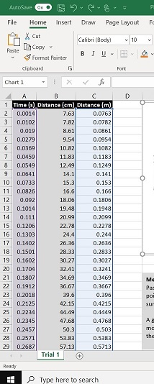
(various Energy values)
Excel Table
Notes:
After entering the raw data of one fall trail into the spreadsheet template, in centimeters and meters. Considering these values of time, I then able to calculate the values for kinetic (K), potential (U) energies and then compute the total mechanical (E) energy, after which it was possible to develop the following (next slide) graphical representation of the data.

Slide 19
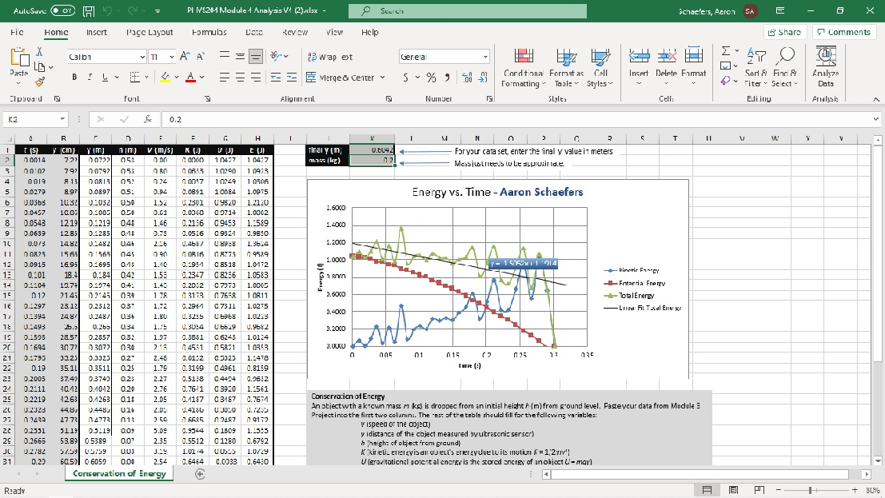
Graphical
(data analysis)
Notes:
This graph shows the graphical representation of the various forms of energy known as kinetic, potential and mechanical energies.

Slide 20
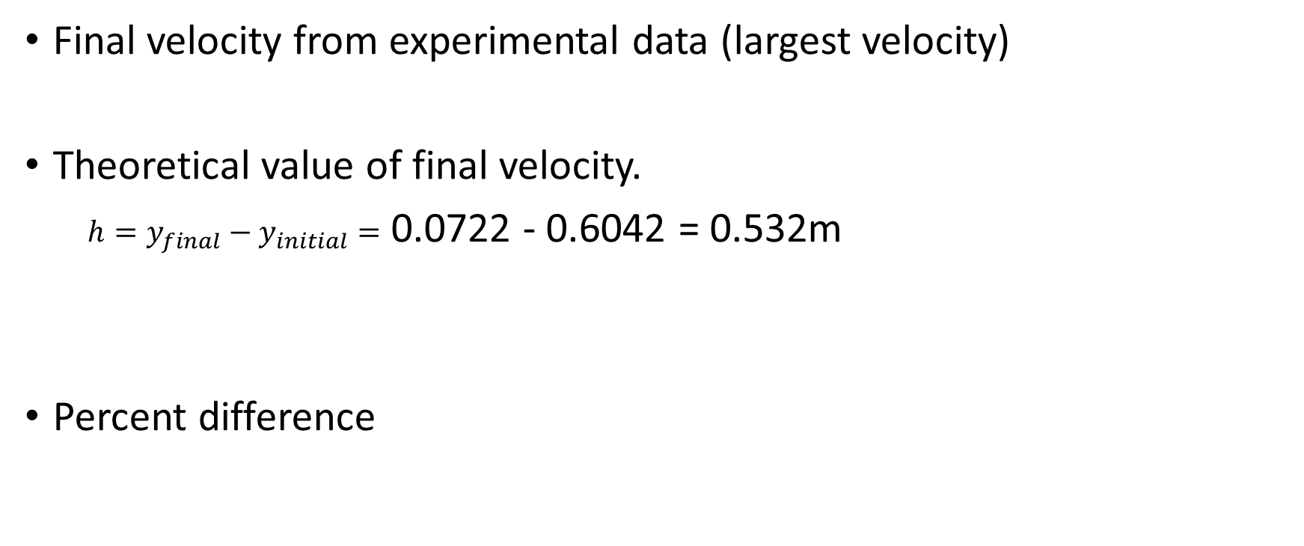

Data Validation
Final velocity from experimental data (largest velocity)
Theoretical value of final velocity.
$h=y_{final}−y_{initial}=$ 0.0722 - 0.6042 = 0.532m
Percent difference
$v_{experimental}$ = 3.19 m/s
$v_{f}=\sqrt{2gh}$ = 2*√9.8m/s2*0.532m = 3.23 m/s
$Percent difference =\frac{\left|v_{f}−v_{experimental}\right|}{v_{f}}×100\%=$ 1.24 %
Notes:
The key characteristics of this testing were as the shoe box is at its highest point (K = E) is at its highest and when the shoebox is at its lowest (at rest, on the floor) (U = E) is at its lowest point. The significance between K and U are that K= kinetic energy and U = the potential energy of an object. Another observation is that because the object’s mass and the atmospheric resistance the mechanical energy was not well maintained, which caused a slight decrease (lowering) of mechanical energy. Note: conserved energy is when the total of potential and kinetic energies are unbroken (constant).

Slide 21
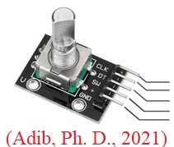
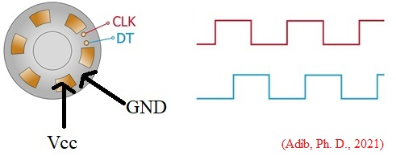
Rotational Motion
Using a Rotatory Encoding to collect data
Notes:
Previously I learned how to the radial displacement of circular motion and change it to linear displacement, at this point we are going to use an electro-mechanical device, called a rotatory encoder to collect data from the electrical signals on a rotational movement device. While there are several types of rotatory encoders, I will be using one that contains an evenly space zone on a disk and five pins that have specific purposes (for collecting data) as follows: the SW pin (switch) and two other separate contact pins called “CLK” (clock) and “DT” (data). These two pins, as the disk rotates, will turn on and off contact with the SW pin and two square wave output signals will be generated. The Vcc “+ pin” is the operating voltage pin and finally the GND pin is the ground pin. When the rotation is clockwise the CLK pin leads, but if the rotation is counter-clockwise then the DT square wave will lead.

Slide 22
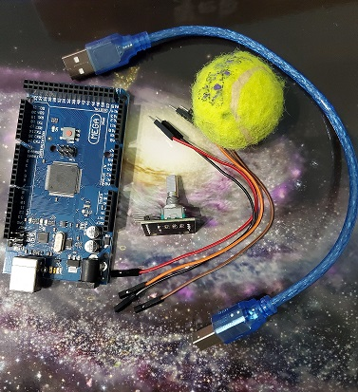
Rotatory Experiment
Materials List:
Mega 2560 Board
Rotary Encoder Module KY-040
Male to Female Wires
A ball to attach onto rotary encoder
Ruler or tape measurer
Notes:
After programing the Mega 2560 Board and attaching the Rotary Encoder I attached a small ball to collect the rotational data. I will be able to collect the following information: the number of pulses, the angle of the object and the linear distance traveled. I will show the raw data collected and then display that data in a table, followed by a graphical representation.

Slide 23
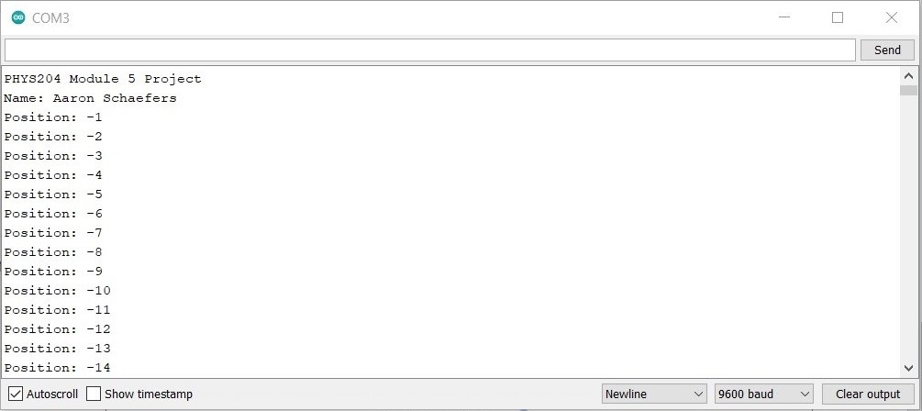
Raw Data

Slide 24

Data Collection
Object diameter: d = 6.5 cm
Object radius: r = 13 cm
Number of pulses for one revolution: x = 34
Resolution = $\left(\frac{1 }{34 }\right)∙\left(\frac{2∙π }{1 }\right)=$.185

Slide 25
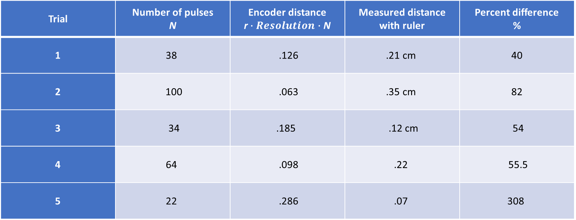
Data Analysis
Trial | Number of pulses N | Encoder distance r$∙Resolution∙$ N | Measured distance with ruler | Percent difference %
1 | 38 | .126 | .21 cm | 40
2 | 100 | .063 | .35 cm | 82
3 | 34 | .185 | .12 cm | 54
4 | 64 | .098 | .22 | 55.5
5 | 22 | .286 | .07 | 308

Slide 26

Data Graphical Representation
Notes:
In my original test the Arduino board was not registering data, so I had to start the Arduino board and was able to preform the data analysis for the rotational effects of a toy ball. When we collect the rotational reading of a moving object, we can determine the effect that object had on the area of contact. As well as what effect the area had on the object itself. We collect data in both linear and nonlinear forms, for example we can determine how much force is needed to move an object from one end of a warehouse to another, or how much rotational movement is required to keep the space station in orbit around the earth.

Slide 27
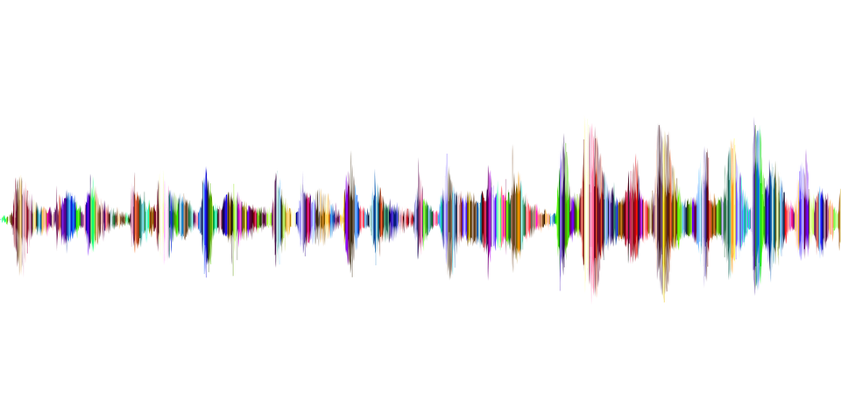
Observing the Hall Effect
Visualizing the unseen wave(s)
Notes:
When we think of the term sound waves, one commonly thinks of the sound we heard from a television, someone talking, music, the ocean or perhaps something a running vehicle or microwave oven. But there are many that can not be seen visually, for example infrared, cosmic rays, ultraviolet and those low frequency that are all around us, like electrical or magnetic fields. The raw data collection during this experiment will gives one the ability to visualize the effect a proportional voltage has on a magnet field.

Slide 28
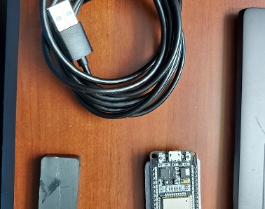
Experimental Set-up
Materials List:
ESP32 microprocessor
Micro-USB cable
Magnet
Notes:
Using the ESP 32 microprocessor one can demonstrate how a magnet can influence the Hall sensor located inside the processor. Square or Rectangular magnets have a north-pole (-) and south-pole (+) end and depending on which end is being used the measurements can be either positive or negative.

Slide 29
Halls Sensor (Raw Data)
Notes:
The microprocessor has been programmed to collect a 1000 readings, then find the average of those readings and finally to get the actual value of the magnetic level. The following slide shows the graphical representation of those reading allow one to visualize the affect the proportional voltage had on the magnetic field as the magnet was moved back and forth using first one end and then the other.

Slide 30

Data Analysis (of Halls Data)
Notes:
The magnet used in the Hill Experiment has a North-pole (-) and South-pole (+), as the magnet is moved closer to the sensor the magnetic flux increases which is in indicated in the graph when the blue line climbs from zero to positive three, then drops as the magnet (object) is move away from the sensor, causing the flux field to drop down to two and when object is brought closer the reading increases to three on the graph. The North-pole (-) magnet has the same effect on the right except that the readings are in the negative numbers.
The Hall sensor has a very broad range of applications throughout technology. The most significant areas are 1) The digital Hall Effect Sensor Automotive (i.e., crankshaft that sensing the position of the crankshaft to determine the proper firing of the spark plugs, or analog type sensor used in monitoring/control of the ABS braking system. 2) Appliances and Consumers goods where the Digital unipolar sensors are used in washing machines to keep the machine balanced during use or analog sensors used in power supplies or the to feed paper into a copier machine. 3) Fluid Monitoring which uses the digital effect sensor to track the flow rate and valve position in places like water treatment plans or the analog Hall effect sensor use to pressure level of the diaphragm pressure gauges. 4) Automation digital proximity-sensing in automatic toilet, sinks for example, and 5) Personal Electronics both the analog and digital Hall effect sensor in such products as disk drives (analog) and the timer (digital) on a photographer’s camera.

Slide 31
Knowledge Gained
Challenges
    Time management
    Corrupted files
    Inaccurate readings
Skills
    Higher confidence
    Better communication
    Problem solving
Notes:
I felt that one of the biggest challenges I encountered during this course, was time management. Normally, I am a well organization person and have allotted adequate time for any task I undergo. However, I found that during the first few weeks I had serious problem with achieving individual/project deadlines. At first, I attributed this to having to work more hours for my employer, but by beginning of the third week I realize that it was also in-part because I was not able to fully grasp the mathematical procedures (correct theories applied) for the task at hand. My second hurdle was corrupted coding files, which I was able to resolve by reading each line of the coding and finally discovering that my readings were inaccurate because I was not correctly applying theoretical (mathematical) equation

Slide 32

Conclusion
Newton’s Law
Hooke’s Law
Hall Effect
Notes:
In the analysis of this experiment, I applied three principles of physics: “Newton’s Law”: 1) Law of Motion is that an object at rest will remain at rest unless an eternal forces is applied to the object, 2) states that by applying force the object will speed up and the larger the object the more force required to move the object, 3) is that for every action there is an equal and opposite reaction, for example if you push the vehicle the same amount of force is pushing against you. “Hooke’s Law” is the law of elasticity, meaning that the size of the deformation is directly proportional to the bending force or weight. The final applied physics principle is the “Hall Effect” which was used to visualize the effects of a magnet field when a proportional voltage is applied (Lammle, 2020).
As a Cybersecurity Specialist I will be able to apply these theories to when analysis data in preventing cyber crimes or in understanding how much force is needed to be able to secure a room with a magnetic locking system.

Slide 33
References
Adib, Ph. D., N. (2021, August 21). Module 5 - Project: Convert Radial Displacement To Linear Displacement Using The Rotary Encoder. Retrieved from DeVry University: https://devryu.instructure.com/courses/70179/pages/module-5-project-convert-radial-displacement-to-linear-displacement-using-the-rotary-encoder-due-by-end-of-week-6?module_item_id=8821440
Lammle, T. (2020). CCNA Certification Study Guide. Hoboken, NJ: John Wiley & Sons, Inc.

