Slide 1
Fundamentals of Information Technology & Networking ll
Devry University
NETW200- Professor Alan Rynrzewski
By Aaron Scheafers
April 29, 2020

Slide 2
Fundamentals of Information Technology & Networking ll
The final course project covered the following six topics:
  Importing Virtual Machine software into VMware
  Subnetting & VLAN (Virtual Local Area Networks)
  Assessment of Vulnerability
  Password Management
  Monitoring Network Performance
  IP Routing

Slide 3
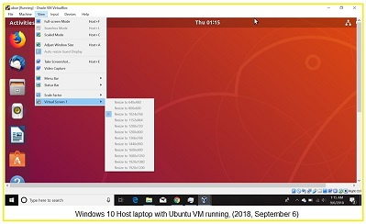
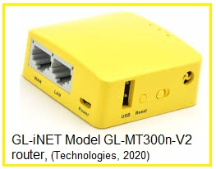
Fundamentals of Information Technology & Networking ll
Initial Network Diagram
Laptop
LAN
Power
USB connection
NIC connection
WAN
Notes:
The Laptop OS is Windows with VM Player 15 that is hosting the installed Ubuntu Virtual Machine (VM), this same host machine will also be running another VM environment known as Kali which required an additional installation.

Slide 4
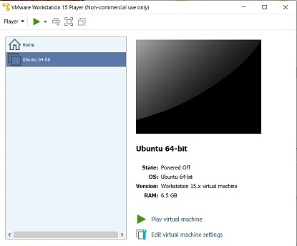
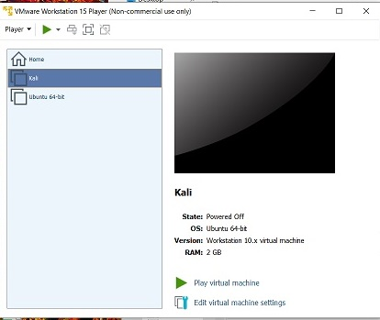
Fundamentals of Information Technology & Networking ll
Notes:
The image on the left demonstrates that one can access the VMware player and that Ubuntu is already installed and the image on the right shows that the Virtual Machine software known as Kali was successfully installed using the OVF file located on a different computer using the software. Now the technician working from this location (laptop) can work with (either or both) these virtual machine environments. OVF files are a collection of multiple files in a single directory. Generally, this file will consist of hardware requirement, network description, list of virtual hardware, virtual drives, certification files and information about the OS. OVF is one of serval standards supported by the Distributed Management Task Force according to TechTarget.com (2012, May). Whereas an ISO file is a copy of the entire source such as a CD or DVD according to Power Software Ltd, 2004-2020).

Slide 5
Fundamentals of Information Technology & Networking ll
Definition and purpose of following terms:
     DHCP
     Bridging
     Confirmation of IP addresses
     Testing Connectivity
Notes:
Dynamic host configuration (DHCP) in the OSI model is part of the application layer in the of the TCP/IP suite and manages the distribution of IP addresses on for the network. Bridging allows the vNIC (virtual NIC) to obtain its own IP address, default gateway and subnet mask information from the physical LANs DHCP. We can confirm what IP addresses are for the Ubuntu VM and test the connectivity by running specific commands in the terminal window of that program as shown in the following slide(s), (Jill West, 2018).

Slide 6
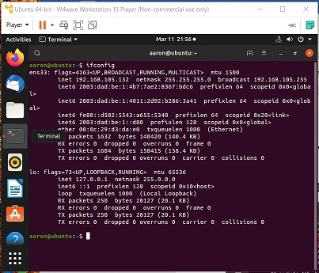
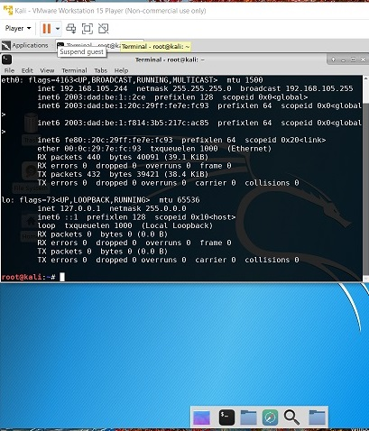
Fundamentals of Information Technology & Networking ll
Confirmation of IP addresses
Confirmation of the IPv4 assigned to the GL-MT300n-V2 Travel Router in the Ubuntu VM
Confirmation of the IPv4 assigned to the GL-MT300n-V2 Travel Router in the Kali VM
Notes:
In these displays within the terminal command window of both the Ubuntu and Kali VMs the command “ifconfig” was used to show the information for the IPv4 address that was assigned by the physical LAN’s DHCP. Now to confirm the connection is working and that the each of these VMs can communicate with each other and the host machine the technician can use the command “ping” as shown in the following slide.

Slide 7
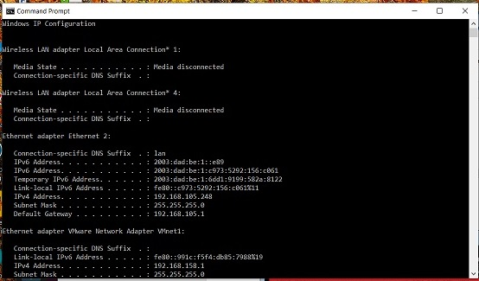
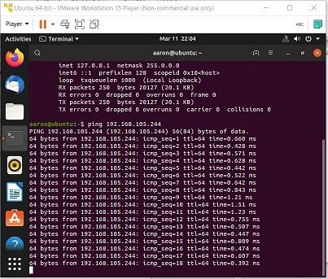
Fundamentals of Information Technology & Networking ll
Testing Connectivity
Ubuntu results when IP for Kali was pinged.
Kali IP address
Notes:
(Upper left) Shows the Windows 10 Command Prompt window where the technician ran the command “ipconfig” to confirm the status of the Wireless IP Configuration. The middle image shows the IPv4 address assigned to Kali, and the final image on the right, shows the results received when the technician entered the Ubuntu terminal command “ping 192.168.105.244” which is the IP address of the Kali Virtual Machine (Schaefers, 2020), these successfully ping result let the technician know that Ubuntu and Kali are able to communicate with each other.

Slide 8
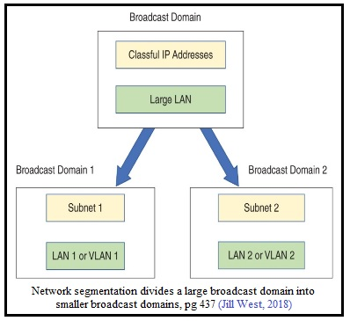
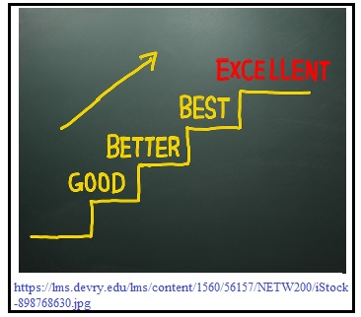
Fundamentals of Information Technology & Networking ll
Subnetting & VLAN (Virtual Local Area Networks)
Questions:
What do these terms mean; Network Address, useable Host Addresses and the Broadcast address?
What is Subnetting (segmenting) a network mean?
Advantages of segmenting a network and why it is done?
What are the formulas and rules for subnetting?
Notes:
The following three terms, Network Address, useable Host Addresses, and the Broadcast address, have a vital role in every network, as follows: Network Address: The first three octets of a Class C IP address that identifies the network portion, Useable Host Addresses: Is the fourth octet of the IP address that represents the host portion of the network’s IP address. Broadcast Address: is a network address that receives data that can be received by all hosts on that network (Jill West, 2018).
Subnetting (segmenting) a network is where the Network Technician take the primary network and segments into smaller networks, where each network segment has its own domain. Three benefits of Subnetting (segmenting) a network are; 1) improved performance because it limits the about of traffic on the broadcast domain, allowing for more efficient use of bandwidth increasing the overall performance of the network, 2) Troubleshooting, rather then having to examine an entire network the technician can narrow down the problem to a specific area, for example if all the email the technician/administrator about a problem are coming from one department, he/she would be able to look at just that one departments portion of the network to start determining where the issue is located, and 3) Improved Security, because transmission within that broadcast domain are limited to each network, making it harder for intruders to reach protected networks within the organization network. An example of this is a DMZ (demilitarized zone) which is an area of the network surrounded by two firewalls, generally the first (external) firewall that is more types of traffic into the network and the second (internal) firewall that is hardened to provide greater protection to the internal network (Jill West, 2018). The formulas and rules for subnetting and VLANs are discussed on the following slide.

Slide 9
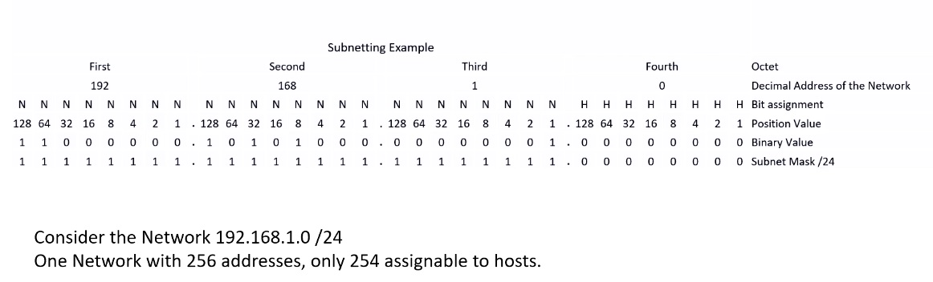
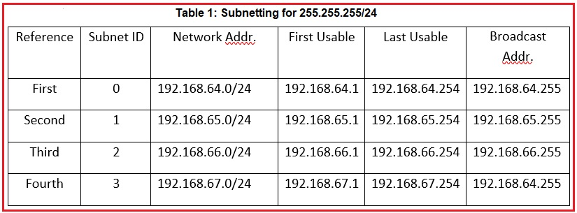
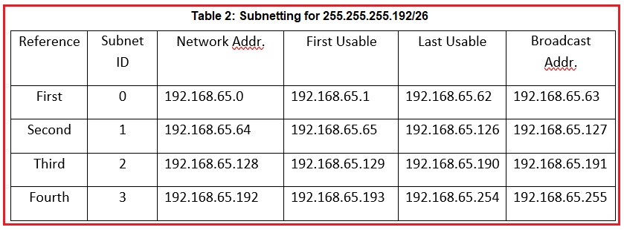
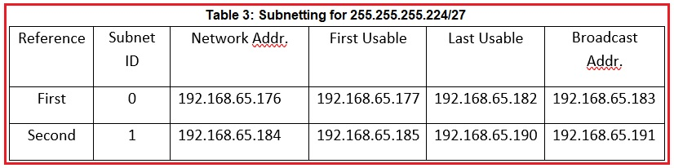
Fundamentals of Information Technology & Networking ll
Example of how-to subnet an IPv4 Network
192.168.64.0/22 (the original network)
The binary code for 192.168.10/24
Notes:
When a network is segmented into multiple smaller networks, traffic on one network is separated from another network’s traffic and each network is its own broadcast domain. For instance, devices connected to a hub belong to the same broadcast domain.
A network administrator might separate a network’s traffic into smaller portions to achieve the following benefits. The three tables show the subnetting of the primary IP address (Schaefers, 2020)
First we realize that the /24 means that the first 24 bits are network bits. We cannot manipulate those bits at all. What we can manipulate are the host bits.
Second we realize that the host portion has 8 bits. So if we want to generate two subnets, we need one bit to achieve that (one bit gives two possibilities; 0 or 1). So that extra bit comes from the 8 host bits (the left most host bits; x0000000). So we repurpose this host bit from being a host bit to being a network bit (even though it resides in the fourth octet in this example).
This bit is either a 0 or a 1. When it is a 0, the fourth octet is 00000000, which is a 0 in octet, and the subnetwork address is 192.168.89.0/25. The reason for /25 is the original 24 bits in the network portion, plus the 1 bit that we repurposed from being a host bit to a network bit. Now when that borrowed bit has a value of 1, the fourth octet becomes 10000000, which is a 128 in octet, and the subnetwork address is 192.168.89.128/25.

Slide 10
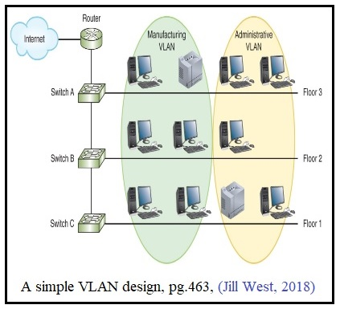
Fundamentals of Information Technology & Networking ll
Subnetting & VLAN (Virtual Local Area Networks)
Notes:
The creation of VLANs allow for the following, the isolation of connections with high or unpredictable traffic, to identify groups that should be given higher priority handling, groups with special security needs or functions, the configuration of temporary networks, and reducing the cost of networking equipment. By creating a VLAN the organization is able to isolate each group in to a private/isolated LAN even though they may be connected to separate switches on different floors in different physical (building) locations as shown in the above illustration (Jill West, 2018). When setting up VLANs security remains important there for using tagged or untagged ports is just as important. It is a good recommendation to use the tagged option any time you have VLAN’s or a private network which is being separated from the rest of the network. A tagged port sends traffic to several VLANs whereas an untagged port will only accept traffic from a single VLAN.

Slide 11
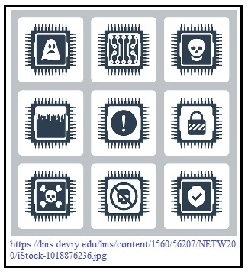
Fundamentals of Information Technology & Networking ll
Vulnerability Testing
Solution to People Risk:
Proper training of Employees on recognizing security risks, background checks when hiring new employees, and implementation of security protocols.
Solution to Technology Rick:
Quarterly Security Risk Assessment
Vulnerability assessment
Penetration testing and
Red team-blue team exercise
Notes:
While a network’s vulnerability can come from a variety of areas ranging from natural causes such as some sort of natural disaster or an unintentional action of an employee, such as accessing an email that has virus or malware attached to it. However most can be generally categorized in to three area: 1. Natural Disasters, which are the acts of mother nature such as hurricanes, tornado, flooding, or major power outage, 2) People, for example Phishing, baiting, Quid-pro-qro, or other people related risks, Tailgating and 3) Technology these are attacks that focus on take advantage of human errors, such as spoofing attack, DNS poisoning (another type of spoofing attack, Virus, Trojan horse, Bot and Ransomware to name just a few. To elaborate (paragraph on left) on ways to solve People Risk, an in-depth training program that teaches employees how to recognize when someone is phishing for information weather in person or via an email, understanding that tailgating is when someone wants to enter the facility claiming that he/she is just making a delivery or had forgotten his/her security credentials, and why it is important that the employee has a password that is strong and that he/she secure the their login and password information in a locked drawer if he or she must write it down and to never leave his or her workstation (computer) without logging off the network first. (paragraph on right) Security Solution should be include programs that can monitor the network and notify the network administration when there is a breach in the network. Security Risk are ranked in three severities; High, Medium, Low and how each of these can be setup so that depending on the severity as to when/how the Administration is notified. There are numerous programs available that can aide the development of strengthening a networks security. Program like Nmap, which identify what devices are running on the network and discovering all the available hosts and their services that are available. Nmap also identifies open ports. Setting up a VM with the metasploitable server allows the technician to have an actual target machine without putting the rest of the network at risk. Another program is OpenVAS (Open Vulnerability Assessment System) which contains a set of tools that work together and runs a series (database) of known exploits and weaknesses to determine how well the network’s security measures are against known attack vectors, according to an author for Digital Ocean, LLC (Ellingwood, 2014). The next two slides show a screen shot of the NMAP and Greenbone Security Assistant (a website that runs similar to the OpenVAS) results ran on my personal network.

Slide 12
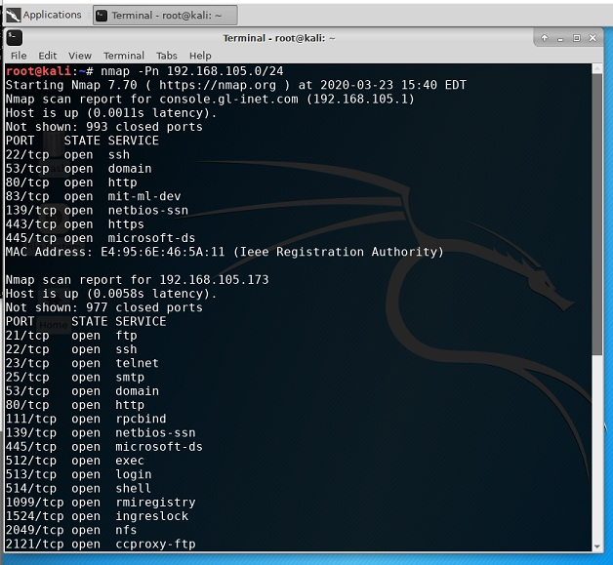
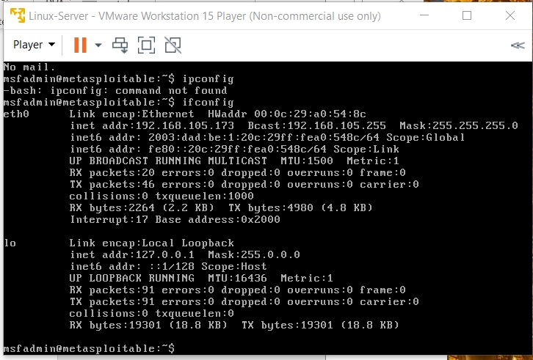
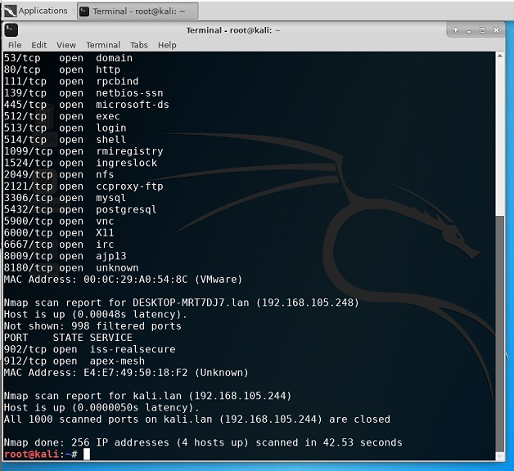
Fundamentals of Information Technology & Networking ll
Screenshot of NMAP Results against the metasploitable Linux Server (Kali)
Notes:
The first two screen shots show that the Kali (VM) terminal window displaying the results of the command “nmap –Pn 192.168.15.0/24” the results show that there was are seven different open ports and that there were 993 (ports not shown) closed ports as well as the MAC address is from Ieee Registration Authority, and that there was a 0.0011s latency) in bring up the host (Schaefers, 2020). We also see that Nmap ran a scan on the IP address of 192.168.105.173 there was a 0.0058s latency in the host response. 977 closed ports and many more open ports and that the MAC Address is VMware and finally we see that the Nmap report from the Kali.lan (192.168.105.244) has a latency of 0.0000050s and that all 1000 ports were closed. In the final screenshot using metasploitable the command ipconfig –bash: ipconfig was given but failed on the ethO and was then sent to the loopback .

Slide 13
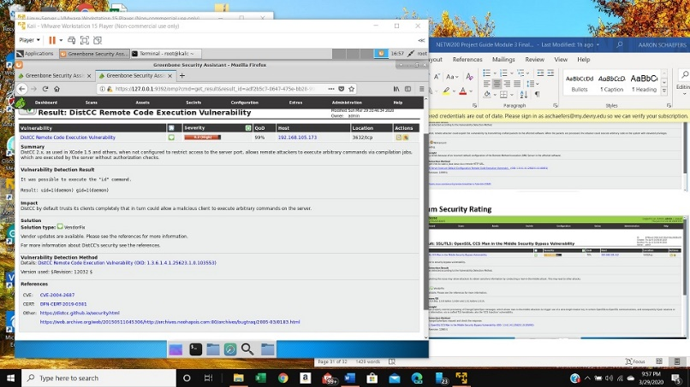
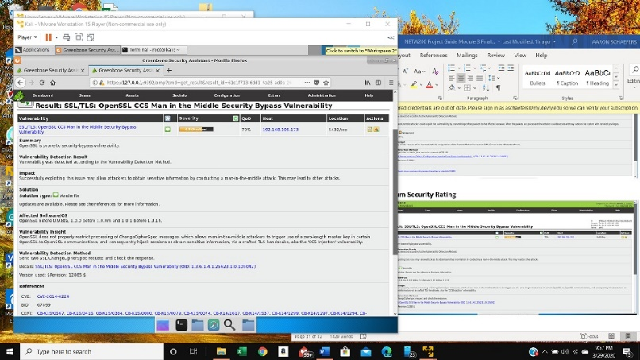
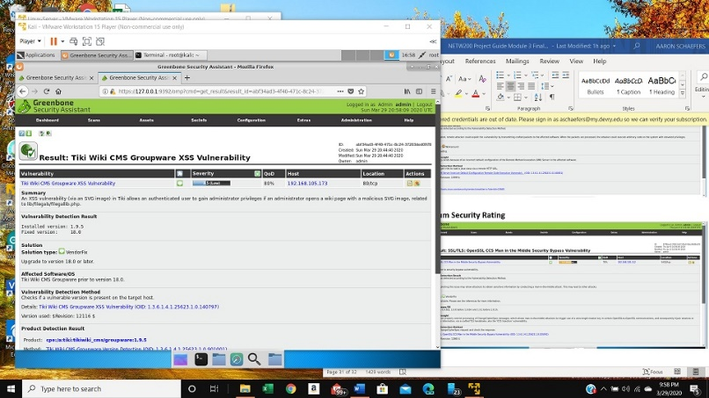
Fundamentals of Information Technology & Networking ll
Screenshot of the OpenVAS results, at the different levels of risks: High, Medium, and Low
High Risk
Medium Risk
Low Risk
Notes:
Greenbone Assistant also give recommendation on what actions can be taken to resolve the risks to the system depending on the level of severity. For example: The vulnerability found under
High Risk: it was able to execute the “id” command, the solution is run the available Vendor update.
Medium Risk: System is vulnerable to a “man-in-the-middle” attack which could lead to other attack as well. The solution recommended is to run the available Vender updates.
Low Risk: Had an XSS vulnerability and it is recommended that the software be upgraded to version 18.0 or later.
The various ranking of the amount of risk allows the network administrator decide what risk need to be taken care of right away, in a few days and by the end of the month, so that the overall network is kept stable and as secure as possible (Schaefers, 2020).

Slide 14
Fundamentals of Information Technology & Networking ll
Password Management
How passwords are stored in Linus
Safeguarding passwords with “password salt”
Ways to uncover week passwords before an attacker can break and gain unauthorized access to the network and its resources.
Notes:
A vital part of any organization is security, this is especially important when it concerns the organization’s network, which is one of the primary tasks of any network administrators responsibility, because a security breach of the network itself weather that breach is from within the organization (meaning it could be an accidental breach or possible a breach from a previous disgruntled employee) or even worse it could be from an unknown individual such as a hacker whom is someone from outside the organization that is trying his/her best to gain unauthorized access to the company’s data. Let’s start with few terms that as a technician or network administrator one is likely hear often, such as what is a shadow file, why is a password salt a safeguard, and how does John the Ripper and FreeRADIUS useful? The “FreeRadius” (Remote Authentication Dial-In User Service) is an open-source and standardized program, which operates on a remote server and highly scalable that can be used to authenticate a various types of users (wireless, mobile or remote) and is often combined with on services on a single machine (DeVry, Module 4, 2020).
The shadow file is an encrypted file located on a Linux system in the /etc/shadow file. The term salt is when the original password encoded with a randomly value “key” between 1 and 4096 and is a one-way hash (the term hash will be explained shortly) creating an encrypted (salted) password, which is then stored by Linux in the etc/shadow file. This file is only available to those individual that have authorized access to the root directory (Rouse, 2007). A hash is a file that use a cryptographic algorithm with a numerical value to identify the file. This allows the administrator the ability to evaluate if the original file has been significantly changed since its original creation (Trend Micro Incorporated, 2019). There are a couple of commonly used programs that can help the administrator/technician use. John the Ripper (JrT) is a password cracking program that technicians can use when preforming system security audits see illustration on next slide.

Slide 15
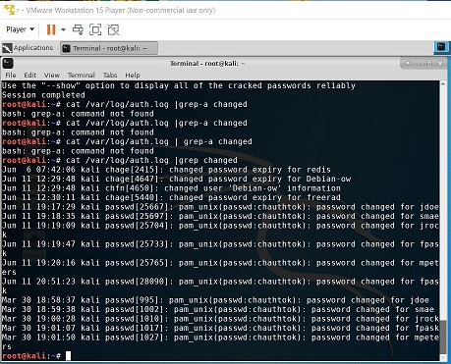
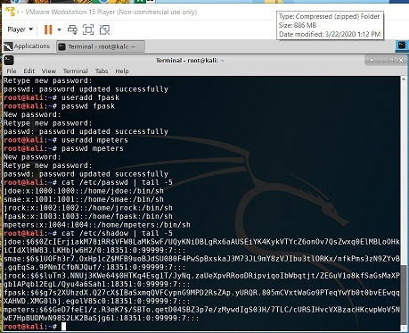
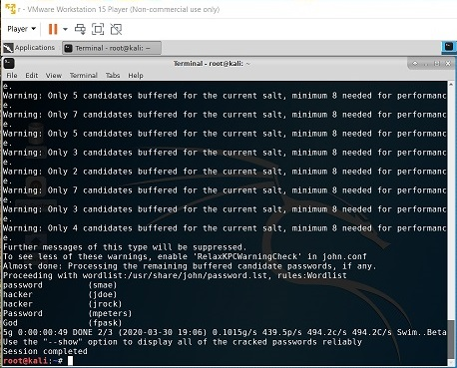
Fundamentals of Information Technology & Networking ll
Notes:
Explanation of screenshots from left to right: (left) The command terminal window of kali showing the result of the /etc/shadow file including the password hashes of the last five recently created new user accounts, (middle) result from the use of the JrT (John the Ripper) software to crack passwords and the final screenshot (right) displays all the result of viewing the c/var/log/auth.log. This log helps keep track of potential security risks and/or internal misuses of information. This help ensure user follow all document protocol and assist in prevent or tracking down fraud. These logs should be reviewed often enough to detect security incidents as early as possible (Schaefers, 2020).

Slide 16
Fundamentals of Information Technology & Networking ll
Network Performance Monitoring
The importance of performance monitoring and three programs that are commonly used by administrators and/or technicians.
EtherApe
Monitorix
WireShark
Notes:
The following three slides show some of the graphical representation of each of these programs and some of the features that each of these programs offer to the user. Overall the primary goal of these types of programs is to provide a central area where the system administrator/technician gain visibility into the network’s traffic/packet flows. The ability to take a proactive role in resolving any issue relating to performance, reliability, availability, scalability, and manageability issues to prevent any failures before they happen.

Slide 17
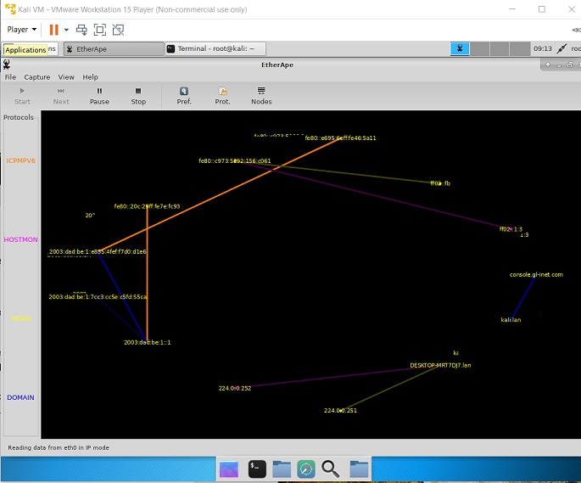
Fundamentals of Information Technology & Networking ll
Network Performance Monitoring – EtherApe monitoring
Notes:
EtherApe: a graphical, packet sniffer, network monitoring tool. That can be used in real time or can create a dump file that can be read from a dump file (which is the capture of network traffic that is dumped into a file). This image (Schaefers, 2020) illustrates the traffic of the network. Showing the IP addresses of each as packets pass through the network.

Slide 18
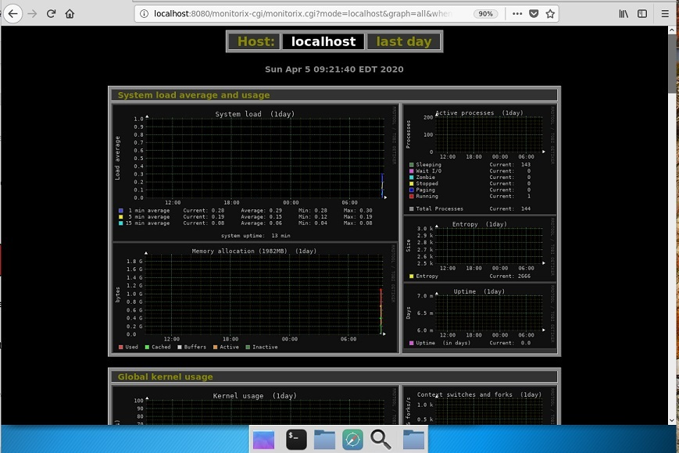
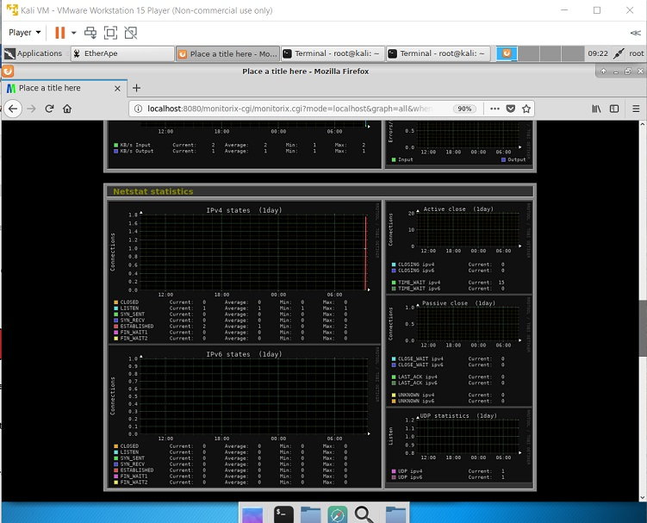
Fundamentals of Information Technology & Networking ll
Network Performance Monitoring – Monitorix monitoring
Notes:
These images (Schaefers, 2020) shows over a 1-day time period the following information: System load average and usage, Global kernel usage and Netstat statistics of the IPv4 and IPv6 states, according to the graphs there was a lot more IPv4 traffic then IPv6 during this time period. These reports can be reviewed and used in the future as a baseline comparison to future reports. While Monitorix allows for the monitoring of the overall system it can also detect bottlenecks, failures, prolonged response times and other abnormalities.

Slide 19
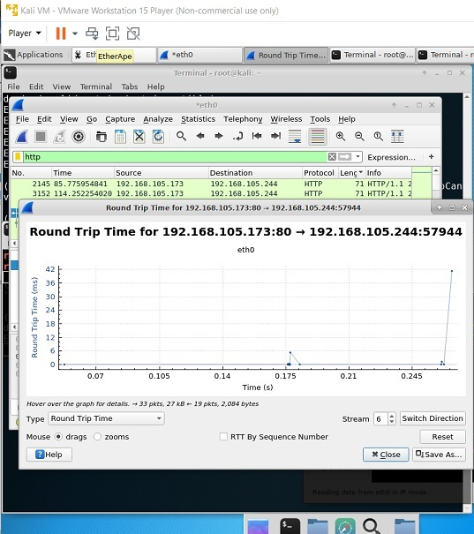
Fundamentals of Information Technology & Networking ll
Network Performance Monitoring – WireShark monitoring
Notes:
WireShark intercepts network data packet in real-time and then stores it so that it can be reviewed in an easy to read user interface. An example is this image (Schaefer, 2020) of the performance of the HTTP traffic between the Kali VM and the Linux Server VM. The use of filters in this program allow the user to focus on the packets of importance based on the “protocols” setup by the user.

Slide 20
Fundamentals of Information Technology & Networking ll
IP Routing
IP routing is the process of sending data from a host on one network to the reciepient (host) on a different network.
Define Loopback Interfaces and what they are used for?
ICMP Ping Testing without the need for dynamic/static routing
The difference between a Physical interface and a loopback Interface.
Notes:
As an organization grows its needs for additional LAN segments in their network. Network administrators are often called upon to develop new VLANs that can support these additional needs. A successful network administrator/technician will use a methodical approach that includes the planning, design, implementation, testing, operating optimization and the decommission. Using Layer 3 switches (know as multilayer switches (MLS)) or routers. The use of Loopback interfaces is primarily used to test the communications infrastructure because they are always available even with the physical interface(s) in the router are down. When the original network is setup the administrator had to assign the IP address(es) for any subnet(s). By turning off the Wi-Fi connection the technician can successfully run the ICMP Ping Test which loopback through the subnet of the router(s) to the host’s gateway IP address. Finally, the difference between the physical interface and a loopback interface is that the physical interface is like Fast Ethernet or Gigabit Ethernet interface and the Loopback interface, is a logical or virtual interface in a Cisco Router.

Slide 21
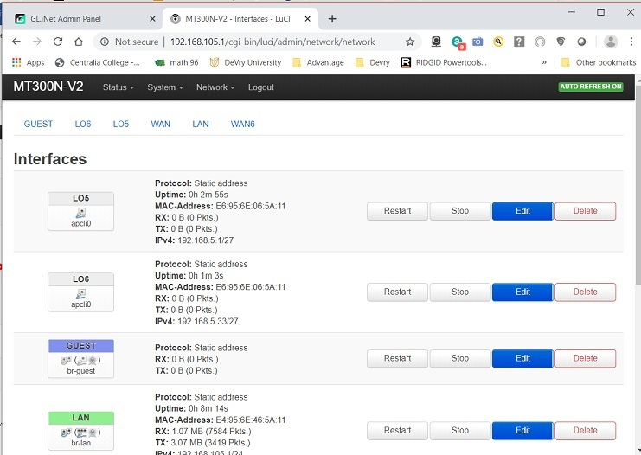
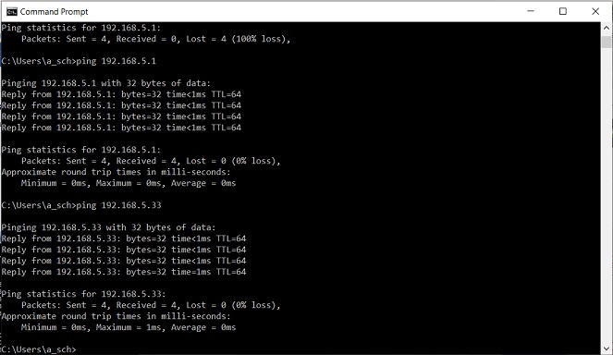
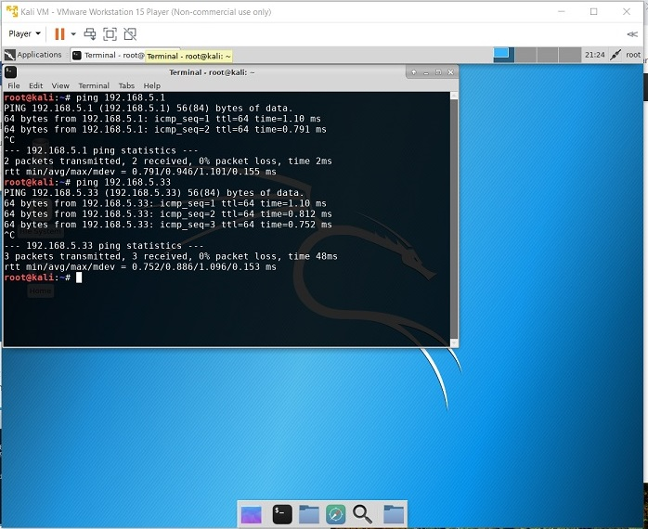
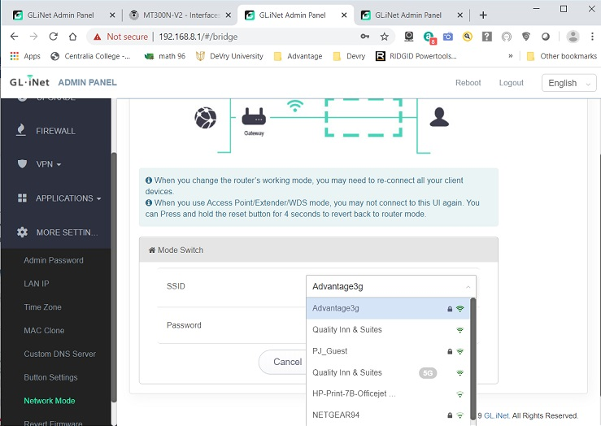
Fundamentals of Information Technology & Networking ll
Notes:
This shows the configuration of the loopback 5 and 6 IP Addresses (top left), Ping results from the Host computer and the two loopback interfaces (top right), in the bottom left is the results from the ICMP Ping testing from the Kali VM and both loopback interfaces, and finally on the bottom right is the screenshot of the WLAN SSID in the extender configuration window of the AR-750 router (Schaefers, 2020).

Slide 22
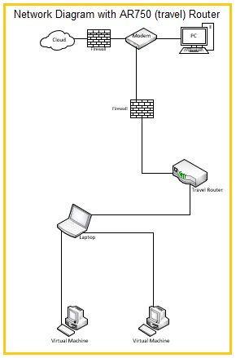
Fundamentals of Information Technology & Networking ll
Notes:
New topology of the network (Schaefers, 2020).

Slide 23



Fundamentals of Information Technology & Networking ll
Conclusions
Challenges
Benefits
Goals
Notes:
There were two primary challenges during the past eight weeks the first was during the second week when students needed to understand binary codes role in creating new IP networks. While I understood the basic of the binary code in relation to the Network address, I had struggle understanding the how to determine the hosting portion of the IP address. To work past this struggle I attending class live chat session, huddles, and accessed several YouTube video tutorials that are readily available on the internet. Which gave me a better understanding of how to manually convert an IP Address into binary code. I also realize that this is a skill that as I use it more often, I will become more efficient in making the conversions. Another skill that I was able to improve on during this course was understanding how important a role that security plays withing the IT environment itself and not just as part of the physical daily operations of an organization. The second was dealing with the effects of the pandemic had on time manage skills. Prior to the pandemic I had a set routine that allowed for ample study time, family/personal time and the obligation to my employer, however because of economic shutdown where only essential business were operating it quickly became increasingly difficult to keep that balance. As an essential worker my work hours went from an average of 40 to 45 hours per week to an average of 80 – 95 hours per week. It quickly became apparent that finding a new routine was necessary. Although, it was difficult I have been able to find a balance that allows me to achieve, my academic goals of maintaining my honor role status, being there as an essential worker for my employer, and spending quality time with my family. What does the future hold? I am working towards completion of my Bachelor degree in Science with a focus on Cyber Security, will continue to seek opportunities within my current employment in which I can use these new skills, as the company grows I will apply for positions within the organization that will advance my career towards become part of the Cyber Security team.

Slide 24
Fundamentals of Information Technology & Networking ll
References:
DeVry. (2020, March). Module 4. Retrieved from RADIUS (Remote Authentication Dial-In User Service): https://devryu.instructure.com/courses/54432/pages/module-4-lesson-3-radius-remote-authentication-dial-in-user-service?module_item_id=6651932
DeVry. (unknown). Security Symbols. https://lms.devry.edu/lms/content/1560/56207/NETW200/iStock-1018876236.jpg.
Ellingwood, J. (2014, January 27). How to Use OpenVase to Audit the Security of Remote Systems on Ubuntu 12.04: Introduction. Retrieved from DigitalOcean, LLC: https://www.digitalocean.com/community/tutorials/how-to-use-openvas-to-audit-the-security-of-remote-systems-on-ubuntu-12-04
Jill West, J. A. (2018). Network+ Guide to Networks, Eighth Edition. Boston: Cengage.
Power Software Ltd. (2004-2020). What is ISO File. Retrieved from Power ISO: https://www.poweriso.com/tutorials/what-is-iso-file.htm
Rouse, M. (2007, June). shadow password file. Retrieved from TechTarget: https://searchsecurity.techtarget.com/definition/shadow-password-file

Slide 25
Fundamentals of Information Technology & Networking ll
References: (continued)
Schaefer, A. (2020, March - April 22-25). Screen Shots from personal computer. Centralia, WA.
Technologies, G. T. (2020). N300 Mini Wireless Router. Retrieved from gl-inet.com: https://static.gl-inet.com/www/images/products/gl-mt300n-v2/mango_1000x1000_2.jpg
TechTarget. (2012, May). open virtualization format (OVF). Retrieved from TechTarget Network: https://searchvmware.techtarget.com/definition/open-virtualization-format-OVF
Trend Micro Incorporated. (2019). Retrieved from Trend Micro: https://www.trendmicro.com/vinfo/us/security/definition/hash-values
Ubuntu. (2018, September 6). F62cP.png. Retrieved from i.stock.imgur.com: https://i.stack.imgur.com/9CaSp.jpg

