Slide 1
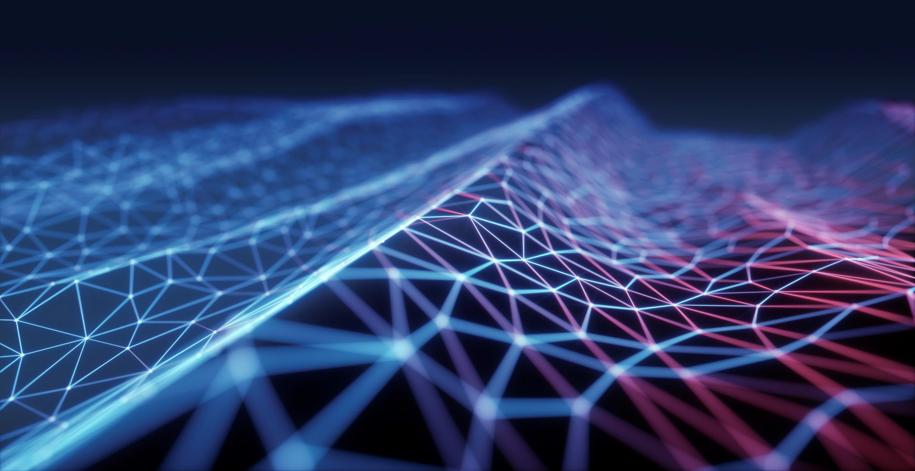
IoT Traffic Controller
By Aaron Schaefers
DeVry University
Introduction to Digital Devices – CEIS 114 Final Project
Professor M. Mortezaie
Due on December 21st, 2019
Notes:
I have always had a natural curiosity about how things work especially anything electronic, over the years though it has become significantly more focused on the inner workings of computers and the growth of the digital world. Which is what has led me to furthering my academic goals beyond just learning how to build a computer, but also to understanding the software and programing of them as well as how to ensure that the information and network system are secure from potential threats. Both on a personal home security level and within my career goals.

Slide 2
Introduction
Define - devices and system found in IoT
Name – electronic component in device
Understand – use of numbering system and Boolean logic in devices
Catalog – basic building blocks in digital systems
Distinguish – each integrated block within the digital system device
Clarify – the needs for networking and securing a digital device in IoT
Research – the evolving employment market in today’s digital world
Create a Multiple Traffic Light Controller with crosswalk, busser, and motion sensor
Notes:
Over the course of an eight-week class (M. Mortezaie, 2019) the student develops his/her skills in a variety of areas that will build on my knowledge digital devices, electronic components and how they can be integrated into the IoT environment that has become so much a part of our daily lives.

Slide 3
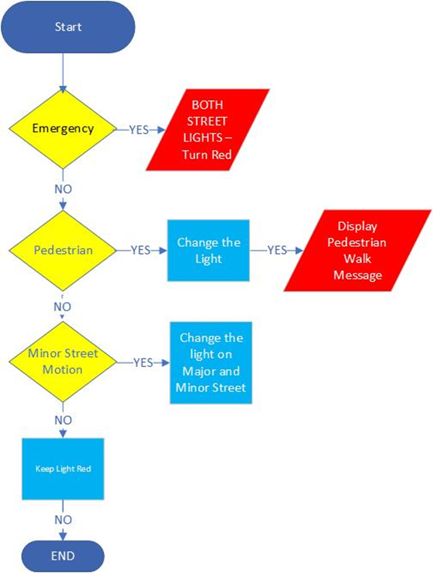
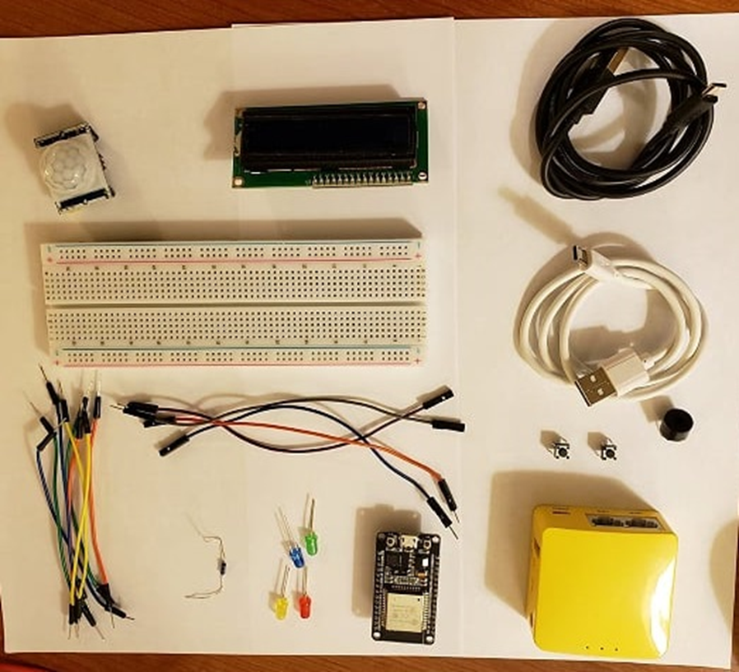
Components & Flow chart of basic Traffic Controller
Components of Basic Traffic Controller
ESP32 Board
Colored LEDs: Red, Yellow, Green, & Blue
Wires (male-male & female-male
Breadboard
LCD Unit
Buzzer
Mini Router
2 Push Button
2 USB cords
220 Ohm Resistors (optional)
Notes:
One example how we gather the materials (both physical and software) we believe we will need, to design, build, and demonstrate a working model of a Multiple Traffic Light Controller (the final project goal).

Slide 4
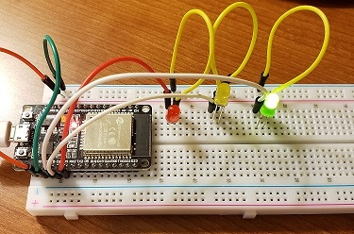
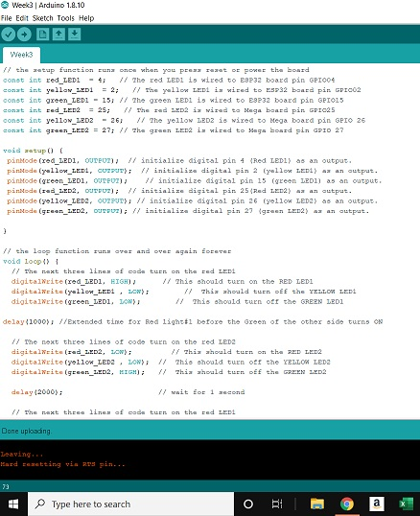
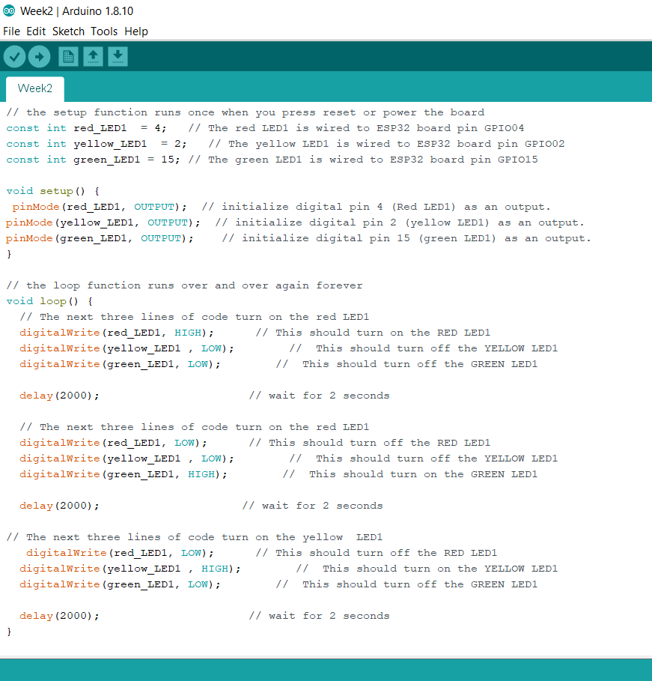
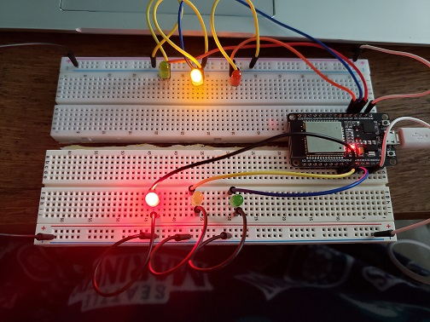
Assemble of Multiple Traffic Light Controller (part 1 of 3 )
Primary lights
&
sample of coding
Primary and Secondary lights
With
sample of coding
Notes:
Assembling the necessary components, in which I use the breadboard, an ESP 32 Board, necessary wires, and LCD lights to represent the primary and secondary traffic, in additional there is a screen shot of the Arduino IDE using the programming code to operate the lights of the traffic signal. working and the screenshot displays just the first page of the coding needed to make the system work correctly (on the left). One the right side is the traffic light showing that the primary street is in the process of changing from green to red with the yellow light lit while the secondary street still showing red, it will change to green next and the primary light would turn red.

Slide 5
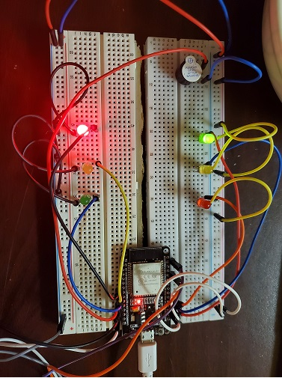
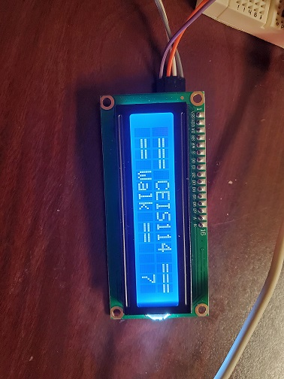
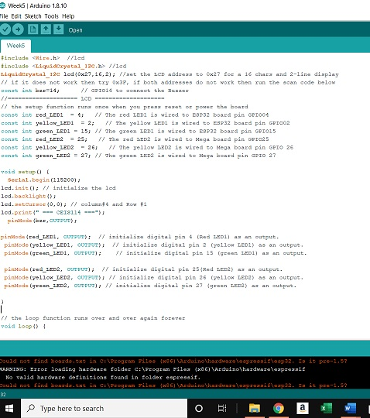
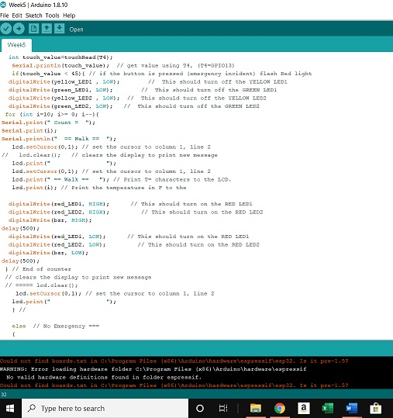
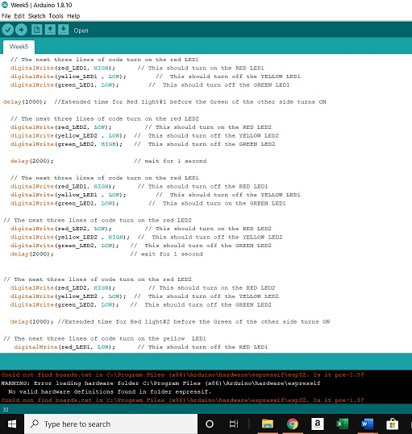
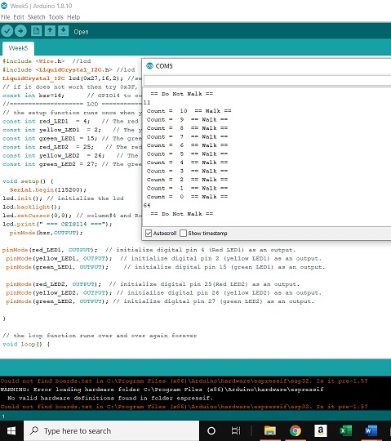
Assemble of Multiple Traffic Light Controller (part 2 of 3 )
Assembled Multiply Traffic Light Controller with Cross Walk & Buzzer
Picture of Circuitry &
displays for the program code.
Arduino IDE, programming code for the traffic light and crosswalk signal to work together.
LCD Unit –Displays Walk & Countdown (Arduino & COM5)
Notes:
Here we have the fully assembled basic Multiple Traffic Light Control and had add the crosswalk with busser. At first there was an issue with getting the LCD Display unit to work correctly due to programming and hardware issues. This presented a challenge at first but, although after checking and testing each component independently a faulty wire was replaced wire. Although, that did not resolve the issue of the LCD display not working. Although there was power to the unit it would not display the message which indicated a possible coding error. After reviewing the programing code and double checking the physical connections corresponded with the pin numbers in the code, I found the error was within the actual programming code, and entered the correct number for the pin, which resulted in the LCD display correctly receiving the appreciate message with countdown. At this point, I have a working model of the Multiple Traffic Light with a crosswalk.

Slide 6

Digital Communications
Cloud (option 1)
Local (option 2)
Notes:
As explained previously there are two options for the full operation of the Multiple Traffic Light Controller. In option 1 the light is accessing the Cloud by using a router and Wi-Fi to send command codes to control the changing conditions of the signal when a change is needed. Whereas in option 2 the use of two buttons, and a motion sensor is needed to the changes to take place. These two options will be highlighted in the next section of this presentation accordingly.

Slide 7
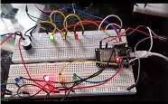
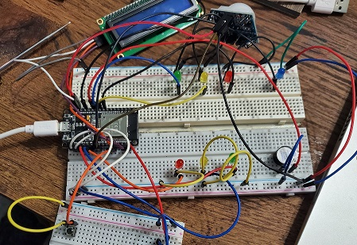
IoT Traffic Controller (option 1 & 2 Illustrations)
Cloud – Option 1
Local – Option 2
Notes:
The purpose here is to visually compare the differences between options 1 (on the left) and 2 (on the right) in the hardware used.

Slide 8
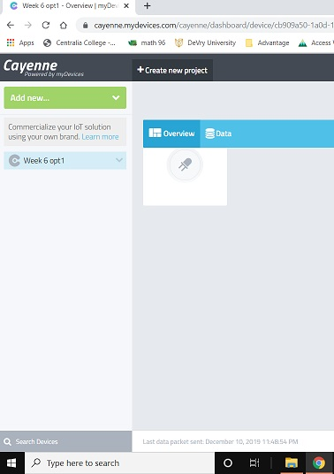
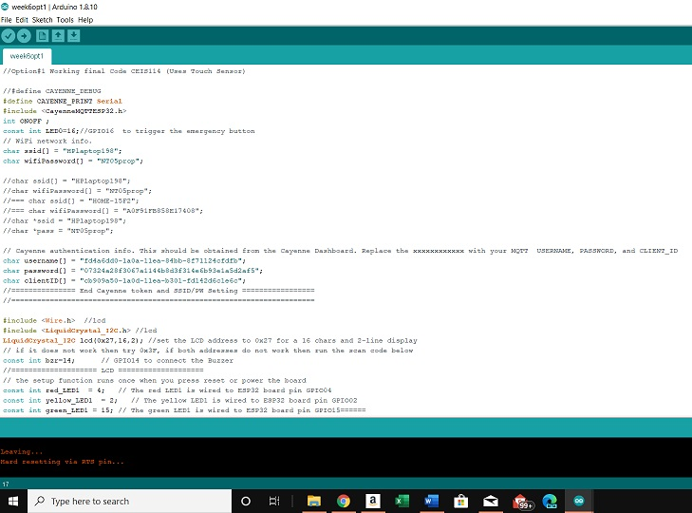
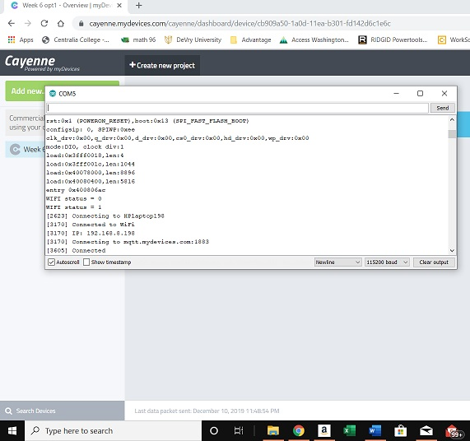
Completed Multiple Traffic Controller with Motion Sensor
OPTION 1 – Using the cloud, router and Wi-Fi in the operation of the traffic light.
Notes:
Here I am demonstrating the use of the cloud to operation my Multiple Traffic Light Controller. When you compare the picture of the Board in Option 1 to the Picture on the next slide for Option 2 the only difference are that in option one, we are using a router and Wi-Fi connection to the cloud, the software being used is Arduino and Cayenne. Because we are using the cloud, we no longer needed the 2 push buttons or motion sensor so they have been removed, although they could have remained these items were unnecessary for the actual operation of the signal and there to highlight the necessary items, they were removed from my demonstration model. The screenshot show the Cayenne software via Arduino being started so that the code can be uploaded, and the final screenshot shows the serial print out that the traffic light is operating correctly.

Slide 9
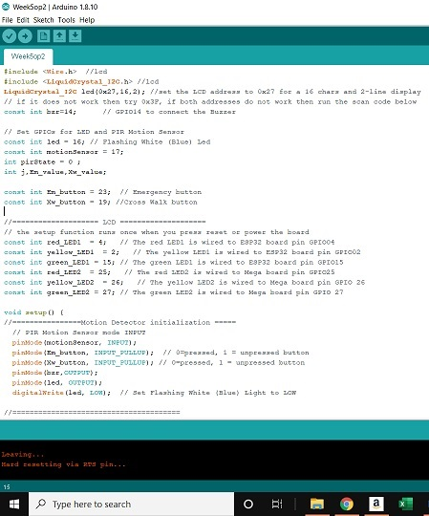
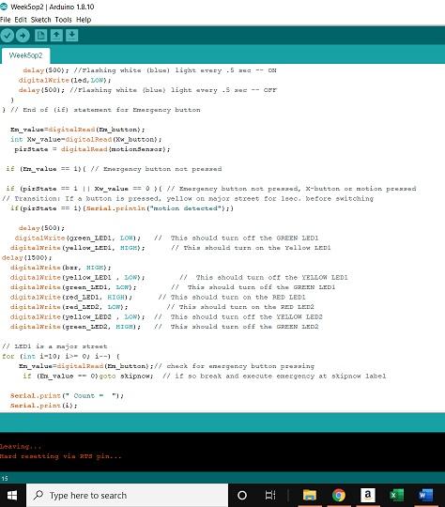
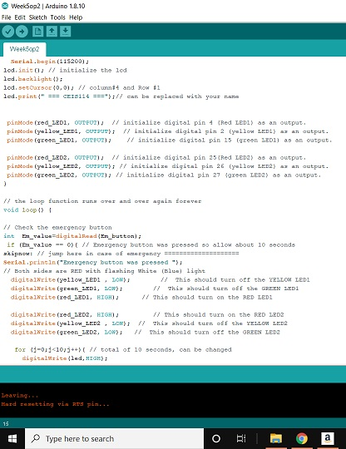
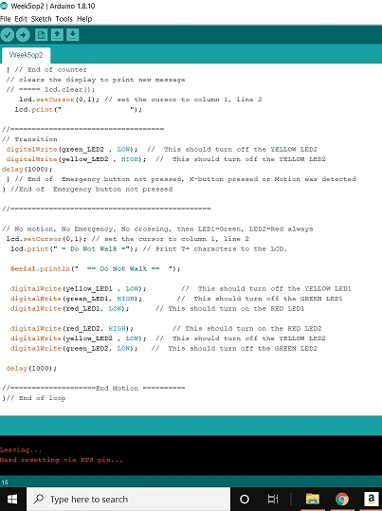
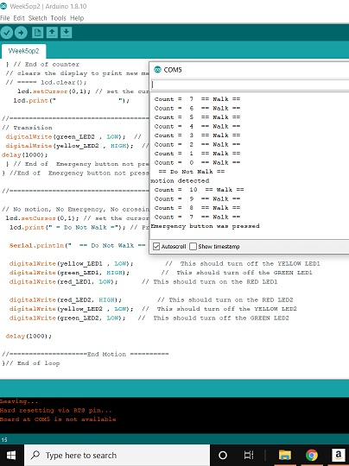
Completed Multiple Traffic Controller with Motion Sensor
OPTION 2 – use of motion sensor, and buzzer for operation of signal
Notes:
The upper left picture shows that the traffic light now has a two push buttons, motion sensor, buzzer, and a blue LED (to signal) emergency light along with the pedestrian crosswalk LCD display. The following five pictures show the Arduino Code and Serial message that indicates the activity of the traffic signal’s operation.

Slide 10
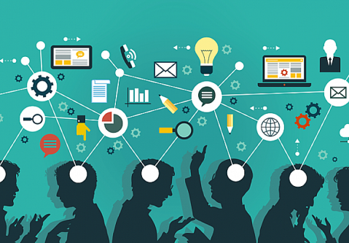
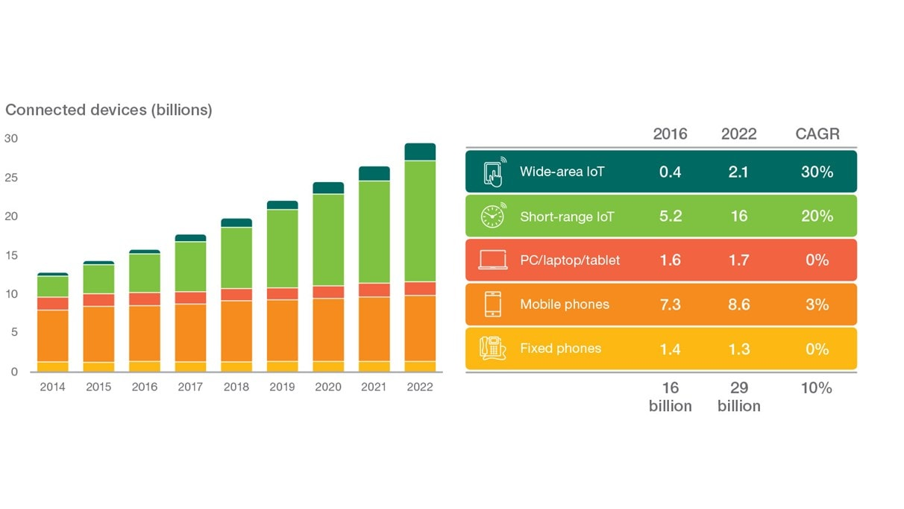
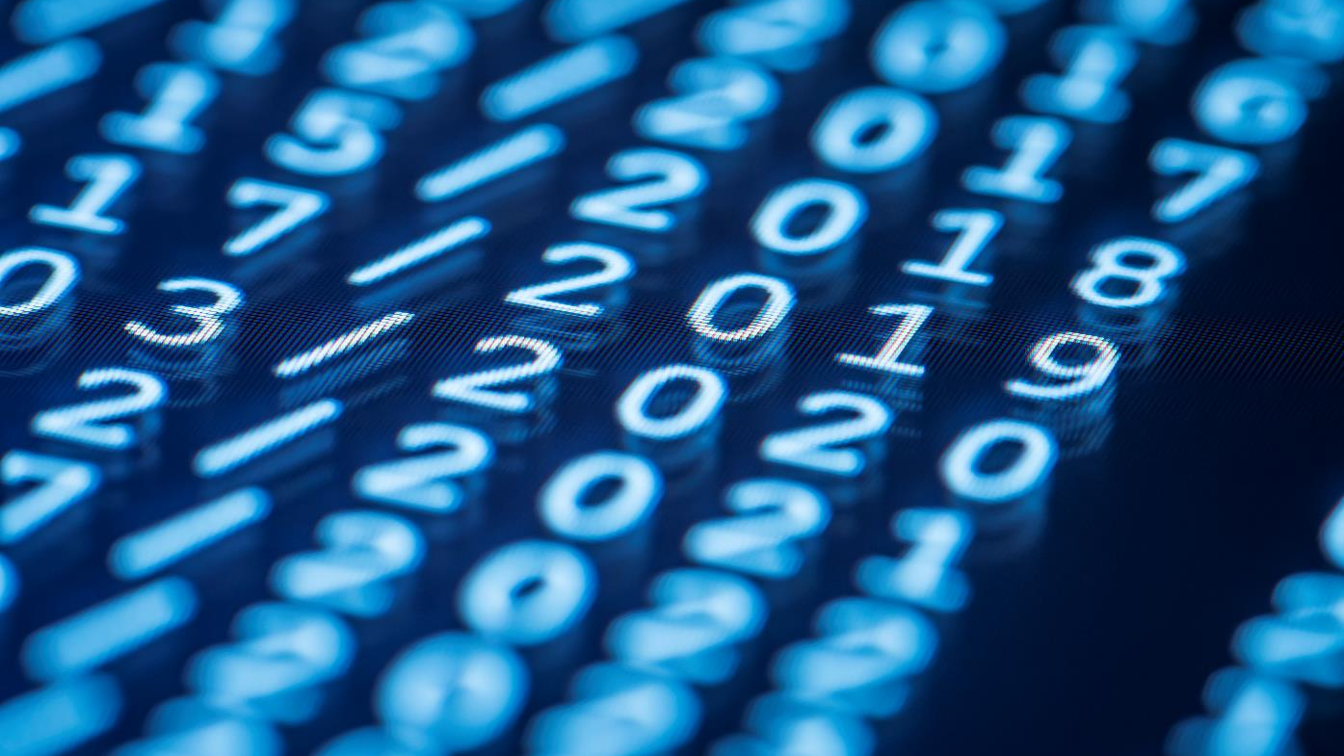
Skills gained
This Photo by Unknown Author is licensed under CC BY-SA
Operation of a traffic signal
Testing phase of a program
Minor programming
Differences in local and cloud operation
Communication
Security protocols
IoT device connections
https://www.ericsson.com/49df93/assets/global/qbank/2016/11/14/connected-devices-billions-v2.jpg?w=1212
Notes:
Having to build a working model of a traffic signal made me realize the necessity of understanding of how electronics and digital technology must be able to communication in a meaningfully manner. By physically building the signal one learns how the physical hardware is connected to the power source and then through various forms of circuitry how the data is collected and converted into data through the microprocessor(s) and the programming software, and the use of flow chart to show how the traffic light should respond to various conditions when fully operational. One might ask what the difference is between a local (hosted) and cloud-based services. According to Casey O’Loughlin of Star2Star Communications, it is a multi-tenancy, allows the sharing of resources and costs. With a larger customer (user) group it allows for centralization of location, thereby lower the costs, maximizing capacity, which improves the utilization and efficiency of systems that are generally used only 10 to 20% of the time (O'Loughlin, 2018). Most everyone can agree that technology plays a critical role in our daily lives. According to an article by ericsson.com forecasted there will be approximately 29 billion connected devices by 2022 but just as important is the forecasting that 18 billion (more than half) will be IoT related. One can see that IoT is only going to become more integrated within our daily lives. When on thinks about the use of technology in our devices we realize that it covers far more than just our basic Computer or Laptop devices we use at home or in the office. Now we have smart phone, tablets, homes, appliances, etc. but this should also raise the question of how secure are these devices? As consumers, employees, and in come cases business owners we all much address the issue of protecting ourselves from unwanted harmful attacks, regardless whether this information concerns our personal identity, the company’s clients or the company assets. Mike Fagan of National Institute of Standards and Technology (NIST) offers a “Core Baseline” guideline six recommended security features as follows: 1. Device Identification, 2. Device Configuration, 3. Data Protection, 4. Logical Access to Interfaces, 5. Software and Firmware Update, and 6. Cybersecurity Event Logging. A detailed description of these recommendation can be found on the NIST website (Fagan, 2019).

Slide 11
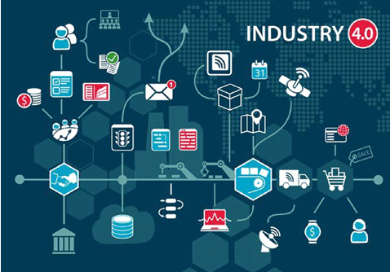
Challenges
Port Conflicts
Programming errors
Equipment Difficulties
Confusion on diagrams from two different boards
This Photo by Unknown Author is licensed under CC BY
Notes:
Port conflicts – The challenge was to figure out what device was already using the port and determine how to result the conflict.
Programming errors – twice this issue occurred due to the difference in the available pin number, this issue occurred be cause of a difference in diagrams.
Equipment difficulties – The only equipment issues that occurred was because of faulty wires and the brightness setting on the LCD Display, both issues were quickly resolved by replacing the damage wire and adjusting the contract setting of the LCD display.
Confusion on diagrams from 2 different boards – In some cases the pin needed per the diagram or instruction could not be located, however this was resolved when it was determined that the location was the same but the assigned name was different an example of this would be when it was referred as a alphanumeric title with it was actual pin number.

Slide 12
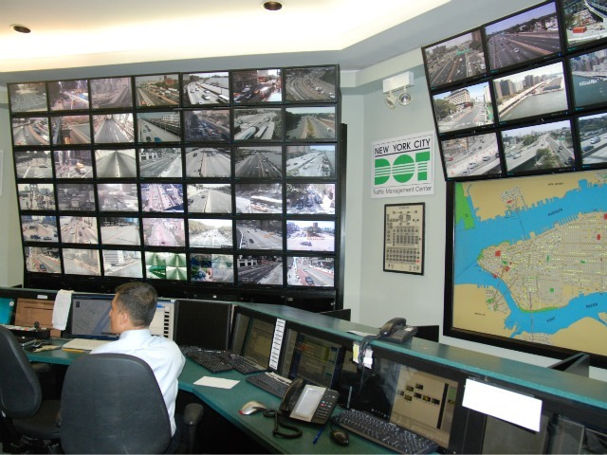
Conclusion
IoT Helping to Control Traffic
In Our Cities
This Photo by Unknown Author is licensed under CC BY-NC-ND
Notes:
In closing the past eight weeks I have learn just how the Internet of Things effects our daily lives. Over the years I have watched a small town grow and change from small tiny community with unprotected intersection to having a traffic light at nearly everyone. I never gave much thought to how the lights were designed or even to how they were controlled until taking this class. Now I realize that from the circuitry to the programming the importance of them is vital in societies ability to safely and effectively travel through the city to accomplish our daily tasks whether it’s going to work, school or take care of personal errands. However the knowledge I have gained through this class isn’t just in relation to physical development of a traffic signal. But it also made me realize just how much the IoT is involved in my daily life. Everything from my personal cell phone, computer, to the security system which protects my home. Perhaps even more importantly the realization that it is just the corporations and businesses that have a responsibility to uphold security but that the individual user’s too. I have always been interested in technology and computers, and my initial thought was to learn more about the software and how to become a systems administrator, however now I have discovered that I am more interested in the development of Cybersecurity.

Slide 13
References
Fagan, M. (2019, August 1). NIST Releases Draft Security Feature Recommendations for IoT Devices. Retrieved from National Institute of Standards and Technology (NIST): https://www.nist.gov/news-events/news/2019/08/nist-releases-draft-security-feature-recommendations-iot-devices
Kazis, N. (2011, July 20). High-Tech Midtown Traffic System Will Ignore Pedestrains and Buses. Retrieved from STREETBLOG NYC: https://nyc.streetsblog.org/2011/07/20/high-tech-midtown-traffic-system-will-ignore-pedestrians-and-buses/
M. Mortezaie, P. (2019, November). CEIS-114 Introduction to Digital Devices. Retrieved from DeVry University Syllabus: https://devryu.instructure.com/courses/50306/assignments/syllabus
O'Loughlin, C. (2018, June 28). The Differences Between cloud & Hosted Services. Retrieved from https://www.star2star.com/insights/blog/cloud-vs-hosted-services
Schaefers, A. (2019, November - December). Personal project pictures and screenshots. WA.
unknown. (2019, 08). picture - digital skills. Retrieved from This Photo by Unknown Author is licensed under CC BY-SA: https://geobrava.files.wordpress.com/2019/08/digital-skills-720x500.png?w=479
unknown. (n.d.). Industry 4.0 This Photo by Unknown Author is licensed under CC BY. Retrieved from This Photo by Unknown Author is licensed under CC BY: https://symbiosisonlinepublishing.com/robotics-automation/images/robotics-automation23-g001.gif

