Slide 1
The Network’s role and IOT
By Aaron Schaefers
DeVry University
Fundamentals of Information Technology & Networking I (NETW190)
Professor Donald McCracken
February 29th, 2020

Slide 2
Introduction
Planning
Building
Programming
networking
Notes:
Over the past several weeks we have learned what it takes to develop a local and wireless network in an area that doesn’t currently have internet access or that is wanting to update (expand) there networking abilities. Understanding the importance of properly planning, development and implementation of the network. How to develop one from the ground up as well as how to maintain or expand on an existing network. This presentation is divided into eight sections to demonstrate the knowledge and skills obtained during this course as follows: 1) Visio Network Design and the OSI model, 2) IPv4 and IPv6 Addressing, 3) Virtual Machine (VM) Dynamic IP Addressing, 4) Connectivity Test – Ping, 5) Make and Test Ethernet Cable, 6) WLAN Implementation, 7) Technology Careers and Opportunities, 8) Conclusion

Slide 3
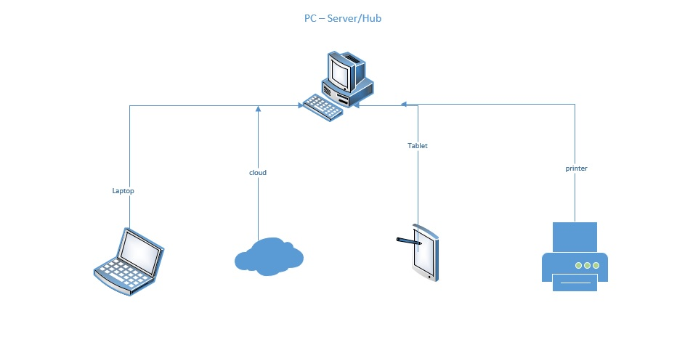
1 – Visio Network Diagram (slide 1of 3)
Weekly Module Goals:
  Client-Server Networking
  The Seven-Layer OSI Model
  Networking Hardware, Safety, and Troubleshooting
Notes:
The term Client-Server Networking, is one central computer is the server “hub” to all other devices within the network. The “clients run programs and retrieve data that is store on the “server” The illustration shows a basic client-server network. All the other devices communicate through the PC to perform its tasks. Another form of networking is the “peer to peer” where each computer is connected via the internet and the server as well as the client. This is a less secure network because each device has the information versus only one central device having the data stored.

Slide 4
1- OSI Model (slide 2 of 3)
Understanding the 7 layers of the OSI Model (mnemonic aid All People Seem To Need Data Progressing.
  Application
  Presentation
  Session
  Transport
  Network
  Data Link
  Physical
Notes:
The mnemonic aid can help an individual to remember what the name and function for each of the seven layers of the OSI model. Starting at layer seven (the highest) and drilling down to layer one. We can recall that layer 7 – ”Application Layer” is the interfaces that occur between two application, an example is the application program that provides services to the user for example a browser and the Utility programs that provide services such as Simple Network Management Protocol (SNMP). Layer 6 - “Presentation Layer” which formats, compresses and/or encrypts data in an acceptable format for the application that is on the receiving end. Layer 5 - “Session Layer” is responsible for syncing and recovered when messages don’t arrive intact at the destination point. Layer 4 – “Transport Layer” sends the data (payload) from one application to another, using either Transmission Control Protocol (TCP), this protocol take more time but guarantees that the data will be delivered, or User Datagram Protocol (UDP) although does not guarantee delivery it is faster and can monitor network traffic. Layer 3 – “Network Layer” sometimes referred to as the internet layer, moves messages from one node to another until the data (payload) reaches the destination host. Layer 2 – “Data Link” or Link layer is the networking/technology used will determine what protocol is used. Such as the “firmware” that is programmed into the hardware devices. The firmware only changes with the if an upgrade is preformed. The data layer puts its specific information into the header and attaches control information at the end of the packet known as the trailer. Once the process is full compiled, the entire “Data Link Layer” message is referred to as a frame. The frame is then given a header which also includes both the source and destination receiver’s NIC address which is the Media Access Control (MAC) address which is embedded on every network adapter around the world. Finally, Layer 1 – “Physical Layer” the easiest layer had one responsibility of sending bits via either wired or wireless transmission.

Slide 5
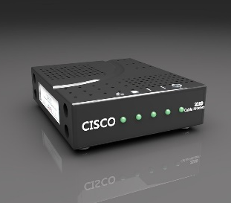
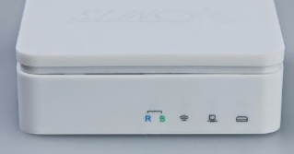
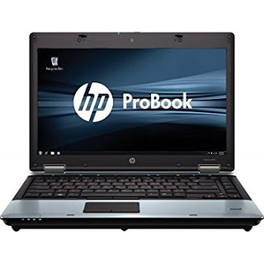
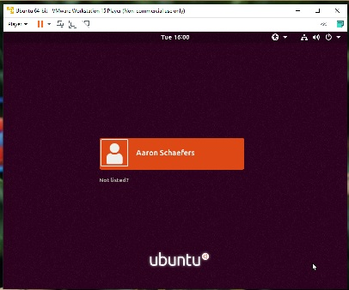
1 - Visio Network Diagram (slide 3 of 3)
Demarc Point (Service Provider connection
The network diagram includes:
Travel Router
Laptop or PC equivalent
Ubuntu Virtual (VM) Machine
Unshielded Twisted Pair (UTP) cables
Modem
UTP cable with RJ-45 connectors (Cat 5e)
UTP cable with RJ-45 connectors (Cat 5e)
This Photo by Unknown Author is licensed under CC BY-SA
Travel Router
This Photo by Unknown Author is licensed under CC BY-SA-NC
Virtual Machine - Unbuntu
This Photo by Unknown Author is licensed under CC BY-SA
HP Laptop
Notes:
With today’s technology most household or business have set up a network to access the network. However, for the purpose of this presentation we are assuming that there is no existing internet within the organization. We know that the local service provider has provided access to the building located on an exterior wall of the building. This is known as the demarc point, because it is from this point forward that the network administrators and technicians are responsible for the implementation of the network and its performance. This illustration shows the basic topology for our network. Using twisted pair cabling (UTP) with RJ45 connectors (Referred to as Cat 5e) cable to connect from the demark point to a modem with will then connect to our router. The router will then provide the connect needed for our laptop and on the laptop, we will create a Virtual Machine.

Slide 6
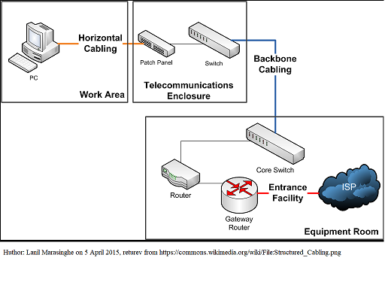
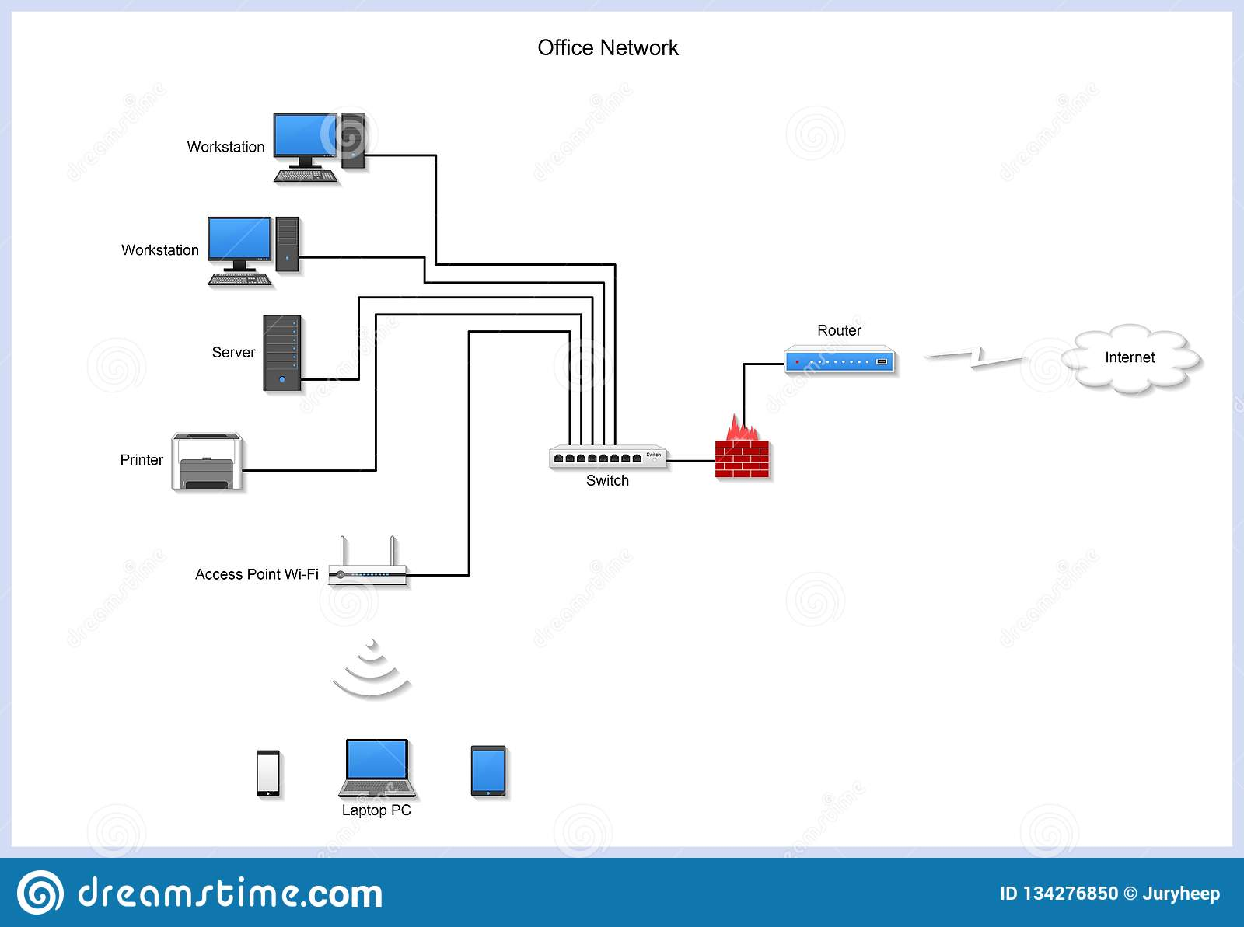
2 - IPv4 Addressing (slide 1of 3)
Weekly Module Goals:
  Structured Cabling
  Network Diagrams
  Network Management
Notes:
In the simplest terms “structured cabling” diagram shown on the top right, (Marasinghe, 2015) is the layout and installation of physical cables that will support multiple hardware uses that are currently being implemented within the organization. Technicians and System Administrators develop the network in a manner that is based on both the current and possible future needs of the business. A properly designed network installation plan includes the current industry standards and the future growth of the organization’s networking needs in determining the type of cabling to be installed in various locations throughout the facility. There are various types of cable some of the most common are Unshielded Twisted Pair (UTP), Shielded Twisted Pair (STP) and Fiber Optic (p.66-pp 1 (Jill West, 2018)). The picture on the bottom right is of a basic office network (Kovrizhnykh, unknown). Both diagrams show the cable and the equipment that it connects from different focus perspectives but achieve the same goal.

Slide 7
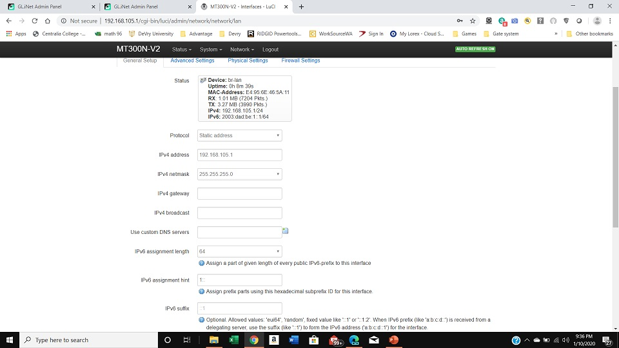
2 - IPv4 Addressing (slide 2 of 3)
IPv4 addressing
Notes:
After installing all the cabling and connecting all the physical equipment to the network the networking administrating must verify that each workstation, and/or device can communicate with each other, not just within the building but also via the internet. Using the internet to access the travel router settings at 192.168.105.1 to locate the IPv4 address and the subnet IPv4 address of the travel router. An IPv4 is the Internet Protocol version 4 address consisting of 32bits written as a set of four decimal numbers referred to as octets, however each octet consists of exactly 8-bits when written in binary code, an example of this is “9.106.50.200” (p. 111 pp.4, (Jill West, 2018)).

Slide 8
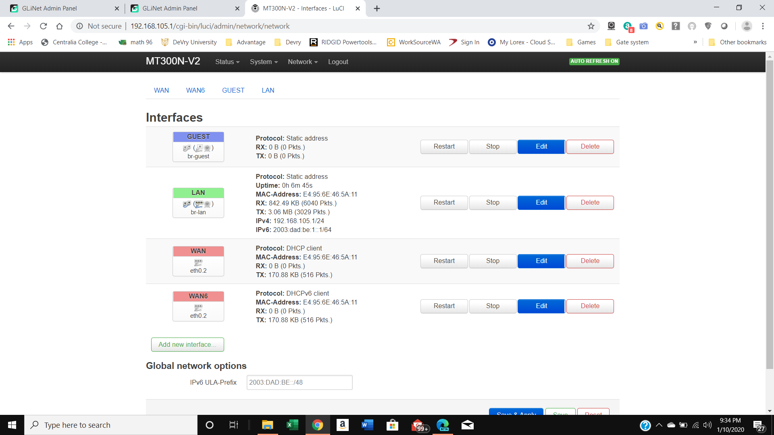
2- IPv6 address (slide 3 of 3)
IPv6 address
prefix
Notes:
Using the internet to access the travel router’s address via 192.168.105.1 we see that under the heading of Interfaces we can find the LAN IPv6 address, displayed as 2003:dad:be1::1/64 and under the heading of Global network options we can find the IPv6 prefix as 2003:DAD:BE:/48. This is the information that allows use to identify the router via its IPv4, IPv6 and or MAC address. This IPv6 is the “Internet Protocol Version 6 and was developed primarily because of the limited availability of addresses under the previous version. The new method of having 128-bits written eight hexadecimal numbers allows each of the eight blocks to contain exactly 16-bits in binary code. An example of the IPv6 address is “2001:0DB8:0B80:0000:0000:00D3:9C5A:00CC”. Remember that in hexadecimal based system the binary representation of number is as follows: 0,1,2,3,4,5,6,7,8,9, A, B, C, D, E, F (the last 6 digits are represented by an alphabetical letter),(p. 111, pp 6-7, (Jill West, 2018)).

Slide 9
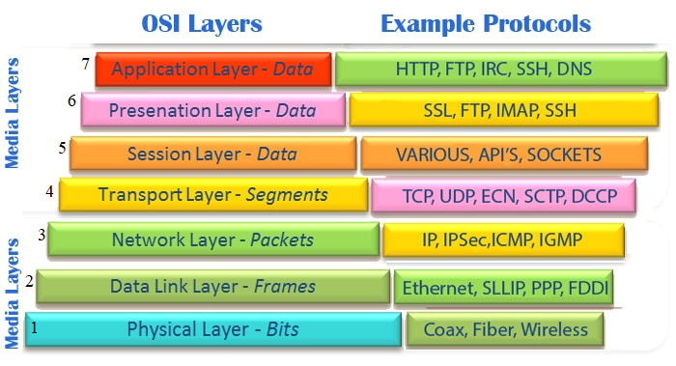
3 - Virtual Machine (VM) Dynamic IP Assignment (part 1 of 4)
Weekly Module Goals:
  OSI Layers 2 & 3 addressing
  OSI Layers 4 & 7 addressing
  CLI (Command Line Interface) Troubleshooting Tools
Notes:
The objects of this week will be to locate and identify the MAC address, IP address, subnet and the default gateway of a computer and the functions of it within the communication network and DNS server. However, however there is no one methodology that can achieve this goal because the source, destination of the data being moved across the network as well as who/what the sender is and who/what the receiver are. Different sections of the addressing system align with these variables, (Module 3 Lesson 1 – Addressing Endpoints (Jill West, 2018)). We take an in-depth look at specific layers of the OSI (ASM, 1992-2020) and some key command for troubleshooting via the Windows command (CLI) window and a VM Terminal as explained in the following three slides.

Slide 10


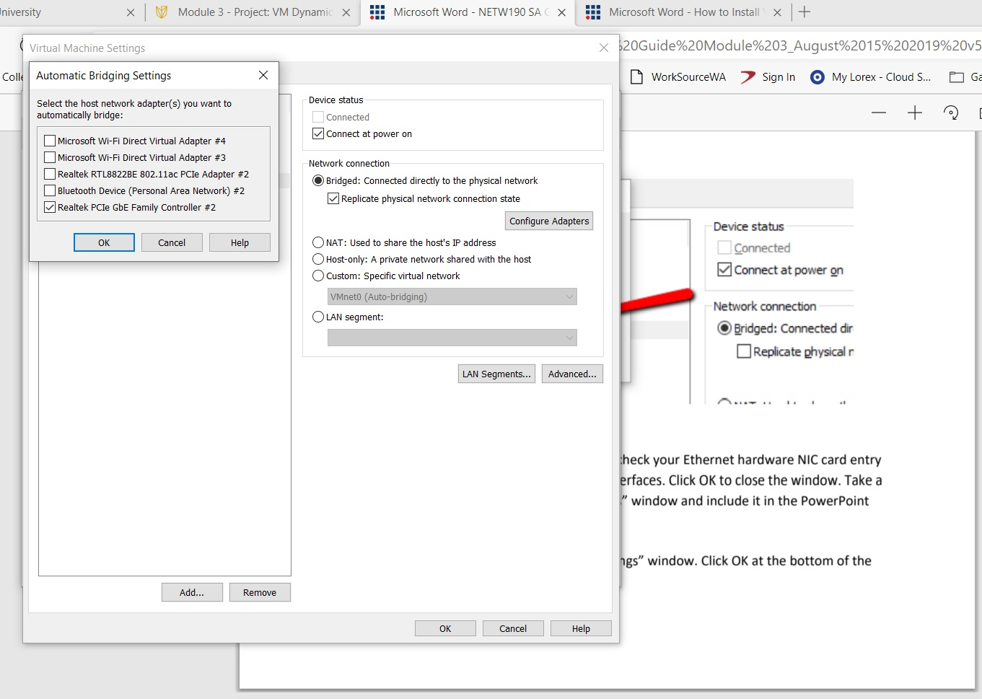
3 - Virtual Machine (VM) Dynamic IP Assignment (part 2 of 4)
This screenshot shows the host network adaptor that we want to automatically bridge
Notes:
Now we need to bridge the VM (Virtual Machine) to the host computer so that the Virtual Machine can connect to the internet. All Virtual Machine have a vNIC which have to be “bridged” with the host machine so that the VM has its own IPv4, IPv6, MAC addresses plus its own subnet mask and default gateway assigned by the host machine’s DHCP (Dynamic Host Configuration Protocol) which will automatically assign these unique addresses (p.378 pp 2, (Jill West, 2018)). The IPv4 packet Diagram shows what is contained in the Header of an IPv4 Packet, however, to gain a better understanding of how the OSI model works with IPv4 Protocol we can look at various parts of the addressing to discover how they align. Layer 2 (BIA/MAC address (e.g. 00-50-56-cc-10-16) identify the sender and receiver that exist on the same network, Layer 3 (IP address (e.g., 152.195.19.94) is used to move data from one location on the network to another. Layer 4 is the utilization of port number(s) at both the sender and receiver location in identifying the programs needed to use to process the data. Layer 7 which is the (Fully Qualified Domain Name or FQDN commonly referred to as the DNS name in which words represent the network address, such as www.devry.edu (Jill West, 2018).

Slide 11
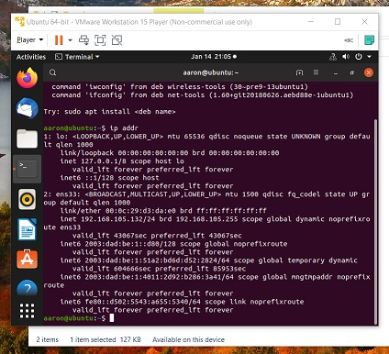
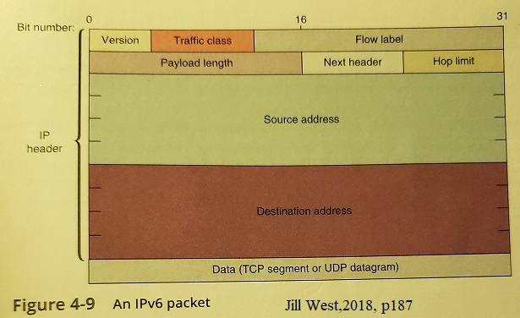
3 Virtual Machine (VM) Dynamic IP Assignment
(part 3 of 4)
This Guest Ubuntu (VM) shows us the IPv4 and IPv6 addresses (top right)
IPv6 Field Packet diagram (bottom right)
Notes:
Continuing out discussion we now look at the how these same OSI layers are utilized in and IPv6 address and look at verifying the both the IPv4 and IPv6 using the VM program Ubuntu (picture on the left) Notice the IPv6 Packet image looks very different from that of the IPv4 on the previous slide. While both protocols use the same layers there are several differences in the what IPv6 does or doesn’t use. IPv4 and IPv6 do both use the following sections: Version, Source Address, and Destination Address, but IPv6 no longer uses the fields: IHL, Identification, Flags, Fragment Offset, Options and Padding. Notice that IPv6 has changed the name and position of some fields (IPv4 shown in bold and IPv6 is in Italics to show changes): Type of Service =Traffic Class, Total Length was deleted but a new field called Flow Label and in place of some of the omitted fields are the following changes: Payload length, Next Header and Hop Limit (Jill West, 2018).

Slide 12
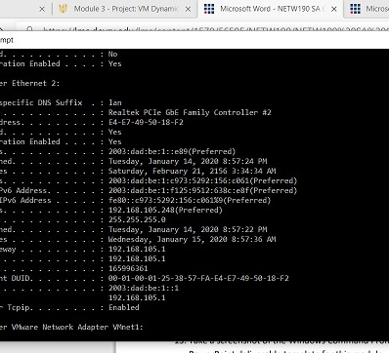
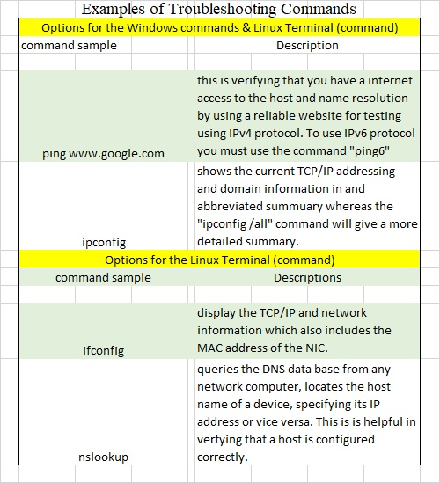
3 Virtual Machine (VM) Dynamic IP Assignment (part 4 of 4)
Notes:
This is the Dynamic IP Assignment for the IPv4 and IPv6 via the window Host computer. This is the Dynamic IP Assignment for the IPv4 and IPv6 via the window Host computer. These dynamic address are assigned through the DCHP can change when the DCHP lease expires or the connection is terminated. Our final goal this week was to learn some basic troubleshooting commands that can help to determine if and/where there is a problem within network when a there is a problem connecting to the network. We can verify that an IP address is working correctly by using the ping command or find out exactly what the IP address is by using the windows command or for Linux we can us the ifconfig and nslookup. How each of these command work is shown in the slide illustration (Jill West, 2018). While there are many more useful troubleshooting command these were the four, I used the most.

Slide 13
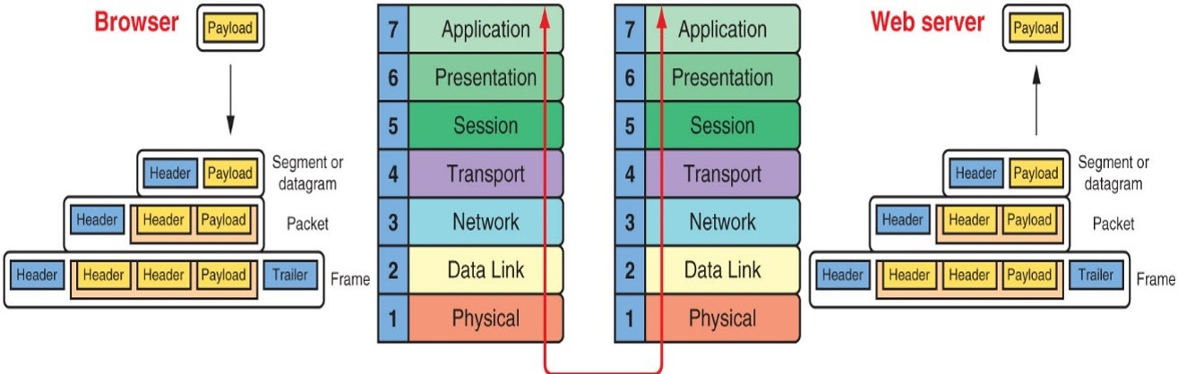
4 - Connectivity Test (1 of 5)
Weekly Module Goals:
  TCP/IP Protocols
  Routers and Routing
  TCP/IP Utilities
https://lms.devry.edu/lms/content/1560/55906/NETW190/NETW190_M4_L1_TCP_IP_Core_Protocols_Operating_System.jpg
Notes:
This week we took a closer look at Layer 4 Transport of the OSI model part of its core function is the TCP/IP protocol which include the encapsulation, decapsulation, protocol headers, how the three-way-handshake works as well as the Address Resolution Protocol (ARP) and Ethernet looking at the mechanics of the protocol’s behavior (Jill West, 2018). The illustration of the OSI shows the payload on the browser and OSI model on the left and beside it is the OSI model again with the payload for the Web server, as each layer adds its own data and addresses its transmission to the corresponding layer in the destination device (DeVry, 2020). Data (sometimes referred to as a message) is created via a suite of TCP/IP protocols which passes it down to the Application (Layer 7) using the OSI. Which is the beginning of its journey through the network, some additional Presentation (Layer 6), and at the Session (Layer 5) before it actually reaches the Transport (Layer 4) where TCP or UPD (Transmission Control Protocol or User Datagram Protocol) which will add control information forming the header that will be attached to the message. As it passes through the Network (Layer 3). At the Data Link (Layer 2) another header is added and verification functions forming the trailer. Which becomes a fully encapsulated message to be sent to the, final layer of the OSI model, Physical (Layer 1). The receiving host will be doing basically the same process in reverse order known as decapsulating the data at each layer respectively.

Slide 14
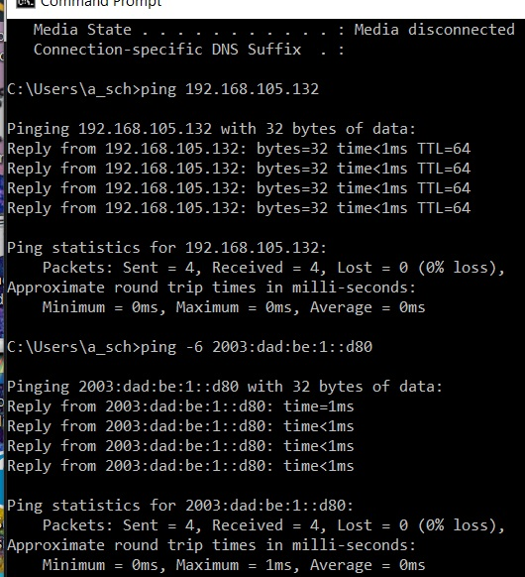
4 - Connectivity Test (2 of 5)
Connectivity test between the Host Computer and the Ubuntu Virtual Machine
IPv4
IPv6
Notes:
Using the “ping” command we can test the IP address for both the IPv4 of 192.168.105.132 and IPv6 address of 2003:dad:be:1::d80. According to the results the ping test was able to successfully send and receive data.

Slide 15
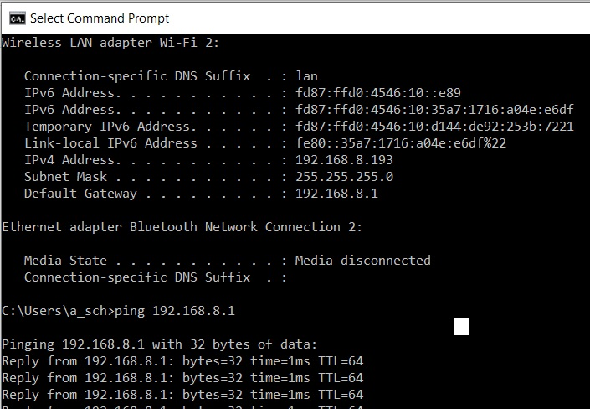
4 - Connectivity Test (part 3 of 5)
Testing connectivity between the Host Computer and the Travel Router.
Notes:
Here we are view the Window Command Prompt window to run a successful “ping” test on the IP address of 192.168.8.1 which is shown as the default gateway of the router.

Slide 16
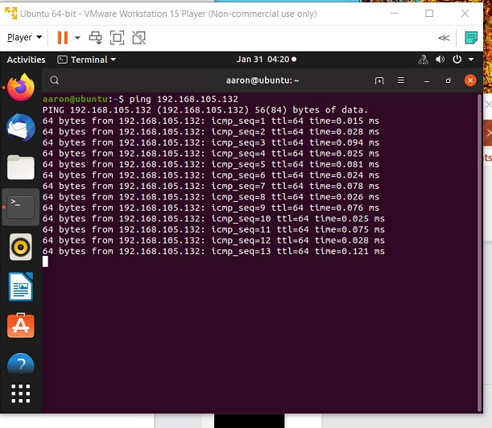
4 - Connectivity test (4 of 5)
Testing the connectivity between Ubuntu VM and Host Computer
Notes:
Here using the terminal window of Ubuntu we are running the ping command on the IP 192.168.105.132 which was also successfully.

Slide 17
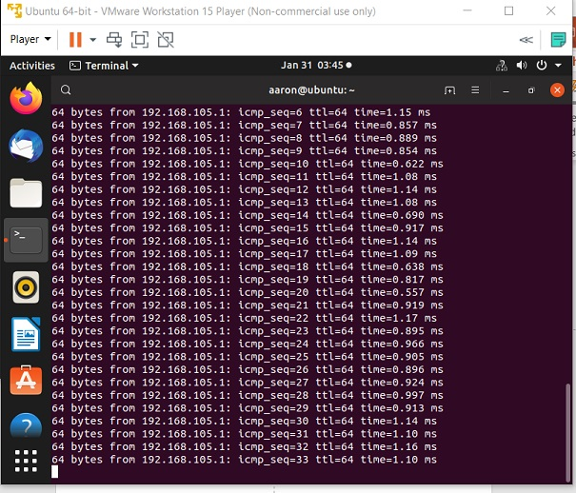
4 - Connectivity Test (5 of 5)
Here we are confirming there is a valid connection between Ubuntu VM and the Travel Router
Notes:
In the terminal window of Ubuntu we have run the ping command for the IP address of 192.168.105.1 the ping was successful, so we now know that we have the ability to connect to others within network and the internet itself.

Slide 18
5 – Make and Test Ethernet cable (part 1 of 6)
Weekly Module Goals:
  Wired Technology –
      Cable Types
      Bandwidth & Throughput
      Transmission Flaws
  Wired Cabling
  Wired Testing
Notes:
Information can be transferred from one point to another via electrical signals being generated by the sending device and electrically connected to the receiving device. These device maybe just a few feet away or miles apart but are joined over numerous links using a variety of media types such as copper or fiber-optic cable. This complete pathway between the two points is also known as a channel. We gained a better understanding of the types of wired cabling, the meaning of bandwidth and Throughput. I now have a better understanding of how to prevent Transmission Flaws or at least limit the likely hood of them.

Slide 19
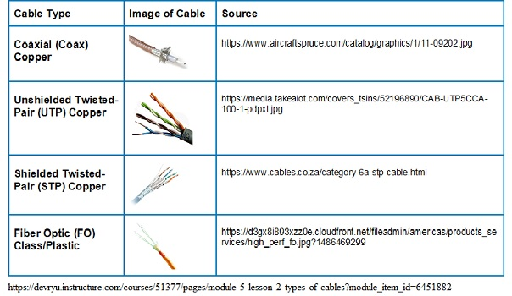
5 – Make and Test Ethernet cable (part 2 of 6)
  Wired Technology – Cable Types

Slide 20
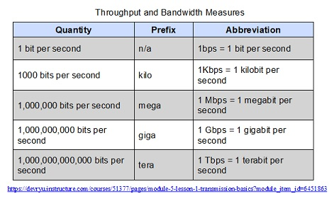
5 – Make and Test Ethernet cable (part 3 of 6)
  Wired Technology – Bandwidth & Throughput
Notes:
Bandwidth is theoretically be transmitted during a given period of time. The example given in our text was of a three-lane freeway is the number of vehicles that can pass a checkpoint in one minute when traffic is bumper-to-bumper and traveling at the maximum speed limit. But, in our daily lives it never happens. The throughput (also refeed to as payload rate/effective data rate) is the measure of how much data is transmitted during a given period of time. Using all the available bandwidth results in more accidents and traffic jams. By limiting the throughput the bandwidth will have more available when spikes in the throughput occurs (Jill West, 2018, p 235 pp1).

Slide 21
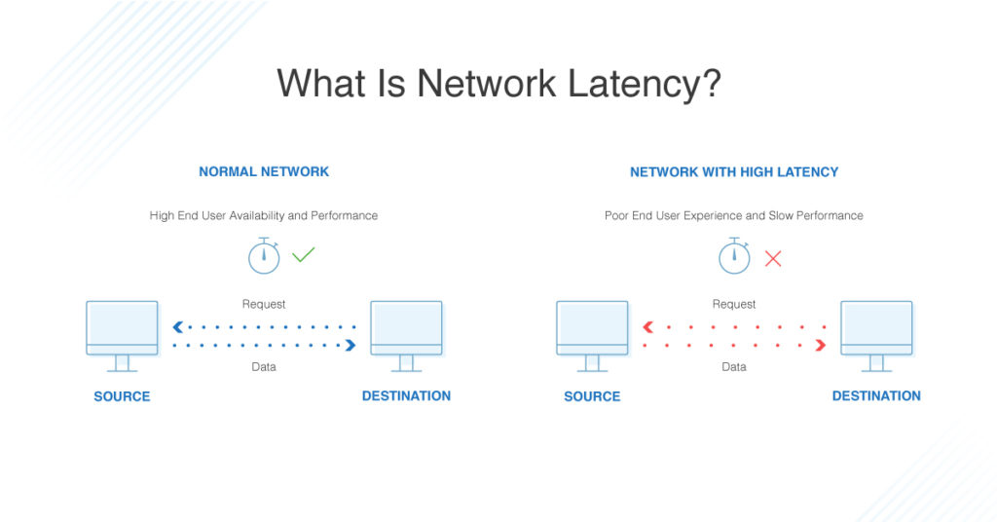
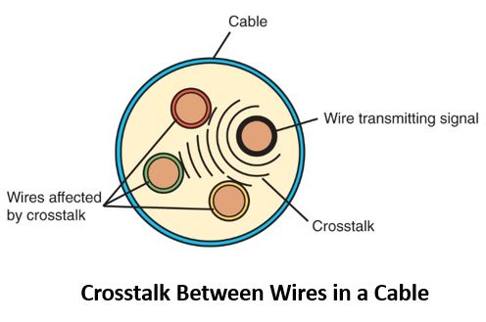
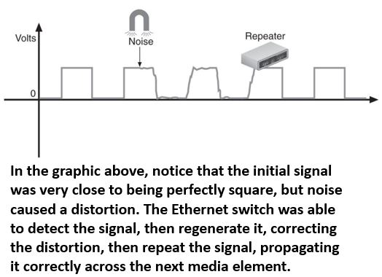
5 – Make and Test Ethernet cable (part 4 of 6)
  Wired Technology – Transmission Flaws
https://www.dnsstuff.com/wp-content/uploads/2019/08/what-is-network-latency-1024x536.jpg
Notes:
Transmission flaw are a degradation of the network performance. The three primary causes of transmission flaws are: Noise (image top left), Attenuation (image bottom left, and Latency (image center right) Noise has two causes, which are electromagnetic interference (EMI) caused by running cables to close to motors, power lines, other office equipment, microwave, some types of lights, or manufacturing machinery or even sever thunderstorms and another type of EMI is the Radio. This type of flaw is commonly referred to as EMI/RMI. Attenuation is the loss of a signal’s strength as it travels further away from the source towards its destination, this can be resolved by using a repeater which regenerates a digital signal in its original form with out the noise and our final type of flaw is latency which are rapidly traveling electrons, while traveling there is a natural delay that occurs between the instant when data leave the source and when it arrives at the destination, which is referred to as latency. (Jill West, 2018, p 236-238).

Slide 22
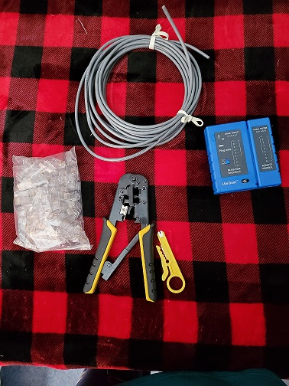
5 – Make and Test Ethernet cable (part 5 of 6)
Making the Cable
UTP (raw) Cable
RJ-45 connectors (2)
Crimp Tool
Cable Cutter and
Cable Tester
Notes:
Depending on the amount of cable the job requires the organization could either purchase already made Cat 5e cable or they could decide that it would be cost effective to purchase the raw materials as shown here and build its own. In either case it is a good ideal that all these tools are part of a networking technicians tool kit. Wire so occasionally go bad and need to be tested. Depending on what the test result reveal it may be something as simple as replacing the RJ-45 connector or as complex as having to replace the entire cable.

Slide 23
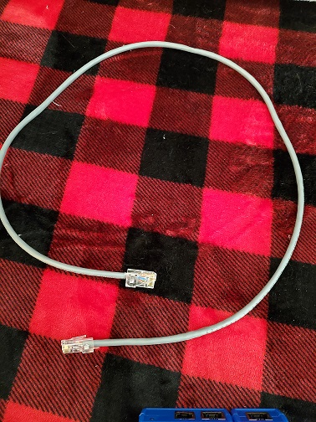
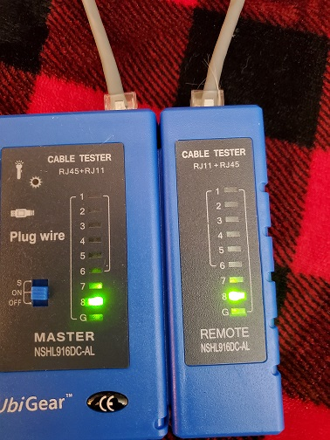
5 – Make and Test Ethernet cable (part 6 of 6)
Ethernet
UnbiGear Cable Tester
Notes:
Starting with a raw piece of UTP (Cat 5e) cable (meaning bare ends) we want trim away the protecting out cover, carefully using the cutter tool we want to remove the outer coding of plastic to exposed about an inch of the bare twisted pair wires, then we had to carefully insert the bared wired into the channels of the RJ-45 connectors and use the crimping tool to secure the plastic RJ-45 to the cable. Once we had both connectors attached to the ends of the cable, we were than able to test the cable with the Cable tester.

Slide 24
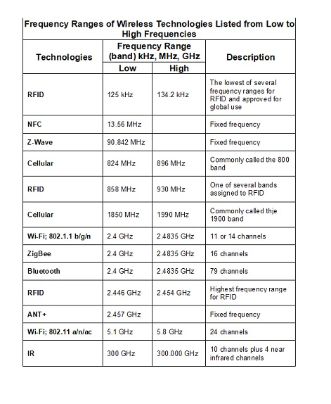
6 - WLAN Implementation (part 1 of 4)
Weekly Module Goals:
  Wireless Technology
  Wireless Standards
  Wireless Implementation and Security
Notes:
With the vast improvements of technology has allowed us to no longer be limited in our networking abilities. We are now able to connect wirelessly and with has come several “Wireless Standards”. The most common are the use of Wireless Personal Area Networks and Home Area Networks. Wireless Networks referred to WLANs, use signals that are known as Radio Frequency (RF) that travel through the air. The picture on the right shows the Frequency “spectrum” lists several standards and shows what portion of the RF spectrum they utilize (p.305, Jill West,2018).

Slide 25
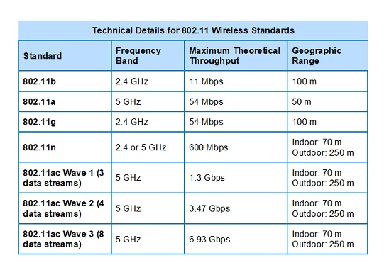
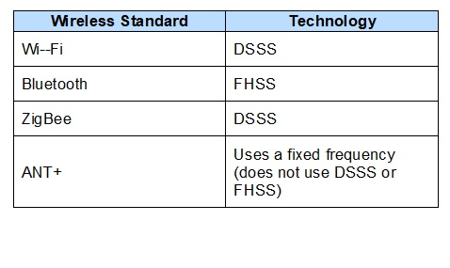
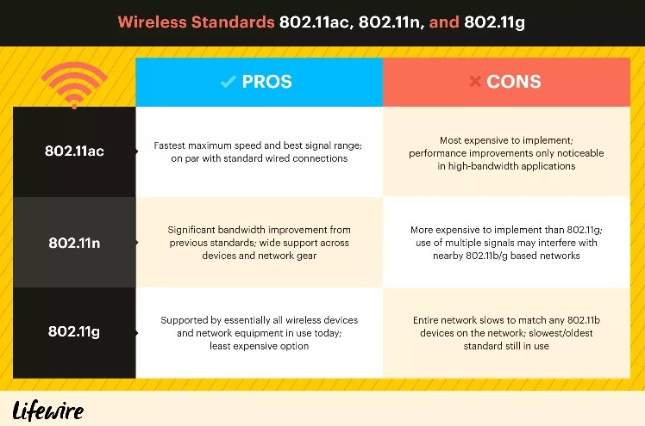
6 - WLAN Implementation (part 2 of 4)
  Wireless Standards
https://devryu.instructure.com/courses/51377/pages/module-6-lesson-1-channel-management?module_item_id=6451990
Notes:
As previous discussed there are many wireless standards, wireless standards that operate at the 2.4 GHz range are: Wi-Fi, Bluetooth, ZigBee, and ANT+ (see image on the left (DeVry,2020). Here is an explanation of each of the technology terms shown: DSSS (direct sequence spread spectrum), and FHSS (frequency hopping spread spectrum) However, we will be looking at the Wi-Fi, 802.11 WLAN standards in more detail (p.323, Jill West,2018). According to Bradley Michelle a writer for Lifewire, “a lot of products work with 802.11a, 802.11b/g/n, and/or 802.11ac wireless standards” however each of these also have its own pros/cons (shown, lower right). Originally 802.11 with a maximum bandwidth of 2 Mbps for most applications was too slow, because of this the original products are no longer made but the lead to the development of an entirely new family 802.11 family of standards. Some of these new developments have added small minor “touch-up” while others have been very large. The largest change was when all these small and big changes were “rolled-up” in December of 2016 known as 802.11-16, according to Bradley. But as technology improves so will wireless capabilities and standards which will lead to another “roll-up” in the future. Already there is other iteration either recently approved, or in the approval process, such as 802.11ax, 802.11ay, and 802.11az (Mitchell, 2019).

Slide 26
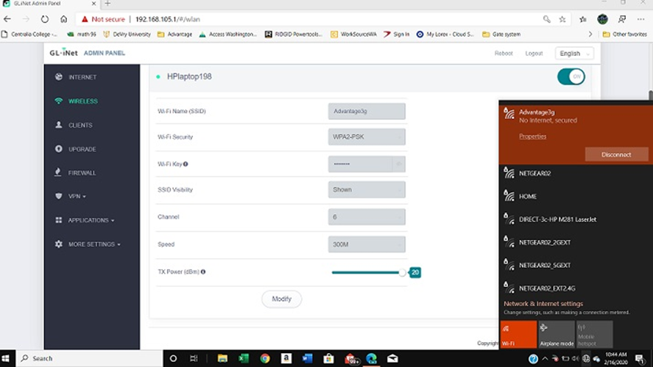
6 - WLAN Implementation (part 3 of 4)
List of WLAN SSID
Names
This is a screen shot of the newly created SSID and others that are available.
Notes:
Wireless Local Area Networks (WLANs) use many of the OSI Model layer but there are some differences in how the information (data) is processed. WLANs operate at Physical and Data Link (Layers 1and 2 respectively), support the same IP, TCP AND UDP protocols, and OS systems like Unix, Linux and Windows these compatibilities allow the communication between a wireless and wired transmissions methods between devices on the same network. SSID (service set identifier) is a unique set of character use to identify an access point on a wireless network, it the wireless version of an IP address. This unique SSID is required for the data packet to travel from the sender to the receiver of the message. During this week we the AP (Access Point) assigned and SSID to a new wireless connection within the network and the image shows this new network connection as well as others that are current available (Jill West,2020, pp.305- 323).

Slide 27
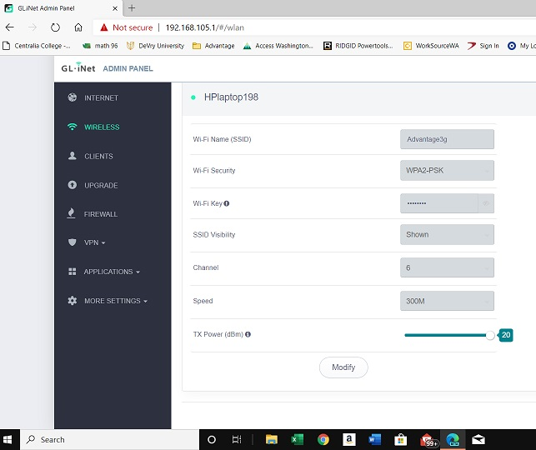
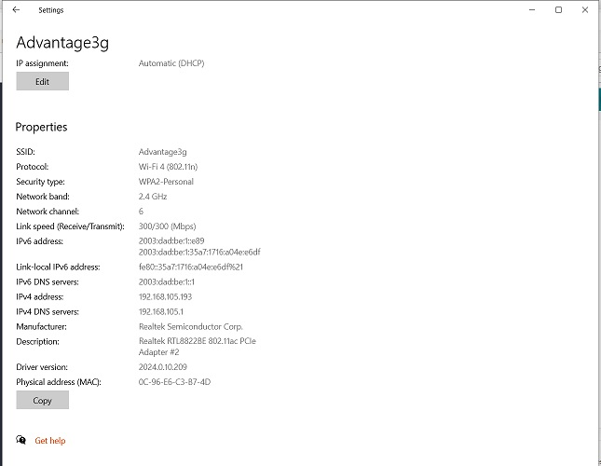
6 - WLAN Implementation (part 4 of 4)
Notes:
This picture (on the left) is accessing the via GL-iNet website and shows the IP address for an HPlaptop198 using WPA2-PSK protocol and the SSID name is Advantage3g from the router. Where as, the picture on the right is as screen shot of the information available via the Windows OS settings. It is show that Wi-Fi 4 (802.11n) protocol at 2.3 GHz. We are also able to identify the IPv4, IPv6 and the Physical address (commonly known as the MAC Address).

Slide 28

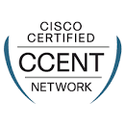
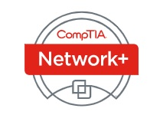
7 – Certification Preparations
Weekly Module Goals:
  CompTIA and Certification Exam Preparation
  CompTIA’s Network+ Certification Practice Exam
https://www.microsoft.com/en-us/learning/mta-certification.aspx
https://www.comptia.org/certifications/network
https://etecenter.com/curriculum/cisco/ccent.html
Notes:
This week’s goal are to enhance our understanding of the different types of certifications that available to individuals that want physical and official documentation of his/her technology knowledge within specific fields. While there are various types of certifications and organization that offer them the logos above are just three commonly known. One of the most popular entry-level certifications for the IT industry is CompTIA Network+ (CompTIA, 2020) there is also Cisco CCENT (CISCO, 1999) and Microsoft MCSE (Microsoft Corporation, 2020) certifications. One of the most important steps to getting certified isn’t just passing the test but in how well we prepare for the test. There are many ways this goal can be achieved but I believe that dedication, study, and repetition work the best. For me I have a calendar and have blocked out 2 hours on workdays and 4 hours on my days off just for studying the course material and doing practice exams. I use the textbook Network+ Guide to Networks, Flashcards, and video tutorials from the internet to further my knowledge. Currently I am focusing on CompTIA’s certification and will continue with the certification for CCENT and then MCSE. One thing is for certain being an IT professional means that there is a constant need to further one education as new technology is developed.

Slide 29
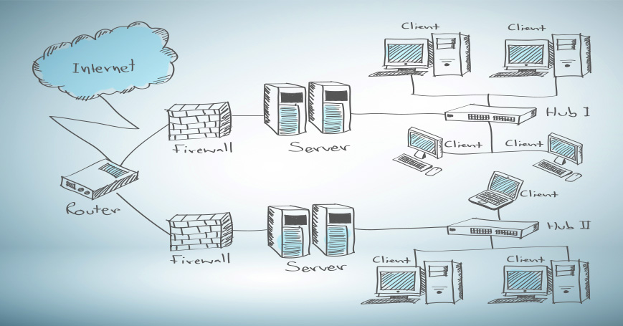
conclusion
(Jackson, 2017)
Notes:
This is an image is a diagram of a Topology Network (Jackson, 2017). Over the past eight weeks see have learned the importance of developing a networking plan that includes several types of documentation and physical equipment. Whether we are setting up a network at home or on a professional level it is important that we know where our responsibility for the internet access begins. The is called the demarc which is where a local company has installed their equipment for access to the internet, this organization is known as our ISP provider. For example on the outside of my home is a box with my provider’s logo. This is where my provider’s responsibility for the performance of the signal and equipment ends. At this point to connect I must install and set up all wires, physical equipment and software needed to access the internet and be able to communicate with other devices within my network environment. The network topology shown here doesn’t show the demarc point but so I assume that that there is a cable (cat5e) would be coming from the demarc outside my home through the wall and then be attached a router, I would continue running cables as shown. The firewall is part of my Operating System (OS) software. After installing the physical hardware and devices we need to take the time necessary to properly document in written form what and where everything was installed. As we progress through the setting up all software application so that we can have access to not just other devices within my home network I also need to be able to successfully connect to the internet. Most OS systems have wizards that can assist us in setting up our devices. Throughout the develop of the network we would test the cables being used with a cable tester to confirm that the cable is good. As we add new devices, we can test its performance by using commands. Depending on which OS is being used, for example my system uses Windows OS so I can test my system using the Windows Commands. One command I frequently use is pinggoogle.com which sends a signal across the internet and waits for a reply from the google website, the results are then shown to let me know if the ping was successful or not. When I need to know a specific IP address, I can use the command ipconfig /all which will generate information about all the IP addresses on my network. After making sure that my all devices are working correctly and able to successfully communicate with others, I then document where each device is located, and any relevant information. In the past I have always relied on a family friend to install new equipment, however, after taking this course been able to change my network wired only so that it now includes wireless. I recently wirelessly connected my laptop and printer after installing a wireless router. Now my focus is on furthering my education and continuing to study for my first certification which I plan take the CompTIA Network+ by the end of the year. My current employment affords me the ability to focus on furthering my education and gaining addition certification, and my employer is encouraging me to continue my academic goals because as the organization grows, he would like to see me join the IT team as one of its Network Security Administrators.

Slide 30
REFERENCES:
ASM. (1992-2020). CompTIA Network+/Microsoft MTA Networking: OSI model. Retrieved from ASM Educational Center: https://asmed.com/comptia-network-osi-model/
CISCO. (1999). Professional's Choice for IT TRAINING. Retrieved from ETEC: https://etecenter.com/curriculum/cisco/ccent.html
CompTIA. (2020). CompTIA Network+ helps develop a career in IT infrastructure covering troubleshooting, configuring, and managing networks. Retrieved from CompTIA: ww.comptia.org/certifications/network
DeVry. (2020, February 24). Module 4 - Lesson 1: TCP/IP Core Protocols. Retrieved from DeVry University: NETW190ModulesModule 4 - Lesson 1: TCP/IP Core Protocols: https://lms.devry.edu/lms/content/1560/55906/NETW190/NETW190_M4_L1_TCP_IP_Core_Protocols_Operating_System.jpg
Jackson, K. (2017, February 23). Network Topology Mapper: What Is It and Why Does IT Need One? Retrieved from helpsystems: https://www.helpsystems.com/resources/articles/network-topology-mapper-what-it-and-why-does-it-need-one
Jill West, J. A. (2018). Network+ Guide to Networks (Eighth ed.). Boston, MASS, USA: Cengage. Retrieved January 5, 2020
Kovrizhnykh, Y. (unknown). office network diagram . Retrieved from dreamstime.com: https://www.dreamstime.com/office-network-diagram-devices-buildings-white-background-computers-servers-laptop-router-switch-smartphone-printer-tablet-image134276850
Marasinghe, L. (2015, April 5). Structured Cabling network diagram. Retrieved from Wikipedia.org: https://en.wikipedia.org/wiki/Structured_cabling
Microsoft Corporation. (2020). Learning. Retrieved from Microsoft: https://www.microsoft.com/en-us/learning/mta-certification.aspx
Mitchell, B. (2019, November 09). The Wireless Connection: 802.11 Standards Explained: 802.11ac, 802.11b/g/n, 802.11a. Retrieved from Lifewire: https://www.lifewire.com/wireless-standards-802-11a-802-11b-g-n-and-802-11ac-816553

